Slide 1

Custom Controls

Slide 2
Custom Controls
Owner Draw Controls
Sub-Classing Controls
Composite/User Controls

Slide 3
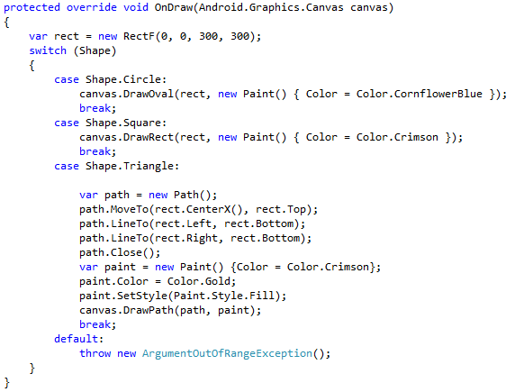
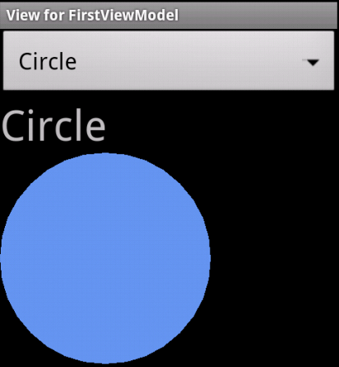
Draw your own controls…

Slide 4
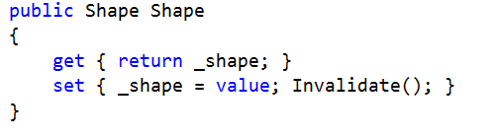
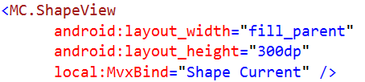
Bind by C# properties

Slide 5
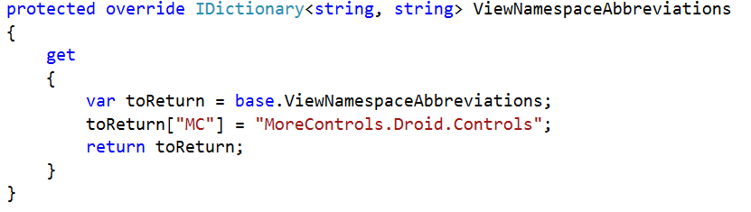
Note: Namespace Abbreviations

Slide 6
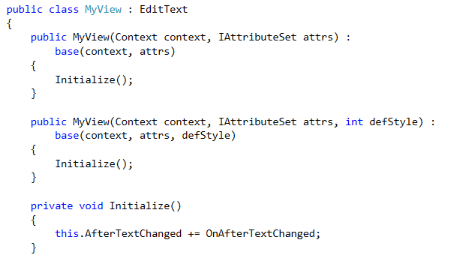
Sub-classing controls

Slide 7
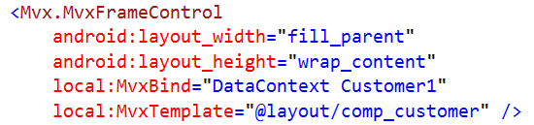
Composite Controls

Slide 8
Also…
Android XML has two nice additions:
include
merge

Slide 9
Sample
Shown in…
https://github.com/slodge/MvvmCross-Tutorials/tree/master/MoreControls
https://github.com/slodge/MvvmCross-Tutorials/tree/master/CustomBinding
https://github.com/slodge/MvvmCross-Tutorials/tree/master/CompositeControl

