Slide 1

Data Binding

Slide 2
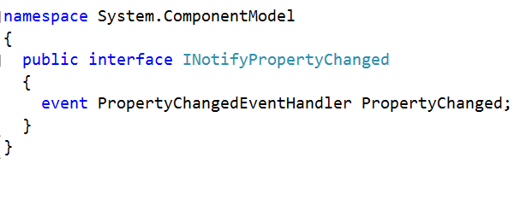
INotifyPropertyChanged

Slide 3
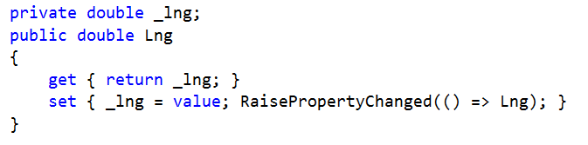
Typical ViewModel Property

Slide 4
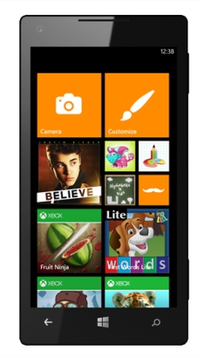
One Way Binding
PersonViewModel
First Name
Jon
Last Name
Doe
Date of birth
12/07/1989
FirstName
LastName
DateOfBirth

Slide 5



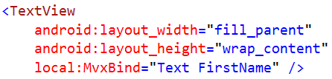

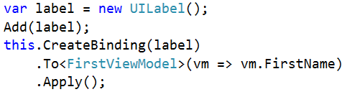
UI Syntax

Slide 6
Two Way Binding
PersonViewModel
First Name
Jon
Last Name
Doe
Date of birth
12/07/1989
FirstName
LastName
DateOfBirth

Slide 7

UI Syntax

Slide 8
Value Conversion
PersonViewModel
First Name
Jon
Last Name
Doe
Age
24
FirstName
LastName
DateOfBirth
“Age” Conversion

Slide 9
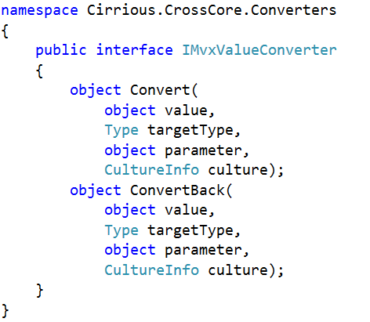
IMvxValueConverter

Slide 10
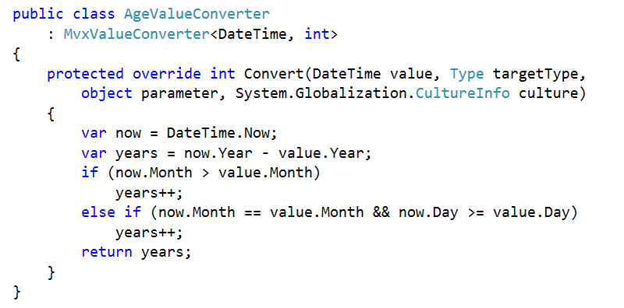
AgeValueConverter

Slide 11
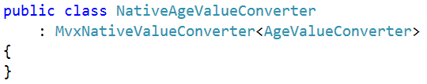

UI Syntax

Slide 12
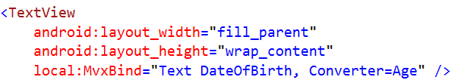
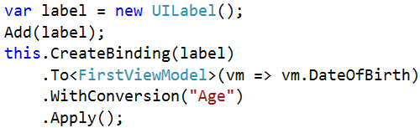
UI Syntax

Slide 13

Binding Actions
PersonViewModel
First Name
Jon
Last Name
Doe
Date of birth
12/07/1989
FirstName
LastName
DateOfBirth
AddCommand

Slide 14
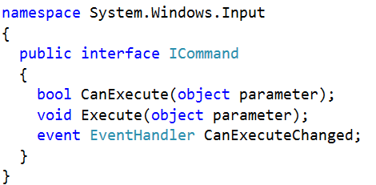
ICommand

Slide 15
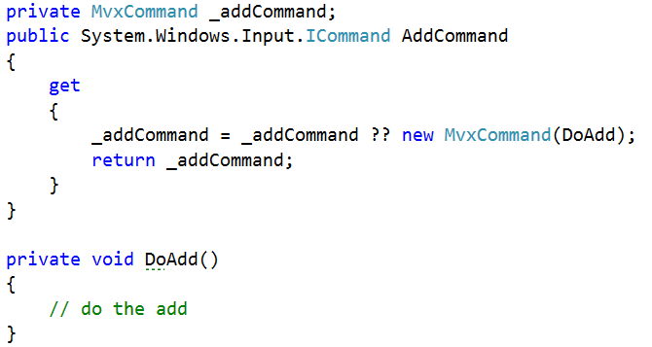
Typical ViewModel Command

Slide 16

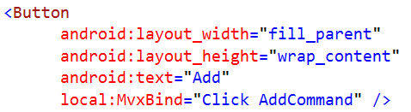
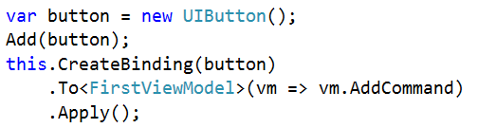
UI Syntax

Slide 17





Collections
PeopleViewModel
Cool Hackers
Greg
@gshackles
Hackers
List<PersonViewModel>
Jon
@redth
Greg
Daniel
@dsplaisted
Jon
Tomasz
@cheesebar
Daniel
Tomasz

Slide 18
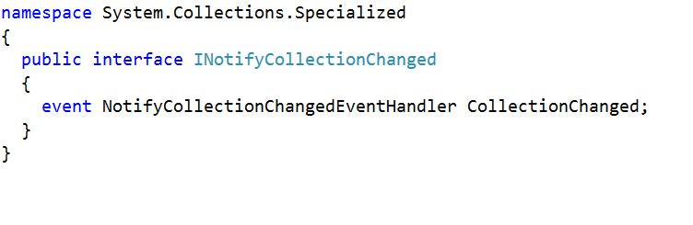
INotifyCollectionChanged

Slide 19
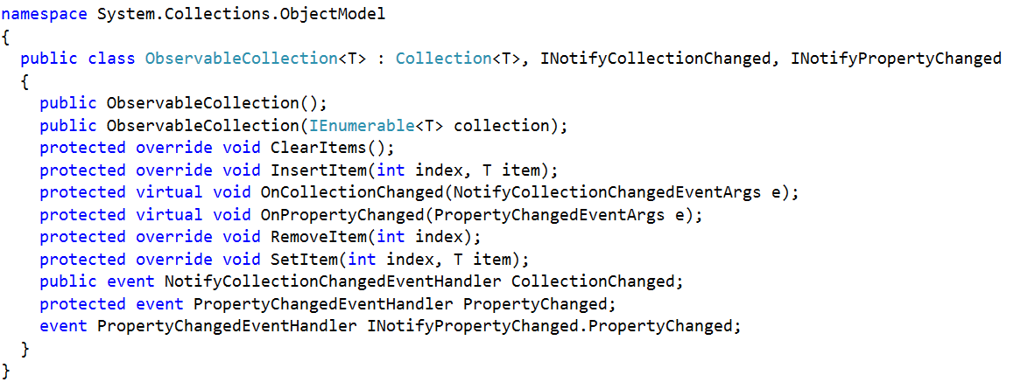
ObservableCollection

Slide 20
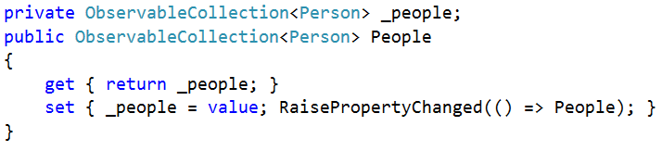
ViewModel Collection Property

Slide 21
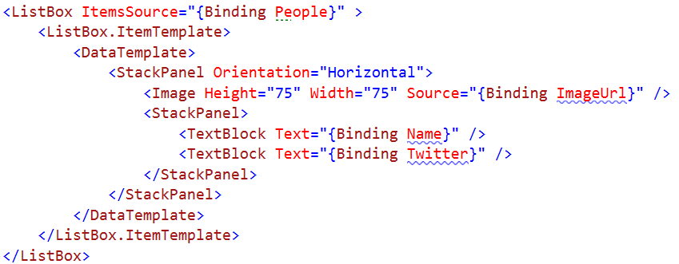
UI Syntax

Slide 22
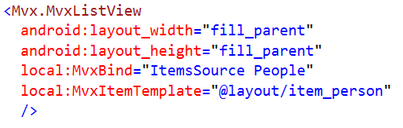
UI Syntax

Slide 23
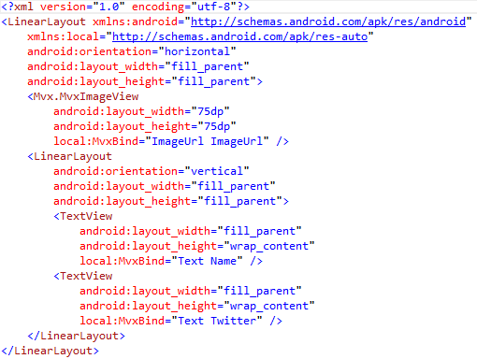
UI Syntax

Slide 24
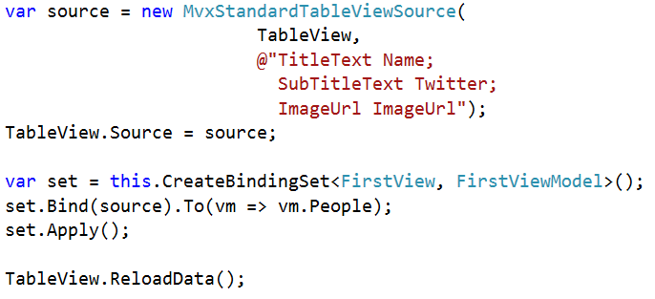
UI Syntax

Slide 25
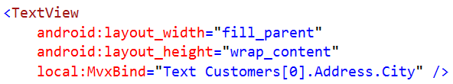
Data-Binding to Sub-Objects
Works using normal . and [] chaining:
obeys INotifyPropertyChanged at every step

Slide 26
Samples
DataBinding:
https://github.com/slodge/MvvmCross-Tutorials/tree/master/TipCalc
Collections:
https://github.com/slodge/MvvmCross-Tutorials/tree/master/Working%20With%20Collections
ValueConverters:
https://github.com/slodge/MvvmCross-Tutorials/tree/master/ValueConversion

