Slide 1

Evolution

Slide 2


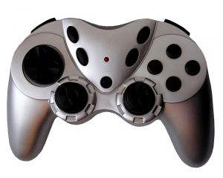
Mvc
THANKS TO JEREMY LIKNESS
FOR THE PICTURES!

Slide 3

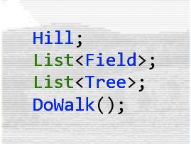
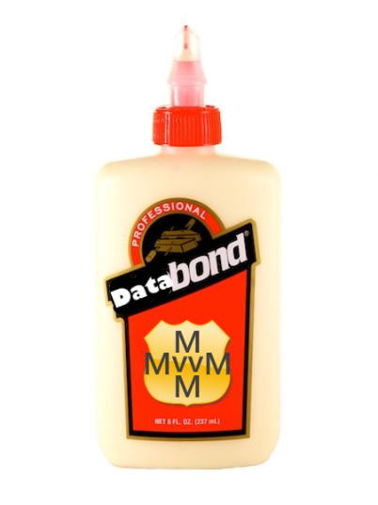
Mvvm

Slide 4



Mvx

Slide 5
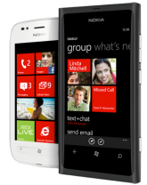
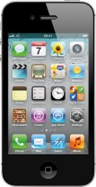
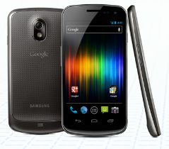
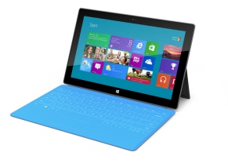
MvvmCross
MVVMCROSS
DataBinding, IoC, Plugins, Trace, INPC, Collections, Helpers, …
Xamarin.iOS
Xamarin.Android
Core
Portable Class Library
Windows 8
WindowsPhone 8
WPF

Slide 6
The DNA Trail so far…
v1
v2
v3
ViewModel++
Binding++
Async++
Patterns++
AutoViews…
TVs? Glasses?
INPC
DataBinding
.iOS
.Android
.WP
PCLs
Plugins
.WinStore
.Wpf
‘Clean’
CoreCross
.Mac
Nov ’11
to
Mar ‘12
Apr ’12
to
Oct ‘12
Nov ’12
to
Jun ‘13

