Slide 1

File IO

Slide 2
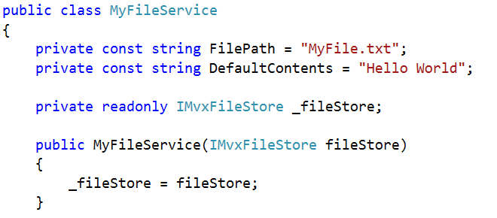
IMvxFileStore plugin…

Slide 3
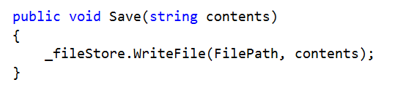
Write

Slide 4
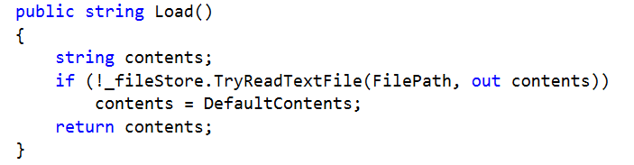
Read

Slide 5
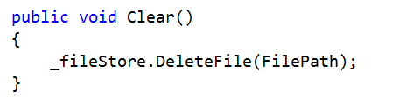
Clear

Slide 6
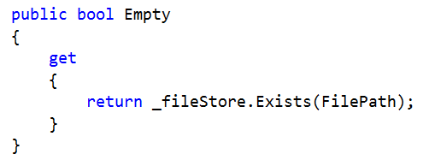
Exists

Slide 7
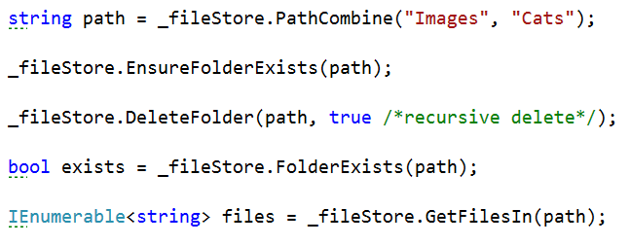
Folder operations

Slide 8
Sample
Operations shown in several apps…
https://github.com/slodge/MvvmCross-Tutorials/tree/master/Sample%20-%20CirriousConference
https://github.com/slodge/MvvmCross-Tutorials/tree/master/Sample%20-%20CustomerManagement/CustomerManagement
http://slodge.blogspot.co.uk/2013/05/n14-adding-picturechooser-and-file.html

