Slide 1

Internationalisation
i18n

Slide 2
3 ways to i18n Text…
Use MS/Xamarin way – .Resx files (possibly with Rdio/Vernacular) and then XAML and code…
Use MvvmCross way – Json
Build your own (maybe on top of 1 or 2)

Slide 3
The MvvmCross way
Use the JsonLocalisation Plugin
(which requires the ResourceLoader Plugin)
Text is linked to ViewModels

Slide 4
Some set up required…
TextProviderBuilder/TextProvider in App
TextSources in ViewModels
Add SharedTextSources if required
ValueConverter in Setup*
* Hopefully gone soon

Slide 5
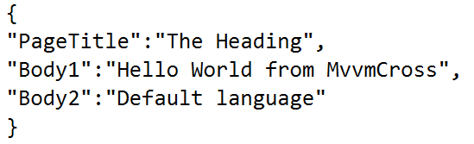
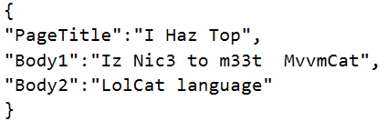
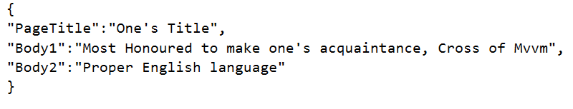
Using JSON for text
Default/Root
LolCat
ProperEnglish

Slide 6
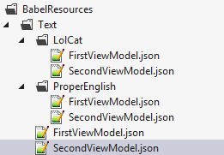
Folders for languages

Slide 7
Build Actions
Droid – AndroidAsset
Touch – Content
Windows – Content
Or… write some code to use EmbeddedResources inside the Core PCL!

Slide 8
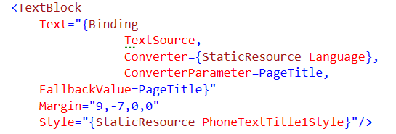
Bindings Windows

Slide 9
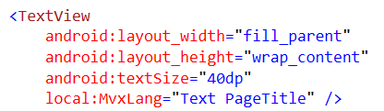
Bindings Droid

Slide 10

Bindings Touch

Slide 11
Sample
Operations shown in a few apps…
https://github.com/slodge/MvvmCross-Tutorials/tree/master/Babel
https://github.com/slodge/MvvmCross-Tutorials/tree/master/Sample%20-%20CirriousConference

Slide 12
See also
https://github.com/rdio/vernacular
http://opendix.blogspot.ch/2013/05/using-resx-files-for-localization-in.html

