Slide 1
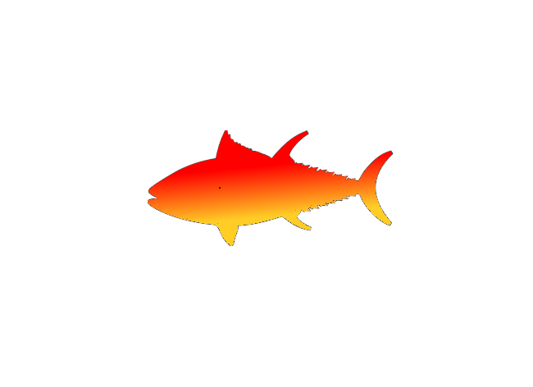
Interface Driven Development

Slide 2

Inversion of Construction (Inversion of Control)
Windows Phone SQL
Needs SQL
MyViewModel
My Tax Calculator
Needs Calculator
Windows Phone Location
Needs Location
The Container

Slide 3
Inversion of Construction (Inversion of Control)
iOS SQL
Needs SQL
MyViewModel
My Tax Calculator
Needs Calculator
iOS Location
Needs Location
The Container

Slide 4
Mvx.Register<T>
The Container
(Mvx)

Slide 5


Mvx.Register<T>
RegisterSingleton
Lazy - RegisterSingleton
RegisterType

Slide 6
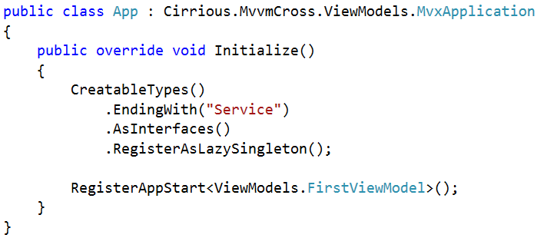
Automatic Registration

Slide 7
Mvx.Resolve<T>

Slide 8

Mvx.Resolve<T>
Resolve
CanResolve
TryResolve

Slide 9
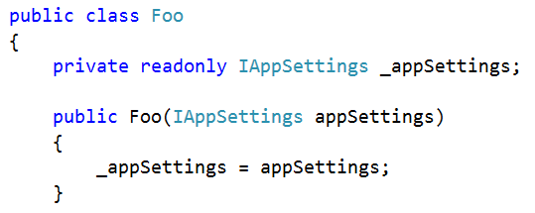
Mvx Construction
Constructor resolution
IoCConstruct

Slide 10
Sample
TwitterSearch is an interesting starting point:
https://github.com/slodge/MvvmCross-Tutorials/tree/master/Sample%20-%20TwitterSearch
A more ‘sophisticated’ example is:
https://github.com/slodge/MvvmCross-Tutorials/tree/master/FractalGen

