Slide 1

Jago?

Slide 2
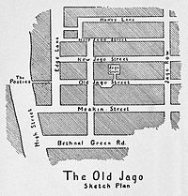
The Nichol
1880s - a dirty slum
Arthur Morrison based a novel here – ‘A Child of The Jago’

Slide 3
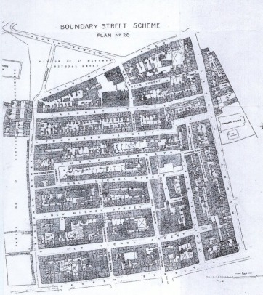
A Child of the Jago
The gradual corruption of a basically decent boy, Dicky Perrott, by the slum in which he was born and grew

Slide 4
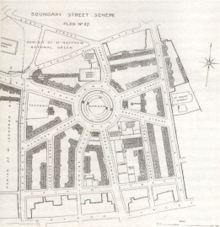
Modern Jago
Area rebuilt as one of Europe’s first Estates
Friendly, multi-cultural and arty area

Slide 5
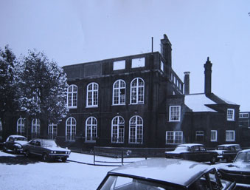
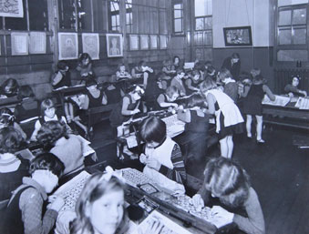
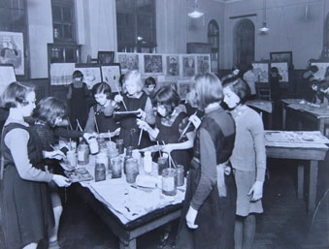
Rochelle School

Slide 6

Microsoft's space in Shoreditch where creative minds are invited to come together to collaborate, learn, play and be inspired by the craft and passion of others.
The space is an open for all: Modern Jago is free to use for co-working, workshops, talks, exhibitions, meetups and it has a large and full series of events.
Everyone is invited to come play!
collaborate, learn, play and be inspired

Slide 7
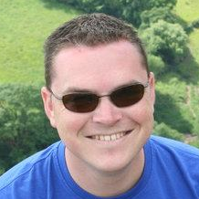
For events, ask Wesley!
@ModernJago

Slide 8
Want to know more…
http://www.londonfictions.com/arthur-morrison-a-child-of-the-jago.html
http://www.rochelleschool.org/history/

