Slide 1

LinkerIncludePlease

Slide 2
Data-Binding Uses Reflection
Views
In your
App
MvvmCross Data-Binding
Android Views/Widgets
or
CocoaTouch UIViews
CreateBinding
.For(view => view.Text)
.To(vm => vm.Name)
UITextField
UITextField::Text

Slide 3
Linker Removes ‘Unused’ Symbols
Views
In your
App
MvvmCross Data-Binding
Android Views/Widgets
or
CocoaTouch UIViews
CreateBinding
.For(view => view.Text)
.To(vm => vm.Name)
UITextField
NullReference ☹

Slide 4
Solutions…
Turn off Linking
Add fake references:
LinkerIncludePlease.cs
Linker Parameters:
--linkskip=ASSEMBLY
Preserve:
[Preserve]
--xml=file

Slide 5
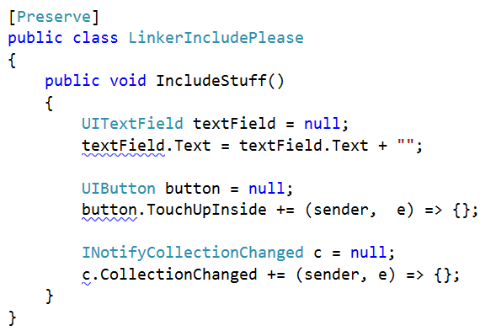
LinkerIncludePlease.cs

