Slide 1

Using Location

Slide 2
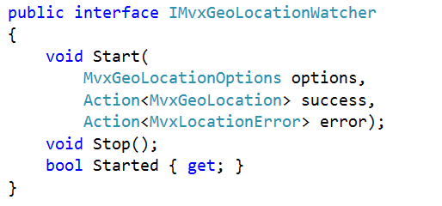
Location Plugin

Slide 3
Permissions Needed
Android
iOS – normally done in-app
WindowsPhone
WindowsStore

Slide 4
Advanced
If you need more advanced:
More specific rules
Background tracking
GeoFencing
… then you’ll need to build it

Slide 5
Sample
Covered in the N+1 at:
http://slodge.blogspot.co.uk/2013/05/n8-location-location-location-n1-days.html

