Slide 1

The Messenger

Slide 2
Messenger
Publisher
Subscribers
Publisher
Subscriber
Publishers
Subscribers
Message

Slide 3
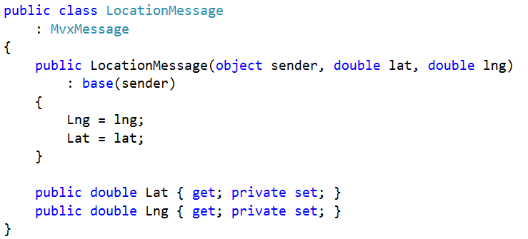
Message

Slide 4
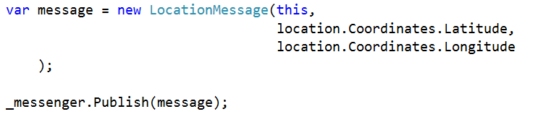
Publish

Slide 5
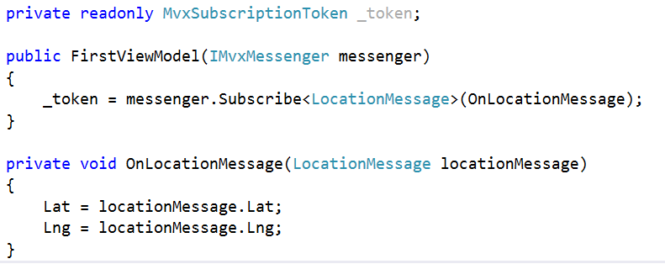
Subscribe

Slide 6
Sample
The TickService and TickMessage in:
https://github.com/slodge/MvvmCross-Tutorials/tree/master/InternetMinute

