Slide 1

Plugins

Slide 2
What is a plugin?
Plugins are just a layer on top of IoC
Each Plugin has:
A Portable Core
Includes the interface definition
Has PluginLoader.Instance entry point
(optional) Platform extensions
Extensions identified by naming conventions
Each has a Plugin entry point

Slide 3

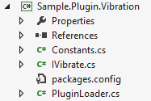
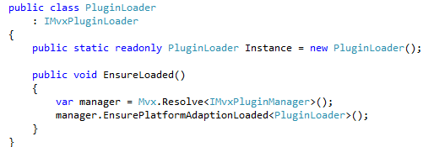
A Vibrate plugin
Core - PCL:

Slide 4
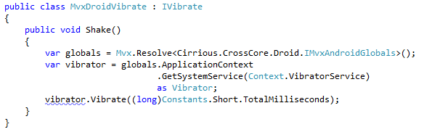
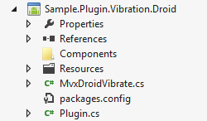
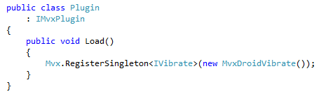
A Vibrate plugin
e.g. Droid Adaption:

Slide 5
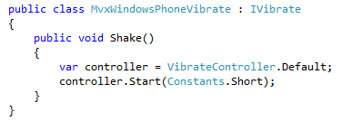
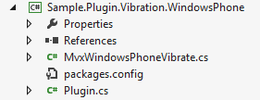
A Vibrate plugin
e.g. WP Adaption:

Slide 6

Using the Plugins
Your PCL app just links to:
the Plugin-PCL
Your UI projects
Link to both:
the Plugin-PCL
the platform adaption Assembly
Add a platform-specific bootstrap class too, e.g.:

Slide 7
General Plugins
Plugins are just a wrapper around IoC
NuGet makes them very easy
NuGet also allows inter-Plugin dependencies
You can have many interfaces in 1 Plugin

Slide 8
Samples
Good Vibrations:
https://github.com/slodge/MvvmCross-Tutorials/tree/master/GoodVibrations
Sphero:
https://github.com/slodge/BallControl/
(warning – many branches/versions)

Slide 9
Samples
Remember you don’t have to use plugins - e.g. see how screen-size is injected in:
https://github.com/slodge/MvvmCross-Tutorials/tree/master/FractalGen

