Slide 1

Portable Class Libraries

Slide 2
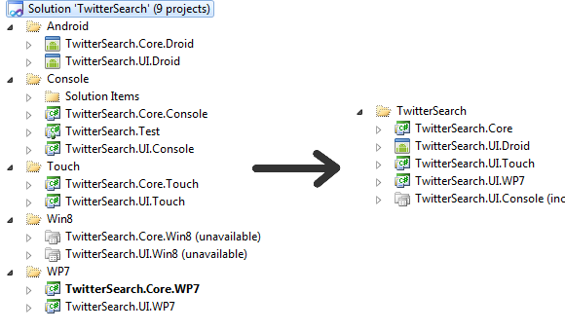

Slide 3
My
.Portable
MvvmCross
.Portable
Plugin1
.Portable
Plugin2
.Portable
…
My
.WP7
My
.Touch
My
.Droid
My
.WinRT
MvvmCross
.Wp7
MvvmCross
.Touch
MvvmCross
.Droid
MvvmCross
.WinRT
Plugin1
.Wp7
Plugin1
.Touch
Plugin1
.Droid
Plugin1
.WinRT
Plugin2
.Wp7
Plugin2
.Touch
Plugin2
.Droid
Plugin2
.WinRT
…
…
…
…

Slide 4
Profile 104
WPF – 4.5+
Windows Store (WinRT)
Windows Phone – 7.1+
Xamarin.Android*
Xamarin.iOS*
async/await via BCL Async NuGet Package… (if you like pain)

Slide 5
Profile 78
WPF – 4.5+
Windows Store (WinRT)
Windows Phone – 8+
Xamarin.Android**
Xamarin.iOS**
async/await “just works”

