Slide 1

Presenters

Slide 2
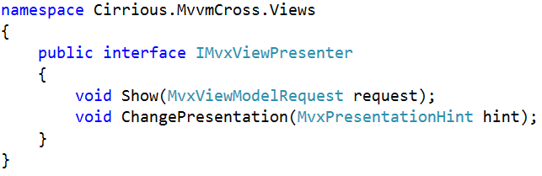
IMvxViewPresenter

Slide 3
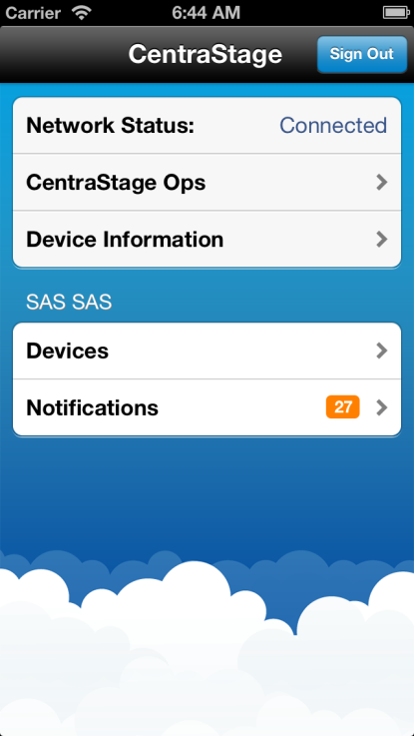
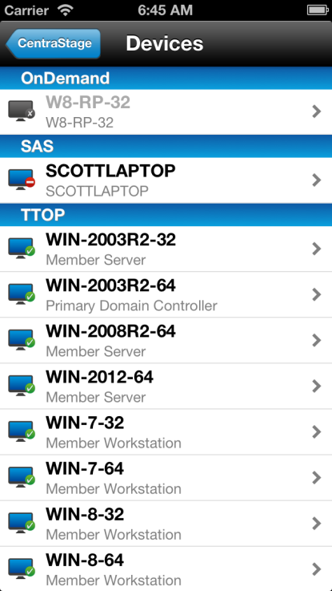
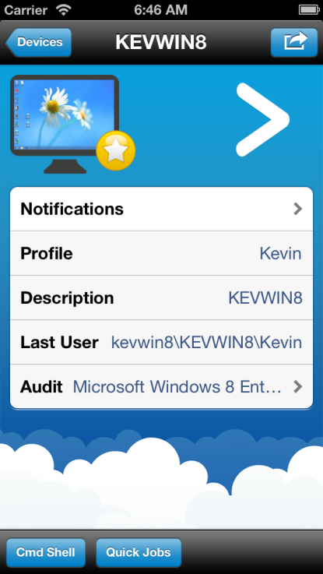
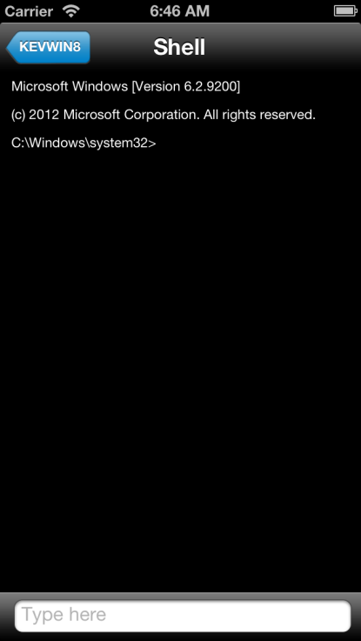
Page by Page

Slide 4
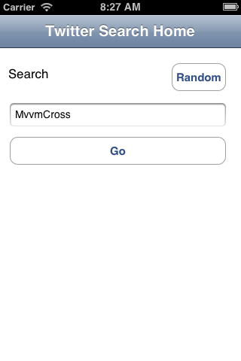
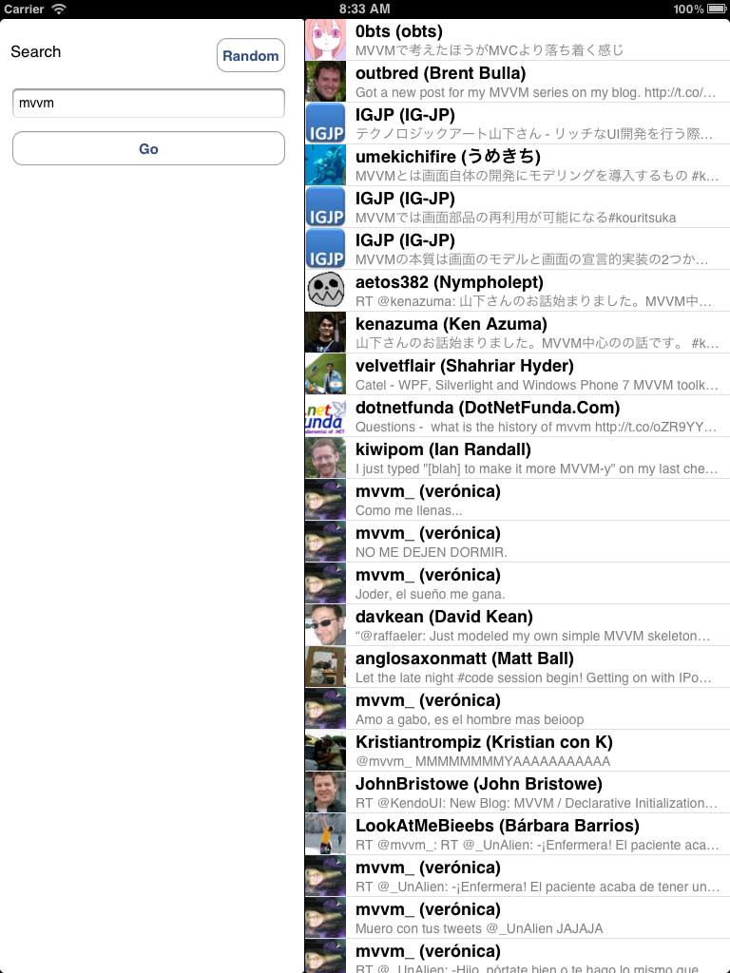
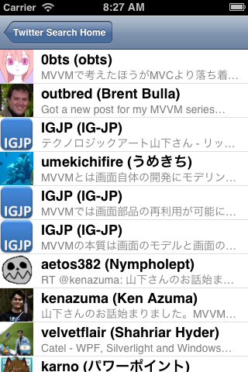
Split View

Slide 5
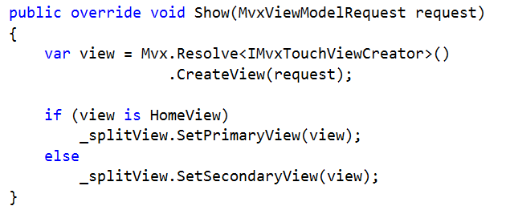
SplitViewPresenter example

Slide 6
Sample
SplitViewPresenter:
https://github.com/slodge/MvvmCross-Tutorials/tree/master/Sample%20-%20TwitterSearch/TwitterSearch.UI.Touch

Slide 7
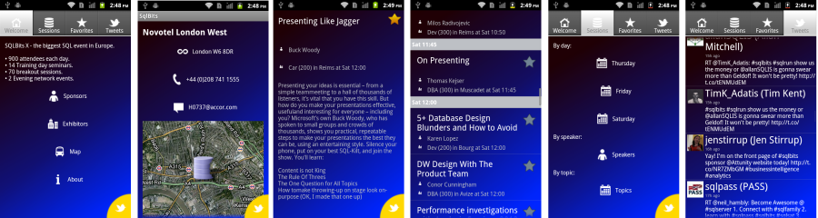
Tabs and Panoramas

Slide 8
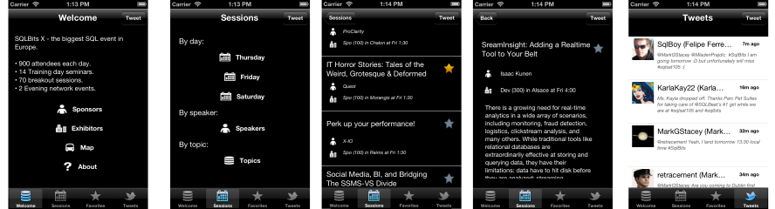
Tabs and Panoramas

Slide 9
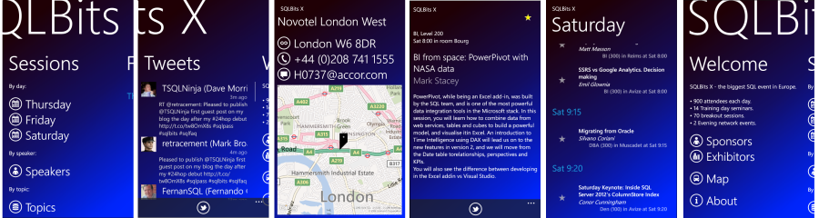
Tabs and Panoramas

Slide 10
Sample
Tabs - especially in iOS with sub-navigation controllers:
https://github.com/slodge/MvvmCross-Tutorials/tree/master/Sample%20-%20CirriousConference

Slide 11
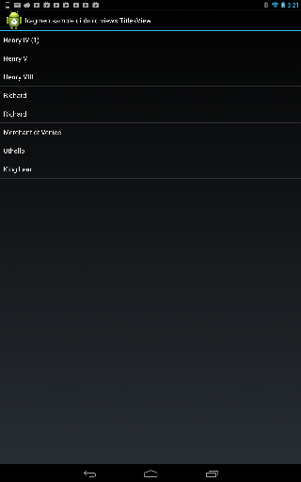
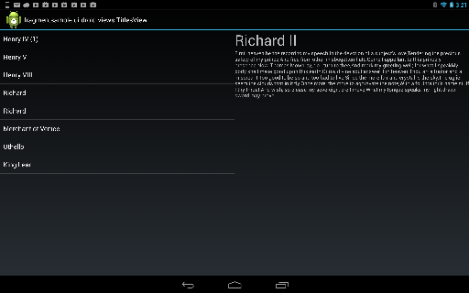
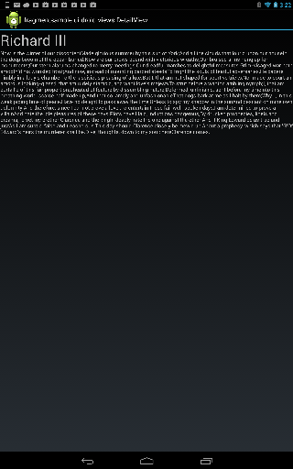
Fragments (Android UserControls)
Titles
Detail
Titles
Detail

Slide 12
Sample
Lots of Fragments:
https://github.com/slodge/MvvmCross-Tutorials/tree/master/Fragments

