Slide 1

Unit Tests

Slide 2
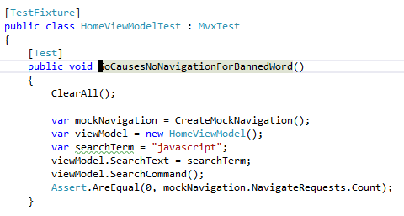
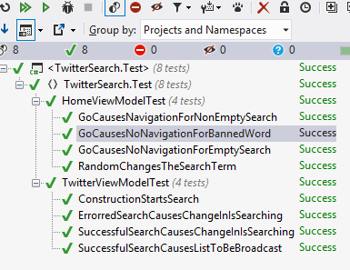
PCLs easy to test

Slide 3
MvxViewModel needs…
IoC helper
reference Cirrious.MvvmCross.Test.Core
Mock Navigation and Dispatcher
see TwitterSearch.Test

Slide 4
Platform specific testing …
.Net differences
especially Xamarin.iOS/MonoTouch
NUnit Runners available on many platforms
No Mocking on iOS devices
BDD testing available on many platforms:
Calabash/Xamarin Test Cloud (LessPainful)
Expensify Windows Phone Test Framework

