Slide 1

Using SQLite-Net

Slide 2
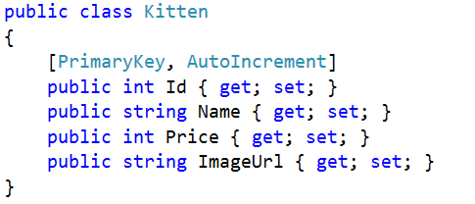
Lightweight ORM

Slide 3
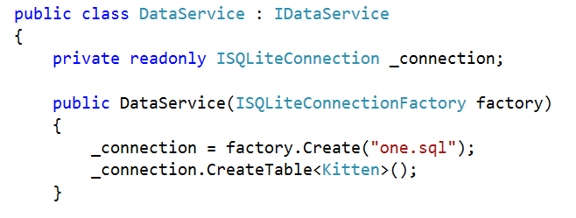
SQLConnectionFactory

Slide 4


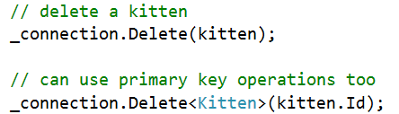
CRUD…
Creation
Update
Delete

Slide 5
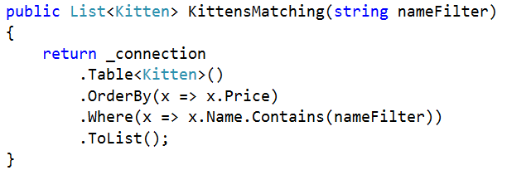
Select Query

Slide 6
Advanced
Much more advanced is possible:
https://github.com/praeclarum/sqlite-net/

Slide 7
Sample
Covered in the N+1 at:
http://slodge.blogspot.co.uk/2013/05/n10-sqlite-persistent-data-storage-n1.html

