Slide 1
Mvvm and C#
Developing apps for all of Android, iPhone and Windows

Slide 2

KEEP CALM AND CODE

Slide 3
The Basics…
Our areas
Washrooms
Food & drink
Health & safety
Enjoy

Slide 4
The essentials…
1Artisan

Slide 5
What YOU asked for

Slide 6
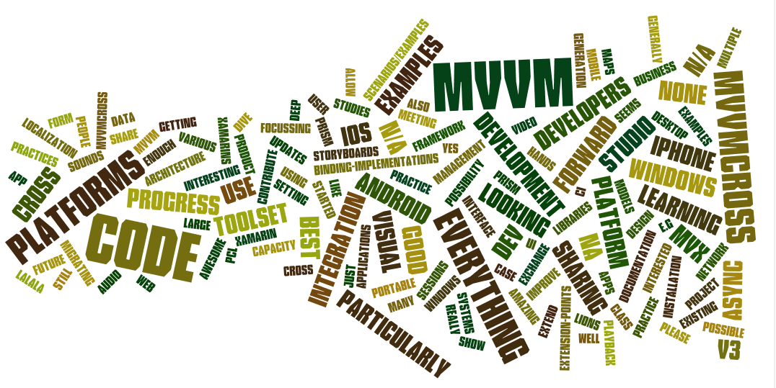
What YOU asked for

Slide 7
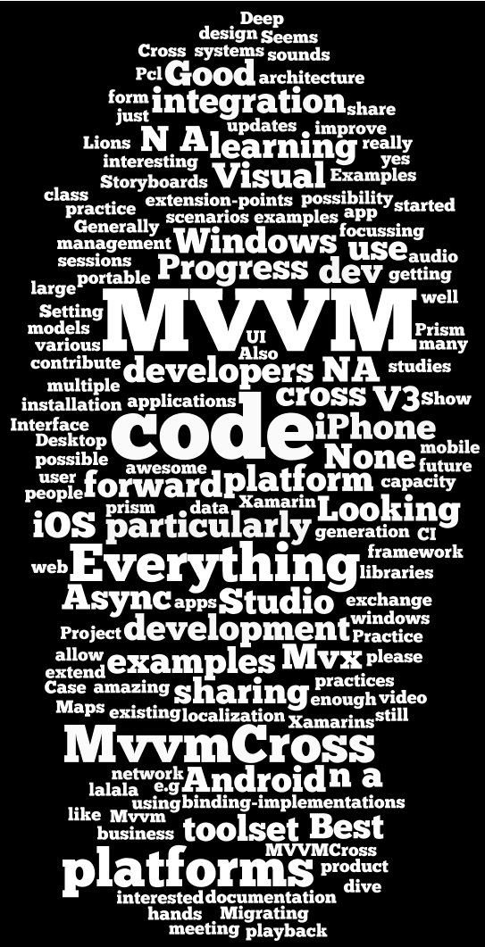
All the platforms
Code
Mvvm
Everything

Slide 8
Schedule
9:15 Getting started
10:30 Break
10:45 Portable code
11:00 Mvvm and Cross Platform
12:15 Lunch
12:45 Mvvm and Cross Platform
14:15 Break
14:30 Real Apps
15:45 Break
16:00 “Advanced”

Slide 9


Huge thanks to…

Slide 10
Tweeting
#mvvmcross
#wpdev
#xamarin
#win8dev
@modernjago
@nokiadeveloper

Slide 11
Sharing…
Chat
https://jabbr.net/#/rooms/mvvmcross
Ideas/Questions
http://bit.ly/mvvmLondon
Story…
http://storify.com/slodge/mvvmcross-london

