Slide 1

What you need

Slide 2
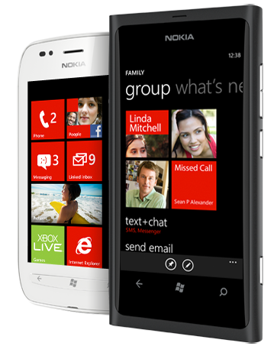

What you need – WP8:
A Windows 8 PC
Free Tools or better!
Nokia or AppHub account $99
A phone sometimes helps…

Slide 3
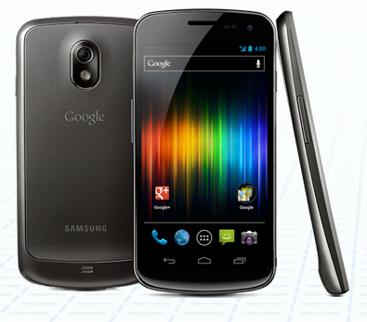
What you need - Android:
Windows PC or a Mac
Free Tools
Play account $25
A phone really helps…
Xamarin.Android $299/999

Slide 4
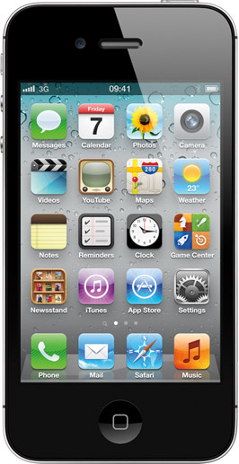
What you need - iOS:
An Intel-x64 Mac
Account-Linked Tools
iOS Account $99
A phone often helps…
Xamarin.iOS- $299/$999

Slide 5

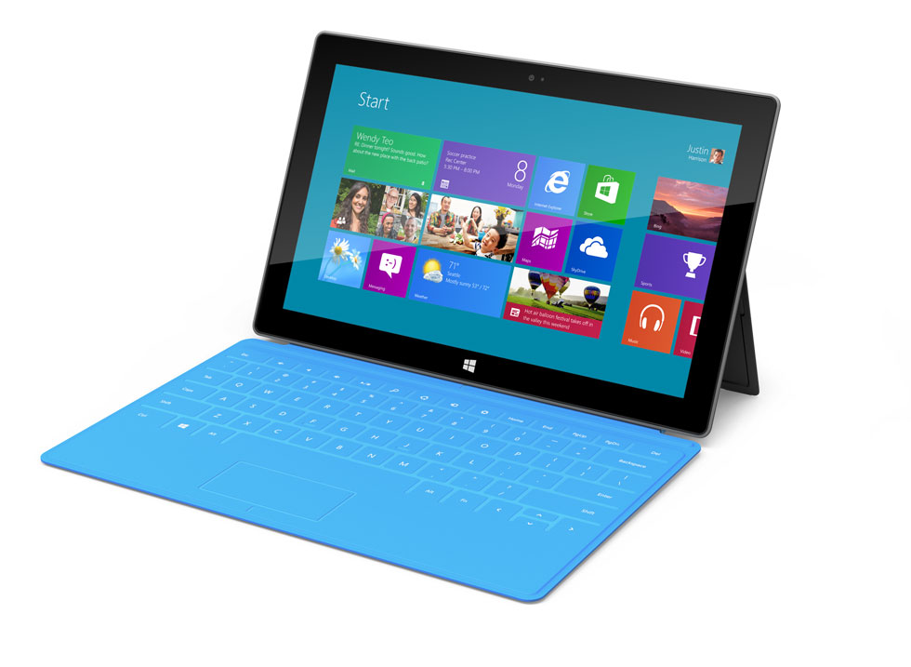
What you need – Windows Store:
A Windows 8 PC
Touchscreen helps
Free Tools or better!
Marketplace account $99
An ARM tablet sometimes helps…

