Slide 1

iOS User Interfaces

Slide 2

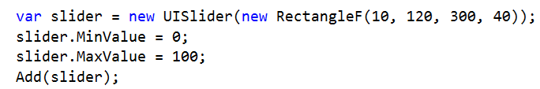
In Code
TODO

Slide 3
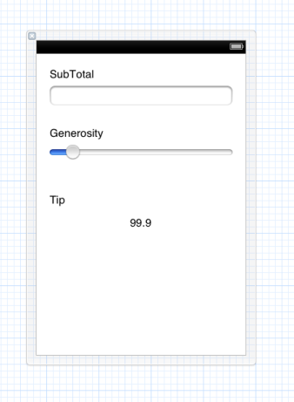
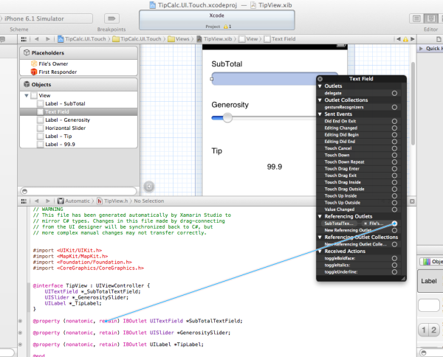
Use the Xcode Designer

Slide 4
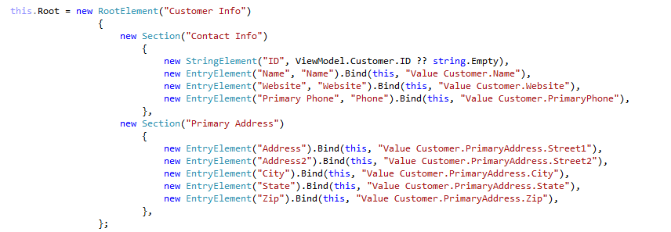
Use .Dialog

Slide 5
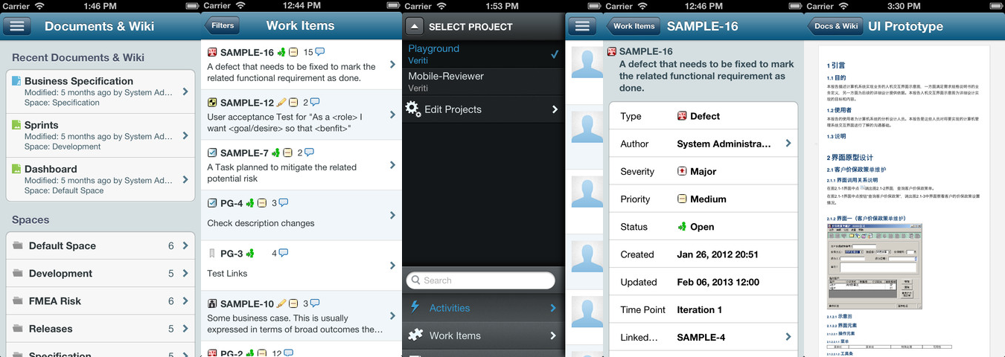
Dialog + MvvmCross in use…
https://itunes.apple.com/app/alm2go/id600778564

Slide 6
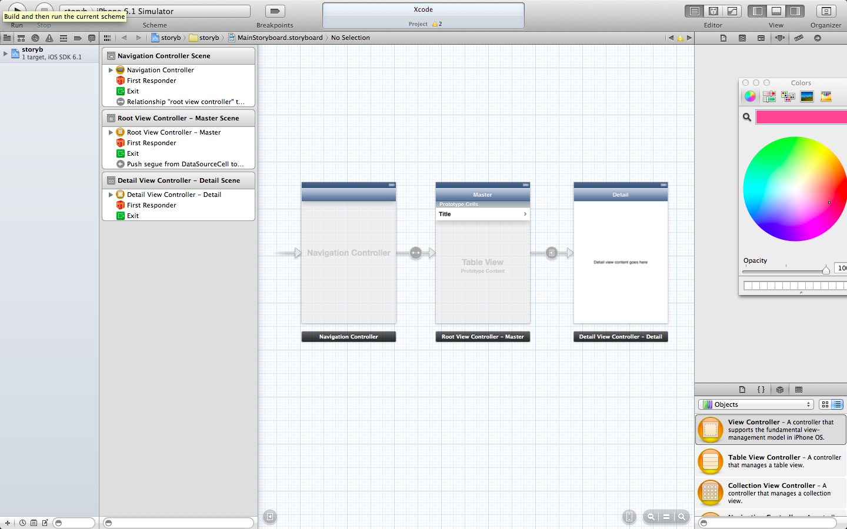
Use Storyboards

Slide 7
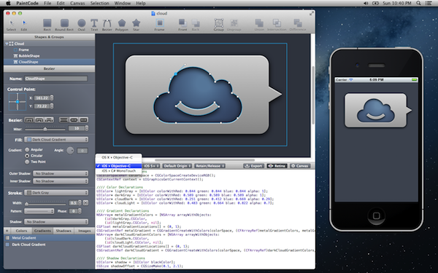
Custom Draw – PaintCodeApp

Slide 8

Custom Draw - CrossGraphics
Cross Platform…
Open Source
Developed in iCircuit
(not an mvvmcross app!)

Slide 9
2D/3D Games
MonoGame…
… a different day!

Slide 10
Other Ideas…
Open Source
Escoz, Clancey, OxyPlot, XIBFree (new!), ProtoPad (new!)
Commercial:
Pixate, TeeChart, Infragistics, Shinobi…
Mixed:
Look in the Xamarin Component Store

Slide 11
Samples
For Dialog:
https://github.com/slodge/MvvmCross-Tutorials/tree/master/Sample%20-%20CustomerManagement/CustomerManagement
For Storyboard:
https://github.com/slodge/eh (temporary!)

