Slide 1
Building Recommendation Systems: Surveying Content-Based Filtering, Collaborative Filtering, & Neural-Network Based Recommenders
SML310 Final Project
Mwad Saleh

Slide 2
Background Context
What is a Recommendation System (RS) ?
From the user’s perspective a recommendation system is a tool that helps the user navigate directories of products/information based on explicitly indicated or implicitly learnt user preferences or interests.
Examples of Popular Recommendation Systems:
Movies to watch, Recommended by Netflix
Topics & People to follow, recommended by Twitter
Products to buy, recommended by Amazon.com
Many, many more!

Slide 3
Types of RS I decided to explore:
Traditional Algorithms:
Content-Based RS
Collaborative-Filtering Based RS
Modern Algorithm:
Neural-Network Based RS

Slide 4
The questions I set out to Answer:
How to build a basic Movie Recommendation Engine, based on these Different RS?
What is the quality of Recommendation?
What are the Pros & Cons of each System?

Slide 5
What Data Did I Use?
MovieLens Dataset
MovieLens 100k dataset collected by the GroupLens Research Project at the University of Minnesota, starting in 1997. Since then, MovieLens datasets have become one of the most popular datasets for exploratory recommendation system research, and have been critical to advancing personalized recommendation.
What the data looks like:
The dataset consists of the following:
100,000 ratings (1-5) from 943 users on 1682 movies.
Each user has rated at least 20 movies.
Simple demographic info for the users (age, gender, occupation, zip)

Slide 6
Content-Based Filtering
Steps:
Building User Profile
Generating our Top 10 movie recommendations for User X
Evaluating the Recommendation Algo

Slide 7
Content Based Filtering
Definition:
Content-based filtering is a recommendation technique where we are able to explicitly obtain or implicitly infer a user’s interests for subsets of items, known as the User Profile. Then, based on the user’s profile we are able to recommend new items to the user, similar to those they enjoyed before.

Slide 8
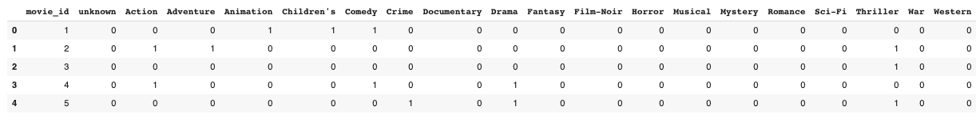
Building User Profile
Obtain the user_movies matrix (shown below after dropping movie_id column and filtering the k movies a user has watched). This leaves us with a k-by-19 matrix of 1s and zeros where each row is a movie and each column is a genre.
all_movies matrix, used to obtain user_movies by filtering the k movies a user has rated.

Slide 9
Building User Profile
Obtain the user_ratings vector. We know user has rated k movies and so we obtain their rating for each of these movies. This gives us a k-by-1 vector (ordered by ascending movie_id).
We know from the dataset creators, GroupLens, that k will be at least 20.

Slide 10
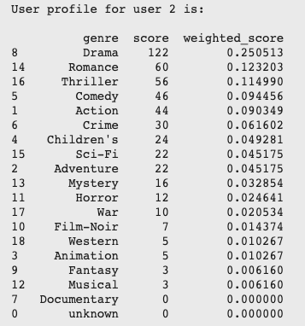
Building User Profile
Multiply the transpose of user_movies by user_ratings.
The transpose of user_movies is a 19-by-k matrix, and we multiply it by the k-by-1 user_ratings vector. This gives us a 19-by-1 vector that indicates our User Profile (their relative preference for each vector).

Slide 11
Generating Top 10 recommendations
Filter out k movies that user has seen from all_movies matrix to give (1682-k)-by-19 matrix, unseen-movies.
Multiply unseen_movies by user_profile we obtain a (1682-k)-by-1 vector, movie_scores, that holds the score for each of the (1682-k) movies User X is yet to see.
Higher score means higher preference. Now match each movie_id to a movie and filter top 10 recommendations.

Slide 12
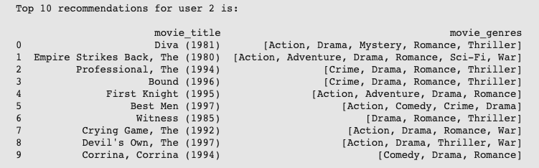
Generating Top 10 recommendations
Example of Top 10 movie recommendations for user (user_id =2)

Slide 13
Evaluating Recommendation Algorithm (Pros)
Movies are all within the Drama genre and none are in the Documentary, which is strictly in line with our user’s preferences.
Only User X’s data is needed to provide User X with fitting recommendations, this makes it significantly easier to scale this recommender to a larger user base.

Slide 14
Evaluating Recommendation Algorithm (Cons)
Again, movies are all within the Drama genre and none are in the Documentary, which shows limited ability to expand its suggestions beyond user preferences meanwhile Documentaries will likely never be recommended.
Requires domain knowledge and significant effort to feature engineer data for improved representations of movies, current representation of movie in binary form by genre is flawed.

Slide 15
Collaborative Filtering
Steps:
Data Wrangling & Building Correlation Matrix
Generating our Top 10 movie recommendations for User X
Evaluating the Recommendation Algo

Slide 16
Item-Based vs. User-Based CF
How are they different:
Item-based:
Given an item that a user likes, recommends similar items
User-based:
Given an item that user likes, finds similar users that also liked it, and recommends other things they liked
Which is better?
Additionally, the GroupLens Research Group also suggested the superiority of Item-based Collaborative Filtering with regard to scalability and maintaining high quality recommendations, hence our choice to build an Item-based model.

Slide 17
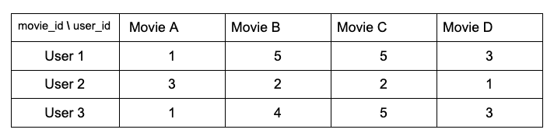
Data Wrangling & Building Correlation Matrix
Manipulate the data so that it looks like the Mock Table below.
Here, we can see that each movie is represented by a column of ratings given by a user. Here, intuitively the vectors for Movie B and C are more similar to each other than they are to Movie A and Movie D. Quantitatively, we do can do this for each of the 1682 movies with the Pearson Correlation, to obtain a 1682-by-1682 correlation matrix.

Slide 18
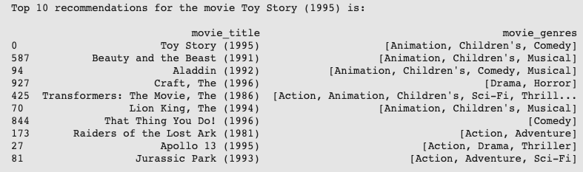
Generating Top 10 movie recommendations for User X
We have a symmetric 1682-by-1682 matrix, where the (i,j)th element - and the (j, i)th element- hold the correlation between the ith and jth movies.
Given a movie the user liked, we use our correlation matrix to return the top 10 correlated movies, per the movie’s column/row in our correlation matrix.

Slide 19
Evaluating Recommendation Algorithm (Pros)
Most recommendations share at least 1 genre w/ Toy Story. In fact, 3 of top 5 recommendations are also produced by Disney!
User also exposed to recommendations beyond their niche interest. Movies not restricted to select genres (e.g. “The Craft”, “Apollo 13”, “Jurassic Park” and “Raiders of the lost Ark”)
Less domain based knowledge is necessary as the embeddings are learnt naturally.no domain based knowledge is necessary as the embeddings are learnt naturally

Slide 20
Evaluating Recommendation Algorithm (Cons)
The ‘cold-start’ problem: When a new user enters the system and we are unable to produce useful recommendations due to lack of information on the user’s interests
Rigidity of the algorithm against adding new features to the recommendation/prediction (i.e using demographic, nationality, or geographic location to assist prediction)

Slide 21
Neural-Network Based Model
Steps:
Building and Training a Neural Network
Generating our Top 10 movie recommendations for User X
Evaluating the Recommendation Algo

Slide 22
Building & Training Neural Network
The Idea behind our neural network is we want our model to predict a rating for a movie, given the movie and the user id:
Use Keras & Tensorflow for framework.
Based some model choices on Keras’ tutorials for building neural nets rating prediction, others on trial and error to receive best results.
Split the data 80/20 into training and testing data to evaluate my training and test performance (using Mean Squared Error Loss as my evaluation metric)

Slide 23
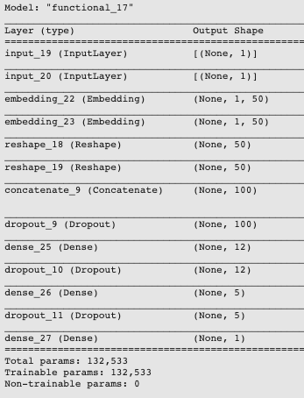
Building & Training Neural Network
What the Final Neural Network looked like:
User X
Movies
Embedding Layer
3x Dense Layer
42% Dropout
ReLU activation
Output

Slide 24
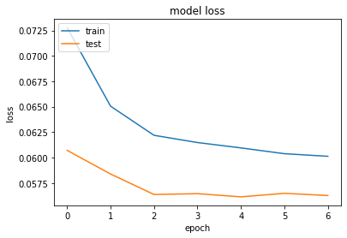
Building & Training Neural Network
Training VS. Test Loss per Epoch:
learning to a relatively significant degree for the first few epochs of training
learning plateaus after the 5th epoch.
Successfully trained model to predicts rating for a movie based on learnt weights for different users and movies.

Slide 25
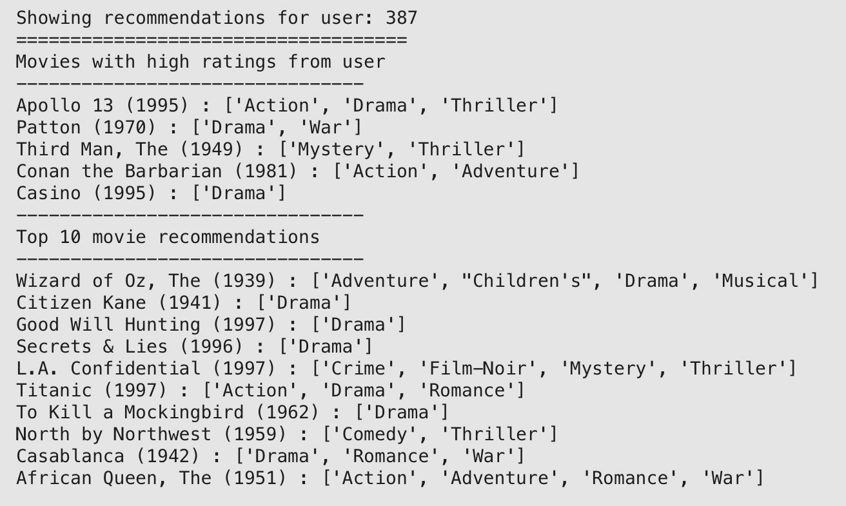
Generating Top 10 movie recommendations for User X
We use the Neural Net to predict ratings for the set of unseen movies, and then report the 10 unseen movies with highest predicted rating!

Slide 26
Evaluating Recommendation Algorithm (Pros)
The 5 movies the user has given highest ratings collectively represent the genres: Action, Drama, War, Thriller, Adventure, & Mystery. All these genres & more appear in recommendations frequently!
From the user’s top 5 movies we know they enjoy Drama movies (most occurring genre). Drama is genre for 7 out of 10 recommendations.
Cater to user’s niche interests, but also recommends movies from less common genres that other filtering approaches would exclude.
Model is flexible to update for new features, and Deep Learning is generally easily scalable to Big Data

Slide 27
Evaluating Recommendation Algorithm (Cons)
The ‘Black Box’ Problem: increasingly difficult to interpret our models as complexity increases, making it harder to understand their implications and evaluate their fairness.
Delegating away feature engineering, and overall recommendation decisions means less ability to understand the different trends, consumption patterns and feature-to-feature relations in our data. This could be crucial information for a company’s business decisions for example

Slide 28
Conclusion

Slide 29
Conclusion
Each standing alone, the neural network based model seemed to be clearly superior to the other two basic recommenders in quality of recommendation, flexibility and scalability.
However this exploration builds a basic recommendation system for each of these techniques, whereas systems deployed in the real world are far more complicated and usually deploy more than one, if not all, of these techniques to deal with different circumstances.

Slide 30
Next Steps

Slide 31
Next Steps
From these insights the following are possible extensions of this project:
Explore different Recommendation System quantitative and qualitative performances using larger, more recently procured datasets (MovieLens 100M), with better feature engineering (tags, relevance score, etc.).
Attempting to build an easily interpretable, high-quality, advanced Deep Learning-based recommendation system, or similar tools to make DL-based models more explainable.
Explore the above suggestions across multiple datasets.

Slide 32
Thank You!

