Slide 1
Predictive Maintenance
for Aircraft Components
Rwanda Civil Aviation Authority — Data Science Assessment
March 2026
Predicting component failure within the next 10 flight cycles

Slide 2
The Problem We're Solving
Every unplanned component failure is a failure of information
AOG Event
Safety Risk
Delayed Flights
Wasted Resource
Aircraft-on-Ground costs $10k–$150k/hr
Unplanned failures compromise safety margins
Cascading disruption across the schedule
Early maintenance costs with no benefit
The Solution: Predict failure 10 flight cycles in advance
Give maintenance planners a ranked list of at-risk components every flight — before any failure occurs, while there is still time to act.
"Catching zero failures is not a data science achievement. Catching every failure before it grounds a plane is."
RCAA — Predictive Maintenance Assessment | March 2026
2 / 12

Slide 3
Our Approach
Five steps from raw sensor data to actionable risk scores
1
2
3
4
5
Data Quality
Explore (EDA)
Engineer Features
Train & Compare
Deploy
→
→
→
→
Validate sensors, flag anomalies
Understand failure patterns and signals
Transform snapshots into temporal signals
4 models, cost-sensitive, cross-validated
Risk scores → maintenance action
Throughout: explainability (SHAP + decision rules) so engineers understand every alert
RCAA — Predictive Maintenance Assessment | March 2026
3 / 12

Slide 4
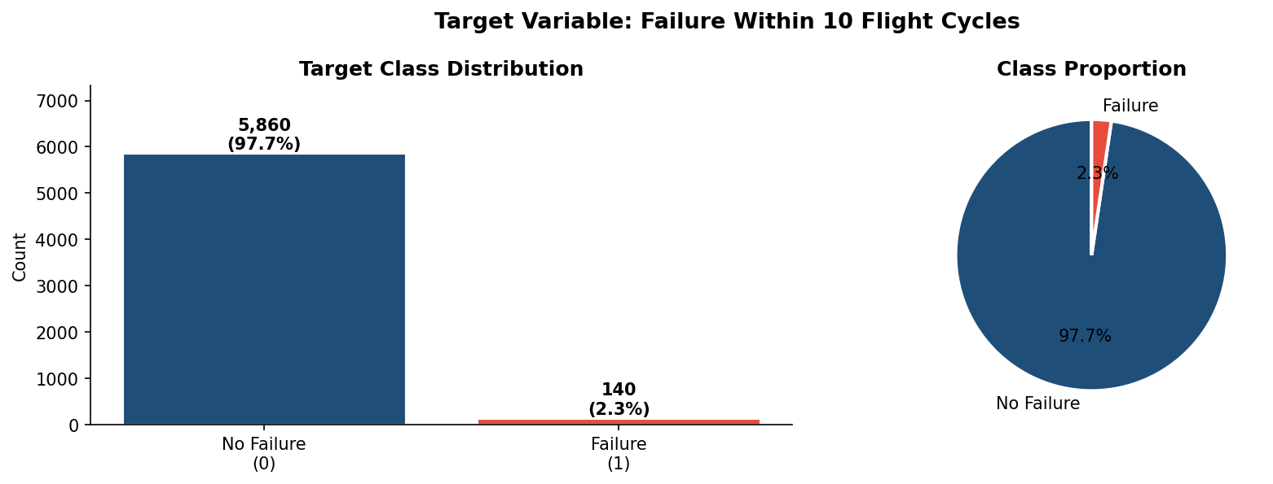
The Dataset
6,000 records | 20 aircraft | 4 components | 1 critical challenge
6,000
20
4
⚠ The Core Challenge
Only 2.3% of records are failures. A model that always predicts 'No Failure' scores 97.7% accuracy — and catches ZERO failures.
Records
Aircraft
Component Types
140
42:1
13
Failure Events
Class Imbalance
Raw Features
RCAA — Predictive Maintenance Assessment | March 2026
4 / 12

Slide 5
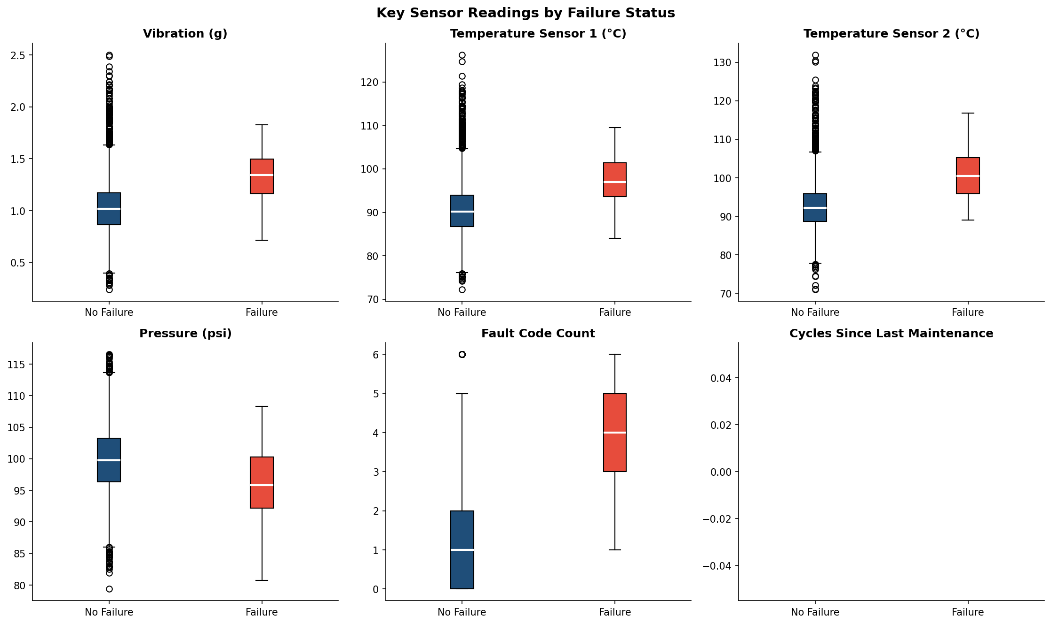
What the Data Tells Us
No single sensor predicts failure — it's the pattern over time that matters
Key Findings
▸ Fault codes: clear separation
▸ Vibration elevated pre-failure
▸ Temperature: mild signal
▸ Humidity/ambient: no signal
▸ Engine1 + Wing: highest risk
▸ Failures cluster at high cycles
▸ Sensor drift flags real issues
→ Single-cycle readings hint at the signal. Tracking accumulation over 5 cycles unlocks it.
RCAA — Predictive Maintenance Assessment | March 2026
5 / 12

Slide 6
Turning Snapshots into Signals
Feature engineering: from 13 raw features to 43 temporal features
Rolling Stats
Rate of Change
Fault Accumulation
Mean & std dev over 3 & 5 cycles
Δ per cycle — speed of deterioration
★ Rolling 5-cycle fault total
Stress Index
Interactions
Maint. Urgency
Vibration + Pressure combined z-score
Vib × Temp Drift × Faults
Faults × cycles since service
★ fault_roll5_sum = #1 predictor | 61% of XGBoost's predictive gain | Validated by SHAP analysis
RCAA — Predictive Maintenance Assessment | March 2026
6 / 12

Slide 7
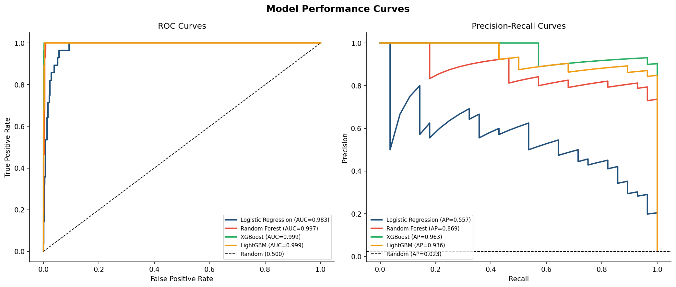
Training Four Models
Cost-sensitive learning + stratified cross-validation for the 42:1 imbalance
Model Comparison
Model
PR-AUC
Recall
Logistic Reg.
0.557
0.857
Random Forest
0.870
0.964
LightGBM
0.936
0.964
XGBoost ★
0.963
1.000
Why XGBoost?
Gradient boosting focuses iterations on hard-to-classify failure events. scale_pos_weight=42 bakes the cost asymmetry into the loss function.
RCAA — Predictive Maintenance Assessment | March 2026
7 / 12

Slide 8
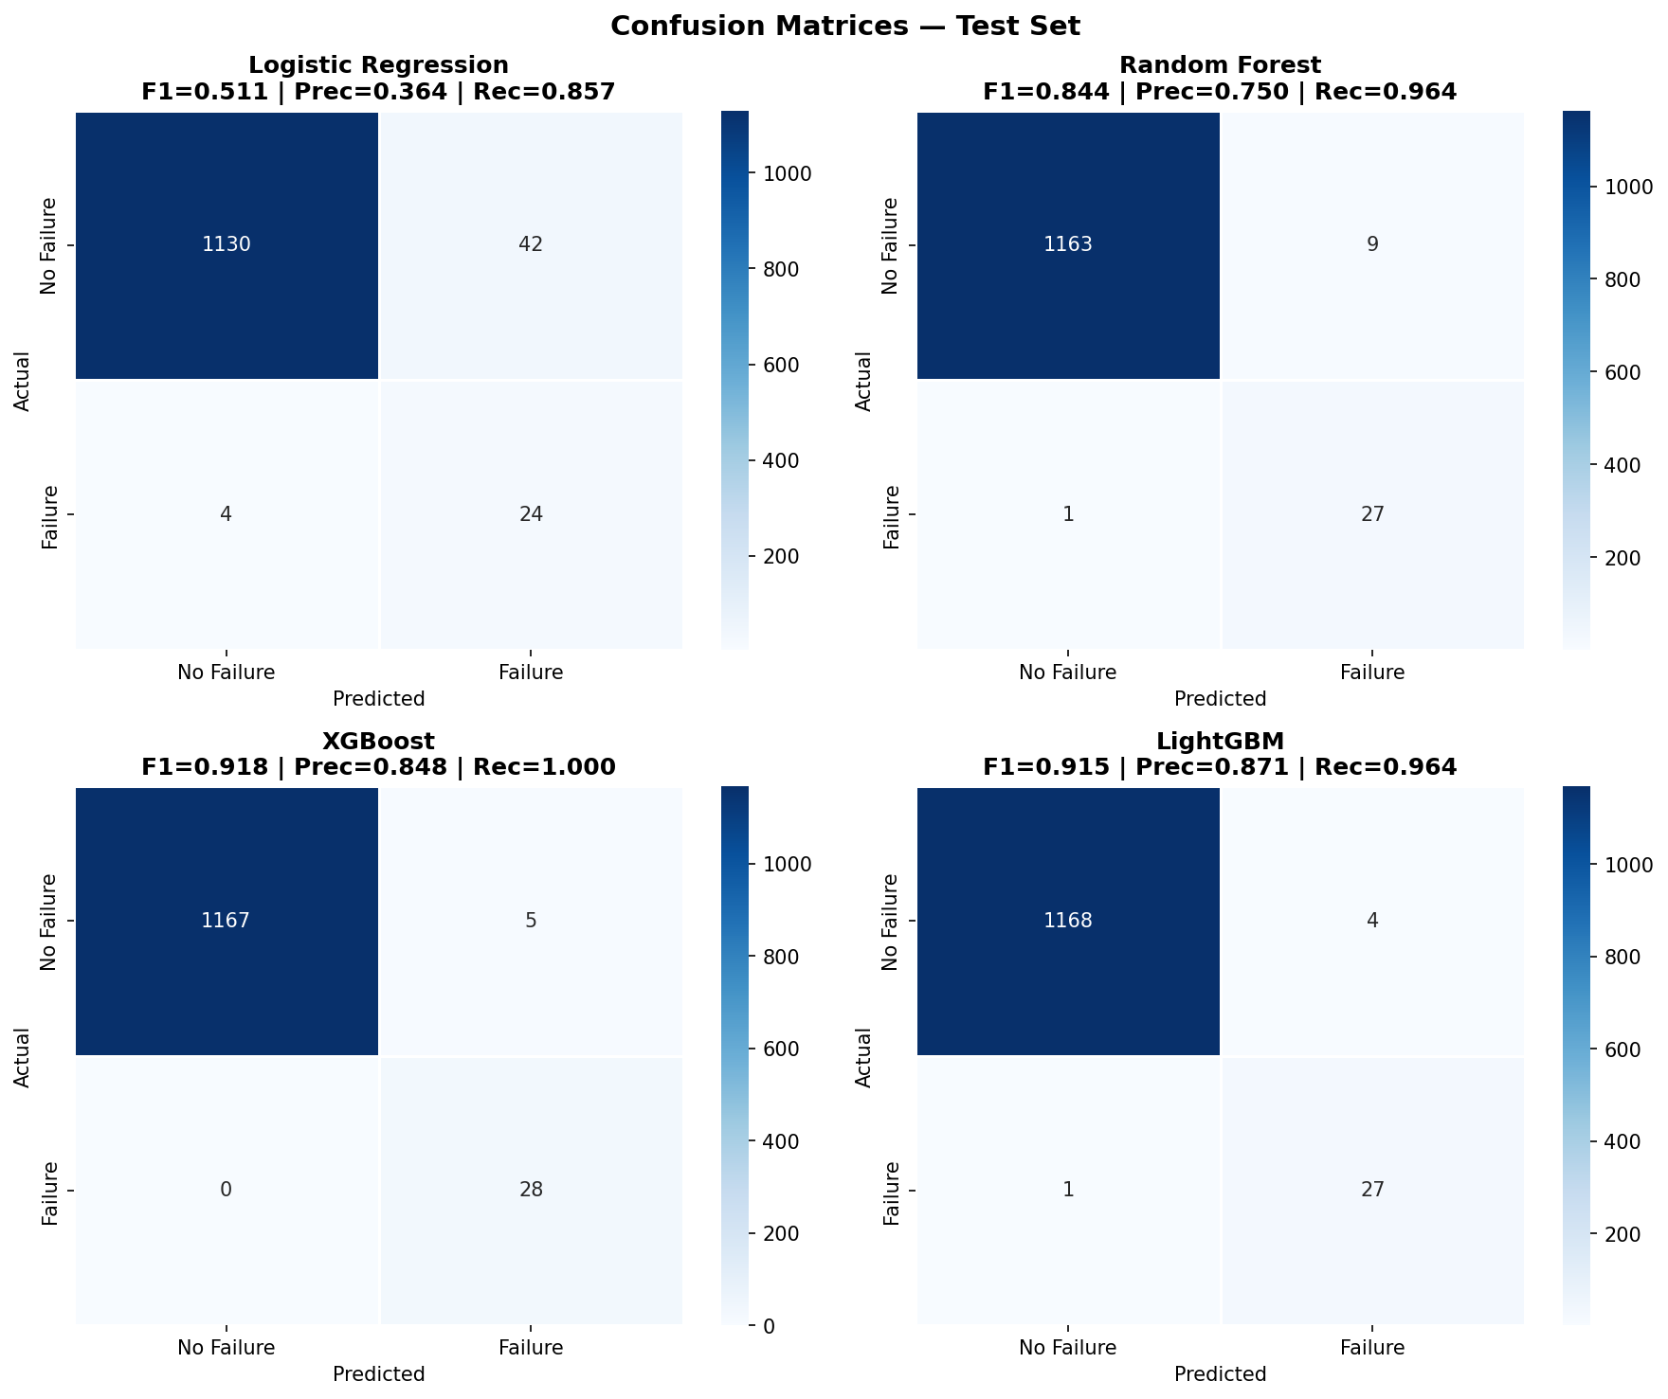
Results: Zero Missed Failures
XGBoost on held-out 20% test set (1,200 records | 28 failure events)
0.9992
0.9632
0.9180
1.0000
ROC-AUC
PR-AUC
F1 Score
Recall
What This Means
▸ Recall = 1.00: every failure event caught
▸ Precision = 0.85: ~1 false alarm per 6.5 alerts
▸ ROC-AUC = 0.999: near- perfect discrimination
▸ CV variance ±0.023: stable, generalisable
RCAA — Predictive Maintenance Assessment | March 2026
8 / 12

Slide 9
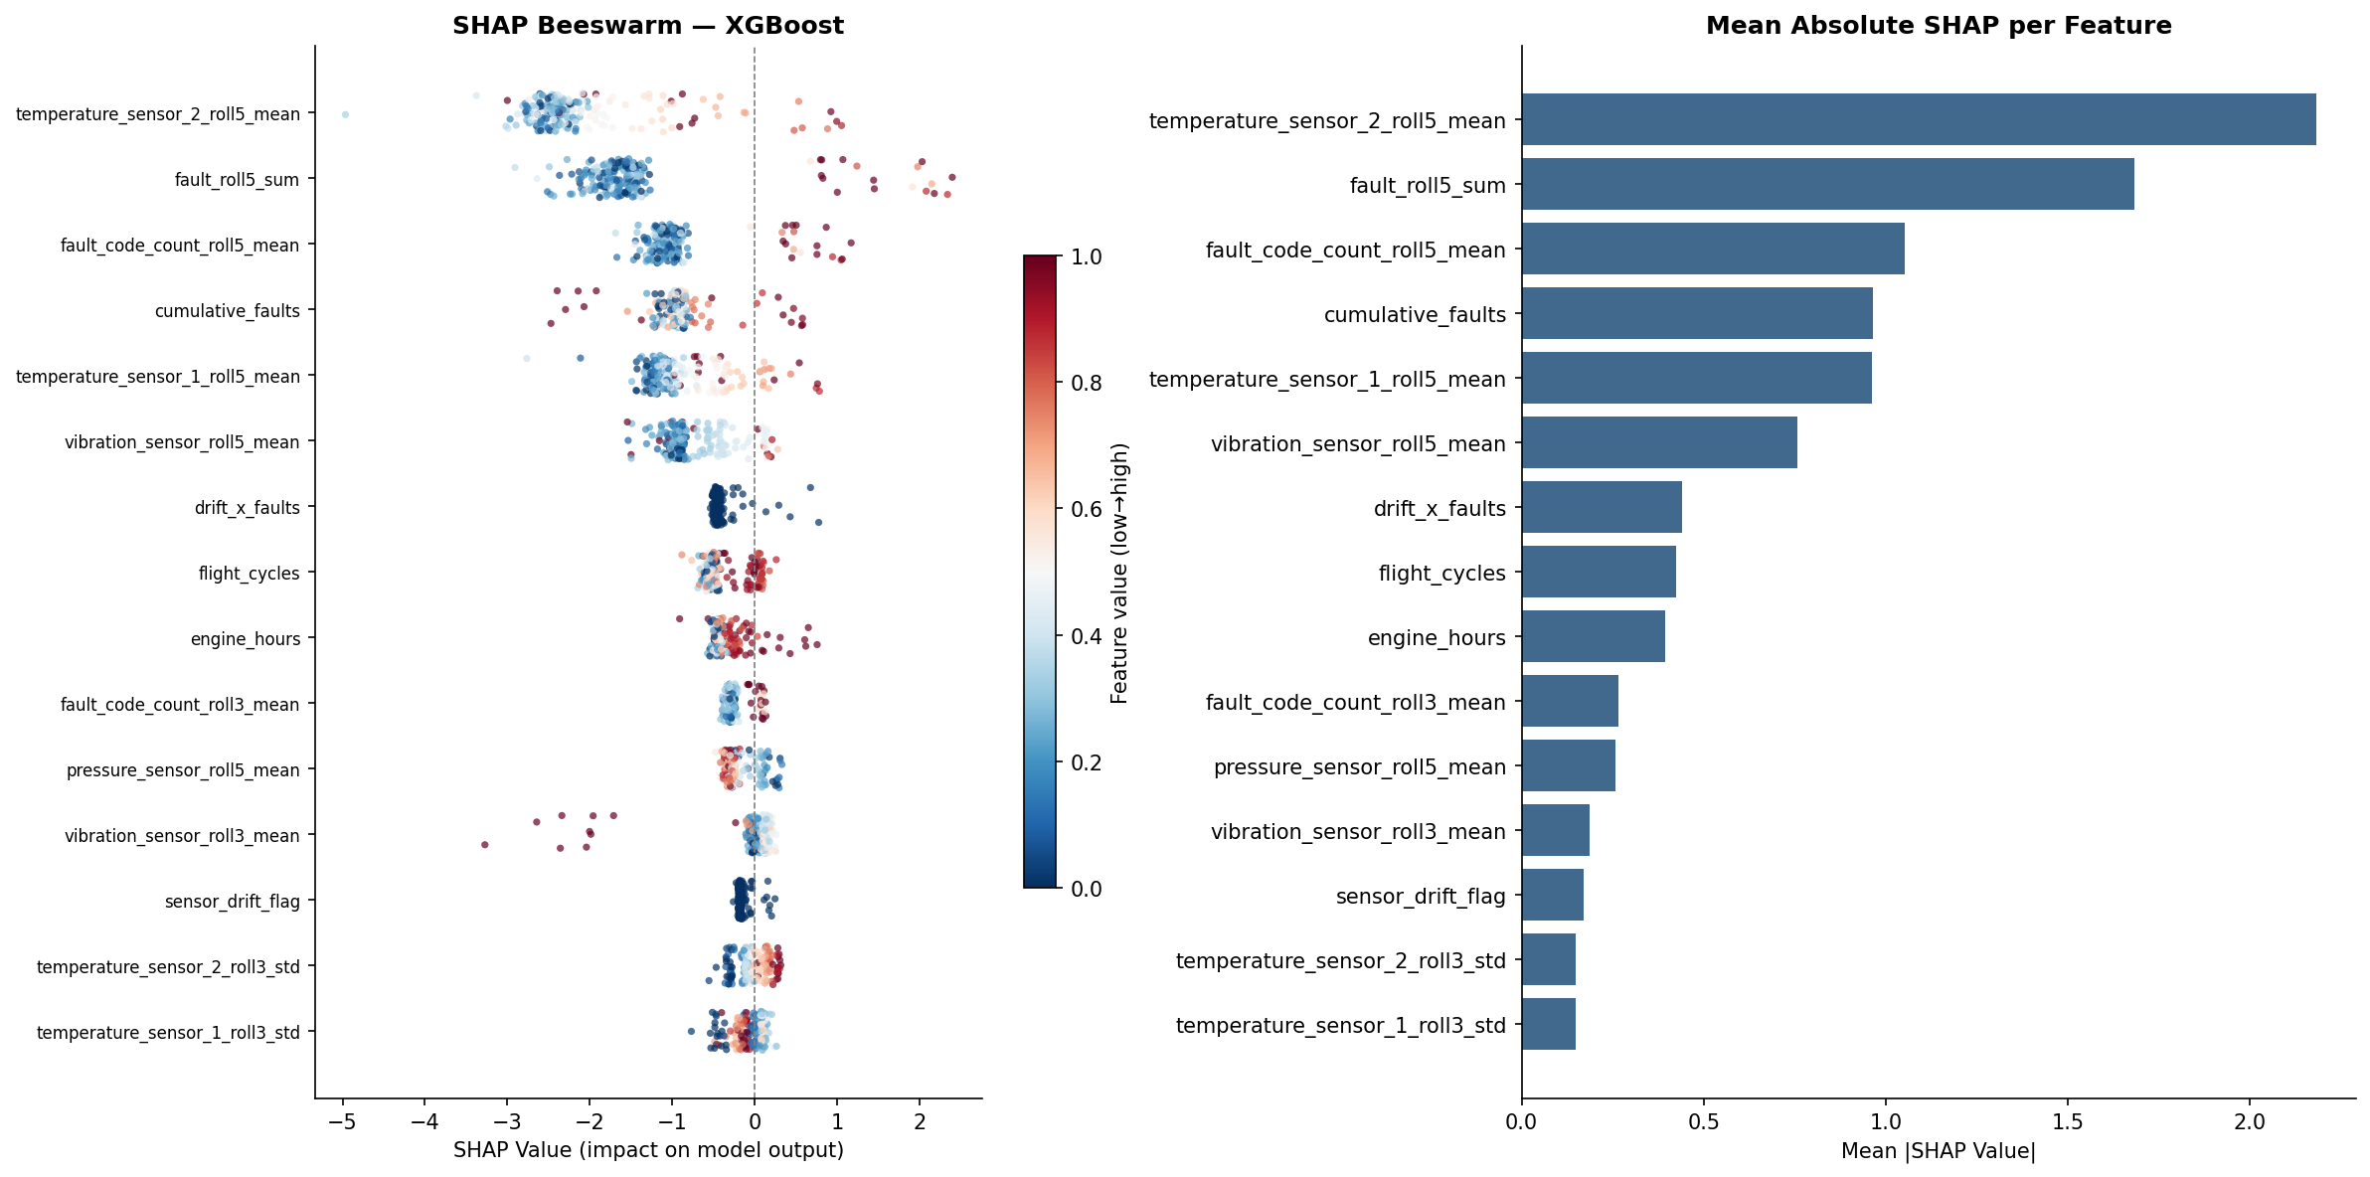
Why Does the Model Predict Failure?
SHAP values + decision rules — every alert is explainable
What Engineers See
▸ fault_roll5_sum (61%): rapid fault accumulation
▸ fault_roll5_mean (21%): sustained fault intensity
▸ vibration trend: mechanical wear signal
▸ temperature trend: thermal stress history
▸ sensor_drift: instrument degradation signal
Decision rule for engineers: IF fault_roll5_sum > 9.5 AND temp_sensor_2_5cycle_avg > 93.8°C → FLAG FOR INSPECTION
RCAA — Predictive Maintenance Assessment | March 2026
9 / 12

Slide 10
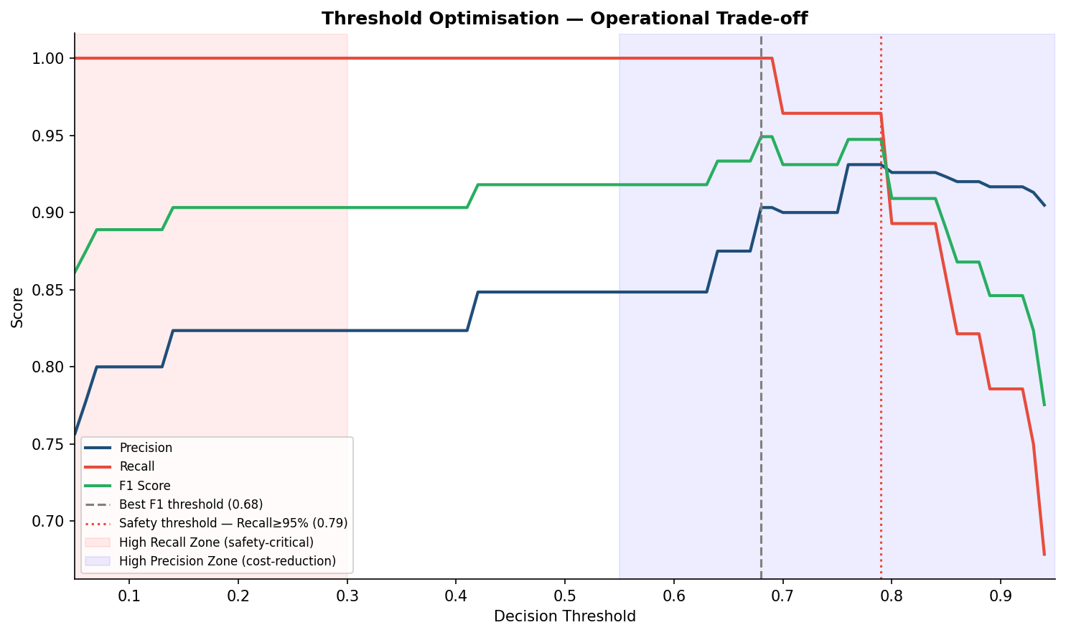
Choosing the Right Alert Threshold
The model outputs a probability — the threshold is an operational decision
Threshold Guide
Safety-critical
Max recall More inspections
Threshold: 0.20–0.30
Balanced (default)
Optimal F1 Balanced cost
Threshold: 0.50–0.68
Cost-optimised
Fewer alerts Marginal risk
Threshold: 0.70–0.80
At threshold 0.68: F1 = 0.949 | Recall = 1.00 | Precision = 0.903
RCAA — Predictive Maintenance Assessment | March 2026
10 / 12

Slide 11
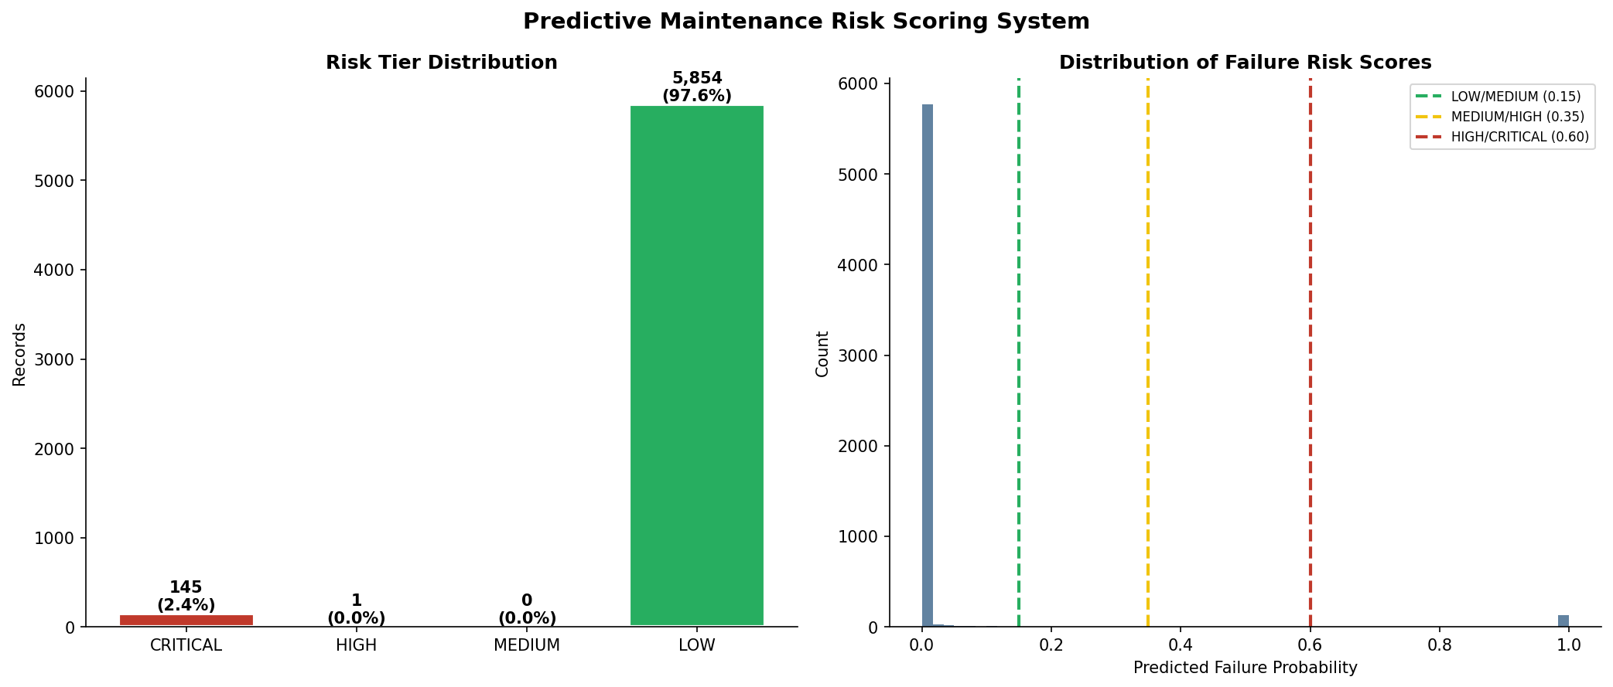
From Predictions to Action
Risk scores mapped to a four-tier maintenance action framework
Risk Tiers
🔴 CRITICAL (≥0.60)
Ground — urgent inspection
🟠 HIGH (0.35–0.59)
Next maintenance window
🟡 MEDIUM (0.15–0.34)
Increase monitoring
🟢 LOW (<0.15)
Standard operations
Integration Pipeline
1. Ingest sensor logs
→
2. Compute features
→
3. Score with XGBoost
→
4. Assign risk tier
→
5. Dispatch work order
RCAA — Predictive Maintenance Assessment | March 2026
11 / 12

Slide 12
Key Takeaways
0.9992
0.9632
1.0000
0.9180
ROC-AUC
PR-AUC
Recall
F1 Score
✓ XGBoost achieves perfect recall — zero failures missed on the test set
✓ Rolling fault accumulation (fault_roll5_sum) is the decisive signal — 61% of model gain
✓ A shallow decision tree provides human-readable rules for maintenance engineers
✓ The inference pipeline (predict.py) is production-ready for integration with FDMS
Prepared for RCAA | Data Science Assessment | March 2026
Questions welcome — I can walk through any section in detail

