Slide 1

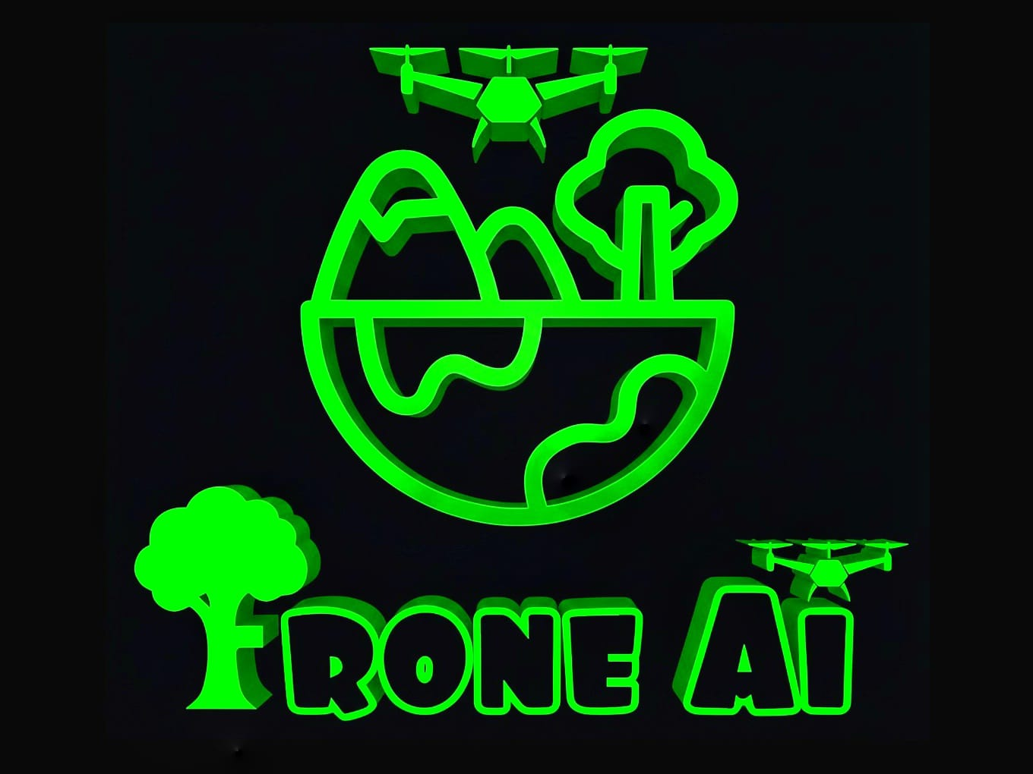
FRONE AI
Agricultural Intelligence First. Autonomous Forest Protection & Sustainable Land Use for the next generation of landowners.

Slide 2

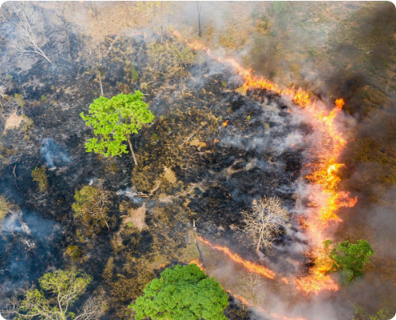
THE SILENT CRISIS
Farms and forests are dying together.
Productive land is bordering threatened ecosystems. Current monitoring is reactive, dangerous, and arrives only after the fire or logger has left.
•
Delayed fire detection destroys yields.
•
Illegal logging encroaches on boundaries.
•
Human patrols are high-risk and high-cost.

Slide 3

ACTIONABLE INTELLIGENCE
Agriculture First, Protection Always
Frone AI turns remote land into data-rich environments. We deliver immediate ROI through crop health monitoring while the same sensors secure the forest perimeter.
• Crop Stress Identification
• Autonomous Threat Verification
• Evidence-Based Escalation

Slide 4
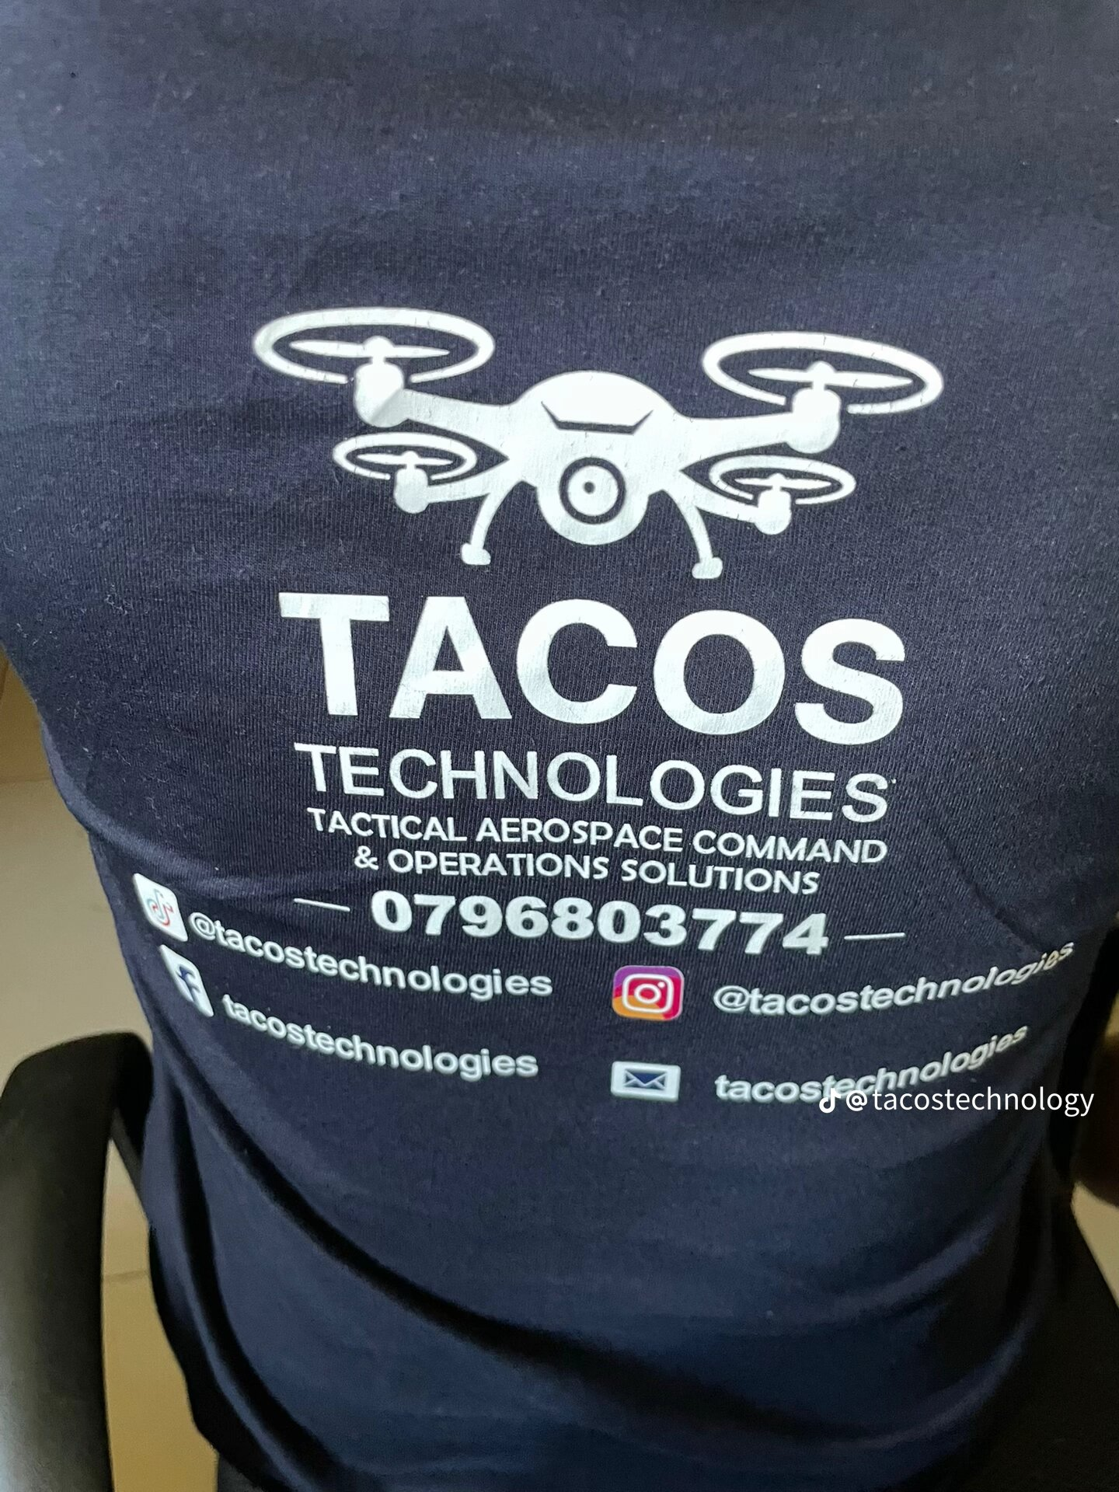
REALIZING THE FLEET
TACOS Technologies Partnership
Strategic alliance with Tactical Aerospace Command & Operations Solutions to manufacture our custom drone fleet.
Leveraging specialized aerospace engineering to build rugged, long-range autonomous drones that operate where satellites cannot see.

Slide 5






CONSENSUS-DRIVEN LOGIC
Detect
Verify
Report
Multi-sensor tree nodes capture audio, heat, and vibration. No single point of failure.
3+ sensors must agree. AI verifies data before dispatching autonomous drones.
Live GPS coordinates and visual evidence sent directly to authorities or rangers.

Slide 6


THE OPPORTUNITY
$12B
$50B
30%
Precision Agriculture
Carbon Credits
Security Savings

Slide 7


SUSTAINABLE REVENUE
The SaaS Layer
The Media Subsidy
Subscription-based agricultural intelligence for farm and forest managers.
High-def data feeds sold to researchers and climate agencies to offset farmer costs.

Slide 8
STRATEGIC ADVANTAGE
Benchmark | Satellite | Human Patrol | Frone AI
Detection Speed | 24 - 48 Hours | Variable | Real-Time
Verification | Low Res | Dangerous | Visual Drone
Visibility | Above Cloud Only | Limited | Sub-Canopy

Slide 9

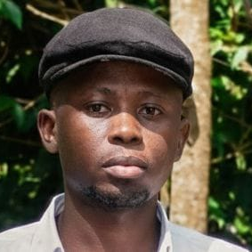
THE VISIONARY
Ian Mwaniki Kanyi
CEO & Founder
"Technology should serve people and the planet, not just profit."
Blending technical expertise with a lifelong commitment to Kenyan reforestation and sustainable land stewardship.

Slide 10
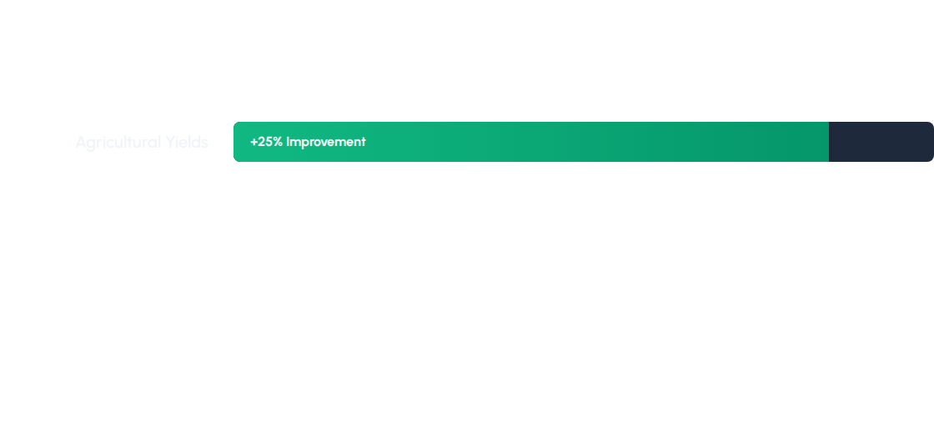
PROJECTED IMPACT
Deforestation Incidents
Monitoring OpEx

Slide 11

Join the Mission
Secure the farm. Protect the forest. Build the future.
Ian Mwaniki Kanyi
gioianaturals@gmail.com
Nairobi, Kenya

Slide 12


IMAGE SOURCES
https://yale-threesixty.transforms.svdcdn.com/production/Cambodia-Burning-Sean-Gallagher-1_web.jpg?w=1500&h=1500&q=80&auto=format&fit=clip&dm=1740244562&s=7ae192b41d1c38fe892398f54055df0b
Source: e360.yale.edu
https://aumovio.scene7.com/is/image/aumovio/25166-AUMES-MVP_GEN2-future?qlt=95&wid=1040
Source: www.aumovio.com

