Slide 1

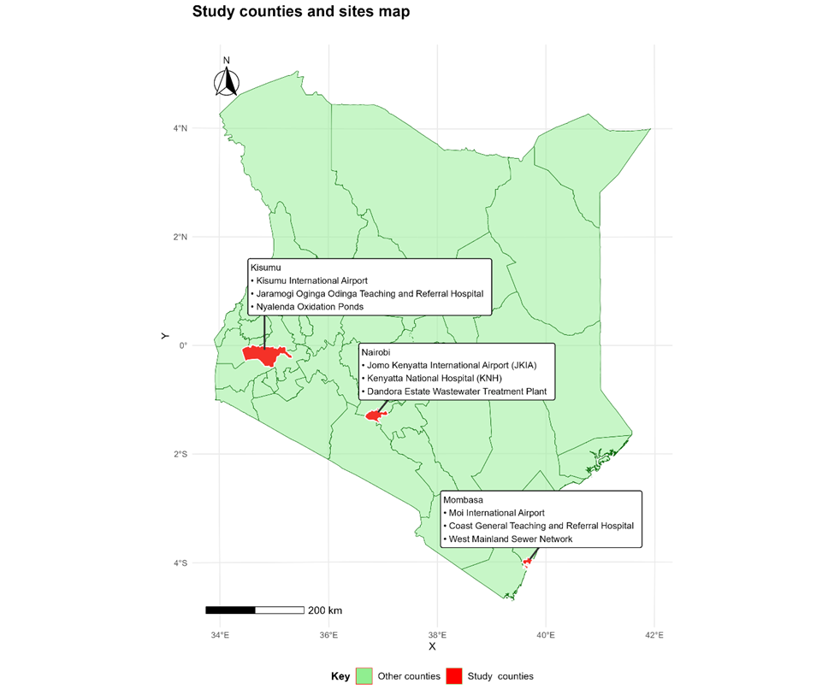
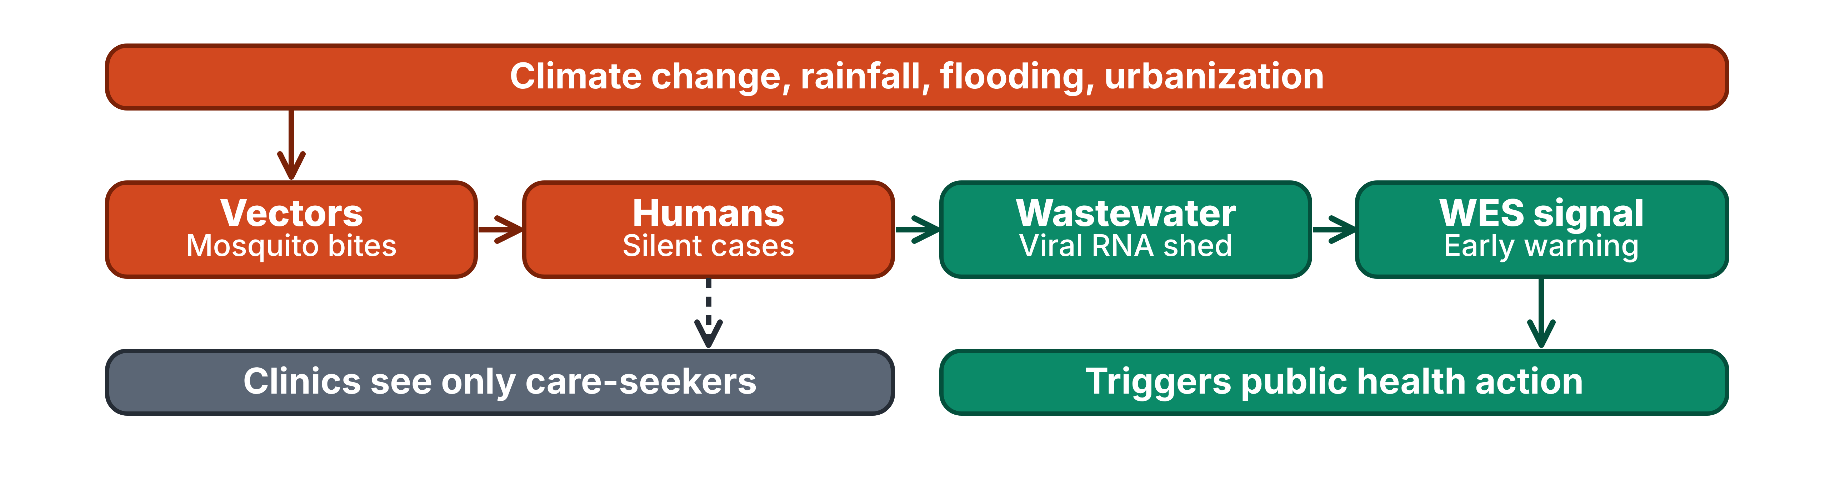
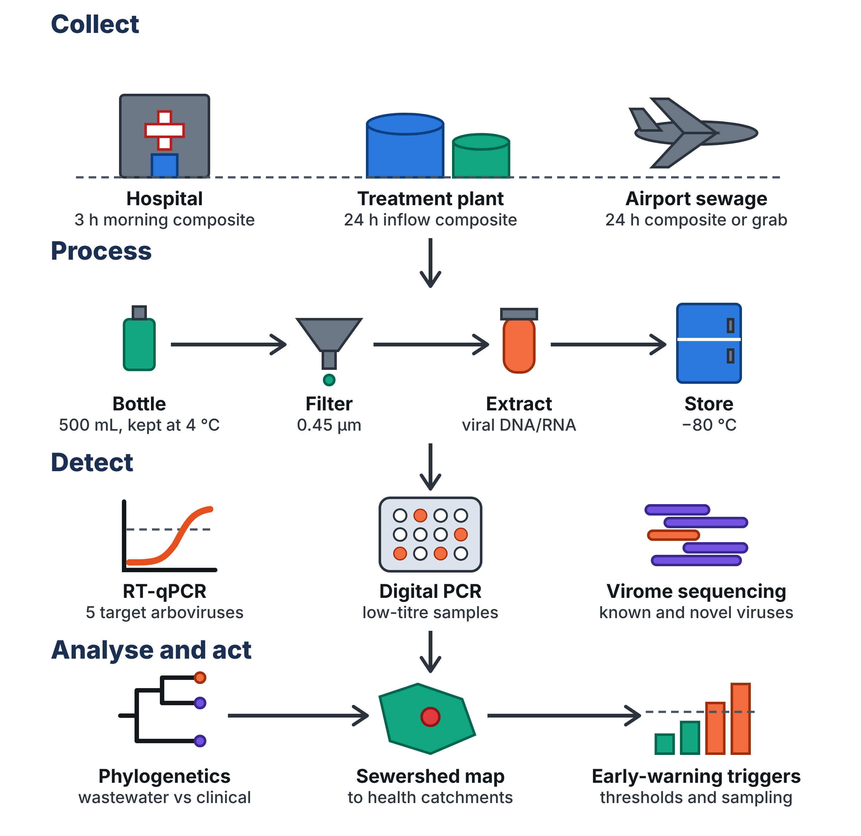


Wastewater-Based Surveillance of Climate-Driven Arboviruses in Urban Kenya
Yvonne Kimata ¹, Patrick Mwaura ¹, Solomon Langat ², Joseph Kamau ¹
Authors/affiliation
Kenya Institute of Primate Research
Kenya Medical Research Institute
Introduction
Generates critical, context-specific evidence for mixed-sanitation and diverse epidemiological settings in Kenya.
Supports integration of wastewater-based surveillance into routine public-health systems in LMICs.
Advances SDG 6 (Clean Water and Sanitation) and SDG 13 (Climate Action
Vector-borne diseases (VBDs) cause over 17% of global infectious diseases and more than 700,000 deaths yearly. In low- and middle-income countries, especially Kenya and sub-Saharan Africa, arboviruses (dengue, chikungunya, West Nile, Rift Valley fever) are major drivers of acute febrile illness but are often missed or misdiagnosed as malaria because of limited diagnostics and passive surveillance. Climate change and urbanization are expanding vector ranges and transmission risk. Wastewater and environmental surveillance (WES) offers a promising population-level tool that can detect both symptomatic and asymptomatic infections early, complementing traditional clinical and entomological approaches.
:
Objectives
1. Detect and characterize arboviruses circulating in wastewater and environmental waters using sensitive molecular and genomic techniques.
2. Assess the genetic diversity and evolutionary relationships of the detected arboviruses.
3. Examine temporal and spatial associations between wastewater detections, clinical acute febrile illness data, and climatic variables.
4. Evaluate the potential of wastewater surveillance to complement existing clinical and entomological surveillance systems.
Figure 1: Study sites in Nairobi, Mombasa, and Kisumu, highlighting wastewater treatment plants, referral hospitals, and international airports targeted for population-level arboviral surveillance
Methods
Study design and sampling
Period: April 2027 to September 2028
Sites: Wastewater treatment plants, referral hospitals and international airports in Nairobi, Mombasa and Kisumu (Figure 1)
Seasons covered: rainy (April–June, November–December) and dry (July–September), to capture seasonal shifts in arbovirus circulation
Samples: about 600 wastewater samples, a size supported by recent solids-based WNV studies showing strong temporal and spatial resolution across multiple treatment plants
Metadata: sampling site, date and local weather, recorded to support spatial and seasonal analyses.
Expected Outcome
References
Scientific: Provides the first integrated assessment of wastewater-based arboviral detection in an African urban setting.
Operational: Demonstrates a cost-effective, scalable early-warning system independent of patient presentation or diagnostic access.
Societal: Enables earlier detection, timelier public-health interventions, reduced morbidity, and greater resilience to climate-amplified vector-borne diseases.
Builds on evidence from Miami-Dade, Brazil, and global assessments confirming the feasibility and public-health value of wastewater surveillance.
1. Zulli, A., et al., West Nile Virus (Orthoflavivirus nilense) RNA concentrations in wastewater solids at five wastewater treatment plants in the United States. PeerJ, 2025. 13: p. e19748.
2.de Araujo, J.C., et al., Uncovering DENV, CHIKV, and ZIKV in Urban Wastewater in Brazil Through Genomic and Molecular Screening. Microorganisms, 2025. 13(9): p. 2164.
3. World Health Organization, (W.H.O) Wastewater and Environmental Surveillance Summary for Arboviruses of Human Significance. Pilot version, 1 December 2025.
4. Gordeev, V., et al., Leveraging wastewater sequencing to strengthen global public health surveillance. BMC Global and Public Health, 2025. 3(1): p. 23.
5. de Sousa, A.R., et al., Arboviruses Wastewater Surveillance in Brazil’s Midwest Region: Extending a Predictive Web Application. 2025.

