Slide 1

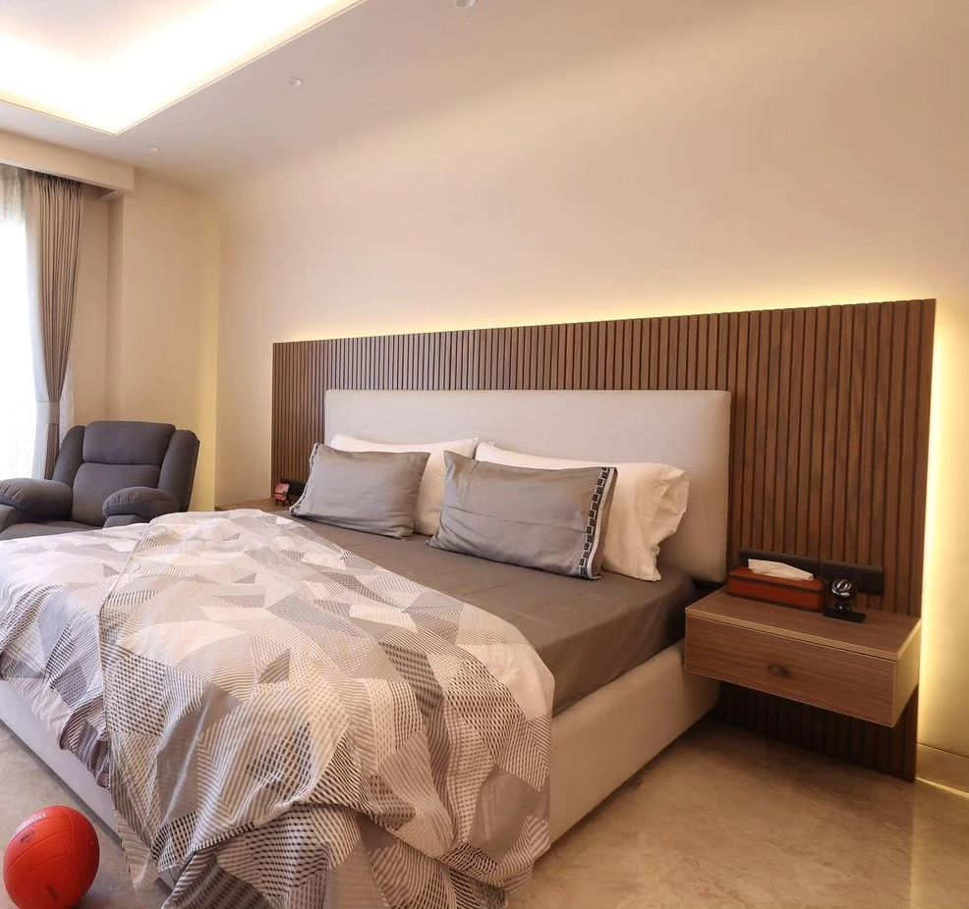
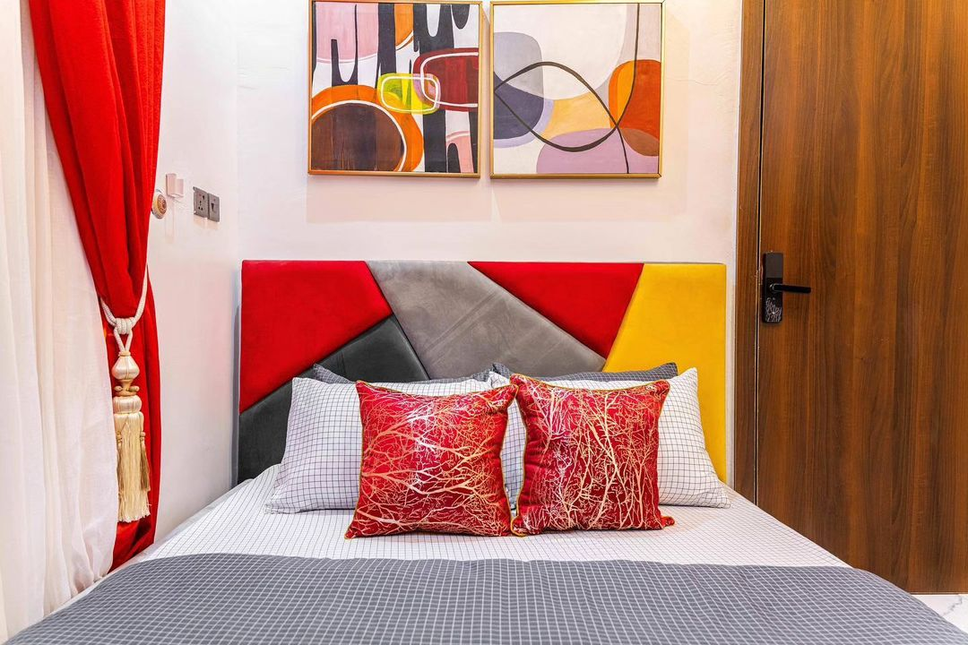
BEDROOM
Made with simple colors
Blended with different colors.

