Slide 1
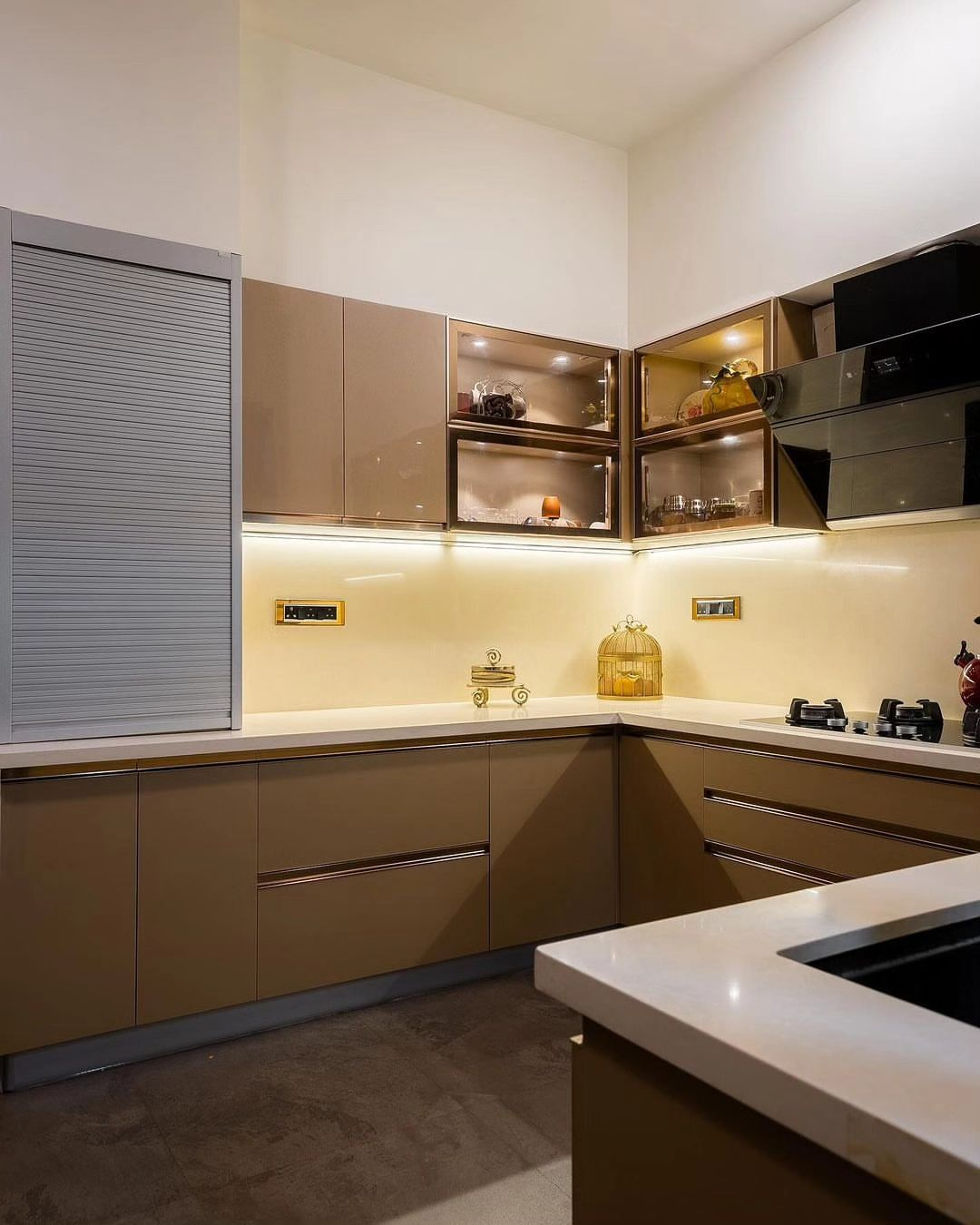
Kitchen
Kitchen is a stunning example of thoughtful design and impeccable taste. The layout is both functional and beautiful, providing a focal point for both cooking and gathering. The color scheme is sophisticated yet inviting, with warm tones and rich textures creating a cozy atmosphere. The use of high-quality materials and finishes is evident throughout, from the sleek countertops to the elegant cabinet hardware. Every detail has been carefully considered, from the efficient storage solutions to the stylish lighting fixtures.

