Slide 1
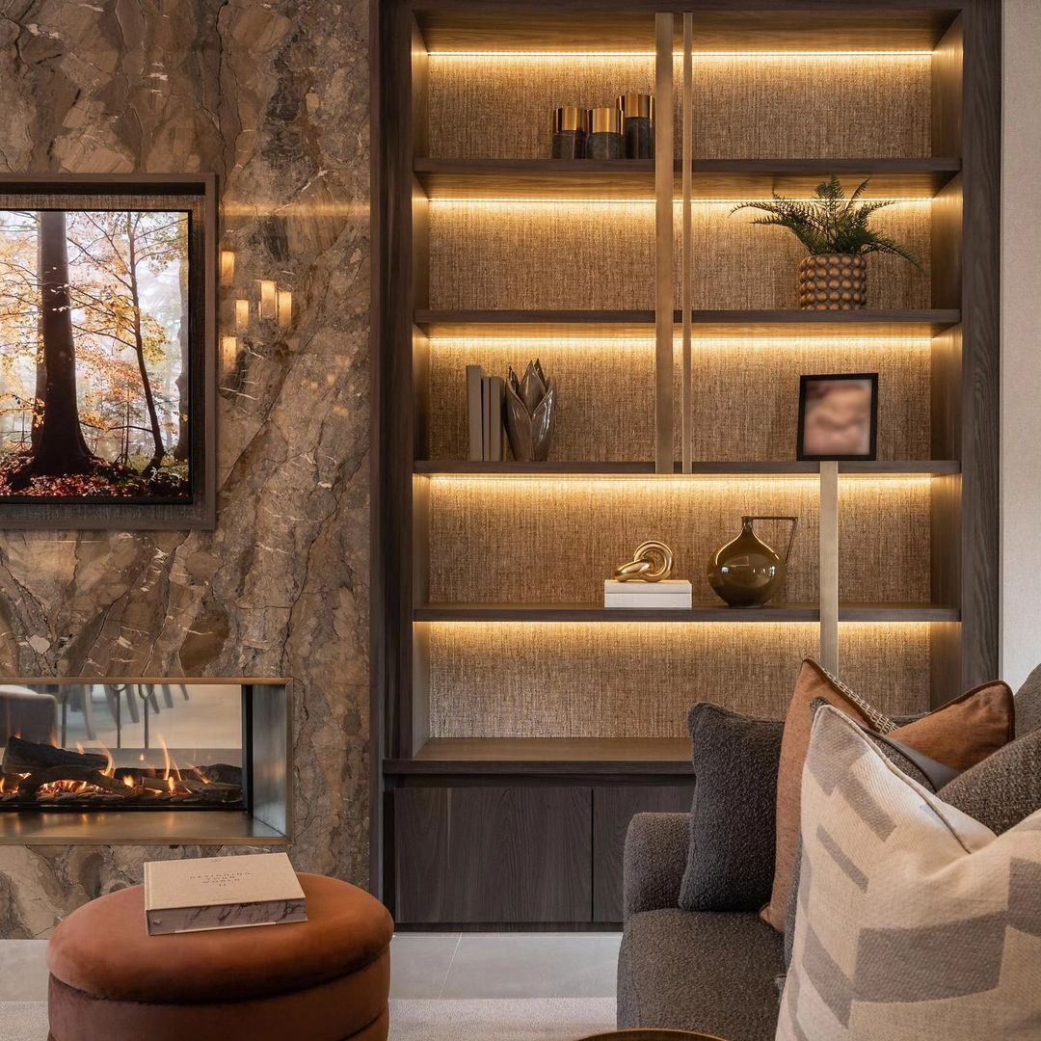
Storage
Make every space count in a room, with a significant blending of its own natural way adding more luxury touch in your living room.

