Slide 1
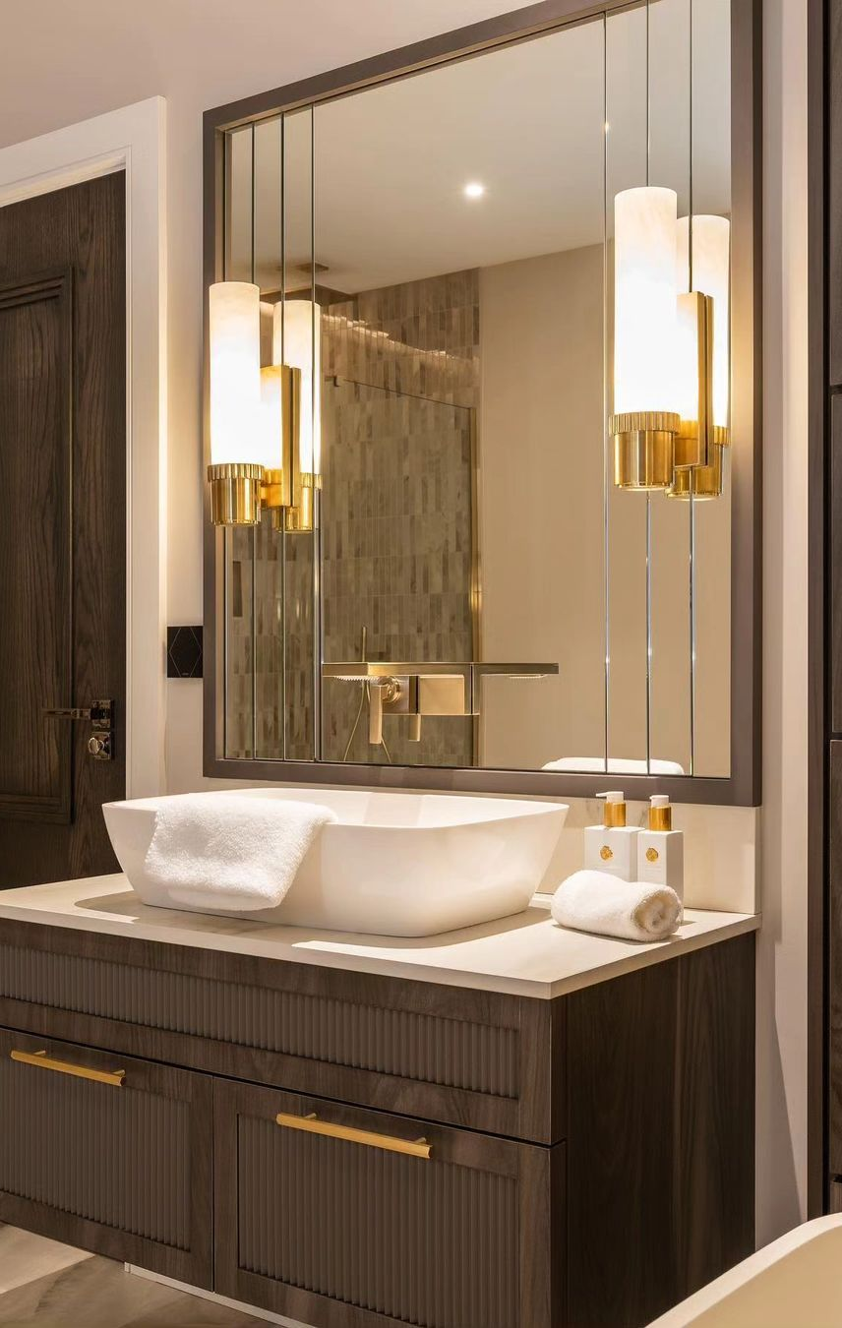
Washrooms
"This washroom is a perfect balance of style and practicality. The layout is efficient, maximizing space. The color scheme is calming, creating a relaxing ambiance. High-quality materials are used, from the elegant countertops to the stylish fixtures. Every detail, including storage and lighting, is carefully considered. It's a testament to thoughtful design."

