Slide 1

Microsoft’s Next Movie Maker
Matthew Christopher Skrimmage Nykaza
November 22, 2020

Slide 2
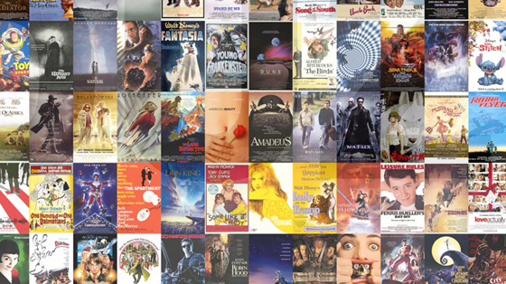
Summary
Thorough Analysis of data that was sourced from the reputable websites IMDB and The Numbers to help ensure a successful launch into the movie production business
Make movies in genres that have the most success in making money
Release movies effectively months that the moviegoing public is most apt to be receptive
Avoid releasing movies during times of the year that have poor historical data for movie releases

Slide 3
Outline
Business Problem
Data and Methods
Results
Conclusions

Slide 4

Business Problems
Genre is key
Release when expected
Guarantee money is made

Slide 5

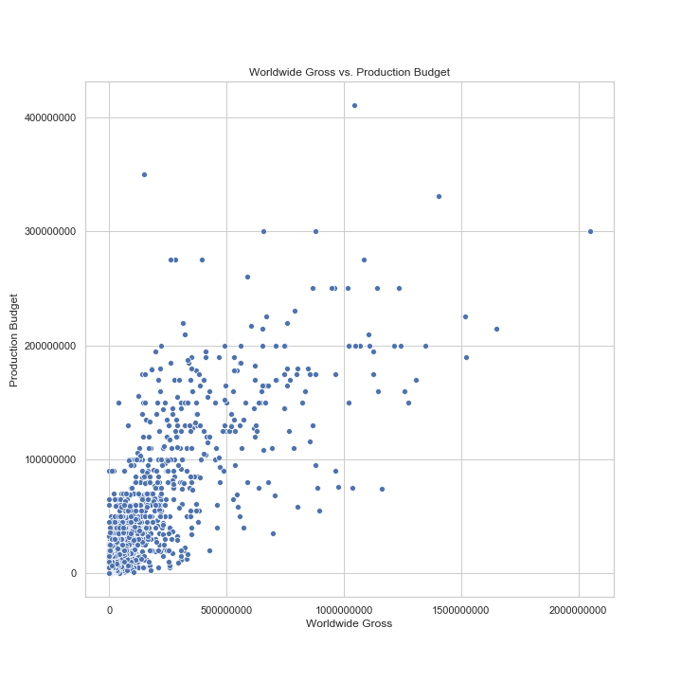
Data and methods
Data from IMDB and The Numbers showing history of movies from 2010-2019
Data includes
Basic information (title, release date, runtime, genres, ratings)
Monetary Information (production budget, domestic gross, worldwide gross

Slide 6
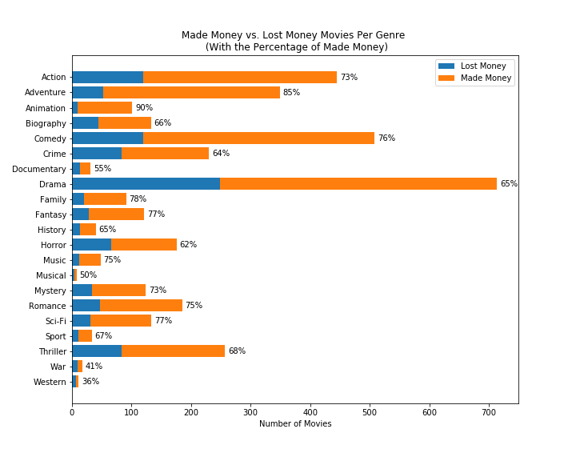
Results
Animation and Adventures have highest percentages of making money
War and Westerns have low percentages
Highest volume of Dramas, but lower than average performance in making money

Slide 7
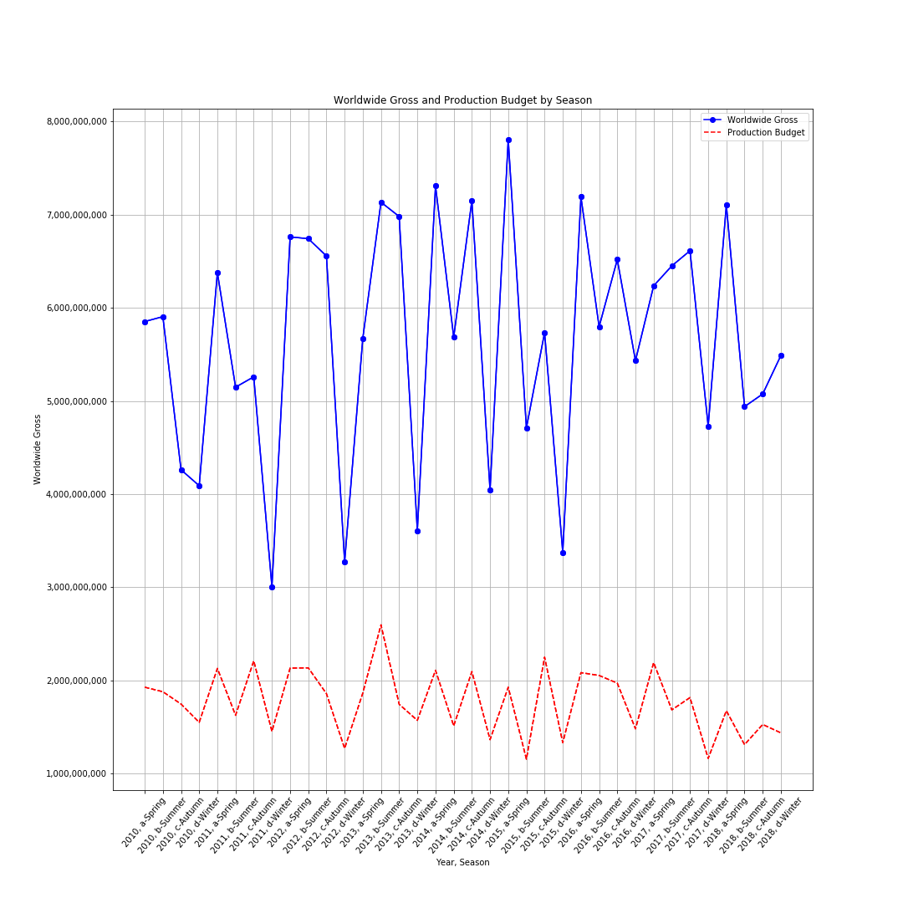
Results
Winter has numerous peaks in Worldwide gross income
Autumn has some of the lowest
Production tends to be highest in Spring and Summer

Slide 8
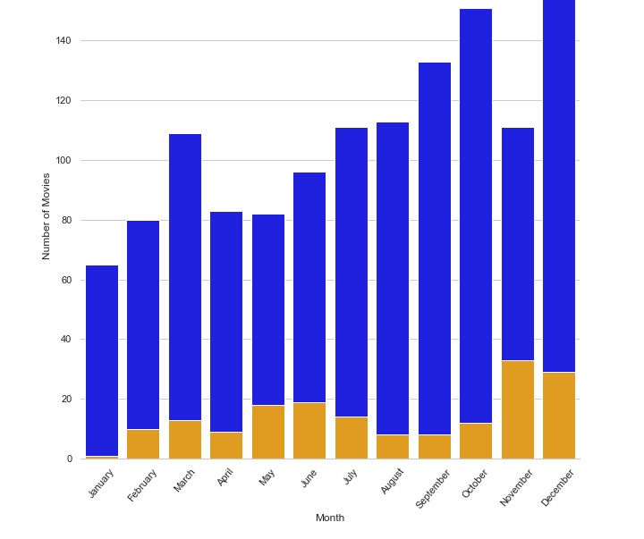
Results
November has the highest percentage and total of commercial success
December also performed well in this metric
January is again a month to avoid

Slide 9
Conclusions
Animation and Adventure have the highest percentages of movies that made money
Movies in late-Spring, early-Summer and November tend to produce the best results
Production will be highest for the Spring and Summer movies

Slide 10
Next Steps
Comparisons of movie budgets and genres
01
Get data on actors/actresses
02
Compare reviews and genres
03

Slide 11
THANK YOU!!!
Email: matt.cs.nykaza@gmail.com
GitHub: @MxCxSxN
LinkedIn: https://www.linkedin.com/in/matthew-nykaza-8a0b726a/

