Slide 1

The Price is Right: A Model For Selecting a Selling Price
Matthew Christopher Skrimmage Nykaza
February 4, 2021

Slide 2
Summary
Predictive modeling using data from home selling data in King County, WA to assist with inexperienced home sellers get the right price
Methods
Preparing data and finding relevant correlations
Design models for prediction
Create pertinent conclusions

Slide 3
Outline
Business Problem
Data handling
Modeling
Conclusions

Slide 4

Business Problems
Home selling for a first-time seller
Risk of price setting
Knowing the market
Selecting the right price

Slide 5
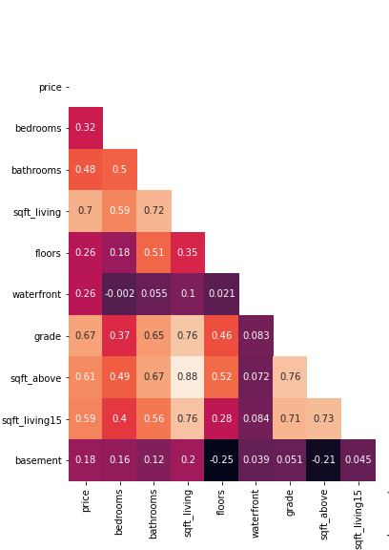
Data Handling
Reviewing the data
Handling non-existent data
Controlling outliers
Review correlations
Select appropriate predictors

Slide 6

Modeling
Split samples into train and test sets
Makes sure that data is useful for future seller
Perform transformations
Confirm appropriate predictors
Validate results

Slide 7
First Model
No standardizations performed
Unaltered data accounted for ~65% of mean variability
There was a high degree of errors
The data was highly skewed

Slide 8
Model With Scaling
Transforming the target variable (price)
Standardizing predictor variables
Scaled data accounted for ~60% of variability
Errors in model heavily mitigated
Less skew

Slide 9
Final Model
Transforming both target and predictor variables
~60% variability accounted for
Errors showing the least impact
Data showing showing most normality

Slide 10

Conclusions
Able to predict home prices with roughly 60% accuracy
Low degree of errors in the modeling
Still work to be done
Home selling needs to include location for accuracy
Homes of the same size can vary widely in price
Home selling is not generalizable over a large area

Slide 11

Future Work
Provide data for location of homes
Compare prices based on geographic areas
Review lot sizes, and home types

Slide 12
Thank You!!!
Email: MATT.CS.NYKAZA@GMAIL.COM
Github: @MxCxSxN
LinkedIn: https://www.linkedin.com/in/matthew-nykaza-8a0b726a/

