Slide 1
COMP1004: INTERIM VIDEO - Typing quiz
By Max Ferguson

Slide 2
Project Vision and background.
Who it’s for?
Employers
Why?
To test potential hire’s typing speeds
Why is it important?
To improve collaboration between team members within office jobs
To improve efficiency in administers jobs
Databases need accurate data
Multitasking and efficiency
Improved response times to customer
While intended for employers, this website can be used by anyone to improve their own typing speed
Ethical, legal and social considerations?
- Accessibility -> display a virtual keyboard on the website?

Slide 3
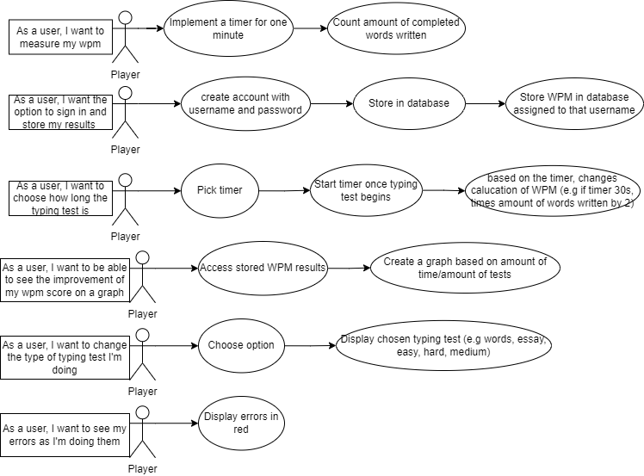
USER STORIES

Slide 4
sprints
SPRINT 1 (WEEK 1 & 2) | SPRINT 2 (WEEK 3 – 4) | SPRINT 4 (WEEK 4-6)
Goals - Create and display user stories - Create a flowchart to display the logic of website (Prototype uses this logic) - Create a wireframe using Figma (UI) -Create UML for prototype logic | Goals - Create a skeleton of the code - Create a working prototype Can do a 60second typing test for non-randomised array of words Gets WPM | Goals - Redo UI to fit the wireframe - Implement the feature to change the timer of typing test - Display WPM + timer onto website rather than console - Create new flowchart to show new structure of code
Status - Completed | Status - Completed | Status - Incomplete (Current sprint)
Next steps - Using UML and flowchart as base, create a working prototype | Next Steps - Creating Ui to be similar or match the wireframe as current looks incredibly dull and outdated | Next Steps - (Assuming completed), implement option to change timer and ensure WPM calculation changes based on the timer change and show errors live

Slide 5
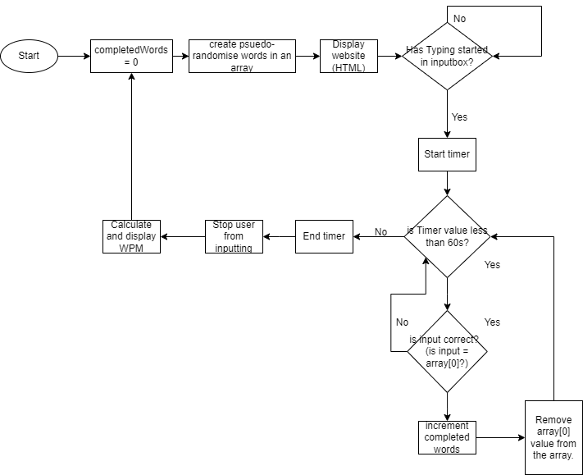
THE FLOWCHART OF LOGIC
Enter text here

Slide 6
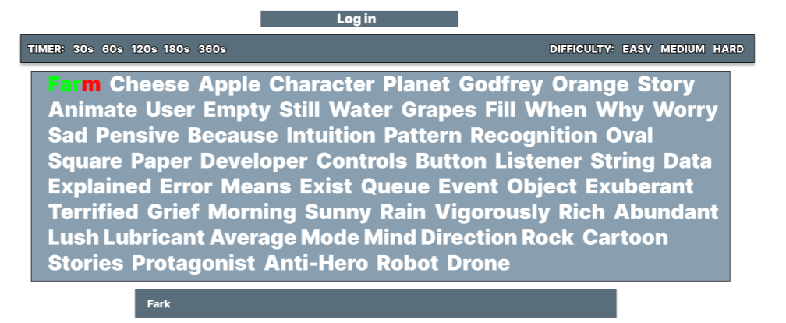
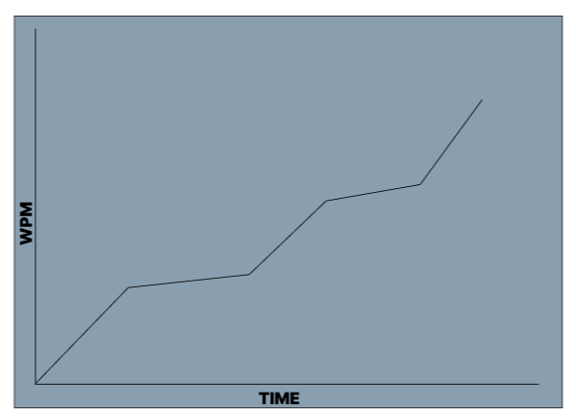
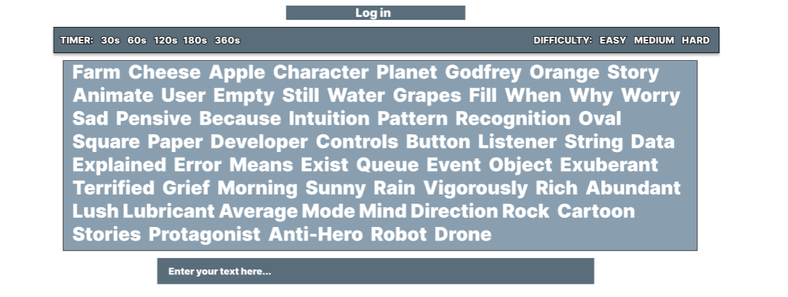
WIREFRAME
Here is what I’d like my website to ideally look like by the end of this project

Slide 7
Show prototype ☺

Slide 8
Challenges I’VE FACED
Coding challenges
Novice at JavaScript, HTML and CSS
Creation of the UI to fit the wireframe
As this changes are made later, it is not shown within the prototype
Time management with other projects

