Slide 1
Factor Analysis of ATP Tennis Matches
Manuel Leutschacher

Slide 2
Overview
Introduction / The Dataset
The Dataset
Visual Analysis
Logistic Regression

Slide 3

Introduction
Tennis DataSet
What is important to win a Tennis match?
Data Split into
A = All Time
L5 = Last 5 Matches
= Last Match
CUR = Current Match
200,000 Rows / 30,000 Rows with no NAs

Slide 4
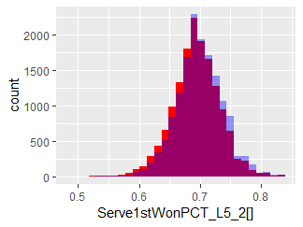
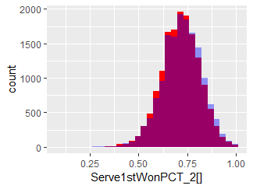
Visual Analysis
The shorter term the data -> the higher the variance

Slide 5
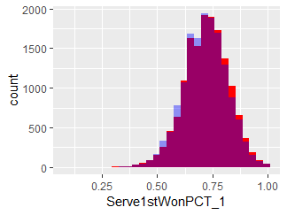
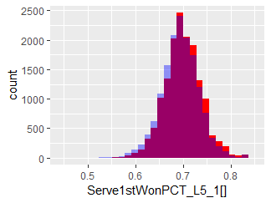

Slide 6
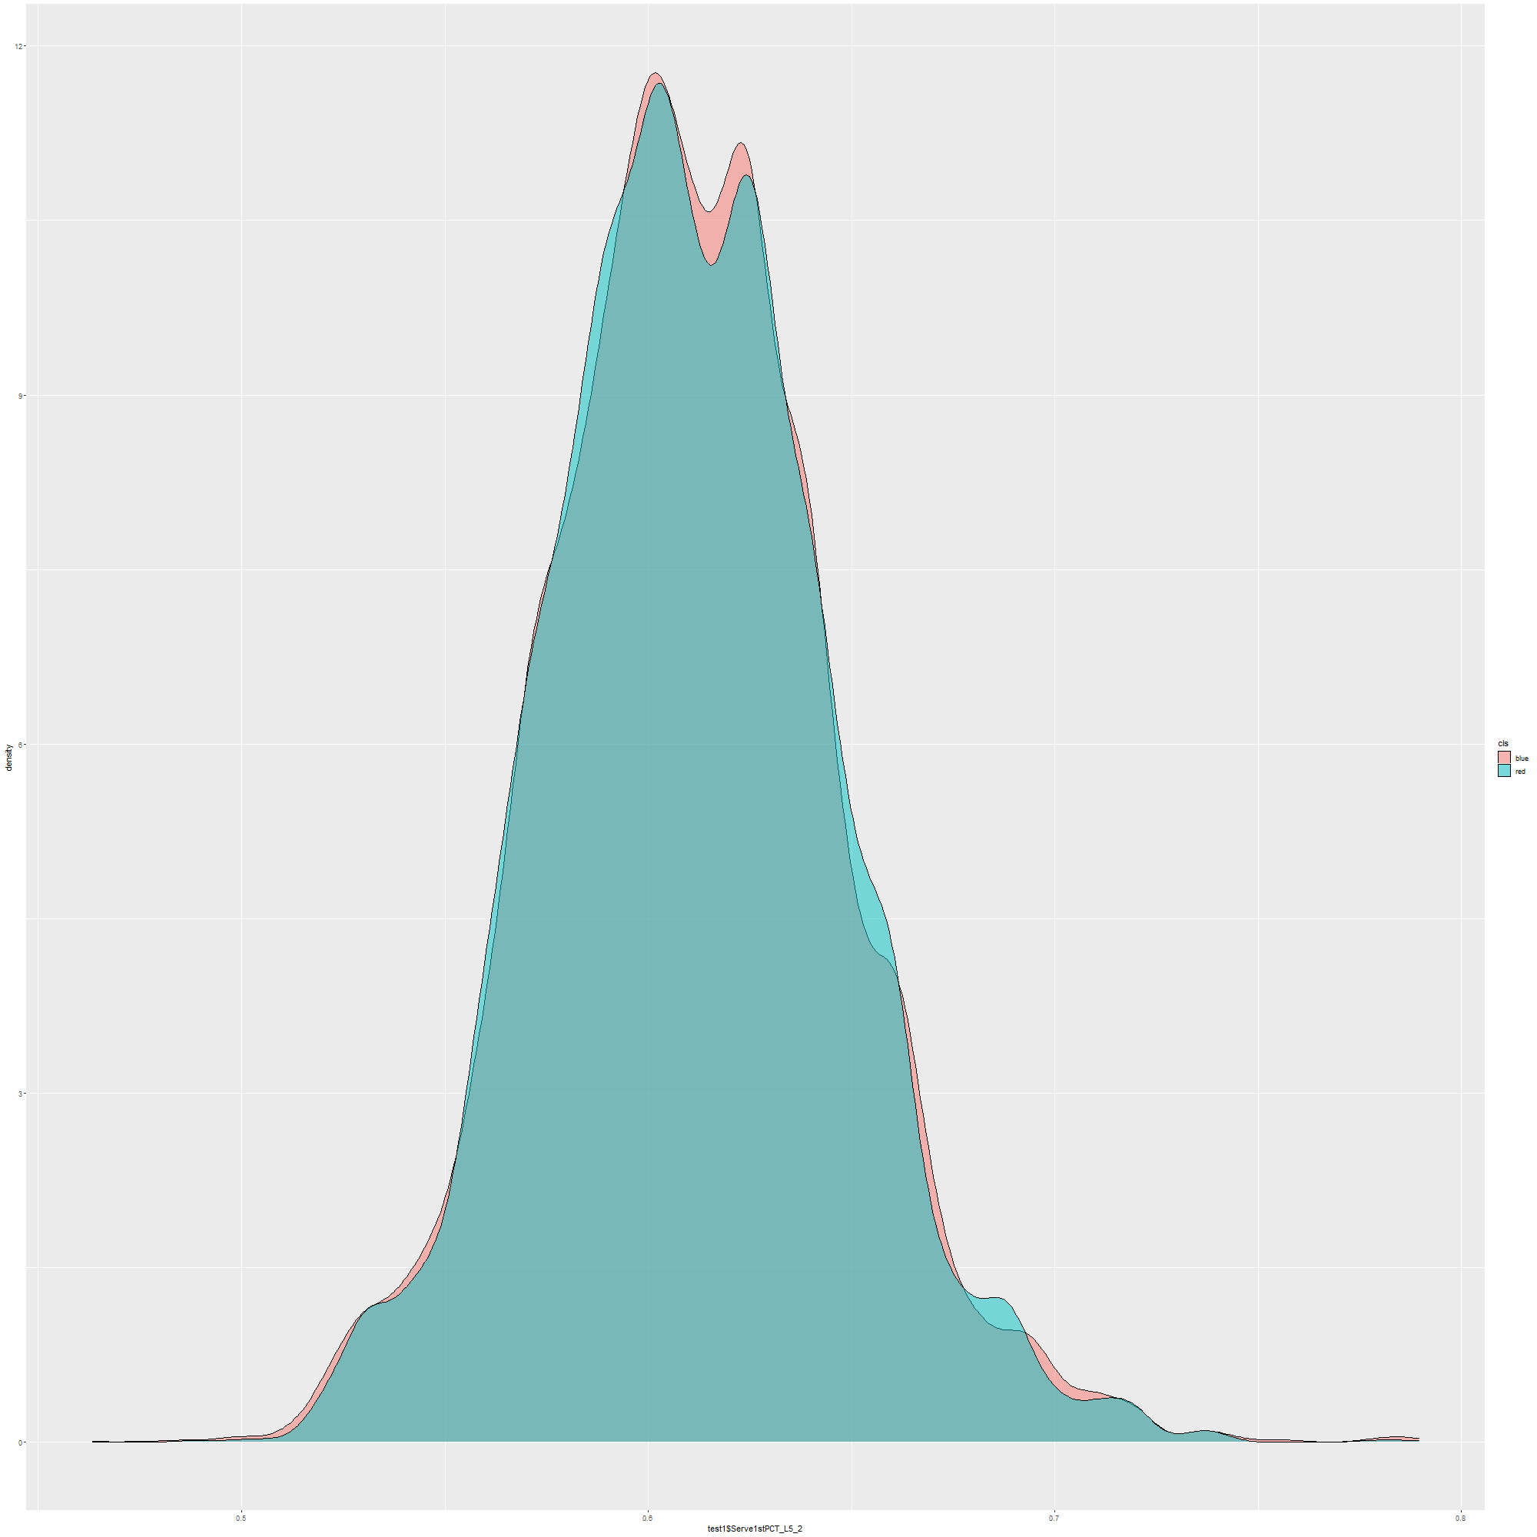
Ttest
Almost the same variance for same time data
Almost same p values for A and L5 data
Way higher p-values for player2 variables
Around 0.90
Lower values on player1 variables
Around 0.08 for A and L5
On last 0.005
Density of L5 for P2

Slide 7
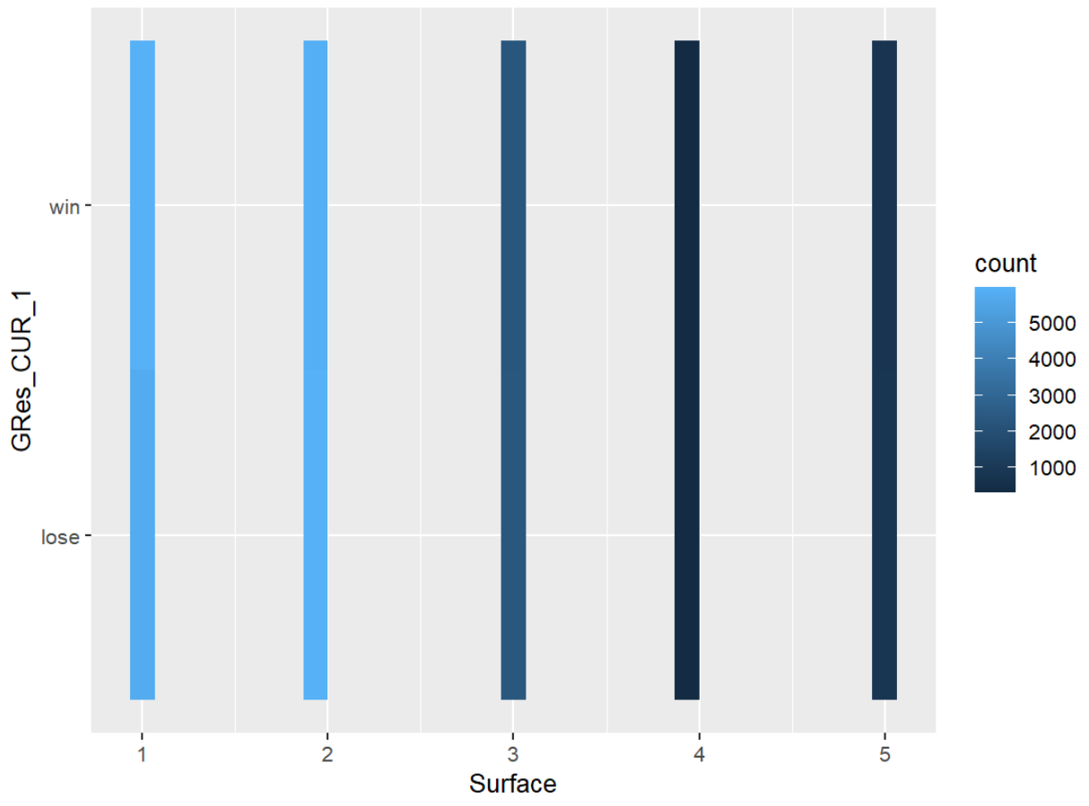
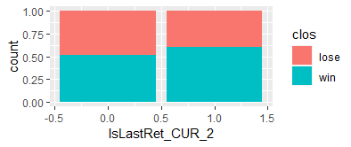
Did P2 retire last game? / What surface is played?

Slide 8
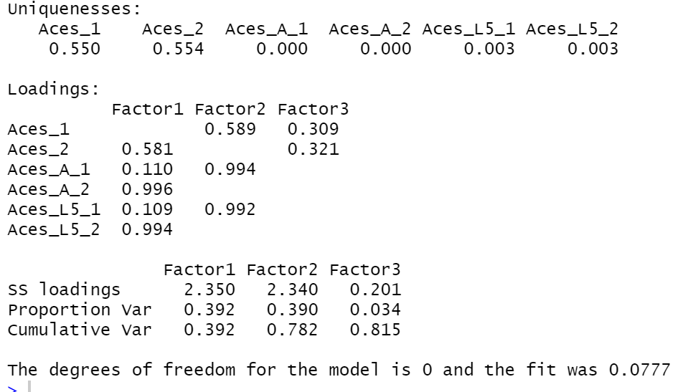
Factor Analysis for Aces

Slide 9
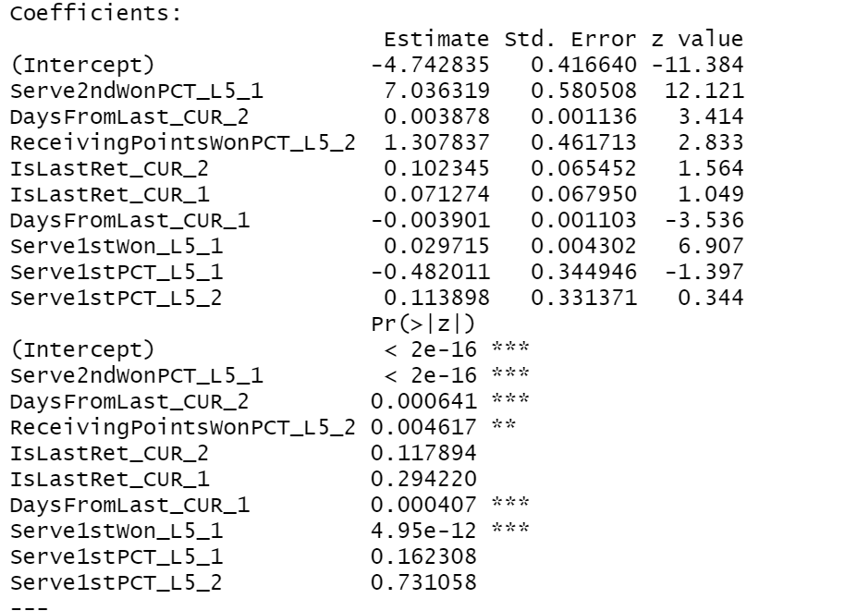
Logistic Regression
Tried to break it down to 11 relevant Variables
Got rid of IsLastRet -> better Results
P: 0.32 on difference in res. deviance
Significant Variables
Serve2ndWonPct_L5_1
Serve1stWon_L5_1
DaysFromLast_CUR_2
ReceivingPointsWonPCT_L5_2
DaysFromLast_CUR_1

Slide 10
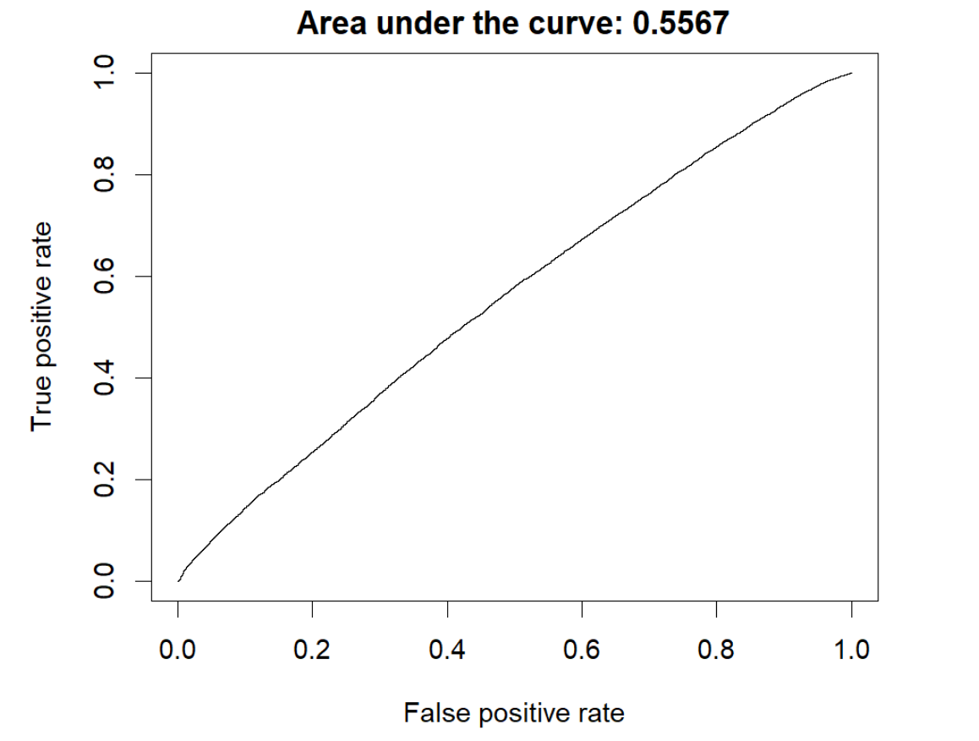
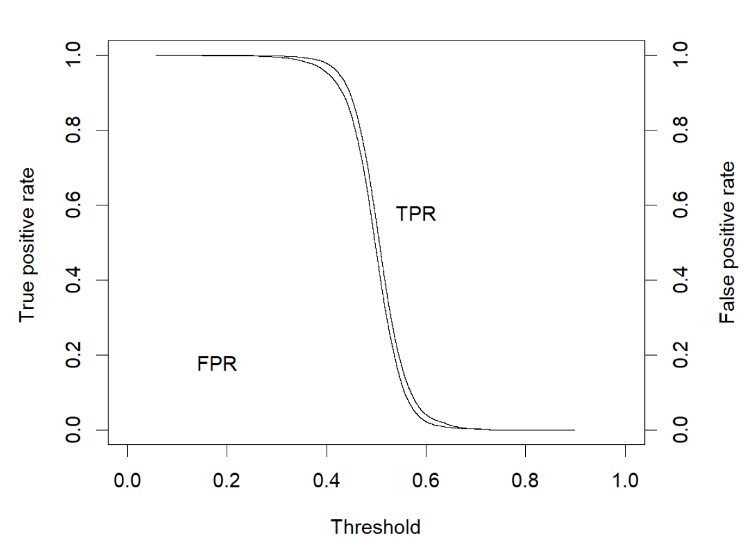

Slide 11
Thank You for Your Attention

