Slide 1
Do We Need FP64 for Supercomputing? What can we do if we don’t have it?
Al Geist
Oak Ridge National Laboratory
MxP4S Workshop at IPDPS
New Orleans
May 25, 2026

Slide 2
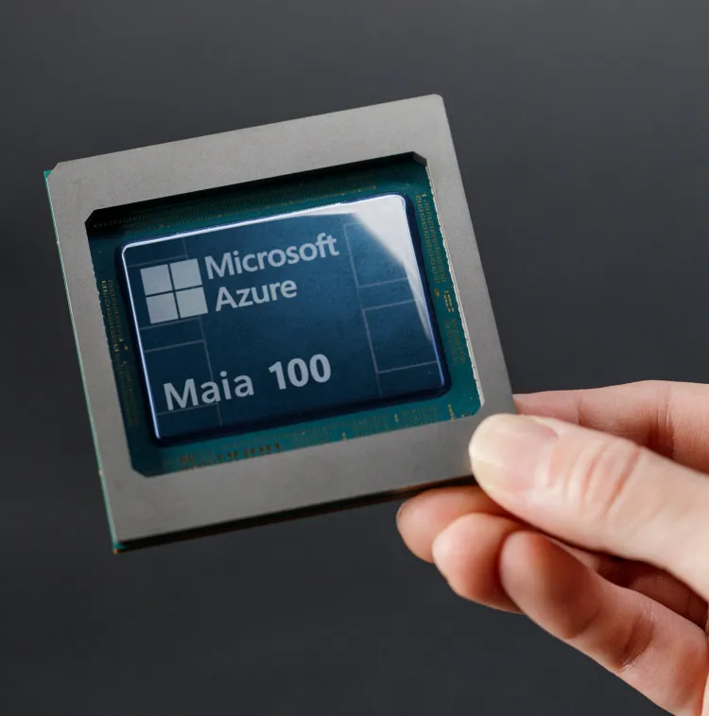
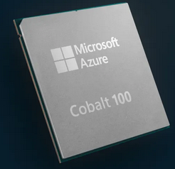
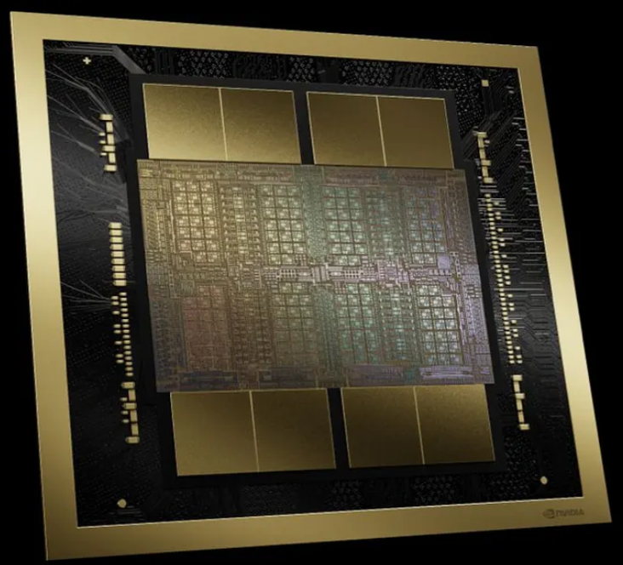
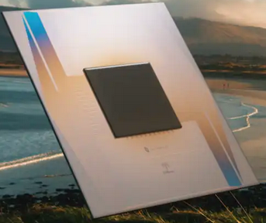
AI bubble has taken over Chip designs How does this Effect HPC Technology directions?
HPC no longer drives chip design
AI Vendors are now driving future chip features
Support for FP64 decreasing or missing entirely
Performance focused on very low precision FP8, FP4
Special inference circuits
How do we adapt to decreasing FP64 support?
How important is it for Leadership Computing?

Slide 3
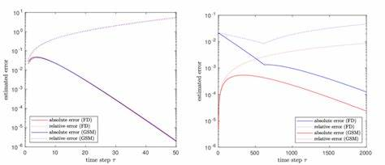
Leadership Computing’s 3 Fundamental Needs for FP64 To reduce error build up, maintain accuracy, and have range to represent the science
Computer Science – floating point is an approximation to real numbers, every operation introduces a small error that can build up to wrong answer after many operations. Error build up
As calculations got larger and longer errors built up pushing the need for higher precision
Mathematics – algorithms used to solve science problems can be sensitive to perturbations and how accurately the solution can be represented, i.e. may not converge to the answer. Accuracy
examples of PDE not converging, diverging, or converge wrong ans
Science Representation – computational problems often require a large range of values from very small to large, and often require calculating the small difference between two values. Range
Examples. Materials catalysts and biology work because of small differences in energy levels
Range of energies can be over 9 orders of magnitude

Slide 4
But FP64 may not be needed for every calculation Mixed Precision Approaches include:
Use low precision to get close to solution then do iterative refinement (this is how MxP works)
Problem must be conducive to an iterative solution such as Newton’s Method
The low precision solution needs to be “close enough” to actual solution to converge
The condition number of the problem has to be small or refinement fails
Use low precision on those parts of problem with small gradients (FP64 elsewhere)
Must be able to determine (perhaps dynamically) where gradients are small
Like adaptive mesh refinement except for floating-point precision rather than space
Algorithm must be tolerant of (perhaps moving) boundaries with jumps in accuracies

Slide 5
Can we generate a general purpose Mixed Precision Prompt?
Use Code-writing AI coupled to agentic exploration to discover where low precision can be used in real applications with no lose in accuracy.
Goal: blackbox mixed precision prompt. Only makes sense if Science application is used a lot because the initial search for mixed precision version is very expensive.
Use FP64 version of the application as the base accuracy and performance.
Analyze for where most of the computational time is done
Vary the precisions of different matrices and computations
Compete different versions
Oscar Hernandez and I are using AlphaEvolve to try this.
Initial results on Jacobi solver encouraging.
Next step is to try on full apps: LSMS, and mini-combustion app

Slide 6
What if there is no Hardware FP64 Support in the Chips?
Old school: Software calculation of higher precision number from multiple lower precision words
Has been around since the 1960’s. Avoided because two orders of magnitude slower
Used in a few problems today that require 128-bit arithmetic (for accuracy and range)
Osaki Method: Emulation of FP64 using lower precision hardware in the accelerator (GPU)
Much faster that SW higher precision but slower than dedicated hardware FP64 GEMM
Consumes up more memory which reduces the Science problems that can be solved
Has advantage of variable precision, for example 54-bit precision. Use only what you need.
Presently limited to matrix multiply. Many Science problems need level-2 BLAS

Slide 7
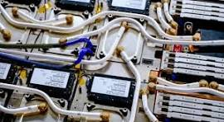
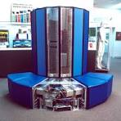
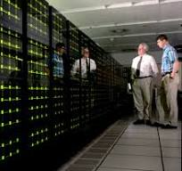



How Can We Continue to Push Science Forward Post-exascale
A Science Supercomputer needs to be general and adaptable
Large-memory, multi-GPU node was the solution at exascale.
What is the Post-Exascale general, adaptable node??
DOE can’t easily create a specialized HPC chip
Once again we may need to rethink the solution methods for the big science problems
Déjà vu: We have done this over and over, going from:
?
Vector
Distributed
Multi-core
GPU
Exascale
Post-Exascale
Exploit multi-precision
AI assisted computation
Energy aware Science/Watt
FP-64 emulation
Quantum side-car

Slide 8
Questions?

