Slide 1

CacheMigrate: Efficient Cache Migration for Load Balancing in Distributed Key-Value Storage Systems
Xianda Meng, Ammar Hawbani, Jiangyuan Chen, Abdulbary Naji, Liang Zhao

Slide 2




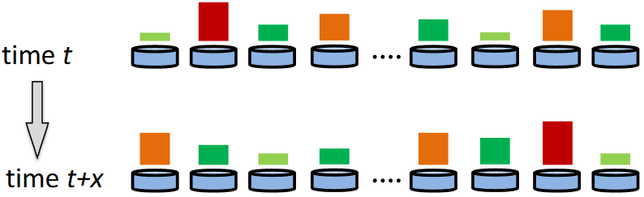



Key-Value Stores
Widely used
Caching mechanisms
Real-time analysis and monitoring
Feature storage for machine learning
Huge scale
Storing billions of data entries
Retrieving millions of records with low latency constraints
Highly load-skewed
Google Data Center

Slide 3
Existing Solutions
Consistent hashing algorithm
Ignoring dynamic and skewed workloads
Front-end caching
Limited cache resources
Single-rack load balancing cannot meet the needs of multi-rack systems
Data migration and replication
Service pause during migration
Incremental migration storage overhead
Data consistency guarantee

Slide 4
Caching + Migration = CacheMigrate
Single-rack systems are better suited to caching methods
Multi-rack systems are better suited to migration methods
A
B
C
A
B
C

Slide 5
Challenges
How to select the right content to migrate
How to minimize service downtime during migration
How to ensure data consistency during migration

Slide 6
Challenges
How to select the right content to migrate
How to minimize service downtime during migration
How to ensure data consistency during migration

Slide 7
Load Management & Content Selection
Migration decision:
The controller monitors the global ToR switch load
Migration start:
A heavy-hit detector was deployed on the switch to detect hotspots in the network in real time
Hotspots are stored in the cache and ready for use during data migration.

Slide 8
Challenges
How to select the right content to migrate
How to minimize service downtime during migration
How to ensure data consistency during migration

Slide 9
Service Downtime Challenges
Conventional migration may cause:
Requests reaching outdated server
Network path inconsistency
Temporary unavailability while routing converges
Key goal：clients should not perceive any disruption

Slide 10
Minimizing Downtime via ToR-Level Handling
Switch-based fast rerouting
KeyMigrationReady → Spine updates routing
ToR temporarily handles all requests (acts as migration proxy)
No client-side retries or REST failures
Rerouting convergence occurs under the switch’s control, not exposed to user traffic

Slide 11
Challenges
How to select the right content to migrate
How to minimize service downtime during migration
How to ensure data consistency during migration

Slide 12
Why Consistency Is Difficult During Key Migration
Transition window：
Source server sending state → new server not ready
Routing updates are not instantaneous
Requests might hit different destinations
Potential risks：
Stale reads
old value still served by old server
Lost writes
updates issued during migration may be dropped
Read-after-write violations
write arrives at new server but read goes to old path
DEAD
old path?
new path?
inconsistent version?

Slide 13
Ensuring Consistency
ToR Cache as a Consistency Barrier
During routing transition, ToR enters migration mode
All reads served by ToR cache
Prevents both source and new server from being accessed
Ensures a single source of truth for all reads

Slide 14
Write-Tracking Filter for Migration Writes
Tracks all writes to the migrating key during transition window
Maintains a strictly ordered write log
Prevents write loss or reordering
Ensures RAW, WAW, and WAR correctness
WRITE(A)
BF
1
1
MIGRATE(A)
KV Cache
Bloom Filter

Slide 15
Final state synchronization
New server finishes receiving migrated state
ToR flushes Write-Tracking Filter in order
ToR exits migration mode and resumes normal routing

Slide 16
Evaluation
Testbed
6.5 Tbps Intel Tofino switch
Commodity servers with ConnectX-5 100Gb.
Logical partition: 32 spines, 32 ToRs, 32 racks × 32 servers.
TommyDS; client workloads via YCSB.
128-bit keys/values.
Cache per switch: 128 KV pairs.
Baselines
CacheMigrate(ours),DistCache, NetCache, NoCache
Workloads
YCSB with Zipf θ = 0.9, 0.95, 0.99

Slide 17
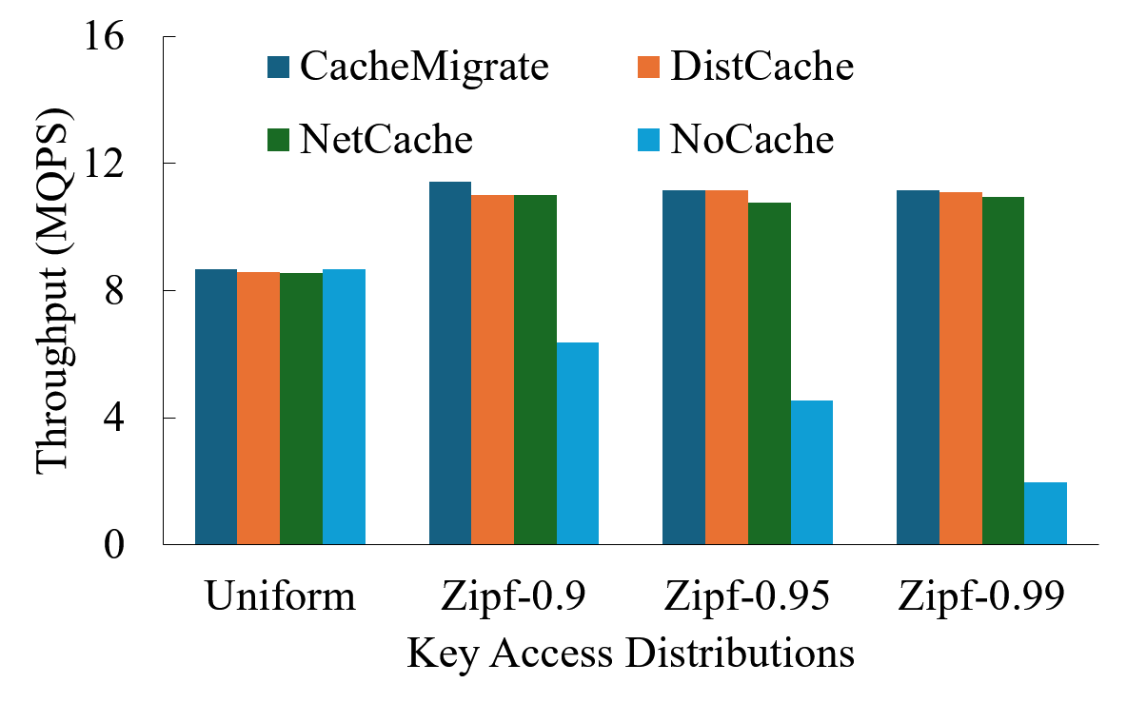
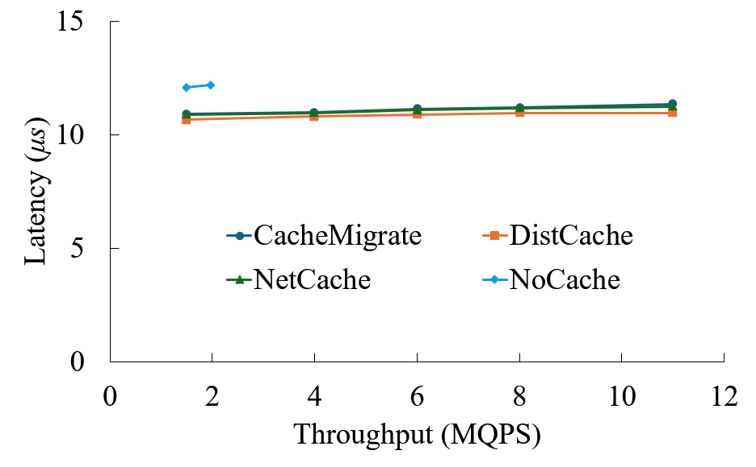
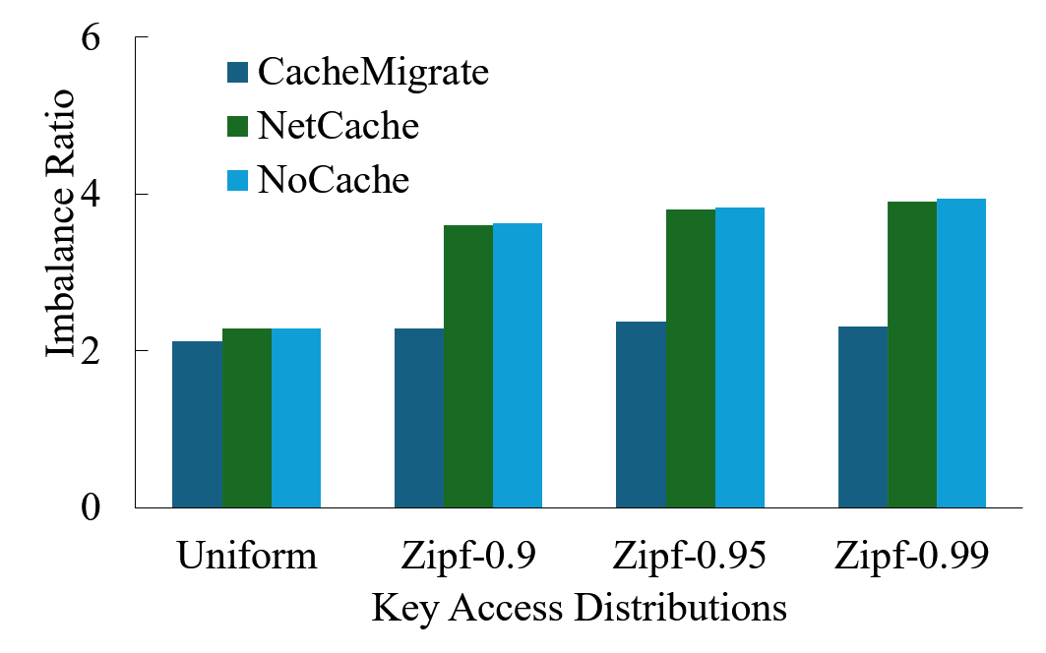
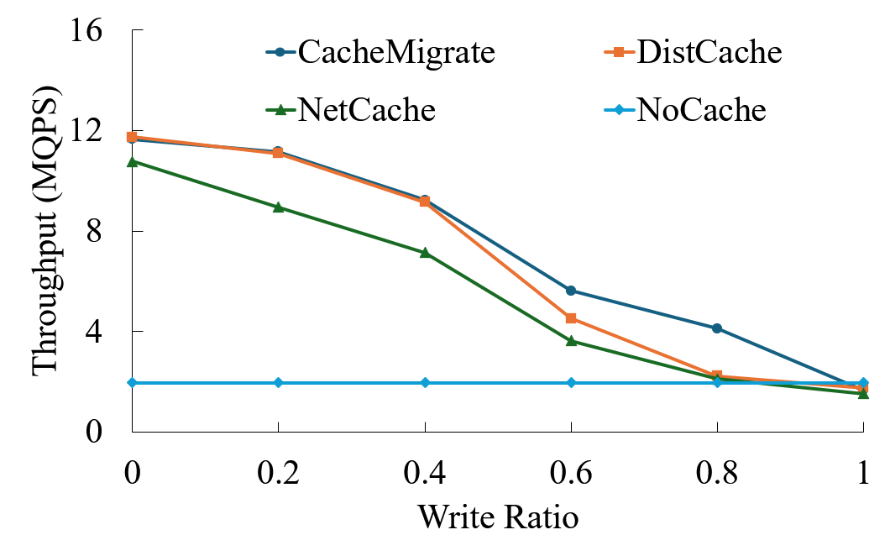
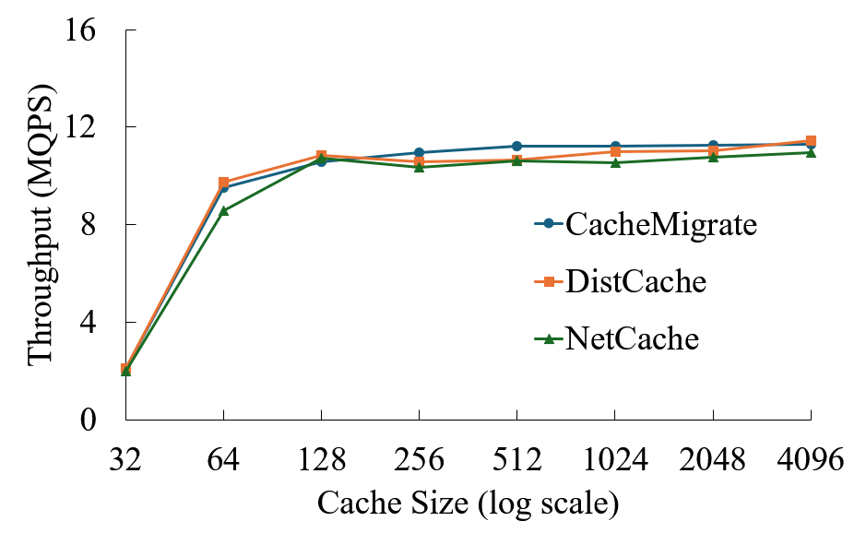
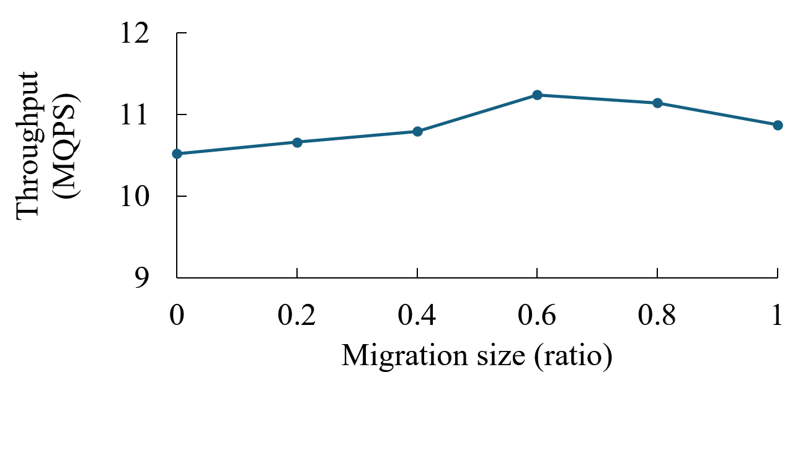
Result

Slide 18
Conclusion
Programmable switches enable dynamic migration.
Decouples data movement and query handling.
Ensures 0 downtime, strong consistency.
Large throughput benefit under skew.
Future: more in-network coordination + fault tolerance.
Thank you!

