Slide 1
Topic : Image Steganography

Slide 2
Our team
Shrutika Malve
Madhushri Wagh
Ayush Meshram
Sushant Langhi
Roll : 21349
Roll : 21346
Roll : 21351
Roll : 21344

Slide 3
Contents of this PPT
Introduction | The basic concept and idea of Steganography .
Types Of Steganography Image Steganography | Involves the brief discription of different types of Steganography methods. Explains in detail how Image Steganography is done.
Algorithm Used | Explains the LSB (least significant bit) algorithm being used.
Code & Implementation | Display and explanation of the Python Code .
Future Scope Conclusion | Advancement and more ideas can evolve around the same technology. Conclusion of the PPT.

Slide 4
Introduction
Steganography is the art of writing hidden messages in such a way that no one apart from the user and intended recipient suspects the existence of the message.
The secret data is then extracted at its destination using process of encryption.

Slide 5
Cryptography VS Steganography
Cryptography
Steganography
Cryptography, or secret writing, is a method where a secret method is converted in cipher text and sent to other person who then decrypt the cipher text into plain text. Cryptography can be classified as Symmetric key cryptography or Asymmetric key cryptography.
Steganography, or cover writing, is a method where a secret method is converted into fake looking message. This technique helps to keep a message secret. It is difficult to use and understand. The structure of data remains unaltered in Steganography. It is used in text, audio, video or images.

Slide 6
Types of Steganography
01
02
Video Steganography
Audio Stegangraphy
03
04
Image Steganography
Text Steganography
In Video Steganography you can hide kind of data into digital video format
In audio steganography, the secret message is embedded into an audio signal
Text Steganography is hiding information inside the text files
Hiding the data by taking the cover object as the image is known as image steganography.

Slide 7
IMAGE STEGANOGRAPHY
Hiding the data by taking the cover object as the image is known as image steganography. In digital steganography, images are widely used cover source because there are a huge number of bits present in the digital representation of an image. There are a lot of ways to hide information inside an image.
Common approaches include:
Least Significant Bit Insertion
Masking and Filtering
Redundant Pattern Encoding
Encrypt and Scatter

Slide 8
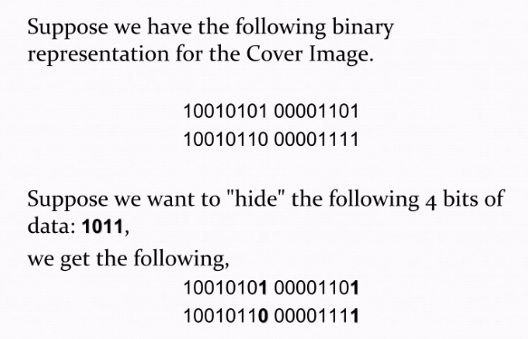
Algorithm Used
Least Significant Bit (LSB) embedding: This algorithm involves modifying the least significant bit of each pixel in the image to encode the hidden message. LSB embedding is simple and efficient, but it is also vulnerable to attacks and
can result in poor image quality if too many bits are modified

Slide 9
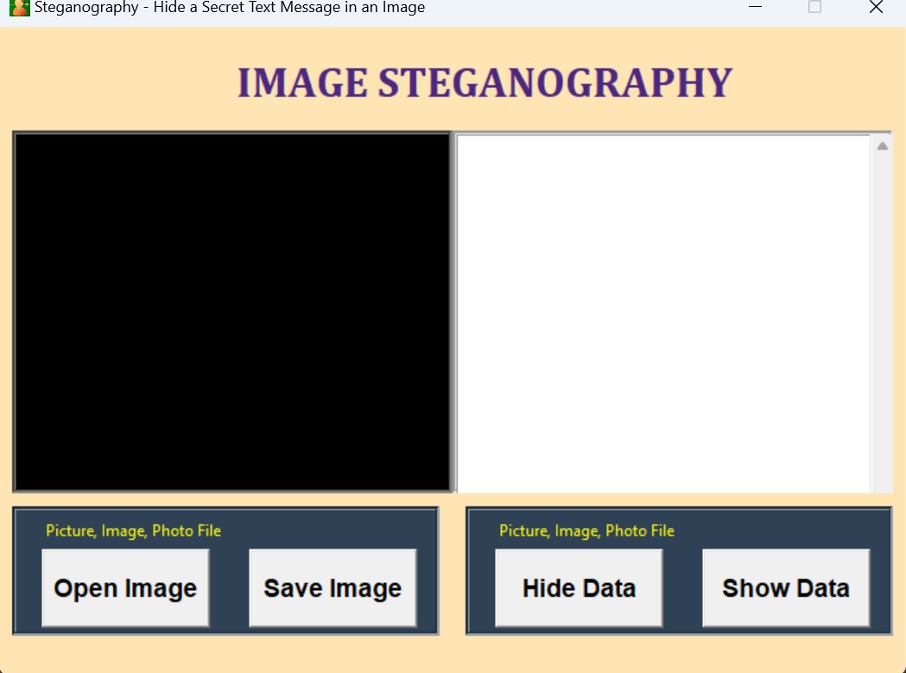
Initial – Implementation and Design

Slide 10



Image size before and after embedding

Slide 11
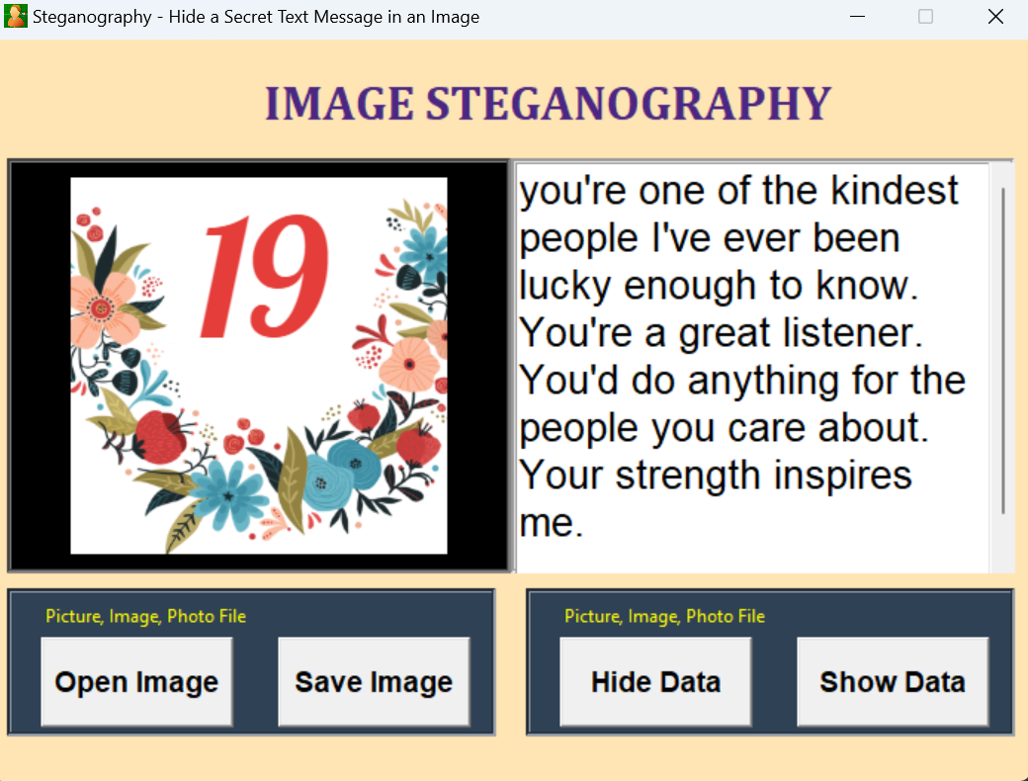
Final – Implementation and Design

Slide 12
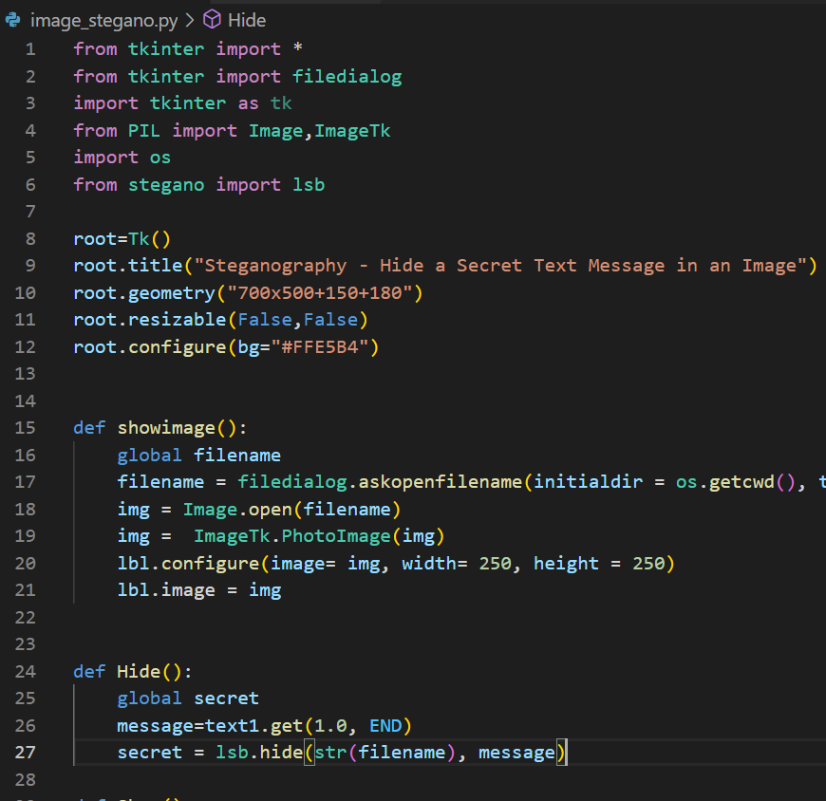
Main Python code
Tkinter is the standard GUI library for Python. Python when combined with Tkinter provides a fast and easy way to create GUI applications.

Slide 13
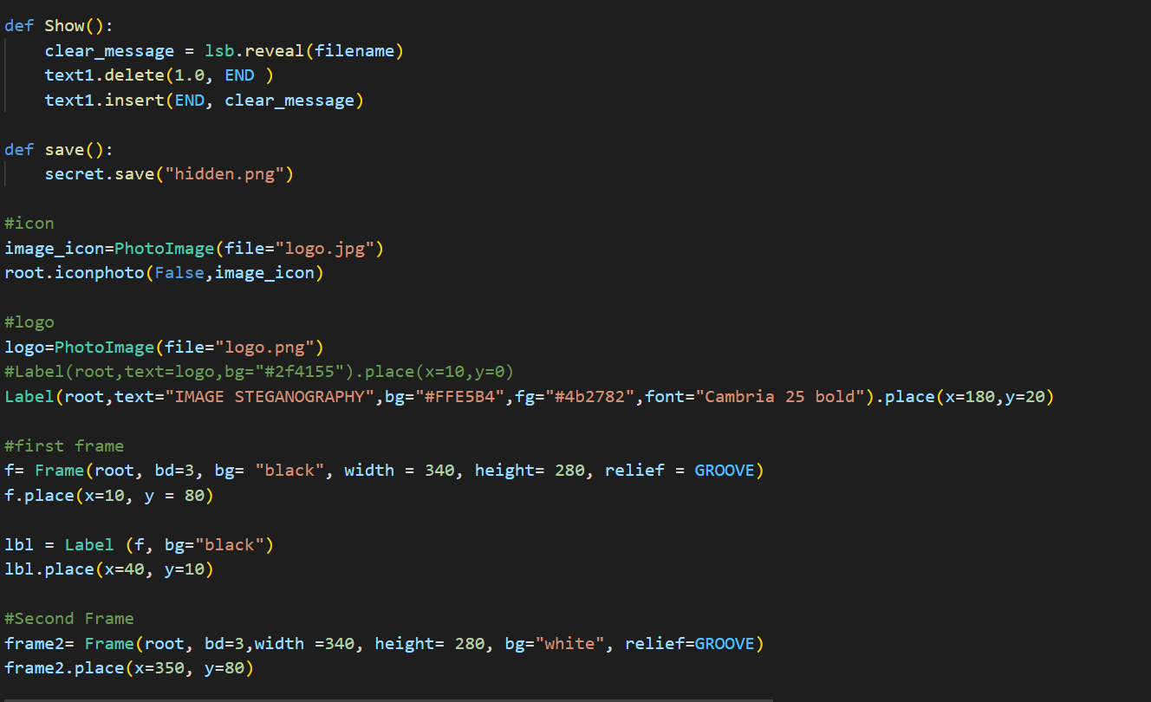
Main Python Code

Slide 14
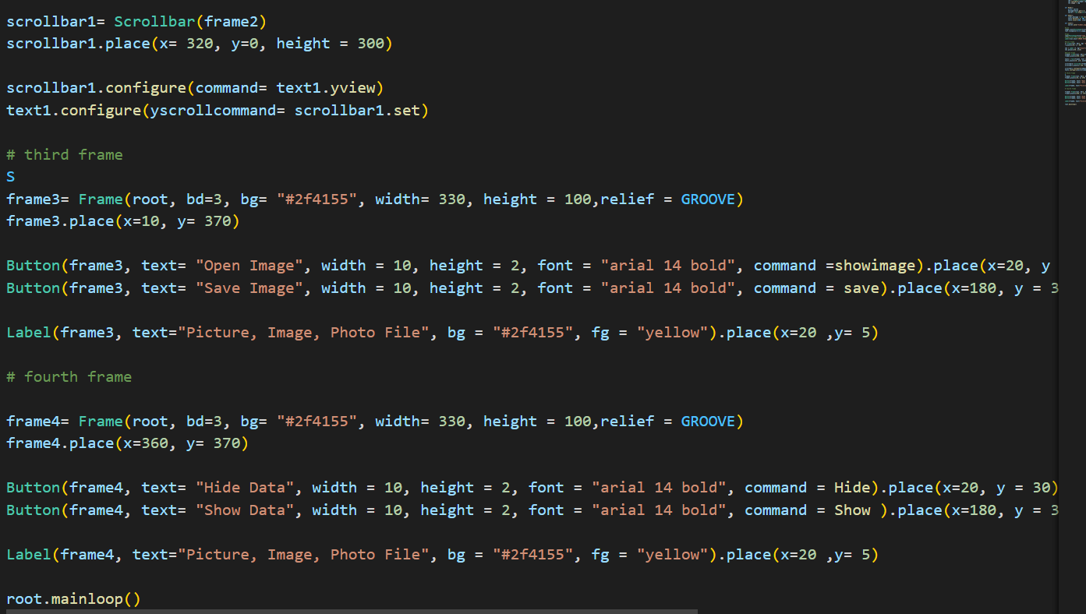
Main Python Code

Slide 15
Conclusion and Future Scope
In the near future , the most important use of steganographic techniques will probably be lying in the field of digital watermarking
Steganography can be utilized for Peer-to-peer private communications , Posting secret communications on the Web to avoid transmission and much more.

Slide 16
References :
Morkel, Tayana, Jan HP Eloff, and Martin S. Olivier. &quot;An overview of image
steganography.&quot; In ISSA, vol. 1, no. 2, pp. 1-11. 2005.
Chandramouli, R. and Memon, N., 2001, October. Analysis of LSB based image
steganography techniques. In Proceedings 2001 international conference on image
processing (Cat. No. 01CH37205) (Vol. 3, pp. 1019-1022). IEEE.

Slide 17
Thank You

