Slide 1
Introduction to Object-Oriented Programming (OOP)

Slide 2
What is Object-Oriented Programming?
A programming paradigm / approach that models real-world objects
Objects have properties (attributes) and behaviors (methods)
Helps in organizing code better, making it reusable and modular

Slide 3
Real-World Analogy
Example: A Car
Attributes: color, model, speed
Methods: start(), stop(), accelerate()
Example: A Student
Attributes: name, age, grades
Methods: study(), take_exam()

Slide 4
Four Pillars of OOP
1. Encapsulation – Wrapping data and methods in a class
2. Abstraction – Hiding complexity from the user
3. Inheritance – Reusing code by deriving classes from a parent class
4. Polymorphism – Using the same method in different ways

Slide 5
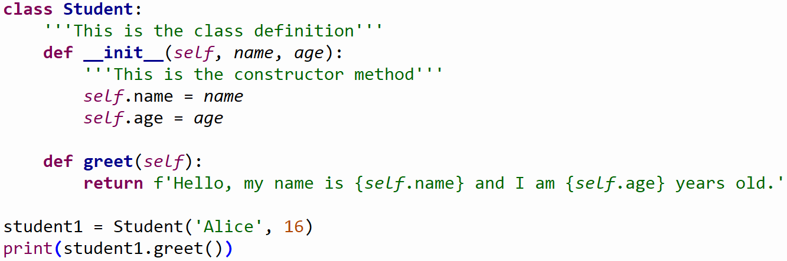
Python Example: Creating a Class
Example: Defining a 'Student' class in Python

Slide 6
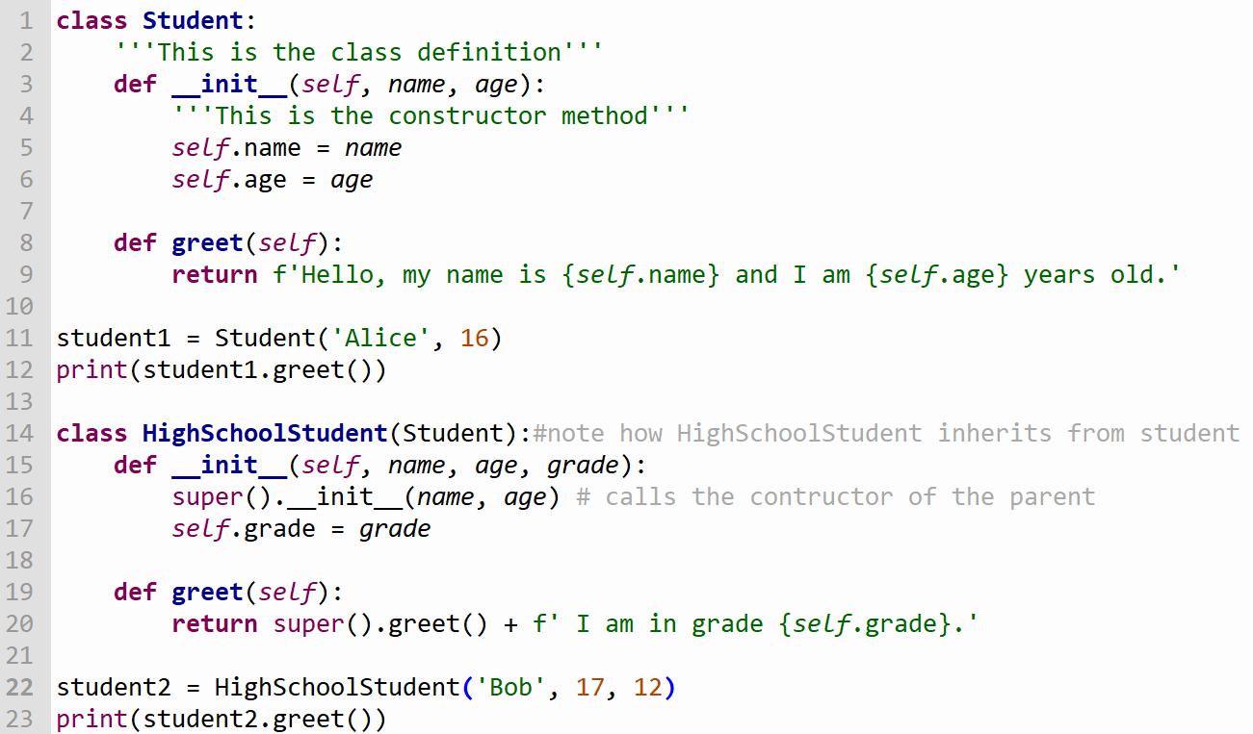
Python Example: Inheritance
Example: Extending the 'Student' class

Slide 7
Summary
OOP helps structure code using **objects and classes**
Four main principles: **Encapsulation, Abstraction, Inheritance, Polymorphism**
Python makes OOP easy with class-based structures
Apply your learning by **building real-world projects!**

