Slide 1


Student Survey Data Analysis
Last data refresh:
3/4/2024 1:36:37 PM UTC
Downloaded at:
3/4/2024 1:46:46 PM UTC

Slide 2
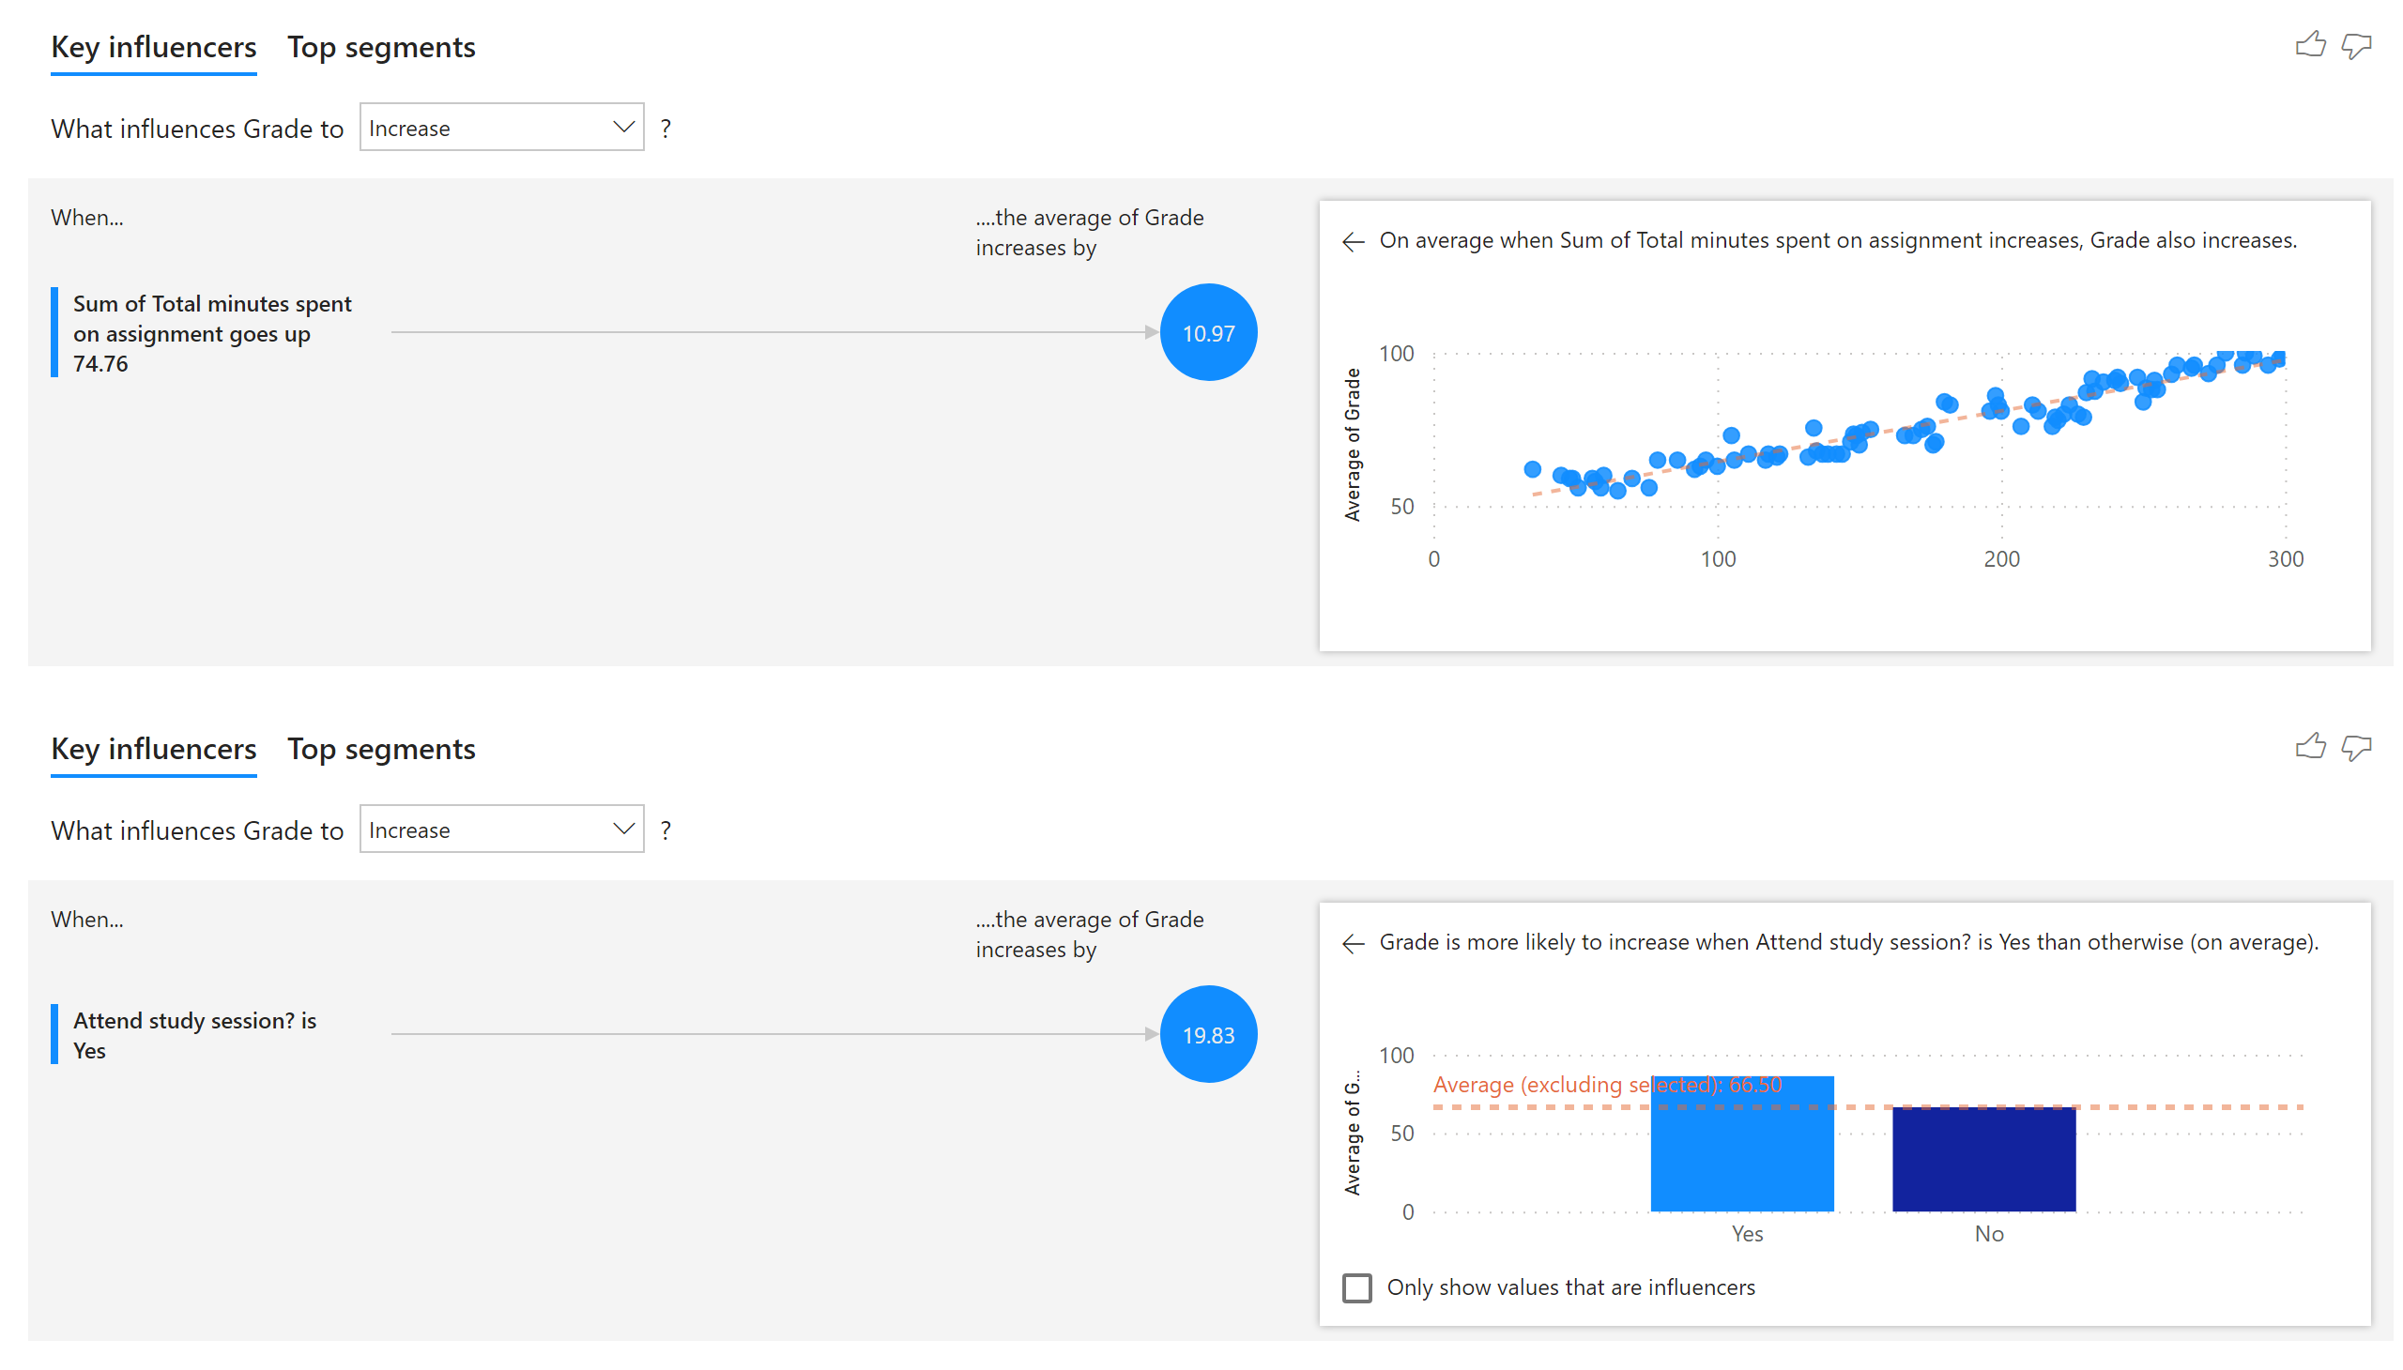
Page 1
Notes:
keyDriversVisual
No alt text provided
keyDriversVisual
No alt text provided

Slide 3
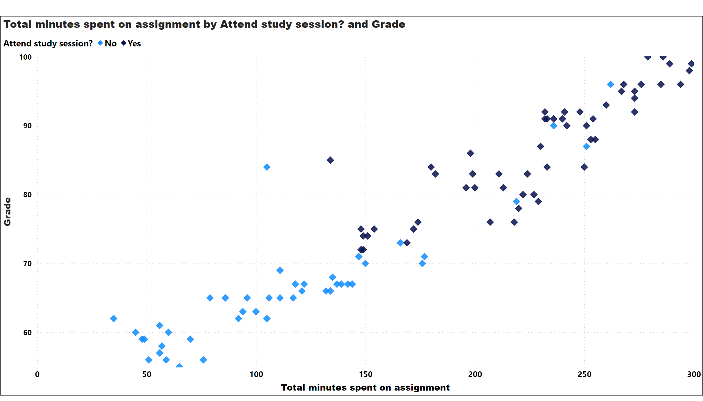
Page 2
Notes:
Total minutes spent on assignment by Attend study session? and Grade
No alt text provided

Slide 4
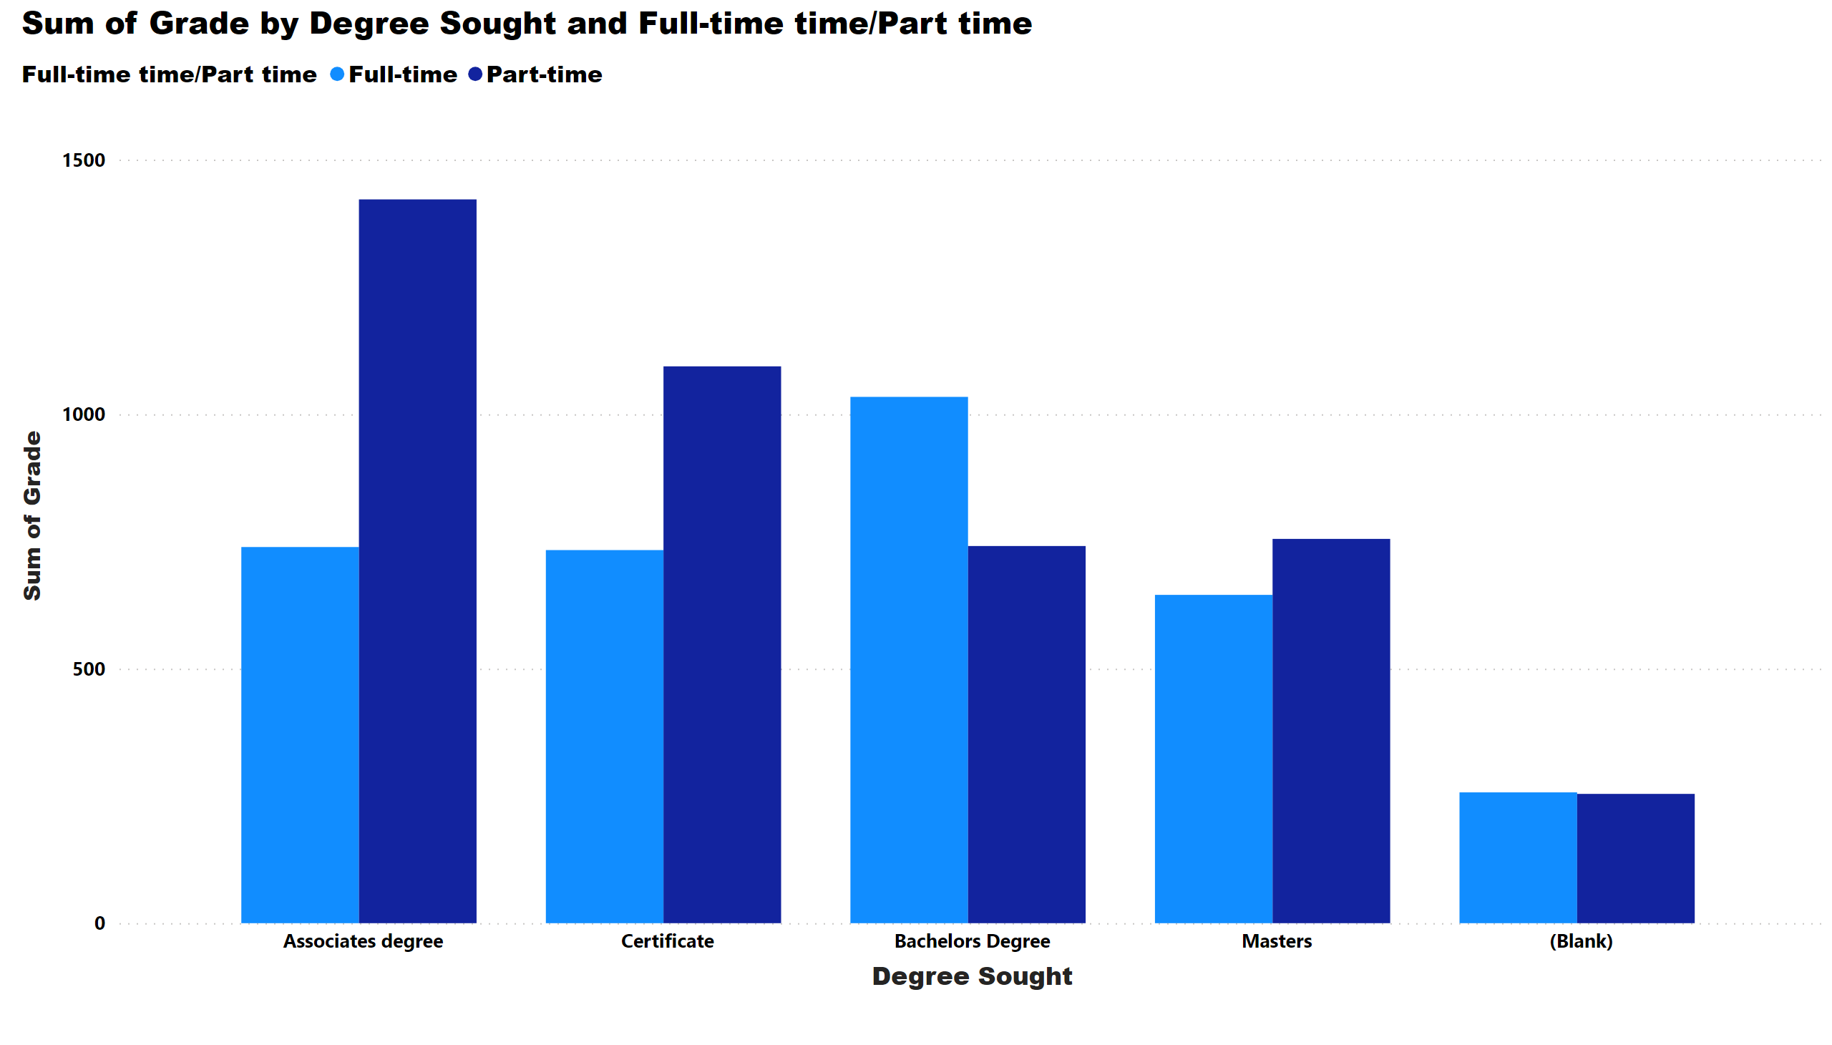
Page 3
Notes:
clusteredColumnChart
No alt text provided

Slide 5
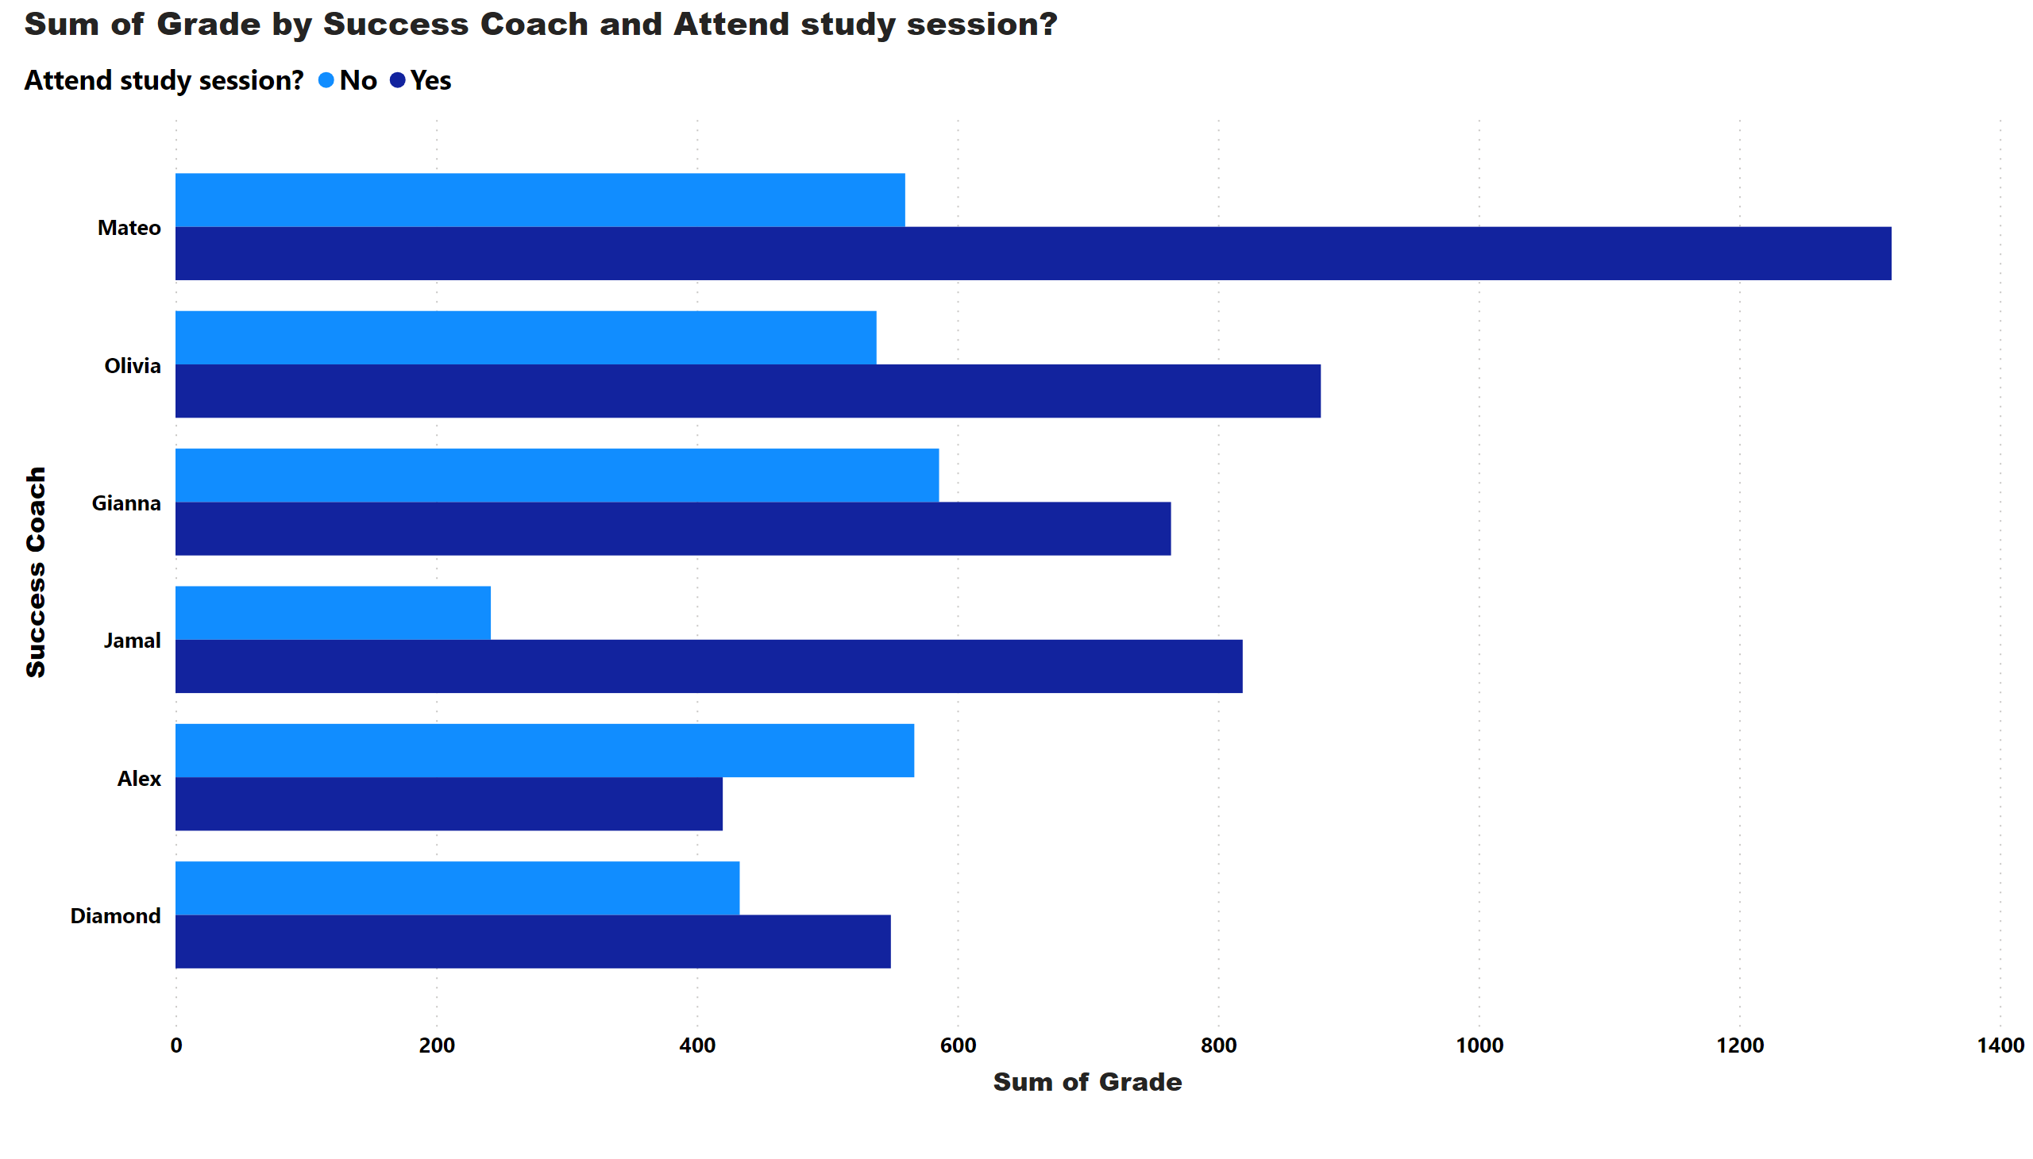
Page 4
Notes:
clusteredBarChart
No alt text provided

Slide 6
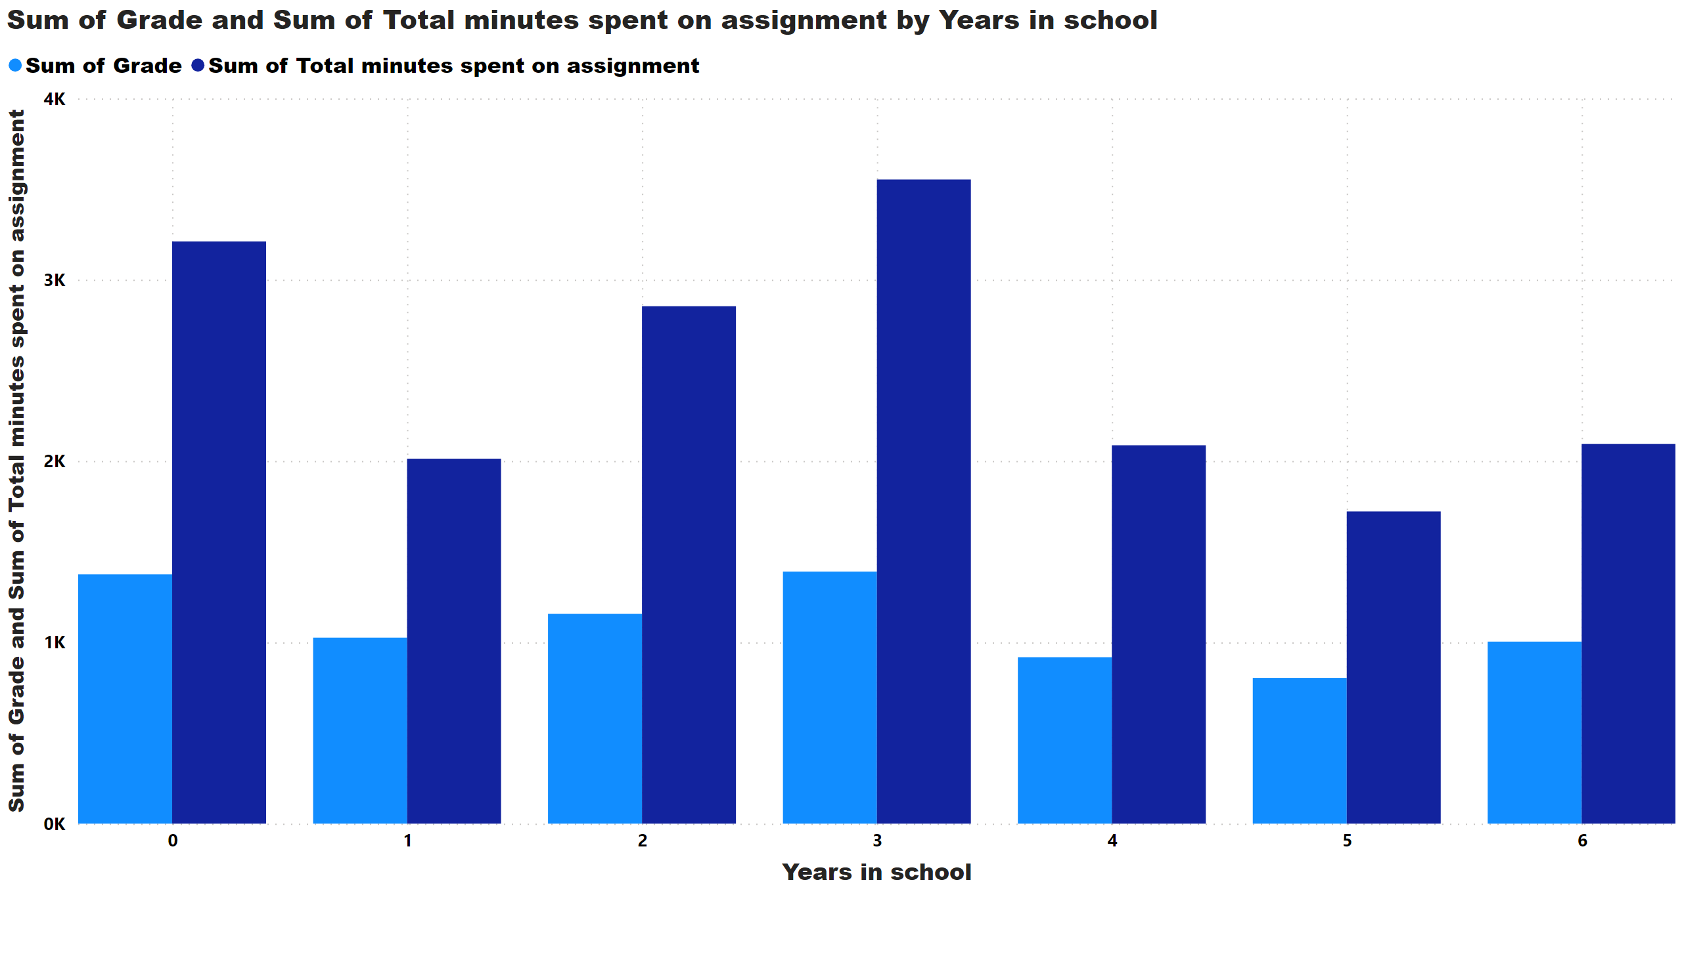
Page 5
Notes:
clusteredColumnChart
No alt text provided

Slide 7
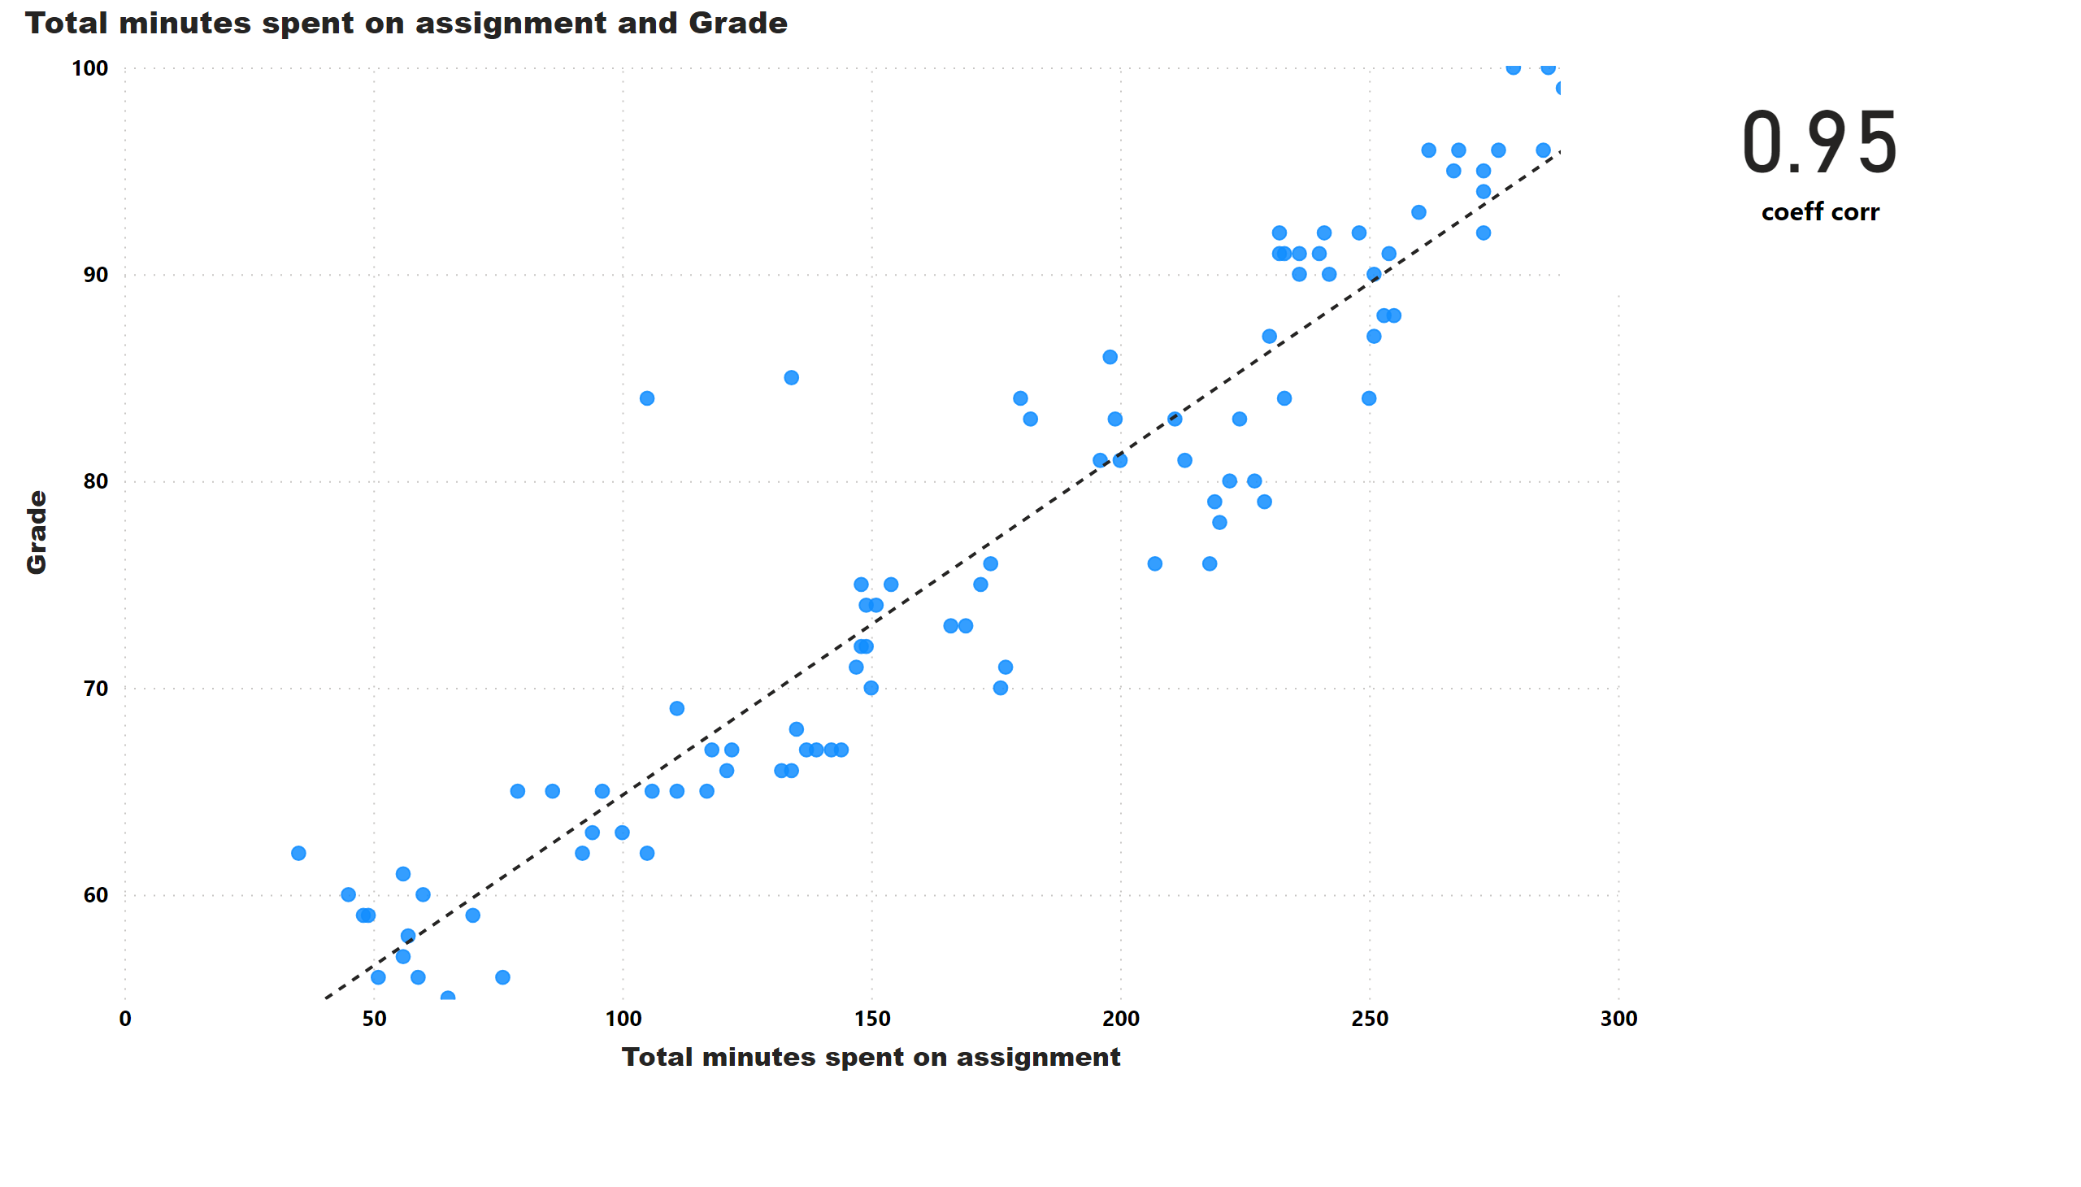
Page 6
Notes:
scatterChart
No alt text provided
card
No alt text provided

Slide 8
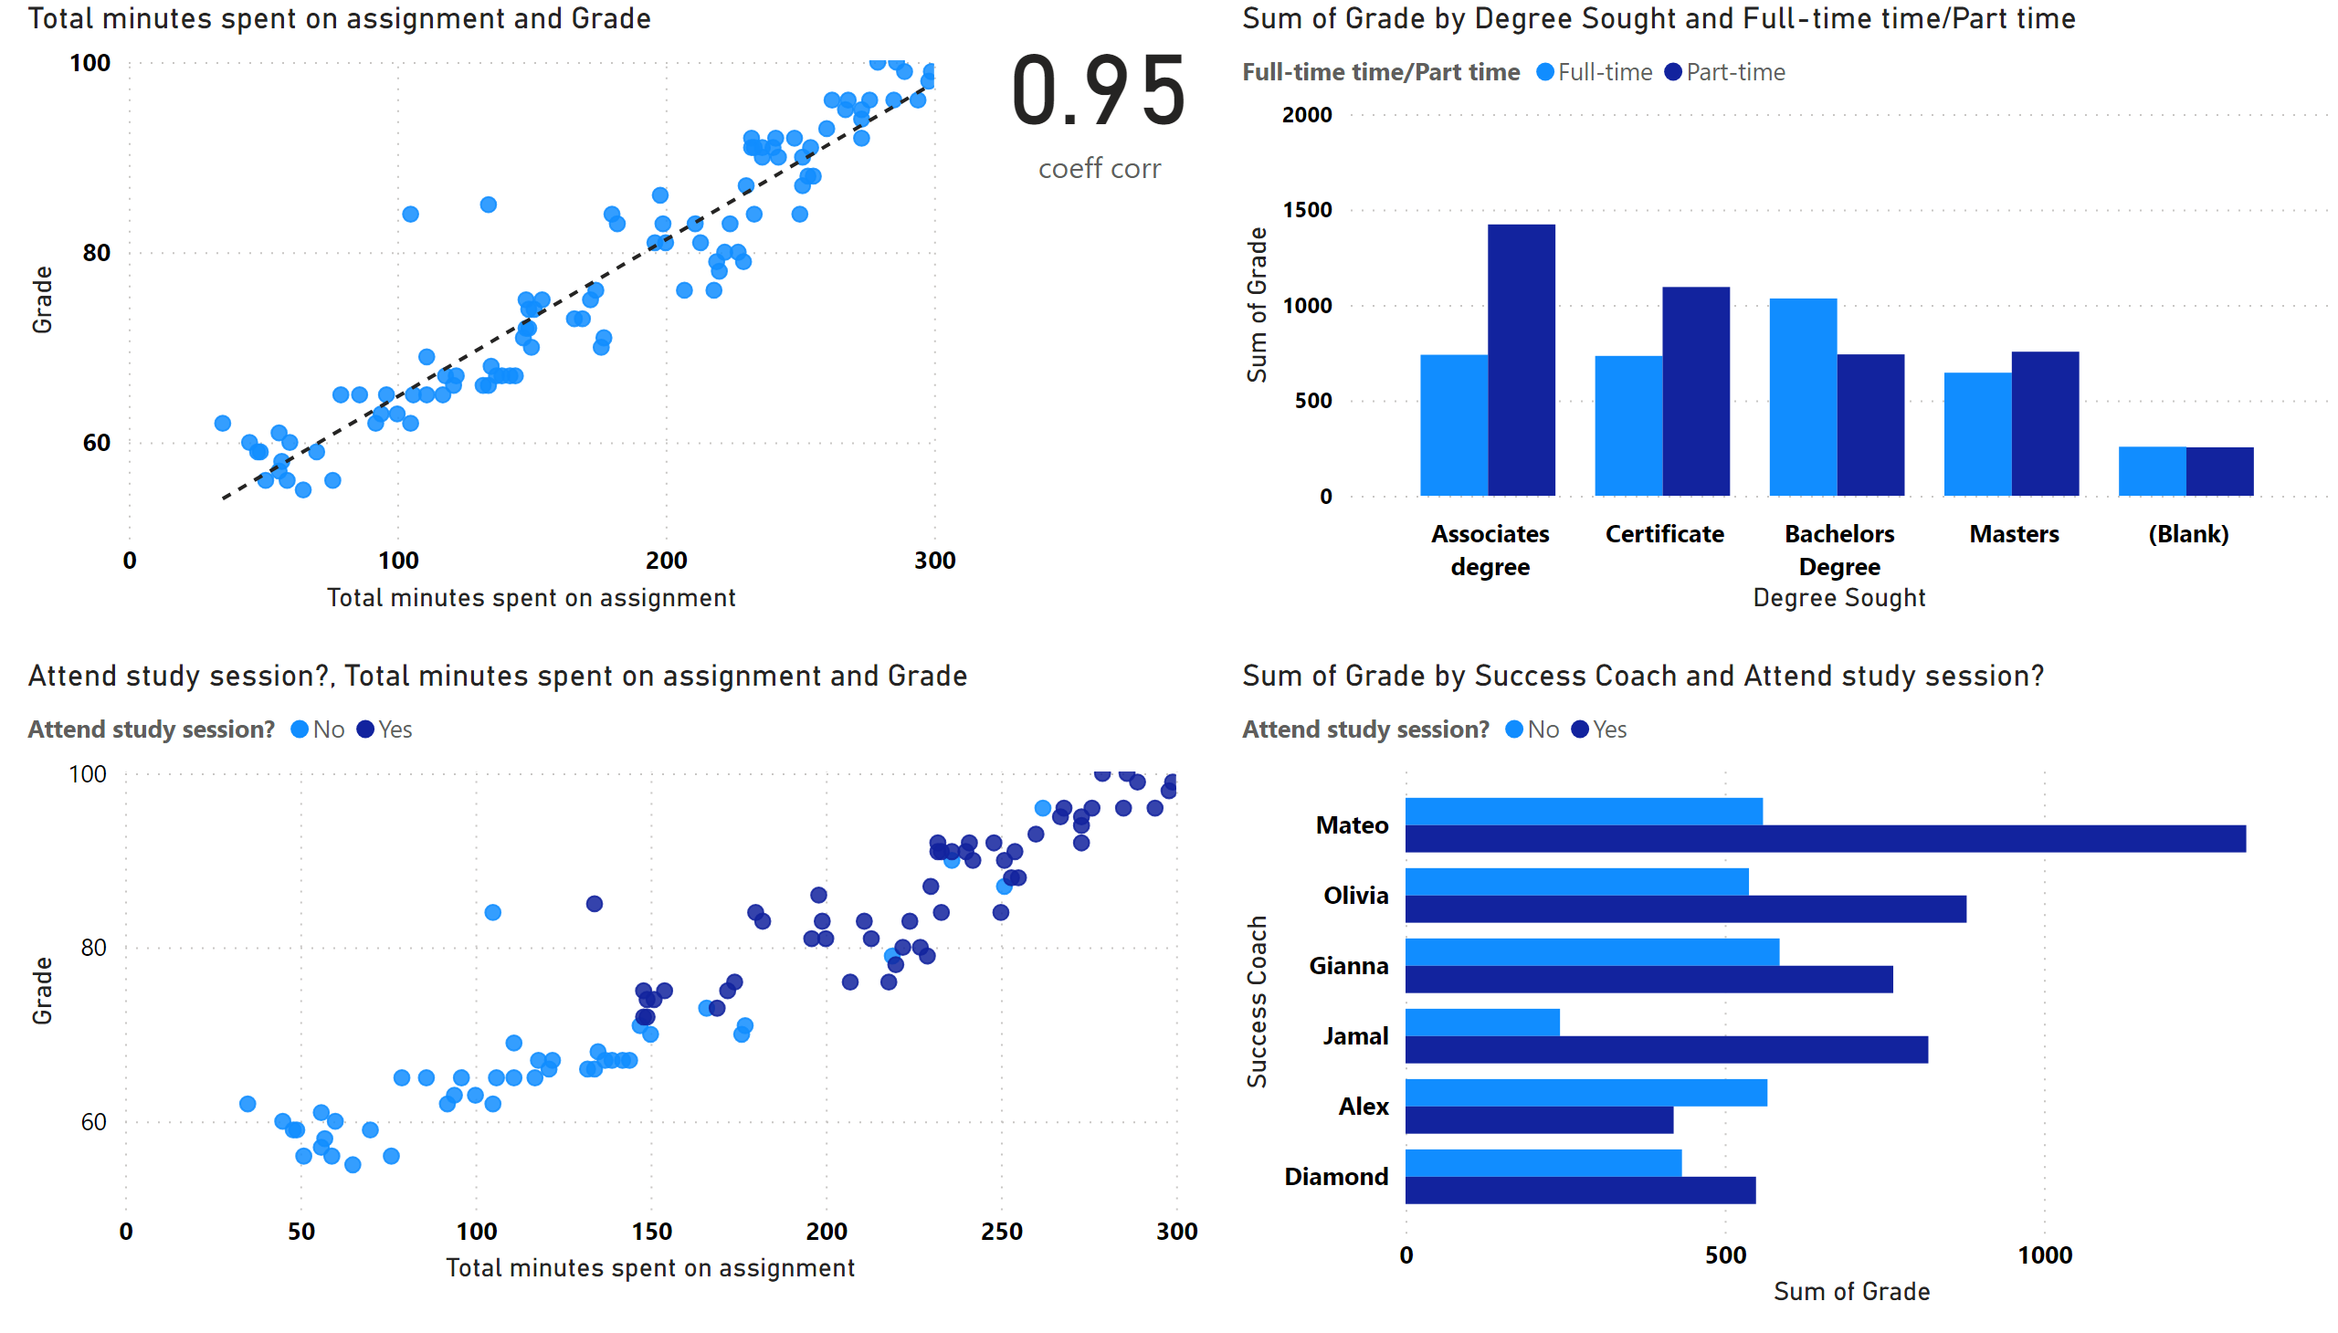
Page 7
Notes:
scatterChart
No alt text provided
scatterChart
No alt text provided
card
No alt text provided
clusteredColumnChart
No alt text provided
clusteredBarChart
No alt text provided

