Slide 1


Project Presentation
RentalPro RMS
Objective
To replace scattered rental records with one reliable platform for properties, owners, customers, rentals, sales and payments.
A full-stack Rental Management System built with React, ASP.NET Core Web API and SQL Server.
Presented as a development story: why we built it, how it works, and what we learned.
Notes:
Open by framing the project as a practical business solution: many rental offices keep property, owner, customer, contract, sale, and payment data in different places. RentalPro RMS brings those records together and demonstrates a professional full-stack workflow.

Slide 2
Project foundation
Project title and objective
The problem
The objective
Success criteria
Rental operations become difficult when property listings, owner details, customer records, rental contracts, sales records and payments are kept separately. Mistakes happen, reports are slow, and managers cannot see the full business picture.
Build a beginner-friendly, real-world full-stack system that collects data from SQL Server through ASP.NET Core APIs and displays it in a responsive React website.
• User can manage every core module
• Data is stored in SQL Server
• API can be tested in Swagger
• React pages call live API data
• Final website can be served from ASP.NET Core using wwwroot
Notes:
The objective is not only to make pages look good. The objective is to make a working software system: database tables, backend endpoints, React pages, and an integration strategy that works in development and in production.

Slide 3
What RentalPro RMS can do
System features
Properties
Owners
Customers
Apartments
Create, edit, search and classify available, rented or sold properties.
Store verified owner contact and address records.
Manage tenants and buyers with contact details.
Show apartment-only records from the Properties table.
Rentals
Sales
Payments
Reports
Link property + customer + dates + amount + status.
Track sale price, paid amount and remaining balance.
Record rent and sale payments with balances and notes.
Dashboard totals, recent records and management summaries.
Four main website navigations: Home • Management Works • About • Contact
Notes:
Present the system as a real business workflow, not as isolated CRUD pages. Properties are the center, and the other modules represent people, contracts, revenue, and reporting around those properties.

Slide 4
Stack overview
Technologies used
Frontend
Backend
Database
React + Vite
React Router
Axios
CSS responsive UI
wwwroot production build
ASP.NET Core Web API
Controller classes
Data/business classes
Dependency Injection
Swagger testing
SQL Server
Relational tables
Primary keys
Foreign keys
JOIN queries
Main integration idea: React is the user interface, ASP.NET Core is the controlled API layer, and SQL Server is the system of record.
Notes:
Explain that each technology has one clear responsibility. React is not accessing SQL directly. SQL is not exposed to the browser. The API is the safe middle layer.

Slide 5
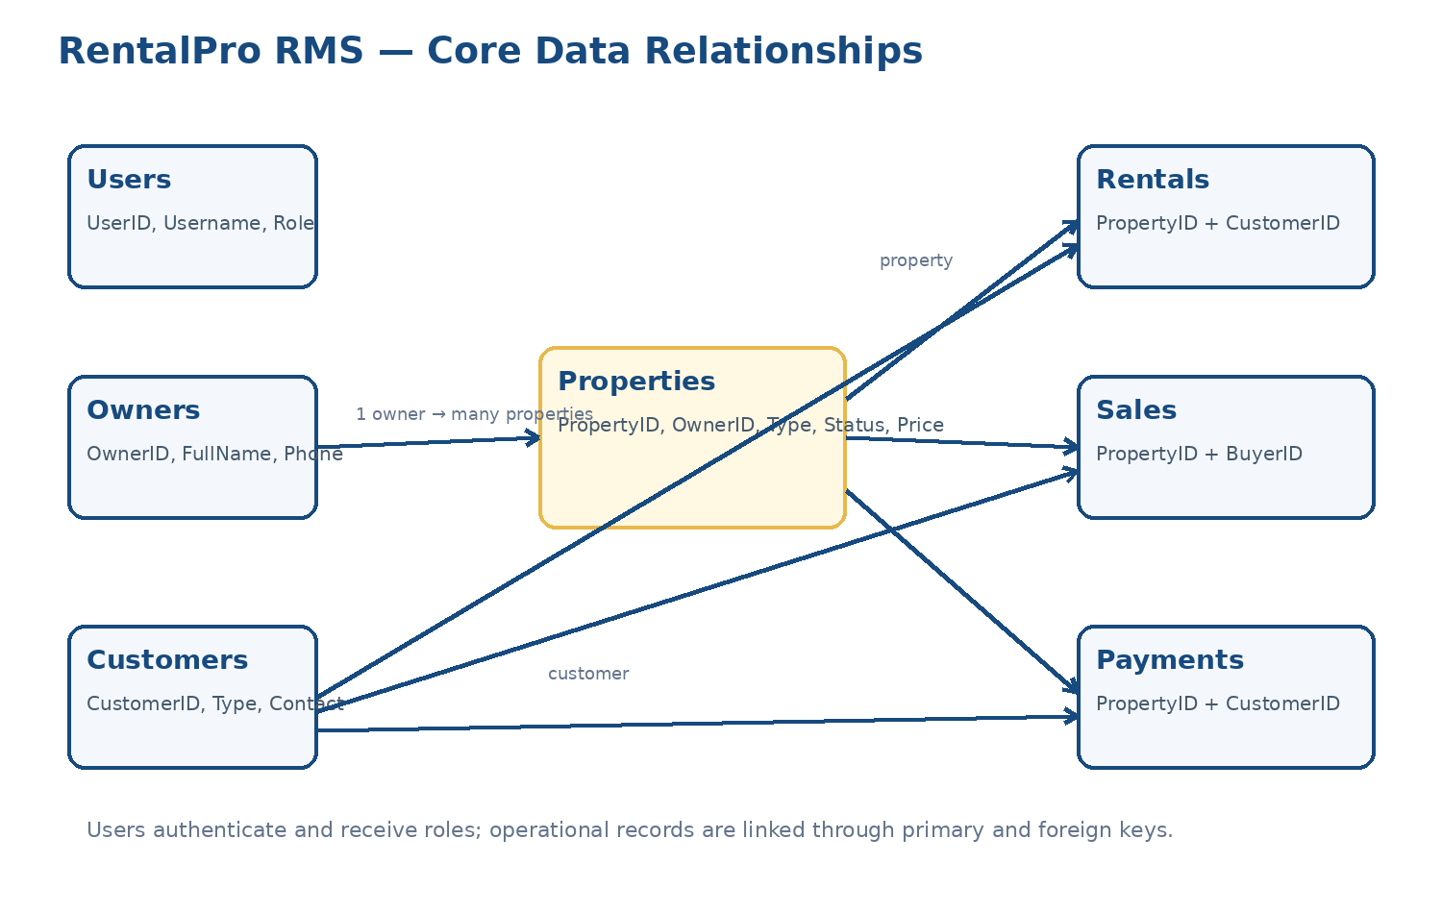
How the data is connected
Database design
Core entity
Properties is the central table because rentals, sales and payments all depend on property records.
People entities
Owners provide supply. Customers represent tenants and buyers.
Financial entities
Rentals, sales and payments convert business activity into trackable records.
Notes:
Use this slide to tell the data story. A property belongs to an owner. A customer can rent or buy a property. Payments record money movement. This is why relational database design is necessary.

Slide 6
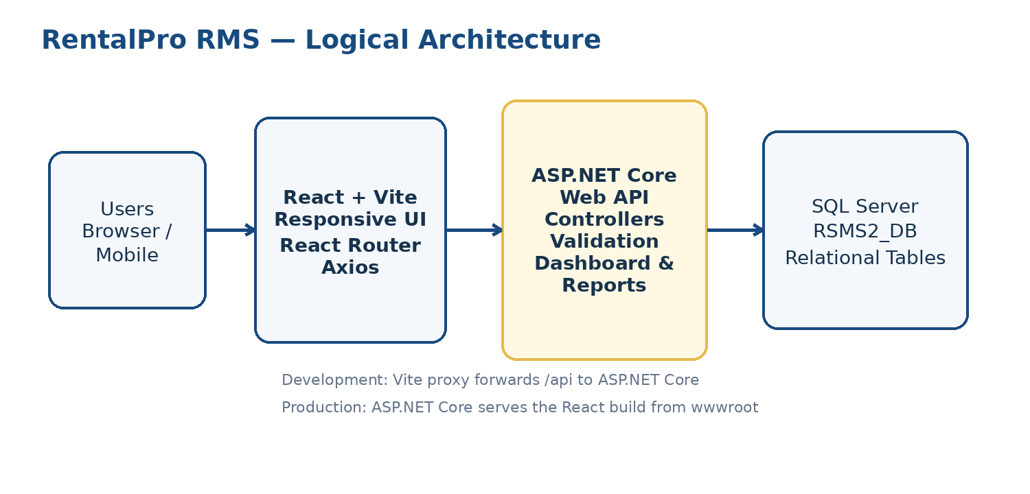
Request lifecycle
System architecture
Development mode
React runs on Vite. Vite proxy forwards /api requests to ASP.NET Core.
Production mode
React is built into static files and served by ASP.NET Core from wwwroot.
Data safety
The browser never talks directly to SQL Server. Controllers validate requests first.
Browser → React → Axios → Controller → Data class → SQL Server → JSON response → React UI
Notes:
The architecture is the backbone. Describe the flow from browser interaction to SQL Server and back. Emphasize the API as the boundary between frontend and database.

Slide 7
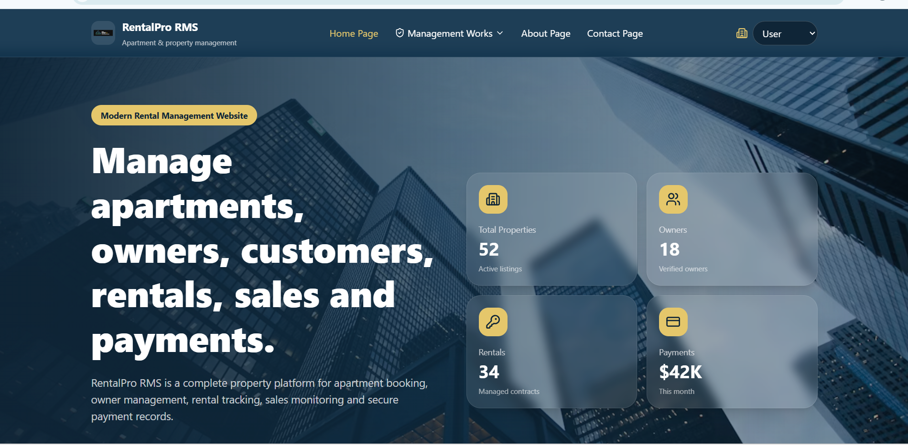
How I would present the live system
System demonstration
1
Open Home
Introduce the purpose and navigation structure.
2
Go to Management Works
Show how modules are grouped in one operational menu.
3
Manage Properties
Create, edit, filter and delete property records.
4
Link records
Show how owners, customers, rentals, sales and payments connect.
5
Check API and database
Demo message
Use Swagger and SQL Server to prove data is live.
The UI is not static. Each tab collects live data through Axios from the C# API.
Notes:
When demonstrating, do not click randomly. Follow a story: start with the home page, move to management, add or edit a property, show the API endpoint in Swagger, and then confirm the database record.

Slide 8
Frontend deployment in ASP.NET Core
What I learned: the wwwroot idea
React source
Vite build
wwwroot
Editable files live in frontend/src: pages, components, hooks, styles and images.
npm run build creates frontend/dist with index.html and assets.
ASP.NET Core serves the finished website from wwwroot.
Program.cs — serving React from ASP.NET Core
Key lesson
app.UseDefaultFiles();
app.UseStaticFiles();
app.MapControllers();
app.MapFallbackToFile("index.html");
wwwroot is not where we edit React. It is the public folder where ASP.NET Core serves the compiled production files. The editable source remains in frontend/src, and wwwroot is refreshed after every production build.
Notes:
This slide explains a common confusion: frontend/src is for editing. frontend/dist is generated by Vite. wwwroot is the copy that ASP.NET Core serves. If a change does not appear on the backend URL, it probably means the new dist was not copied into wwwroot or the browser cache was not refreshed.

Slide 9
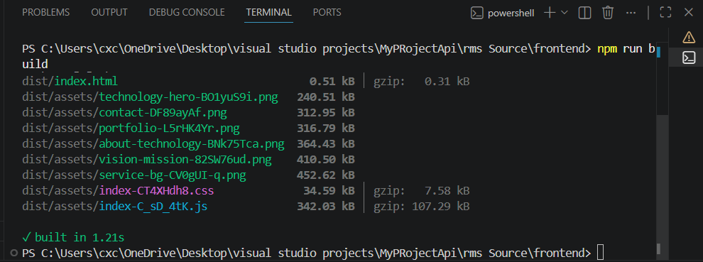
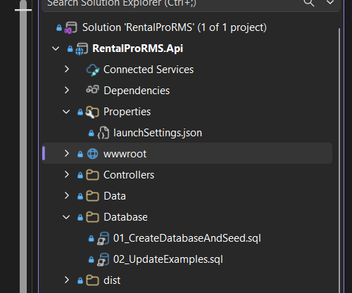
Practical workflow
wwwroot: start-to-end and updating steps
1
Edit React source
Change frontend/src files such as Home.jsx, Header.jsx, styles.css or assets.
2
Build with Vite
Run npm run build. Vite outputs dist/index.html and dist/assets.
3
Copy dist contents
Copy the contents of frontend/dist directly into backend/RentalProRMS.Api/wwwroot.
4
Restart and refresh
Restart ASP.NET Core and use Ctrl+F5 to clear cached JavaScript/CSS.
5
Verify connection
Open /api/Properties and browser Network tab to confirm status 200 responses.
Important: copy dist contents, not the dist folder itself.
Notes:
The update process is manual unless you create a batch file. Explain that wwwroot is a snapshot of the finished React build, not a live connection to frontend/src.

Slide 10
Backend object management
What I learned: Dependency Injection
Without DI
DI container
With DI
Every controller would manually create its own data classes. That creates repeated code and makes the system harder to test or change.
Program.cs registers the classes once. ASP.NET Core creates them when a controller asks for them.
PropertiesController receives PropertyData and OwnerData through its constructor, so it can focus on HTTP rules and validation.
Notes:
Dependency Injection is the backend learning point. Instead of building objects inside controllers, we register them. The framework injects them. This keeps controllers clean and makes the code more maintainable.

Slide 11
Installation, registration and constructor use
Dependency Injection implementation
Package used for SQL Server access
PropertiesController — injection
dotnet add package Microsoft.Data.SqlClient
private readonly PropertyData _data;
private readonly OwnerData _ownerData;
public PropertiesController(PropertyData data, OwnerData ownerData)
{
_data = data;
_ownerData = ownerData;
}
Program.cs — registration
builder.Services.AddScoped<PropertyData>();
builder.Services.AddScoped<OwnerData>();
builder.Services.AddScoped<CustomerData>();
builder.Services.AddScoped<RentalData>();
builder.Services.AddScoped<SaleData>();
builder.Services.AddScoped<PaymentData>();
Why AddScoped?
A scoped service is created once per HTTP request. That is suitable for request-based data access classes because each API call receives its own clean working instance.
DI separates object creation from business logic.
Notes:
Show the dependency idea in code. First we install the database client package. Then Program.cs registers services. Finally the controller requests what it needs through the constructor.

Slide 12
Property.cs
Backend code — Phase 1: Model class
Models/Property.cs
Purpose
public class Property
{
public int PropertyID { get; set; }
[Required, StringLength(100)]
public string PropertyName { get; set; } = string.Empty;
[Required, StringLength(50)]
public string PropertyType { get; set; } = string.Empty;
[Range(0.01, double.MaxValue)]
public decimal Price { get; set; }
[Range(1, int.MaxValue)]
public int OwnerID { get; set; }
public string? OwnerName { get; set; }
}
The model defines the shape of property data that moves between SQL Server, controllers and React.
Validation attributes
[Required], [StringLength] and [Range] help reject invalid requests before bad data reaches the database.
OwnerName
OwnerName is returned by JOIN queries for display in React. It is not a physical column in Properties.
Notes:
Explain that the model is the contract. React sends JSON that matches this model, and the API returns JSON based on this model. The model is simple but important because it defines the data vocabulary of the module.

Slide 13
PropertyData.cs
Backend code — Phase 2: Data class
Data/PropertyData.cs
public PropertyData(IConfiguration configuration)
{
_connectionString = configuration
.GetConnectionString("DefaultConnection")
?? throw new InvalidOperationException(...);
}
private const string SelectSql = @"SELECT p.PropertyID, p.PropertyName,
p.PropertyType, p.Location, p.Price, p.Status,
p.OwnerID, p.Description, o.FullName AS OwnerName
FROM Properties p INNER JOIN Owners o ON p.OwnerID=o.OwnerID";
public List<Property> GetAllProperties()
{
using SqlConnection connection = new(_connectionString);
using SqlCommand command = new(SelectSql + " ORDER BY p.PropertyID DESC", connection);
connection.Open();
using SqlDataReader reader = command.ExecuteReader();
// Map rows to Property objects
}
Responsibility
Talks to SQL Server, runs queries and converts database rows into C# objects.
Security habit
Uses parameterized SQL commands to reduce SQL injection risk.
Business logic
Includes helper methods such as NameExists, UpdateStatus and DeleteProperty.
Mapping
MapProperty converts SqlDataReader fields into a clean Property model.
Notes:
The data class is the database worker. It hides SQL details from the controller, reads the connection string from configuration, and provides beginner-friendly methods like GetAllProperties and AddProperty.

Slide 14
PropertiesController.cs
Backend code — Phase 3: Controller class
Controllers/PropertiesController.cs
[ApiController]
[Route("api/[controller]")]
public class PropertiesController : ControllerBase
{
private readonly PropertyData _data;
private readonly OwnerData _ownerData;
public PropertiesController(PropertyData data, OwnerData ownerData)
{
_data = data;
_ownerData = ownerData;
}
[HttpGet]
public IActionResult GetAll(string? search = null, string? status = null, string? type = null)
{
List<Property> properties = _data.GetAllProperties();
if (!string.IsNullOrWhiteSpace(search))
properties = (from property in properties
where property.PropertyName.Contains(search, StringComparison.OrdinalIgnoreCase)
select property).ToList();
return Ok(properties);
}
}
Routing
api/[controller] means PropertiesController becomes /api/Properties.
Validation
Before creating a property, the controller checks that the selected owner exists and the name is not duplicated.
HTTP responses
Returns Ok, CreatedAtAction, NotFound, Conflict or BadRequest depending on the result.
Notes:
The controller is the public API gate. It receives HTTP requests, calls Data methods, validates business rules, and returns clear HTTP responses that React can understand.

Slide 15
Core concepts mastered
What I learned from the project
React + Vite
wwwroot
Dependency Injection
Backend phases
Route pages clearly
wwwroot is public output
Register data classes
Model defines shape
Use Axios client once
Do not edit generated JS/CSS
Inject through constructor
Data class accesses SQL
Use /api with Vite proxy
Copy dist contents only
Use scoped lifetime
Controller exposes API
Build to dist for production
Restart + hard refresh
Keep controllers clean
Swagger tests endpoints
Big lesson
A professional full-stack system is not one file. It is a chain of responsibilities: user interface, API contract, business validation, database access and deployment workflow.
Notes:
Summarize learning in a confident way: the project taught not only React and C#, but also how a system is connected, built, served, updated and demonstrated professionally.

Slide 16
Conclusion
Next improvements
RentalPro RMS is a complete full-stack learning project that demonstrates professional system thinking: responsive React UI, ASP.NET Core Web API, SQL Server relationships, dependency injection, Swagger testing and wwwroot deployment.
• JWT authentication
• Role-based API authorization
• Image upload for properties
• Printable reports
• Dashboard charts
• Cloud deployment
Thank you
Questions and discussion
Notes:
Close by emphasizing that the system is a strong foundation. It works as a full-stack architecture and can be extended with stronger security, uploads, reporting and deployment.

