Slide 1
Minter
Thanks for Booking — Here's What to Expect
More Bookings.
More Customers.
In 20 minutes, we'll figure out exactly what's holding your business back from showing up online — and whether a website makes sense for you right now.
3–5 days
24/7
Unlimited
Avg. delivery
AI chat included
Edits, forever

Slide 2
The Opportunity
You're Already Being Found.
You're Just Not Getting Credit.
Great Google reviews. Active Instagram. But when someone wants to book a table, check your menu, or call you — there's nowhere to go.
78%
4.9★
14+ hrs
of people who search for a local restaurant never leave Google
avg rating of businesses without a website — wasted social proof
per week local businesses spend on phone calls for info a website handles
A website turns your existing reputation into a 24/7 salesperson — even while you sleep.

Slide 3
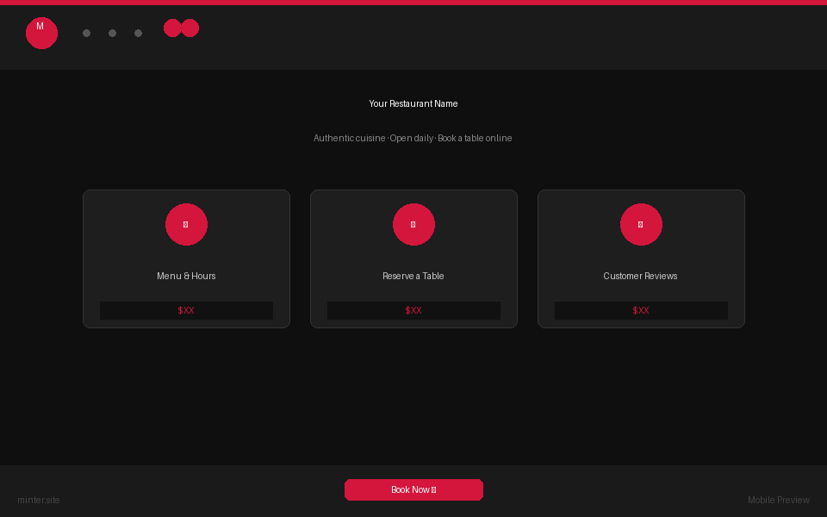
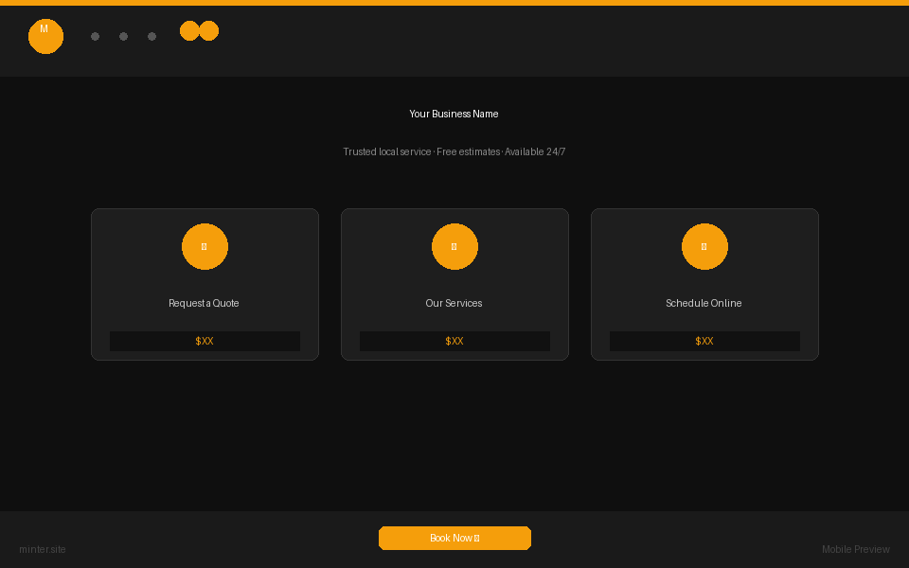
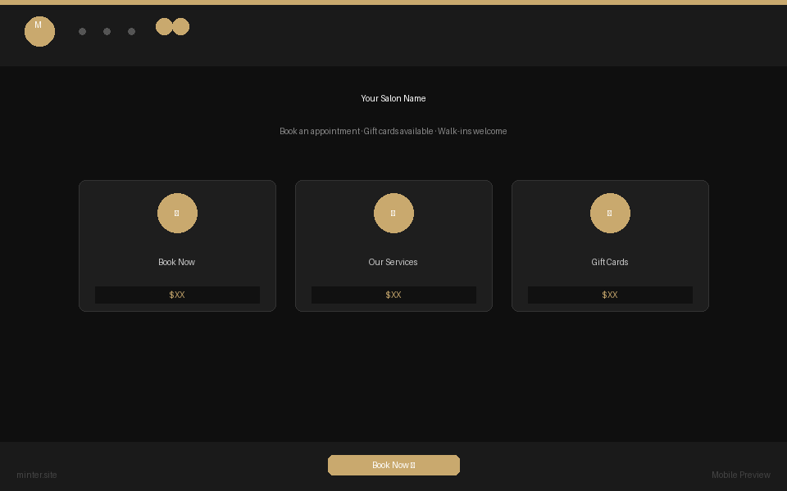
What We Build
Landing Pages That
Actually Convert
Custom-designed for your industry — every page built to turn visitors into booked appointments.
Restaurant
Home Services
Salon & Spa
Menu · Reservations · Reviews
Free Quote · Services · Reviews
Appointments · Gift Cards
Mobile-first · Fast load · AI chat built-in · Google-optimized

Slide 4
Everything Included
$1,497
one-time website build
$497/mo
all-inclusive retainer
No hidden costs. No templates. You approve the design before anything goes live.
✓
Custom design built for your business
✓
Google Maps + SEO optimization
✓
Mobile-first, fast-loading pages
✓
Unlimited edits — always up to date
✓
AI virtual receptionist — handles FAQs & booking
✓
Hosting, SSL, and domain setup
✓
Online reservation / quote request system
✓
Dedicated support — same-day response

Slide 5
How It Works
Three Steps to
More Customers
Three steps from where you are to a live website that brings in more customers every week.
✓
2
3
Discovery Call
→
We Build
→
Go Live
Done. We know your business, your customers, and what the site needs to do.
Custom design + copy. Done in 3–5 days. You review, we refine — until it's right.
We launch it, optimize it, and you're live. Then we handle everything ongoing.
Typical time from call to live: 3–5 business days

Slide 6
What Clients Say
Real Results.
Real Businesses.
"Before the site, we were losing at least 3–4 booking requests a week because people couldn't find our menu or hours online. Now it just books itself."
"Our Google reviews were great but hidden on Maps. Since the site went live, we've had strangers walk in saying they found us online. That never happened before."
— María G., Taqueria Los Primos · Austin TX
— Derek H., Hartwell Plumbing · Austin TX
"The AI chat on the site answers the same 10 questions we get on Instagram every single day. It pays for itself in the time it saves."
"Fast, clean, and they actually listened to what we needed. We went from a Facebook page to a real site in four days."
— Jade L., Glow Studio · Houston TX
— Tom & Sue K., Oakwood BBQ · Austin TX

Slide 7
What You Walk Away With
More of
What You Want
Every website we build is designed around one outcome: more paying customers through your door.
📞
⭐
🤖
More Booked Calls
Your Reviews, Front & Center
Zero Missed Inquiries
People can book a table or request a quote 24/7 — without picking up the phone
Your Google rating displayed prominently — the social proof you've earned, working for you
AI chat handles FAQ and captures leads even at 2am — then sends you the summary
📱
🔍
✏️
Looks Great on Every Phone
Show Up on Google
Unlimited Edits
72% of local searches are on mobile. Your site looks as good on a phone as a desktop
We optimize for local SEO — so when someone searches "best tacos near me," it's you
Menu changes, holiday hours, new photos — update anything anytime, no extra cost

Slide 8
Here's What Happens Next
You Hang Up.
We Get Started.
If a website makes sense for your business, we send a proposal within 24 hours — pricing, timeline, and exactly what we'll build. No contracts, no commitment until you're ready.
📋
Proposal in 24 hours
Custom scope, transparent pricing, no fluff
🎨
Design draft in 3–5 days
We build a custom sample for your business before you pay anything
✅
You approve, then pay
$1,497 build + $497/mo starts only when your site is live and you're happy

