Slide 1
Minter
Thanks for Booking — Here's What to Expect
More Leads.
More Jobs.
In 20 minutes, we'll figure out exactly what's costing you jobs — and whether a website makes sense for you right now.
3–5 days
24/7
Unlimited
Avg. delivery
AI chat included
Edits, forever

Slide 2
The Opportunity
You're Already Being Found.
You're Just Not Getting the Call.
Great reviews on Google. Word-of-mouth working. But when a homeowner is ready to book — there's no way to request a quote online.
62%
4.8★
$200–$500
of homeowners search for a contractor on Google before calling
avg rating of contractors without a website — wasted social proof
avg value of one new service call — missed every time someone can't find your number
A website with online quote requests turns every search into a real lead — even at 11pm.

Slide 3
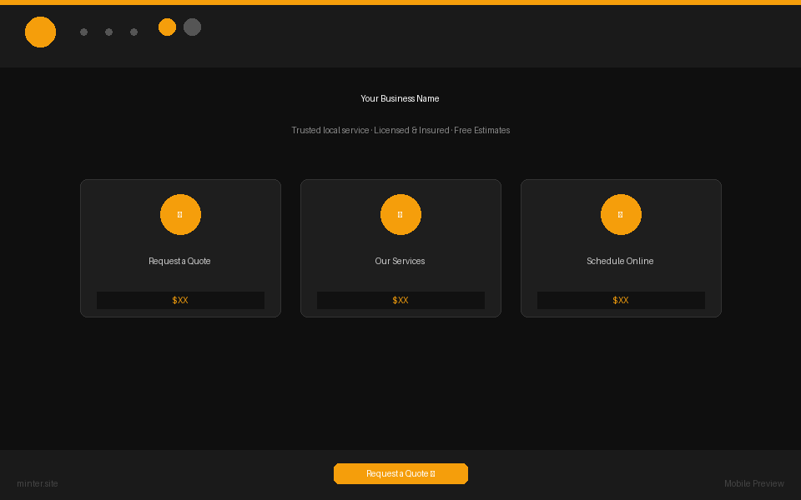

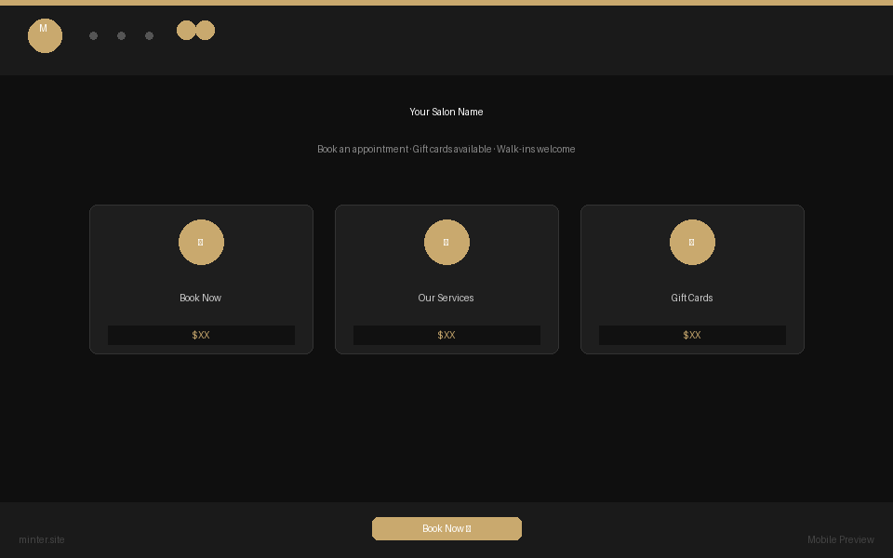
What We Build
Landing Pages That
Get Quote Requests
Custom-designed for contractors — every page built to turn visitors into booked jobs.
Contractor / Trades
HVAC / Plumbing
Electrical
Request a Quote · Services · Reviews
Free Estimate · Services · Areas Served
Same-Day Service · Request a Quote
Mobile-first · Fast load · AI chat built-in · Google-optimized

Slide 4
Everything Included
$1,497
one-time website build
$497/mo
all-inclusive retainer
No hidden costs. No templates. You approve the design before anything goes live.
✓
Custom design built for your trade and service area
✓
Google Business profile + local SEO optimization
✓
Mobile-first, fast-loading pages
✓
Unlimited edits — always show current services & areas
✓
AI virtual receptionist — handles quote requests 24/7
✓
Hosting, SSL, and domain setup
✓
Online estimate / service request form
✓
Dedicated support — same-day response

Slide 5
How It Works
Three Steps to
More Jobs
Three steps from where you are to a live website that brings in quote requests every week.
✓
2
3
Discovery Call
→
We Build
→
Go Live
Done. We know your services, your area, and what the site needs to do for your business.
Custom design + copy. Done in 3–5 days. You review, we refine — until it's right.
We launch it, optimize it, and you're live. Then we handle everything ongoing.
Typical time from call to live: 3–5 business days

Slide 6
What Clients Say
Real Results.
Real Contractors.
"Before the site, we were losing jobs because homeowners couldn't find a way to request a quote online. Now the quote requests come in while we're on job sites."
"Our Google reviews were great but hidden on Maps. Since the site went live, homeowners find us online and book same-day service. That never happened before."
— Mike T., Hartwell Plumbing · Austin TX
— Derek H., Hartwell Plumbing · Austin TX
"The AI chat answers the same questions we get on every call — 'do you service my area?', 'what's your hourly rate?' — and captures the lead even at midnight."
"We went from a Google Business profile to a real website in four days. First month after launch, we got 11 new quote requests we would've never gotten otherwise."
— Carlos R., Crestwood Electric · Houston TX
— Tom & Sue K., Oakwood HVAC · Austin TX

Slide 7
What You Walk Away With
More of
What You Want
Every website we build is designed around one outcome: more booked jobs and higher revenue.
📋
⭐
🤖
Quote Requests While You Sleep
Your Reviews, Front & Center
Zero Missed Inquiries
Homeowners can request a quote 24/7 — without calling, without waiting for a callback
Your Google rating displayed prominently — the trust signal you've earned, working for you
AI chat handles common questions and captures every lead — then sends you the summary
📱
🔍
✏️
Looks Great on Every Phone
Show Up on Google
Unlimited Edits
Most homeowners search on their phone. Your site looks as good on mobile as it does on desktop
We optimize for local SEO — so when someone searches "plumber near me," it's you
New services, service areas, licensing info, photos — update anything anytime, no extra cost

Slide 8
Here's What Happens Next
You Hang Up.
We Get Started.
If a website makes sense for your business, we send a proposal within 24 hours — pricing, timeline, and exactly what we'll build. No contracts, no commitment until you're ready.
📋
Proposal in 24 hours
Custom scope, transparent pricing, no fluff
🎨
Design draft in 3–5 days
We build a custom sample for your business before you pay anything
✅
You approve, then pay
$1,497 build + $497/mo starts only when your site is live and you're happy

