Slide 1

College of Professional Studies, Toronto
Guided By: Dr.Prof. M. Shafiqul Islam
Presentation By: Manan Soni Nuid: 002982645
Boxoffice Revenue Analysis

Slide 2
Data Source
The Data is from a repository of fivethirtyeight (https://github.com/fivethirtyeight)
Data is of Box Office Collection of Movies that are Biographies of personalities .
Timeline of Data is from 1940 to 2015 in which data before 2000 is quite noisy. By noisy it has missing values. To add to that, Data has redundancy as duplication of samples.
Actual data coming from is IMDB so IMDB is the actual source of the data.
After asking to Data, there are surprising facts.

Slide 3
Processing of Data
Correlation of year and revenue is not relative as value is near to 0.
We can’t guess the revenue so removing samples was only options to past movies.

Slide 4
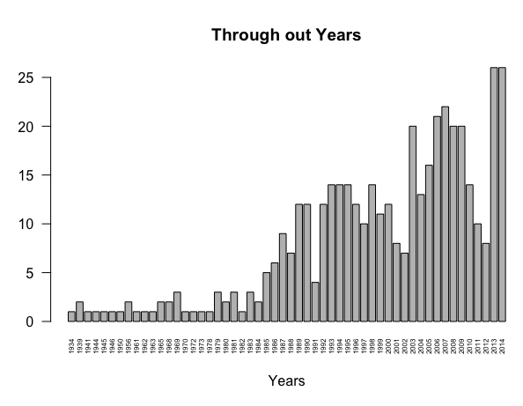
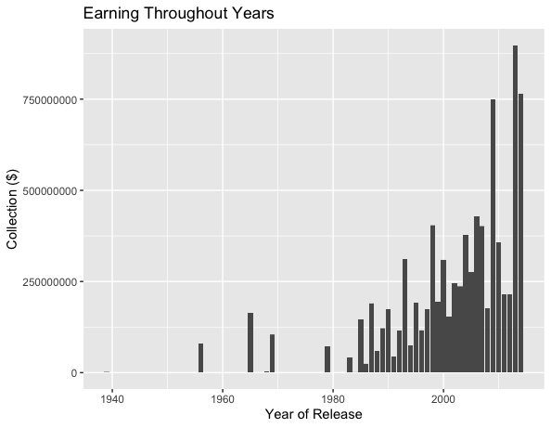
How much earning through out years
As seen trend is going up through out years and some falls can be seen as well.
Movies earned well after 2008 as we can see in the bar plot.

Slide 5
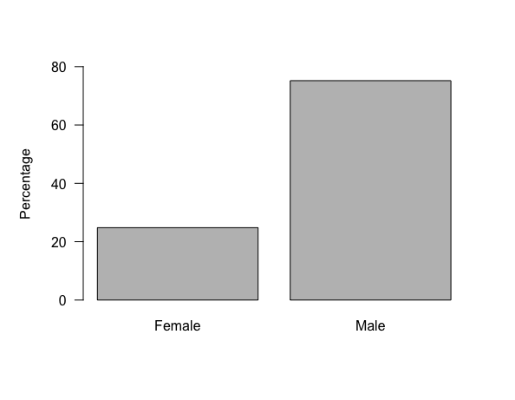
Subject Sex affects BOR
We can see that movie made on male have 75% chances to earn more than movie made on women

Slide 6
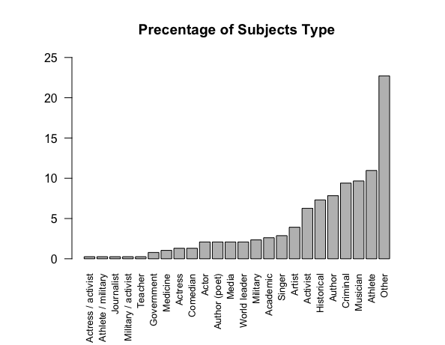
Subject Sex affects BOR
80% of the movies have categorized in other.
Movies made on actresses/activists have lowest percentage.
We can say people are more interested in Historical, based on author, Crime related, based on athlete.

Slide 7
Subject Type for BOR
80% of the movies have categorized in other.
Movies made on actresses/activists have lowest percentage.
We can say people are more interested in Historical, based on author, Crime related, based on athlete.

Slide 8
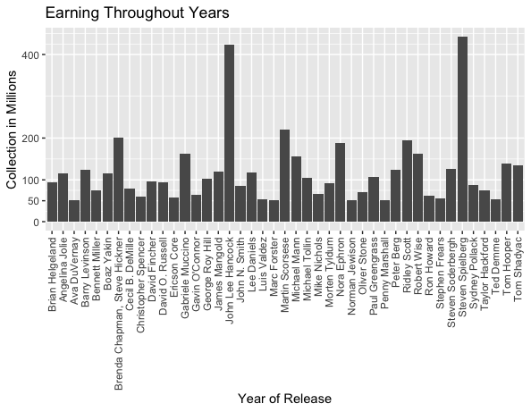
Directors for BOR
These are the directors who were successfully captured audience through their direction.
Steven Spielberg and John Lee Hancock have earned highest amongst all.

Slide 9
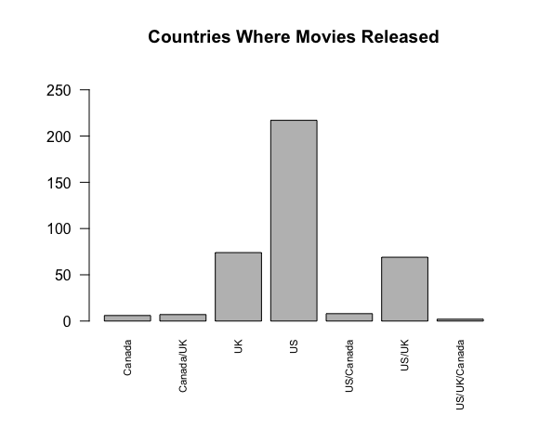
Country who played good role in BOR
Us has the highest frequency. To add to that, 200 plus movies releases in US.

Slide 10
Country who played good role in BOR
Us has the highest frequency. To add to that, 200 plus movies releases in US.

Slide 11
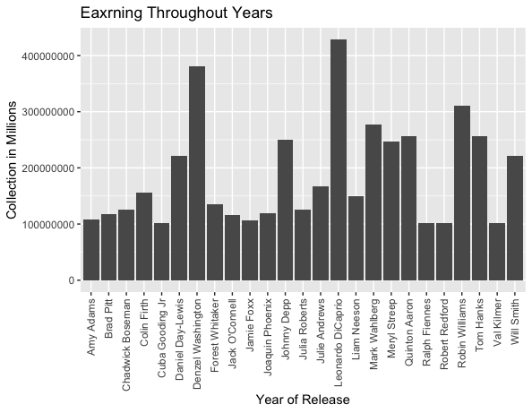
Lead Actors/Actresses for BOR
This are the actor/actresses who made movies successful and get good revenue.
Highest earner is female and best actresses of her time.

Slide 12
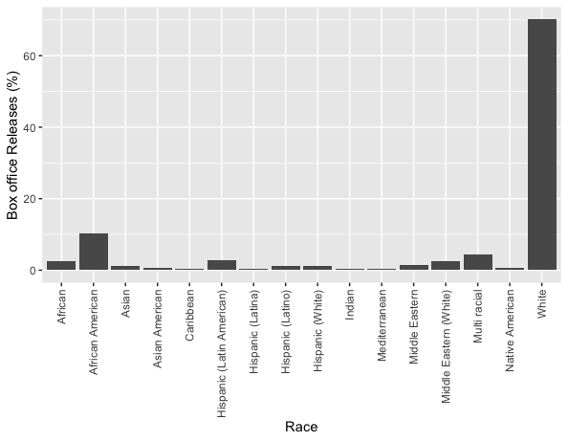
If Race affects BOR
Here, We can’t say that people have interest in watching biography of white personalities.
It’s a possibilities that most of the movies which had released were of white and less movies of other races.

Slide 13
Conclusion
If a production house thinking to make a biography movie and to generate more revenue we need to get good director, actor (not actress), a famous personality of US, Subject can be vary and last we need to release it in US because most of the revenue will come from US.
We can see that past movies made less money but todays inflation is 16% compared to 1960. So 1$ can be 16$ of todays.

Slide 14
Additionals
If dataset had gender of director, we can dig more like whom directed better.
We can add a feature/variable like Multi country release, Single country release.
If dataset had ratings of movie from imdb than accuracy of analysis can be increase.

Slide 15
References
FiveThirtyEight, IMDB:https://github.com/fivethirtyeight/data/tree/master/biopics
Admin, & *, N. (n.d.). 12.1 million in numbers – 12.1 million written out. Numbers in Words. Retrieved February 21, 2022, from https://numbersinwords.net/12-1-million-in-numbers
Anand, Group by a column and sort by another column in R. Stack Overflow. Retrieved February 21, 2022, from https://stackoverflow.com/questions/39470731/group-by-a-column-and-sort-by-another-column-in-r
Hadley, et al. “Subset rows using column values.” the Grammar of Data Manipulation • dplyr, RStudio, https://dplyr.tidyverse.org/index.html.

Slide 16
Thank you

