Slide 1

Final Project Intermediate Data Analysis
Guided By: Dr. Alex Maizlish
Project By: Dhairya Dave
Manan Soni
Parth Savaliya

Slide 2
Table Content
Dataset and Source
Objectives
Data cleaning
Analyzing data and its snippets.
Hypothesis testing
Model and prediction
Conclusion
Reference

Slide 3
Dataset and Source
This dataset is about product recommendation of H&M and Source of this data is Kaggle. This was officially released by H&M for competition.
It have 105542 rows and 25 variables about product, sections, description, color, etc. Another dataset related to this is customer like if customer has membership, what is age, etc. This dataset is officially given by H&M and it requires approx. 300 mb storage space.
This is for proposal and understanding the research objectives. In nutshell, what we can do to H&M using this data.
As a perspective of analyst, this kind of data we will have to sort in future for company.
Most of the data is category expect the age in customers.csv

Slide 4
Objectives and Aim
Distribution of H&M Customers and something about their membership status.
To be specific, relative frequency of different product type? Which product has significant portion of sales.
Which are the most purchased product in terms of group of products.
Graphical appearance on products and their percentages to the sales.
Which model we can used on our featured variables and why?
Determination of customer their status of membership with respected age and frequency to the fashion news.
Determination of customer purchases with respected types of product and graphical appearance.
Determination of customer purchases of product with respected color and type.
We are focusing that what people were tried to purchased and based on that tried to predict and gain confidence.

Slide 5

Data Cleaning
Dataset of articles was cleaned but not the customer.
For Customer, we used MODE as missing data was categorical data.
Though customer data had many NA values which were omitted, when cannot be replaced with imputed data.
To process we used to separate and labelling at most.

Slide 6
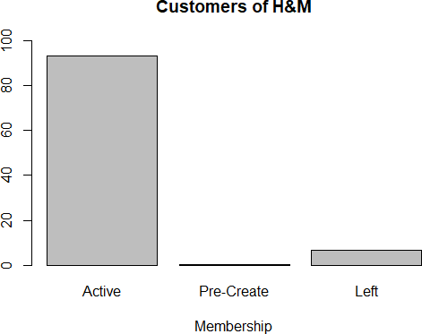
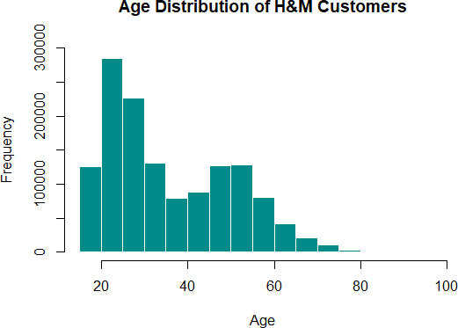
Analyzing data and its snippets.
Here, this graph depicts how customer membership has been present. Majorly the customer memberships are active and with compare to it very little of them have left and has their membership status as Pre-create.
This graph depicts the trend of age of the customers who are H&M’s potentials targeted audience.
Here, it is clearly seen that age group from 20 to 25 has highest number of buyers from H&M. Then trend gradually drops, rises and drop again.

Slide 7
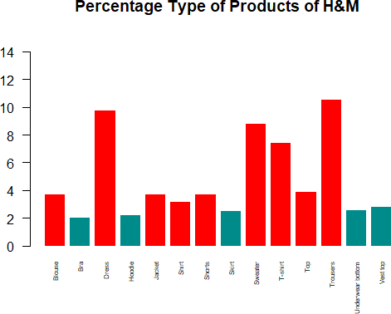
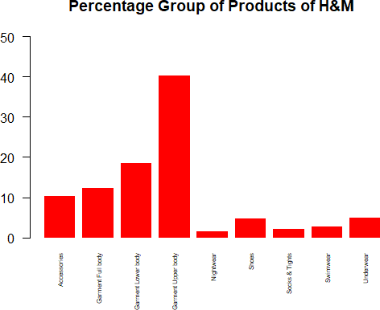
This graphs shows, the percentage type o f products kept at H&M outlets. It is seen that trousers and dresses are kept in store in large amount. Also we can infer from that they might have high sales in their outlets.
The following graph shows the category of apparels kept in H&M store, which accessories, garment upper body, night wears etc.
This graph can inform us about the type of categories which should be kept in H&M outlet and also can provide us with the sales of individual category.
Garment upper body has highest percentage and night wear has the lowest percentage.

Slide 8
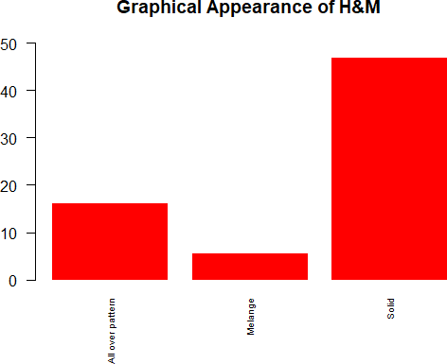
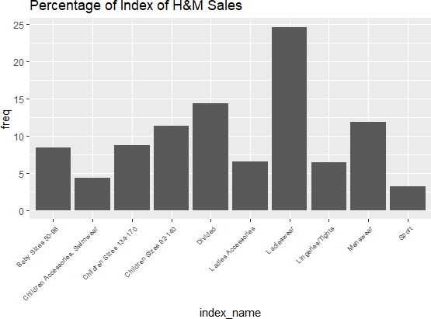
We can see most product sold by H&M have graphical pattern as solid (47%) and next is All over pattern and the last is Melange.
This are are which is greater than 5% of relative frequency.
The highest percentage sold according to index name is ladies wear which comprise of 25%. Sport wear and Children Accessories Swimwear is sold the least.

Slide 9
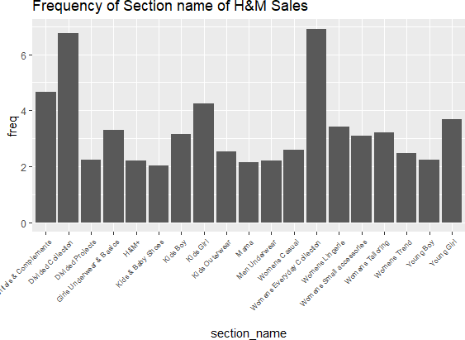
The highest frequency is for Divided Collection which is 7 and Women Everyday Collection which is 7 , rest all of them have range between 2-4.

Slide 10
Hypothesis Testing and Confidence
Statement 1: How has fashion news and age influenced the purchase in H&M store.
Statement 2: How has graphics and product type has impacted the sales.
Statement 3: How has colours and product type affected the sale in H&M

Slide 11
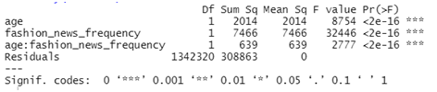
Analysing Statement 1
How has fashion news and age influenced the club membership in H&M store.
H0: There is no effect of fashion news and age on the club membership.
H1: There is effect of fashion news and age on the club membership.
H0: There is no effect of fashion news on the club membership.
H1: There is effect of fashion news on the club membership.
H0: There is no effect of age on the club membership.
H1: There is effect of age on the club membership.
Interpreting the outcome we can say that as p-value is less than significance value hence, we reject the null hypothesis.

Slide 12
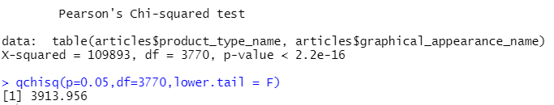
Analysing Statement 2
How has graphics and product type has impacted the sales.
Null Hypothesis: Graphic patterns and Type of Articles do not have any impact on purchases.
Alternative Hypothesis: They are not independent of purchases made by customers.
Intrepreting the outcome we can say as p- value is very much less than significance value we reject the null hypothesis

Slide 13
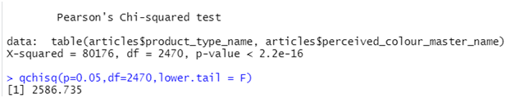
Analysing Statement 3
How has colours and product type affected the sale in H&M.
Null Hypothesis: Colours of product such as dark, light and Type of Articles (product) do not have any impact on sales made by clients of H&M.
Alternative Hypothesis: They do not have impact on purchases.
Interpreting the p-value which is very less than alpha and that is why we reject the null hypothesis.

Slide 14
Models and Prediction.
Logistic Regression (GLM): In this test, there are multiple samples of different graphic patterns of articles in which we focused on Solid pattern to predict. If a random article whether or not having a solid pattern instead other one.
So made a dummy variable named solid and those samples whom have solid pattern it will denoted as 1 and others as 0. So we will perform binomial Logistic regression for checking between 1 & 0. So in simple, model will test if a article has solid pattern or not. Input variables will be graphical pattern and its colour.
First we split dataset into train and testing sets which had threshold of 0.7.
For the training, we put solid (0,1) variable as independent and other as dependent. From this we can say P value is 0 for all the variables. Accuracy is 94% and false positives are 4617. But this is for training set so we need to test this model with testing set. To add to this, 34644 are true positives and 34516 are true negatives, surprisingly false negatives are 0.

Slide 15
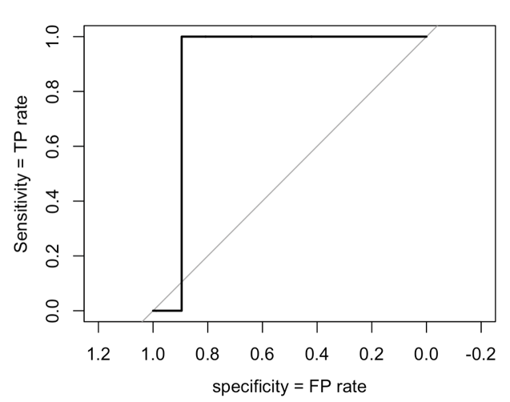

ROC & AUC
ROC (Receiver Operating Characteristics) and AUC is Area under curve. Basically, These are the measures to gain the performance of a classification model. And For our model the AUC is 0.8955 which is almost 90%.
AUC tells how much the model is capable of determining between classes. The higher this value, the better model Is to tell if yes and no

Slide 16
Conclusion
By performing above tests we can conclude that the tests taken helps us to understand the analysis and interpretation of the dataset as hypothesis testing gives us gain confidence with proper proof.
To figure out whether the article picked up by the customer is solid or not we have performed logistic regression which has accuracy of 94% on training set and that same model was able to achieve 93.67% in our testing set.
The ROC & AUC helped us to check how much specific our model is to predict a given random event(customer picking up a specific category of t-shirt). We were able to get AUC value equal to 0.8955. Closer the value to 1, better the model.

Slide 17
References
H&M Personalized Fashion Recommendations, Provide product recommendations based on previous purchases, H&M Group Sources: https://www.kaggle.com/competitions/h-and-m-personalized-fashion- recommendations/data

