Slide 1

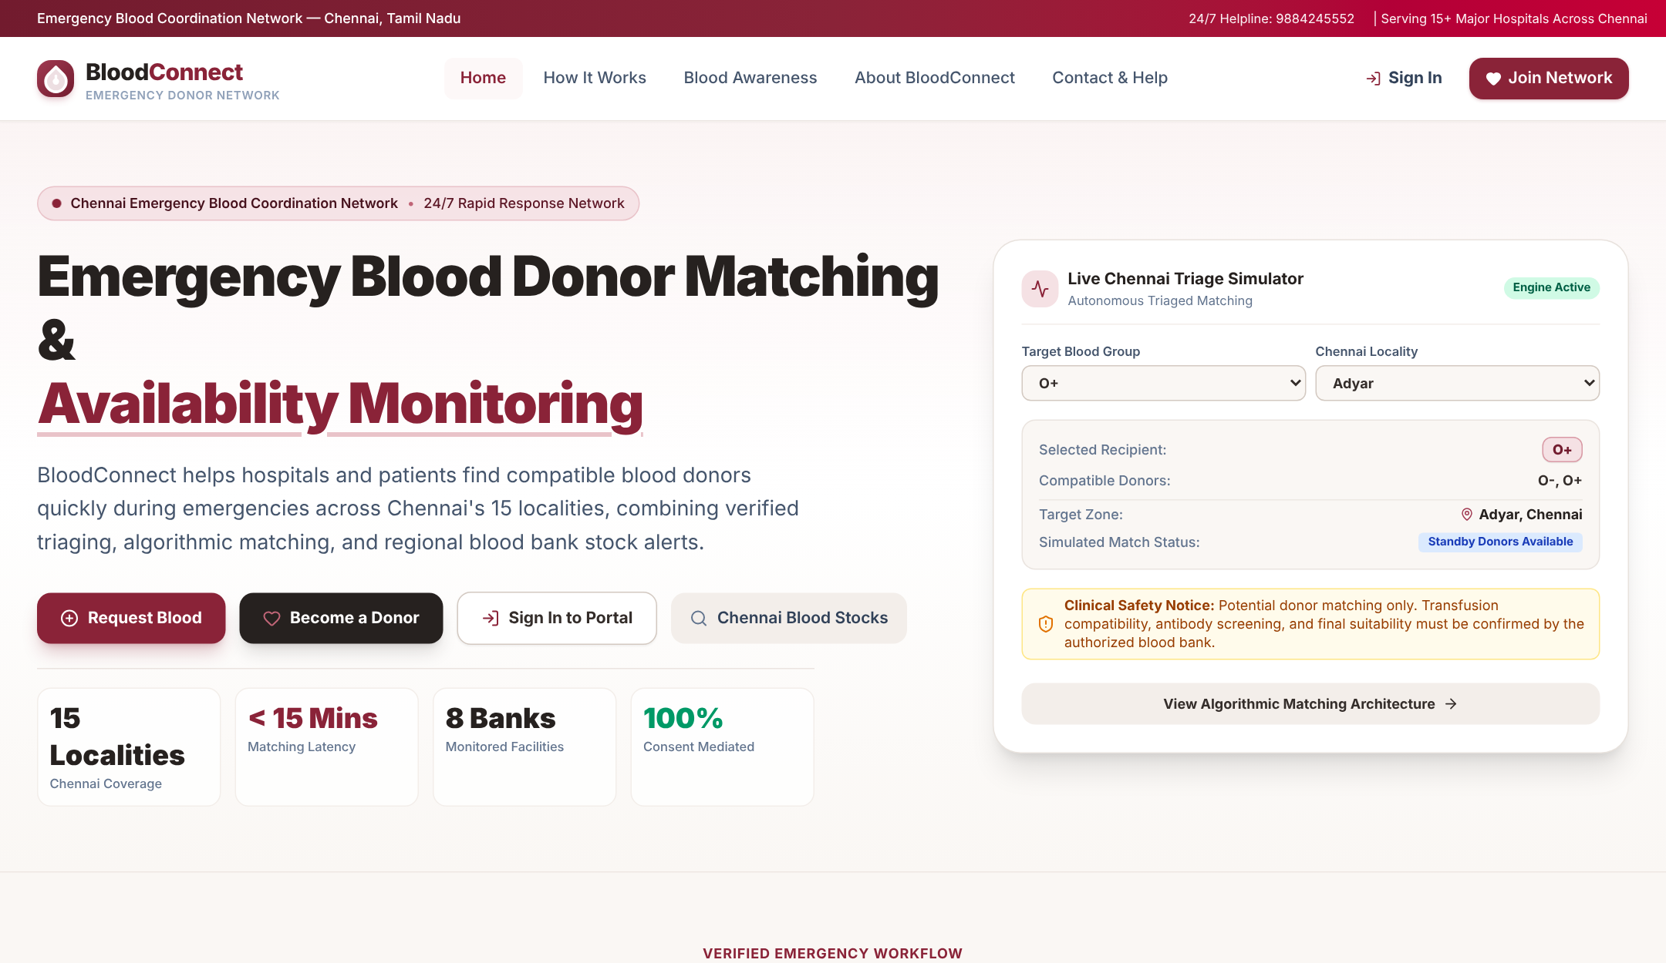
23OED971 · INTRODUCTION TO DESIGN THINKING
BloodConnect 2.0
Addressing the challenges in finding blood donors: an adaptive emergency blood-donor coordination system
Freddy Matthew R
Boopathi P R
Harisankaran J
Team Leader
Research Lead
Data Analysis Lead
Every second matters. Every connection counts.
Balakumaran E
Abilash Alexander E
Joshua Bennet
Problem Definition Lead
Documentation Lead
Design Lead
Guide: Mr. Ravi Karthik R Department: CSE, III Year
KCG College of Technology, Karapakkam (Autonomous)

Slide 2





Urgent emergencies, scattered information
Finding suitable blood donors in an emergency is difficult because information is fragmented, rare blood groups are scarce and coordination is slow. Once a request goes out, nobody follows up on who has actually agreed.
Slow donor search
Hospitals check the blood bank, then phone known donors one by one.
Rare groups are hard to find
Groups such as AB-negative are difficult to keep in stock.
Scattered information
Donor details sit in social-media groups and personal contacts.
No follow-up
Requests are broadcast once; nobody tracks who responded.
How might we help hospitals find compatible blood donors quickly during emergencies?

Slide 3
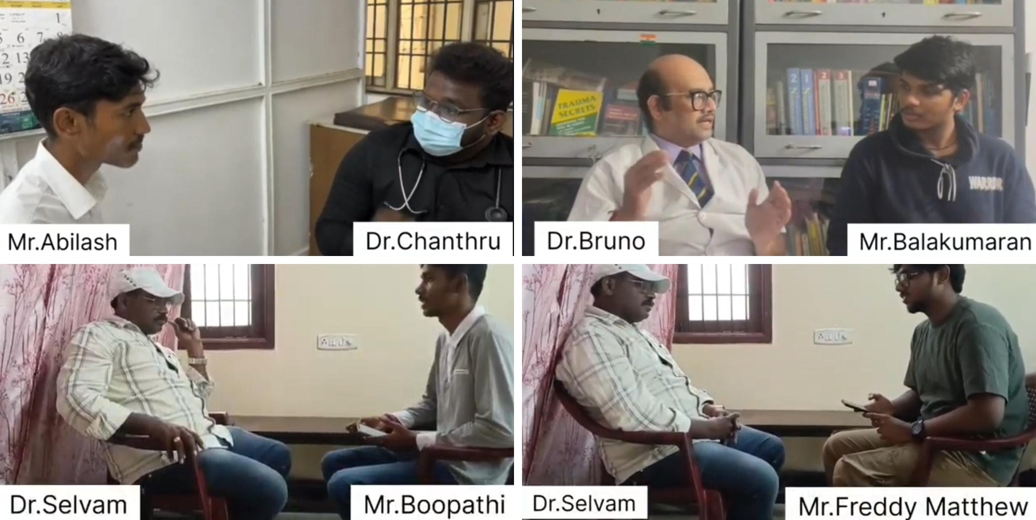

Empathize: we interviewed three doctors
Dr. Chanthru
Interviewed by Abilash Alexander
Dr. Bruno
Interviewed by Balakumaran E
Dr. Selvam
Interviewed by Boopathi P R, Freddy Matthew R and Joshua Bennet
Sample questions
What is the biggest challenge in arranging blood for patients?
Which blood group is the hardest to keep in stock?
Can a mobile app help find blood donors faster?
20 open-ended questions, using the Five Whys to dig deeper. All interviews were video-recorded.

Slide 4





What the doctors told us
Rare groups run short
No centralised system
Delays when stock is out
Finding the required group quickly is hardest in emergencies and for rare groups such as AB-negative.
Hospitals depend on social media and personal contacts to reach donors.
When the group is unavailable, contacting donors takes time the patient may not have.
Awareness gap
Safety comes first
Technology can help
Fear, misconceptions and lack of awareness stop people from donating.
Donor fitness is checked and every unit is screened before transfusion.
A faster donor connection system and accessible camps can improve availability.

Slide 5
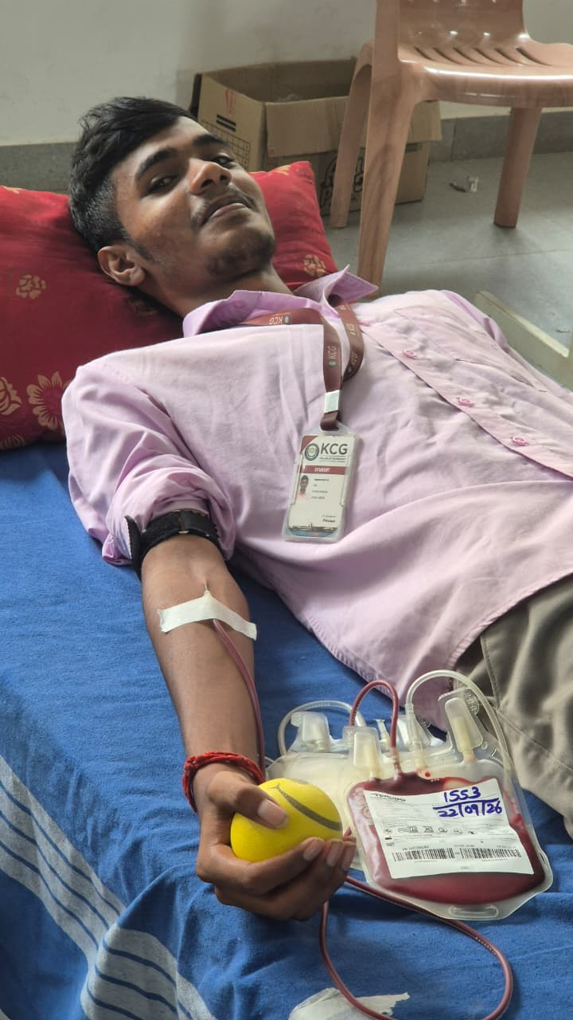
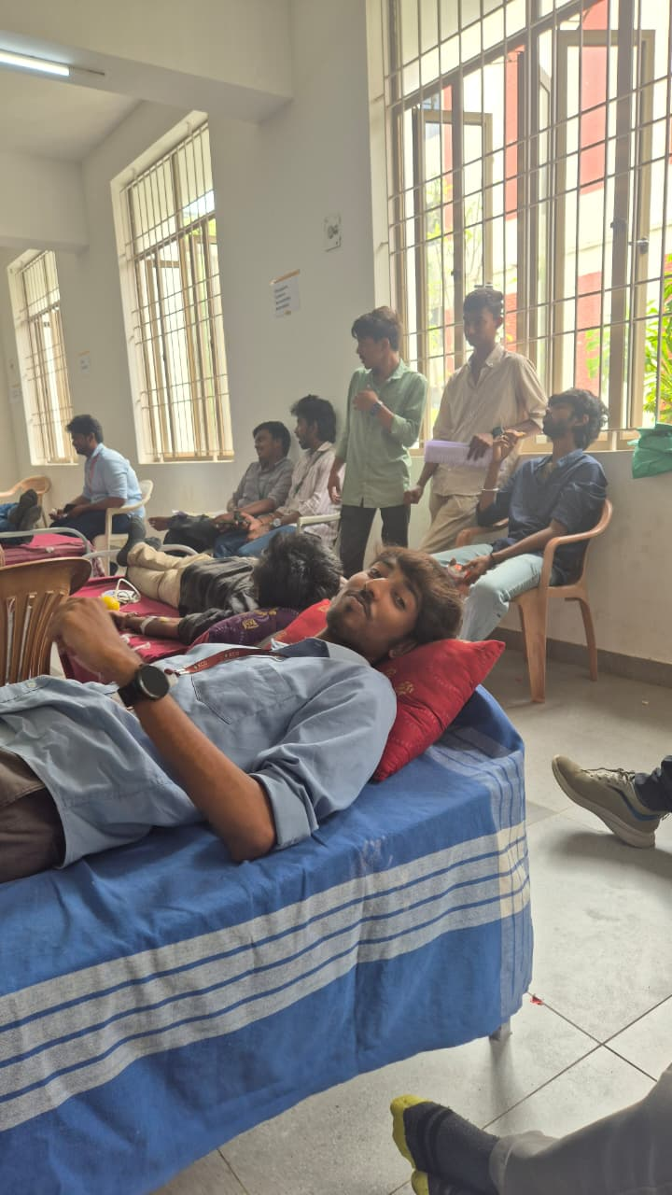



Experiencing it first-hand: blood donation camp
Our team took part in a voluntary blood donation camp held at KCG College of Technology, to see the donor side of the problem for ourselves.
Willing donors exist
Many students turned up when the camp came to the college, as the doctors suggested.
Every unit is tracked
Each bag is labelled and recorded before it goes for screening.
Donor care matters
Donors rest and are looked after before and after giving blood.
The donors are there. The real challenge is reaching the right one at the right time.

Slide 6
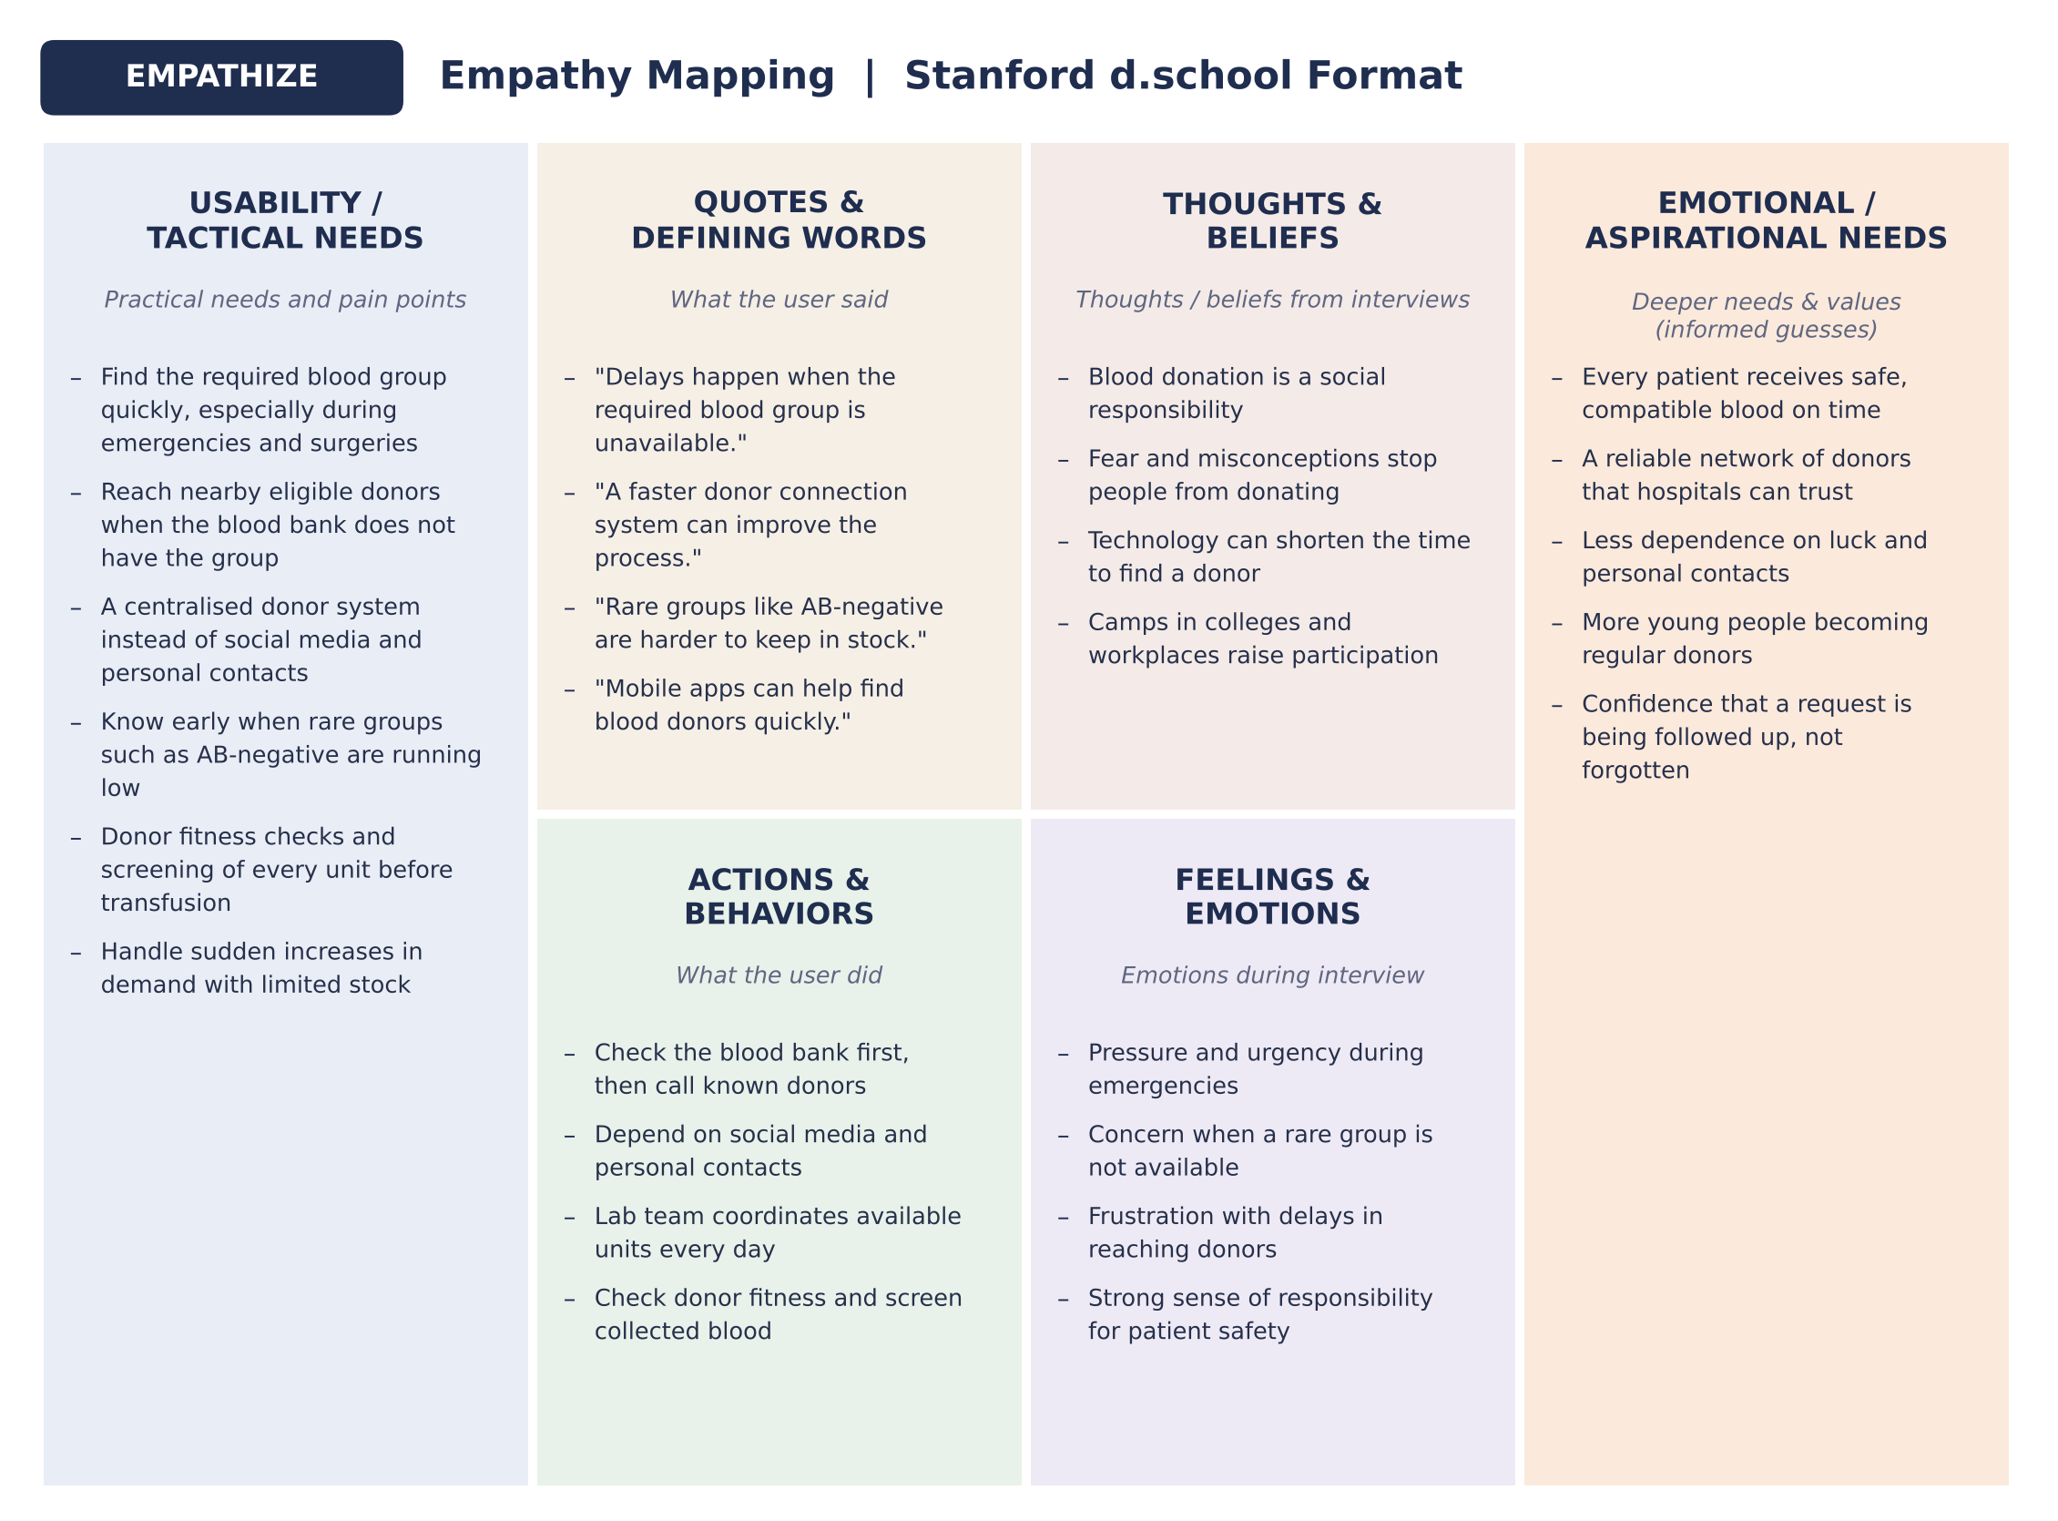
Empathy map: Stanford d.school format
What stood out
NEED
Find the right group quickly, without relying on personal contacts.
BEHAVIOUR
Check the blood bank first, then call known donors.
FEELING
Pressure and frustration when a rare group is unavailable.
ASPIRATION
Every patient gets safe, compatible blood on time.

Slide 7




Define: How Might We?
01
02
03
How might we help hospitals find compatible blood donors quickly during emergencies?
How might we connect nearby eligible blood donors with patients who urgently need blood?
How might we encourage more people to become regular blood donors and improve blood availability?
Problem statement: How might we make sure enough nearby eligible donors respond to an emergency blood request in time, without alerting every donor at once and while keeping every decision explainable?
User needs we designed for
One centralised donor system
Fast matching of nearby donors
Verified requests only
Live view of who has agreed

Slide 8
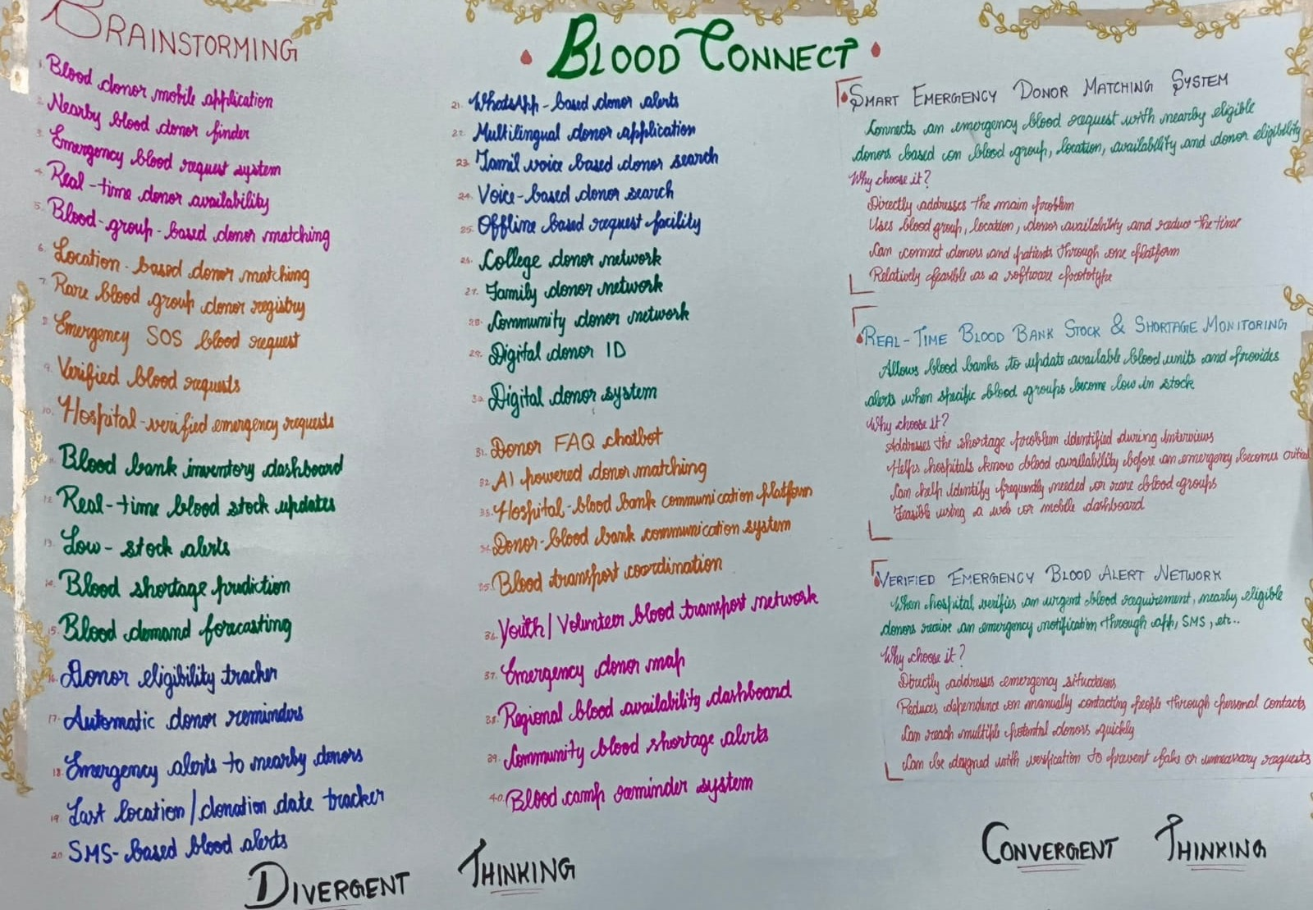
Ideate: from 40 ideas to 3 concepts
40 ideas in divergent thinking
1
Smart Emergency Donor Matching
Match requests with nearby eligible donors by group, location and availability.
2
Real-Time Blood Bank Stock Monitoring
Blood banks update units; alerts when a group runs low.
3
Verified Emergency Blood Alert Network
Once a hospital verifies a request, nearby donors are alerted.

Slide 9



Existing models solve only fragments
EXISTING MODEL
GAP
HOW BLOODCONNECT 2.0 ANSWERS IT
Hospital blood banks
Limited real-time visibility
Stock levels and low-stock alerts in one dashboard
Telephone-based search
Manual and slow
Ranked donors alerted in batches automatically
Social-media groups
Fragmented and unverified
Admin-verified requests before any alert
Online donor directories
No follow-up of responses
Every response tracked; remaining need recalculated
Key insight: information is scattered, coordination is slow and no one tracks the response. BloodConnect brings discovery, verification, stock visibility and follow-up into one platform.

Slide 10



BloodConnect 2.0: one workspace, three roles
Requester
Donor
Administrator
Submits blood group, component, units, hospital and urgency
Tracks verification and accepted volunteers
Cancels when no longer needed
Keeps blood group, locality and availability
Receives in-app emergency alerts
Accepts or declines each alert
Verifies requests before any alert
Runs the Command Center and Simulator
Manages blood-bank stock and audit log
NEW IN 2.0: ADAPTIVE EMERGENCY ESCALATION ENGINE
Rank
Alert
Track
Recalculate
Expand
nearest best-scored donors
a small first batch
accept / decline / no response
remaining volunteer need
the search only when needed

Slide 11









From request to response
1. Request
2. Verify
3. Rank
4. Alert
5. Respond
6. Re-evaluate
Requester submits group, units, hospital, urgency
Administrator approves the request
Engine scores eligible donors
First batch gets in-app alerts
Donors accept or decline
Wait, top up or expand the search
Technical architecture
Frontend
Backend API
Escalation engine
Database
React 19, Vite, Tailwind CSS, React-Leaflet maps, Recharts
Django + Django REST Framework, token authentication, three roles
Pure decision rules, row locks, idempotent updates, simulator
SQLite: 18 project tables with integrity constraints

Slide 12
How the engine decides who to alert
Search stages (cumulative)
Rules
1
Immediate area
5 km
Target
units × 2 volunteers (2 units → 4)
2
Nearby localities
10 km
Need
target − accepted volunteers
3
Greater Chennai
20 km
Wait
10 / 20 / 45 min by urgency
4
Whole metro area
No limit
Stop
on cancel, expiry or need met
Expands to the next stage only when the current one has no eligible donors left.
Accepted means a volunteer said yes, not a confirmed donation. No response means status unknown, not declined. Final suitability is always confirmed by the blood bank.

Slide 13
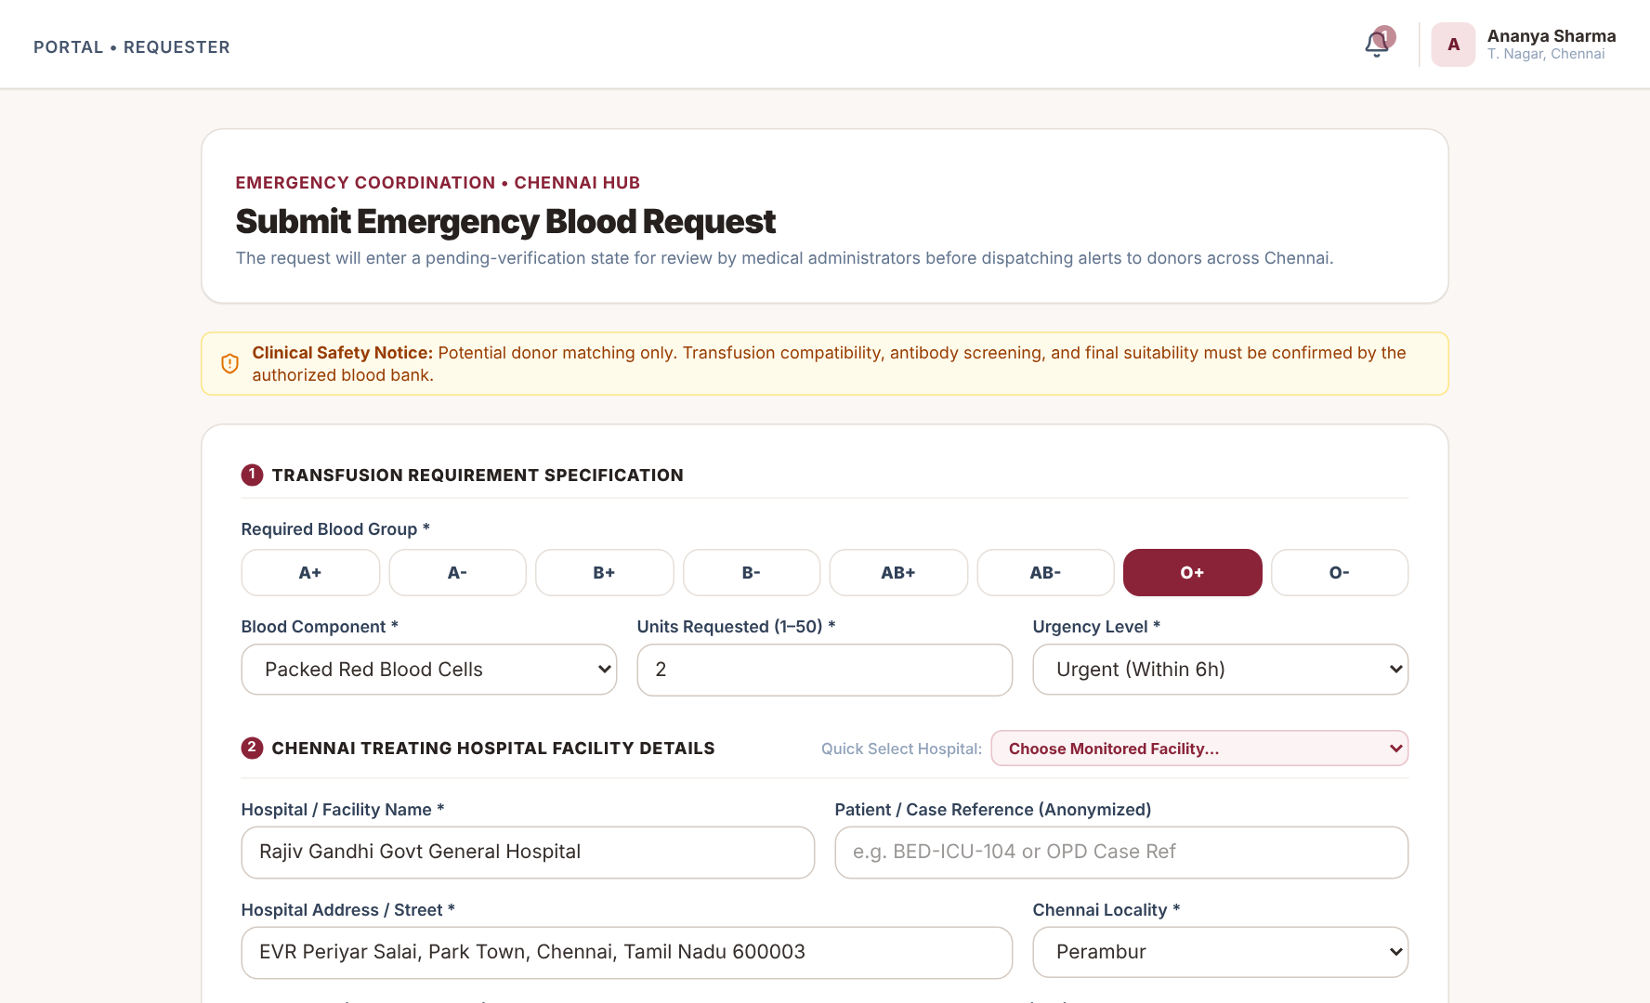
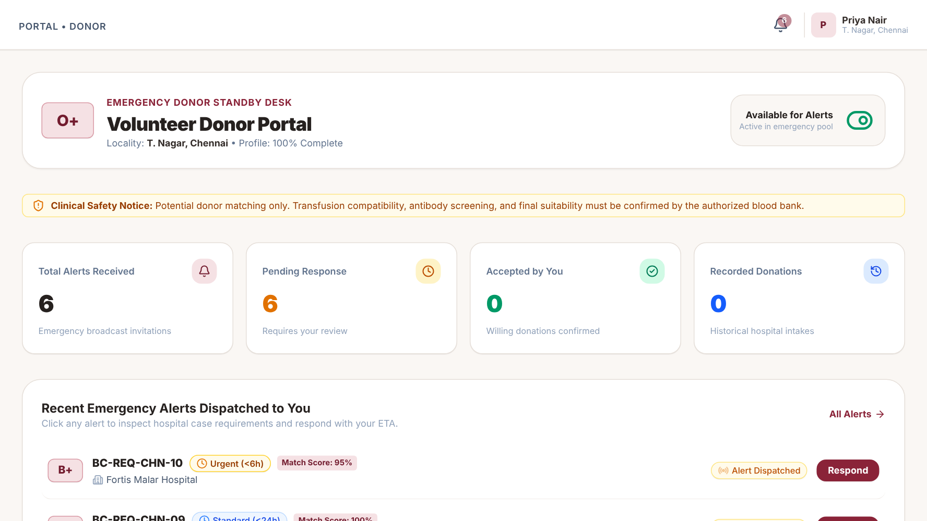
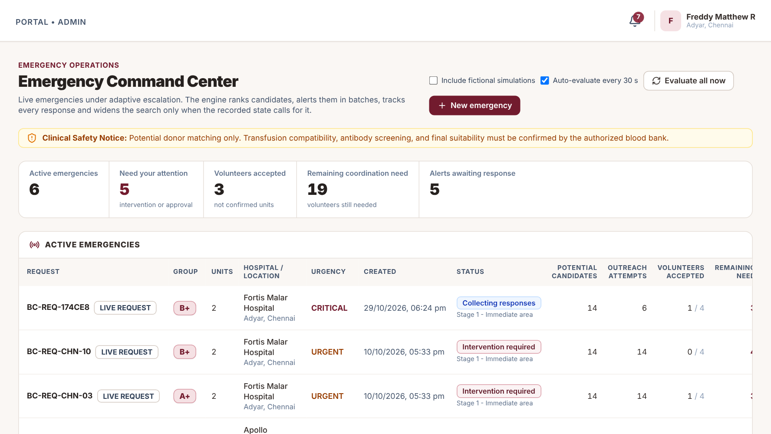
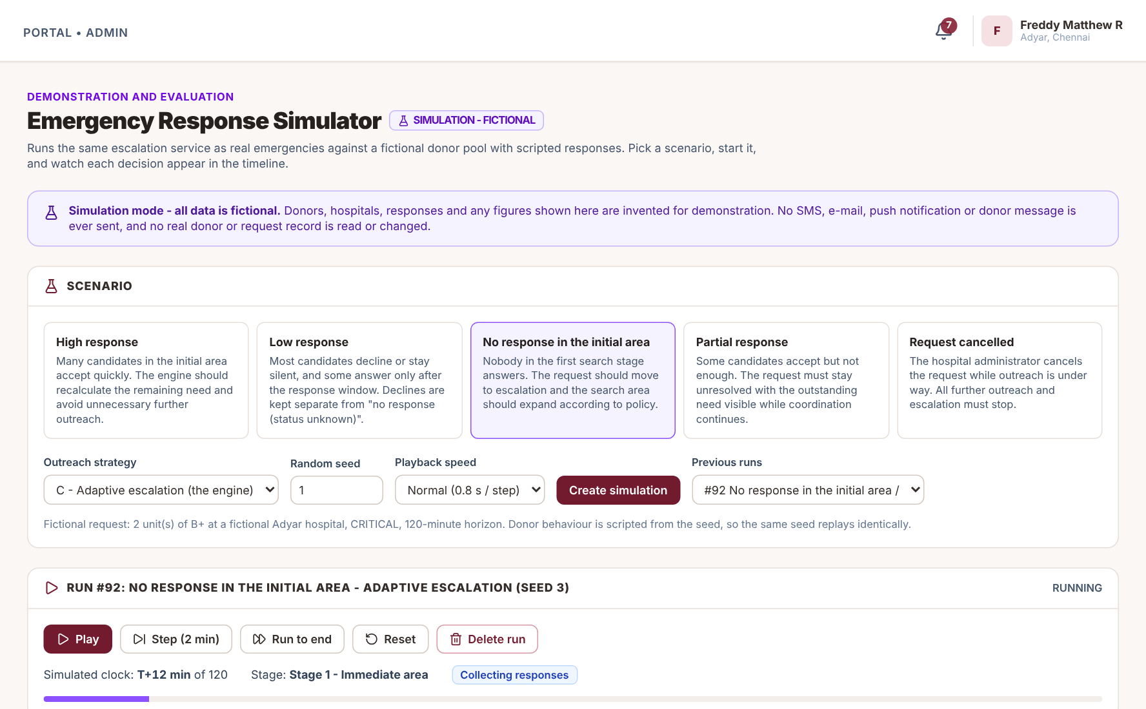
Working prototype
Requester: submit emergency request
Donor: alerts and availability
Admin: Emergency Command Center
Admin: Emergency simulator (fictional donors)

Slide 14
Testing and results
116 / 116
automated backend tests passed: decision rules, engine, API, simulator and parallel-thread concurrency
≈75%
fewer donors alerted than broadcast in the high-response scenario (10.4 vs 41.6), but slower to reach the target (11 vs 3.6 min). A trade-off, not a win on every axis.
5 scenarios × 3 strategies × 5 seeded runs, using scripted fictional donors. Not measured hospital performance or real donation outcomes.

Slide 15




Bill of materials and expected benefits
Bill of materials
Faster donor discovery
Nearest suitable donors are alerted first.
Existing laptop and internet
₹0
VS Code, Git and GitHub
₹0
Less alert fatigue
React, Vite, Tailwind (open source)
₹0
Donors are not spammed once the need is met.
Django, DRF, SQLite (open source)
₹0
Local prototype / free-tier hosting
₹0
Clear visibility
Paid cloud hosting (optional)
₹600–1,500 / month
Live remaining need and blood-bank stock.
Custom domain (optional)
₹800–1,500 / year
SMS / e-mail gateway (future)
Extra, per message
Accountability
Every alert and decision has a recorded reason.
The prototype costs ₹0; costs are estimates for an optional deployment.

Slide 16
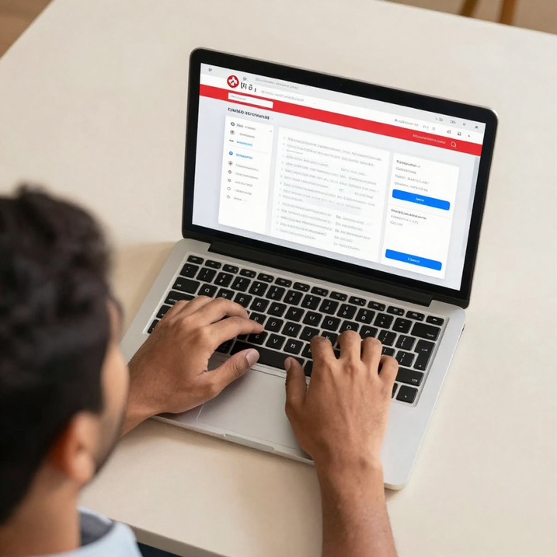
CONCLUSION
One platform. A clearer emergency workflow.
BloodConnect 2.0 turns one-shot alerting into a followed-up, explainable process: verified requests, ranked donors, staged outreach and a live view of the remaining need. It is a coordination aid; clinical suitability stays with the blood bank.
Future scope
SMS / WhatsApp gateway with delivery receipts
Integration with hospital and blood-bank stock systems
Mobile app for donors with push notifications
Scheduler and PostgreSQL deployment
THANK YOU
Every second matters. Every connection counts.

