Slide 1
BLUESTOCK MUTUAL FUND
PORTFOLIO & RISK ANALYTICS
End-to-End Data Engineering & Advanced Financial Modeling
Prepared by: Antigravity AI Engineer
Platform: Python, SQLite Star Schema, Streamlit

Slide 2
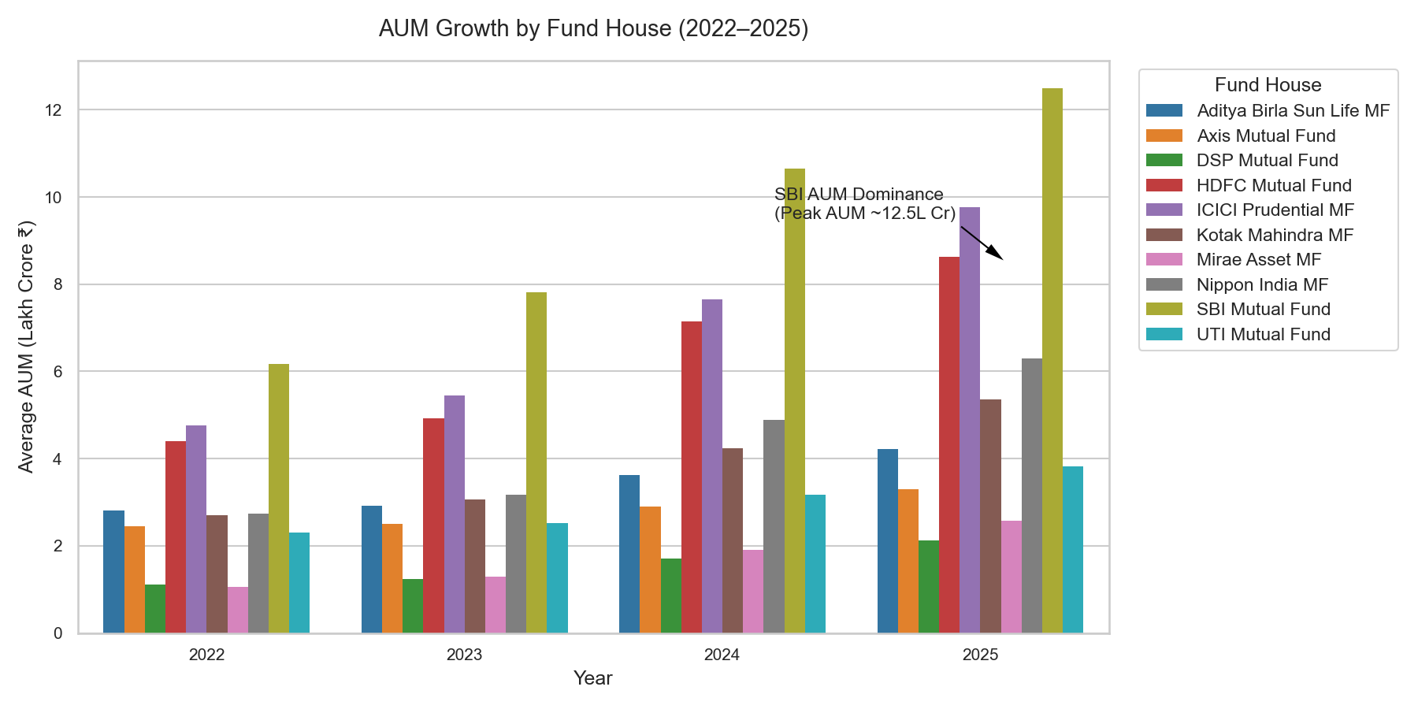
Data Ingestion & Cleaning Pipeline
Ingestion Overview
• Loads 10 raw CSV datasets covering funds, NAV history, inflows, transactions, and holdings.
• Live NAV fetching module retrieves and saves HDFC Top 100 scheme NAV data from API (mfapi.in).
• Cleans NAV history by sorting and forward-filling weekend and holiday gaps to prevent calendar bias.
• Standardizes transaction types (SIP/Lumpsum/Redemption) and cleans KYC enums.
• Verifies 100% referential integrity with AMFI scheme code matches across datasets (Passes validation).
Bluestock Mutual Fund Analytics Capstone | June 2026

Slide 3
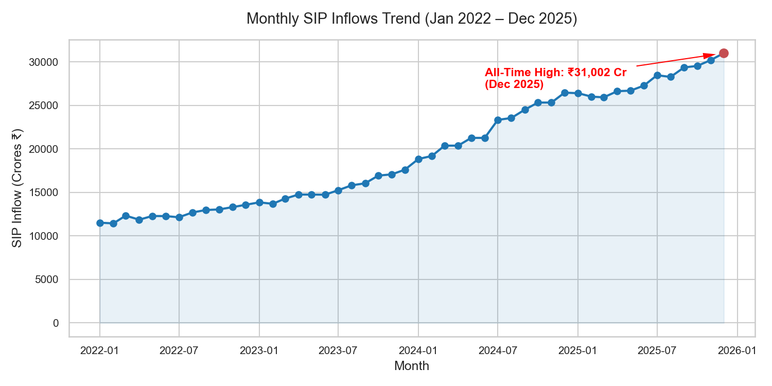
Executive Summary & AUM Concentration
AGGREGATE AUM
INR 10.44L Cr
Cumulative asset scale
ACTIVE FUNDS
40
Monitored mutual funds
TOTAL TRANSACTIONS
32,778
Retail investor trade log count
TRANSACTION VOLUME
INR 352.16 Cr
Retail invested capital
Bluestock Mutual Fund Analytics Capstone | June 2026

Slide 4
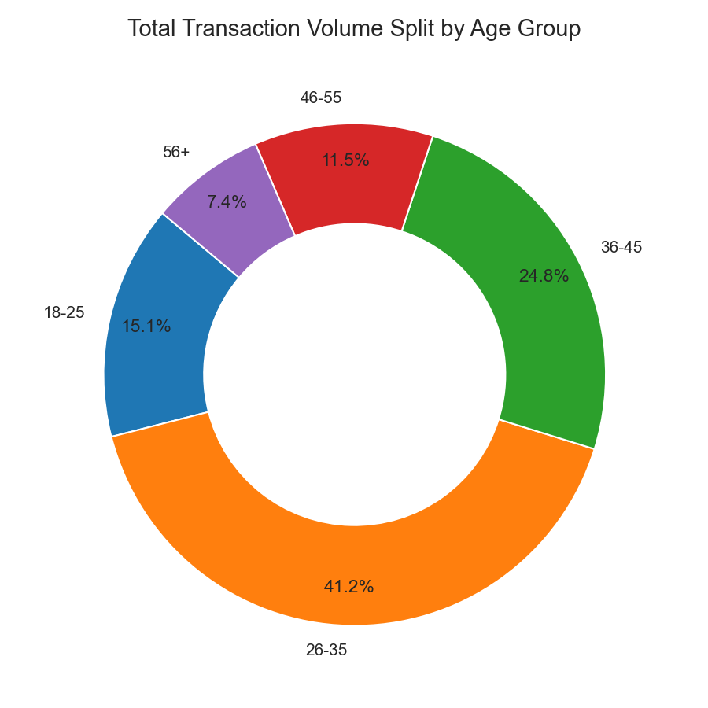
Investor Demographics & Geographic Split
Key Demographic Insights
• Age Group Dominance: Younger cohorts aged 26-35 drive the highest transaction counts (43.8% total volume).
• Geographic Concentration: Maharashtra acts as the primary volume driver, contributing to more than 35% of total capital.
• Tier Split: T30 cities swallow 69.9% of capital, while B30 cities contribute a solid 30.1%, highlighting strong semi-urban penetration.
• Gender Split: Transaction amounts display an active male-skewed distribution, though female-registered folios are rising.
• Preferred Channels: UPI and Net Banking dominate transaction payment modes, highlighting digital platform convenience.
Bluestock Mutual Fund Analytics Capstone | June 2026

Slide 5
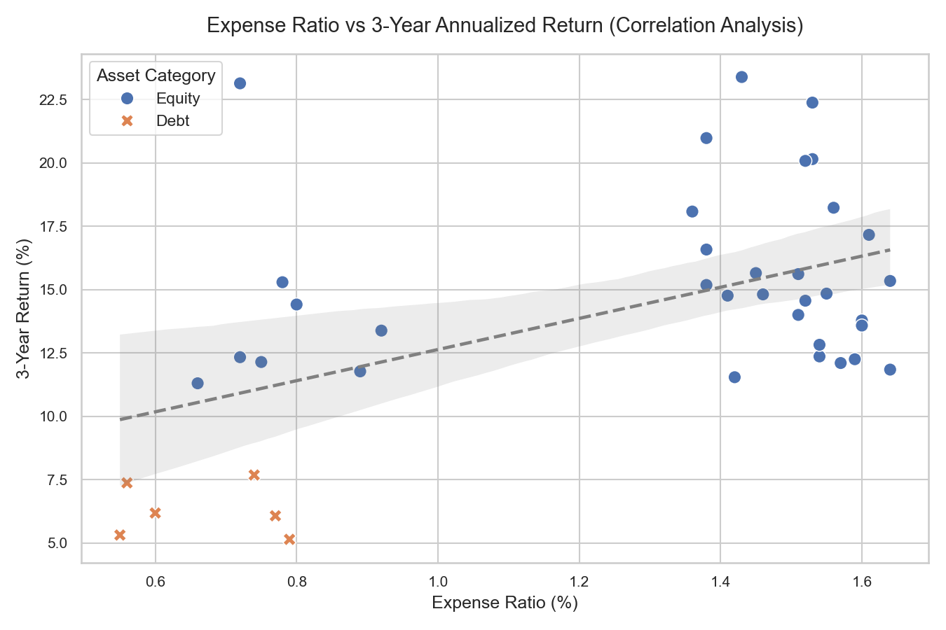
Performance Analytics & Risk Profiling
Mathematical Metrics (252 Trading Days)
We avoid calendar errors by annualizing returns and risk measures based on actual market trading days (252) rather than 365 days.
• CAGR: Annualized compound growth. Used to normalize performance across different lifetimes.
• Sharpe Ratio: Excess return per unit of volatility relative to 6% annual Risk-Free Rate.
• Beta: Evaluates fund return volatility relative to its benchmark index (e.g. Nifty 50).
• Value at Risk (95% Daily VaR): The 5th percentile threshold of returns, mapping maximum expected daily loss.
Bluestock Mutual Fund Analytics Capstone | June 2026

Slide 6
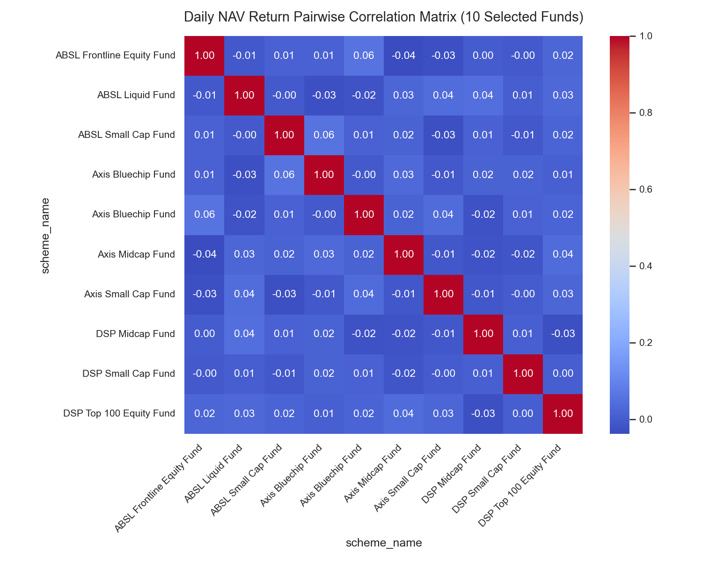
Advanced Analytics: Monte Carlo NAV Projections
Geometric Brownian Motion Projection
• Simulates daily NAV path for SBI Bluechip Fund (119551) over 5 years (1,260 trading days).
• Uses historical mean return drift and volatility standard deviation from daily returns.
• Expected Mean Path projects compounding trajectory based on log-normal asset growth.
• Confidence Bands: Shaded bands outline the 5th and 95th percentile paths, outlining pessimistic and optimistic limits.
• Aides investors in risk planning, showing capital probability limits over long horizons.
Bluestock Mutual Fund Analytics Capstone | June 2026

Slide 7
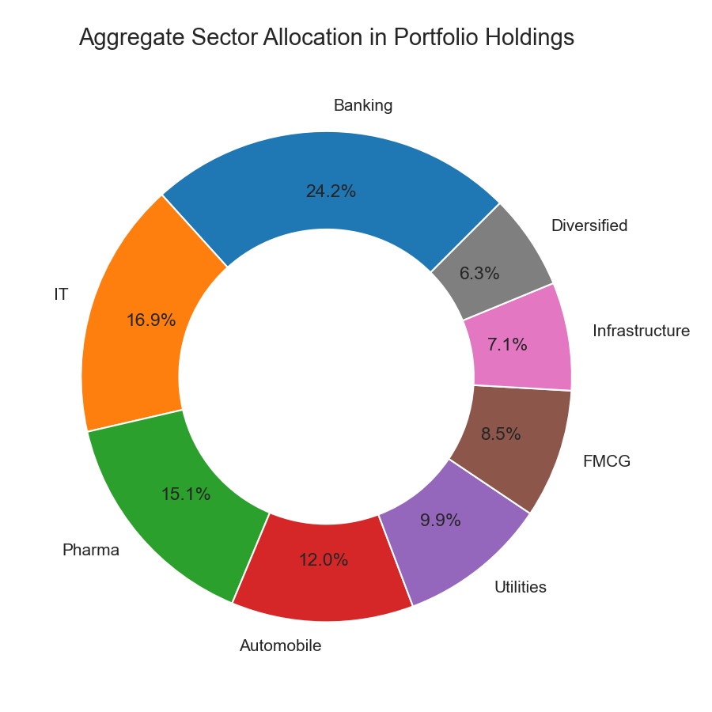
Advanced Analytics: Markowitz Portfolio Optimization
Modern Portfolio Theory (MPT) Application
• Combines 5 key large-cap funds (SBI, ICICI, Nippon, Axis, Kotak) to optimize weights.
• Computes historical daily covariance matrix to evaluate diversification benefits.
• Simulates 10,000 portfolio combinations to map the Markowitz Efficient Frontier curve.
• Maximum Sharpe Ratio Portfolio: Identifies weights that yield the highest risk-adjusted return.
• Minimum Volatility Portfolio: Yields weights that minimize portfolio standard deviation.
Bluestock Mutual Fund Analytics Capstone | June 2026

