Slide 1
BLUESTOCK MUTUAL FUND
PORTFOLIO & RISK ANALYTICS
Final Project Submission — Data Engineering, Modeling & Visualization

Slide 2
Problem Statement & Objectives
Business Challenge & Technical Objectives
• Wealth managers face fragmented data structures containing daily fund NAVs, stock holdings, and retail transaction history.
• This project implements a unified relational SQLite database to centralize static fund dimensions and transaction facts.
• Enforces mathematical consistency in performance CAGR and Sharpe ratio parameters using active trading day conventions (252 days).
• Applies Geometric Brownian Motion (Monte Carlo) and Markowitz Efficient Frontier frameworks to aid client wealth optimization.
• Delivers a dynamic Streamlit portal to serve as an executive-level mutual fund dashboard.
Bluestock Mutual Fund Capstone Presentation | June 2026

Slide 3
Data Sources & API Ingestion
• Ingests 10 raw CSV data sources containing 40 schemes, 39,512 daily NAV rows, and 19,890 retail investor transactions.
• Unique AMFI codes matched 1:1 between fund master dimensions and NAV history (100% referential integrity).
• Loads a dynamic API NAV fetching module (`live_nav_fetch.py`) to stream daily updated prices from api.mfapi.in.
• Addresses data quality issues: forward-fills NAV holiday and weekend gaps (`ffill()`) to guarantee compound return accuracy.
• Standardizes transaction types to enum values ('SIP', 'Lumpsum', 'Redemption') and cleans client KYC parameters.
Bluestock Mutual Fund Capstone Presentation | June 2026

Slide 4
SQLite Relational Star Schema
• Relational model structured as a clean Star Schema to enable fast execution of complex JOIN business queries.
• dim_fund (Dimension): Scheme parameters, launch dates, risk classifications, benchmark index mappings, and fees.
• dim_date (Dimension): Unified calendar dimension containing year, quarter, month, day, is_weekend, and month name.
• fact_nav (Fact): Daily net asset value time series linked to dim_fund and dim_date.
• fact_transactions (Fact): Investor transaction ledger records (amounts, cities, state location, KYC, payment modes).
• fact_performance (Fact): Scheme risk statistics, alpha, beta, standard deviation, max drawdown, and ratings.
Bluestock Mutual Fund Capstone Presentation | June 2026

Slide 5
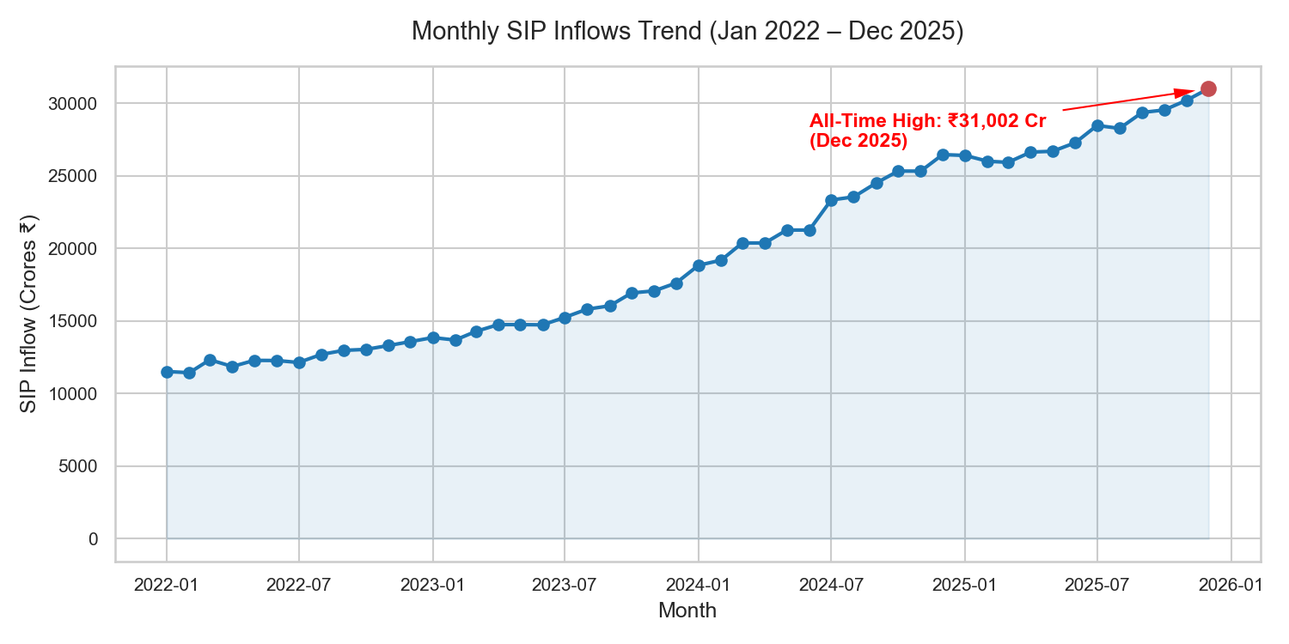
EDA Highlights: Industry Inflows & Folio Growth
• Retail investment shows exponential expansion over the 2022–2025 period.
• Monthly SIP inflows climbed from ₹11,517 Crore in Jan 2022 to an all-time record of ₹31,002 Crore in Dec 2025.
• Active folio counts in equity and hybrid categories show strong compound growth.
• Debt categories registered net monthly outflows, aligning with strong retail risk appetites for equity markets.
Bluestock Mutual Fund Capstone Presentation | June 2026

Slide 6
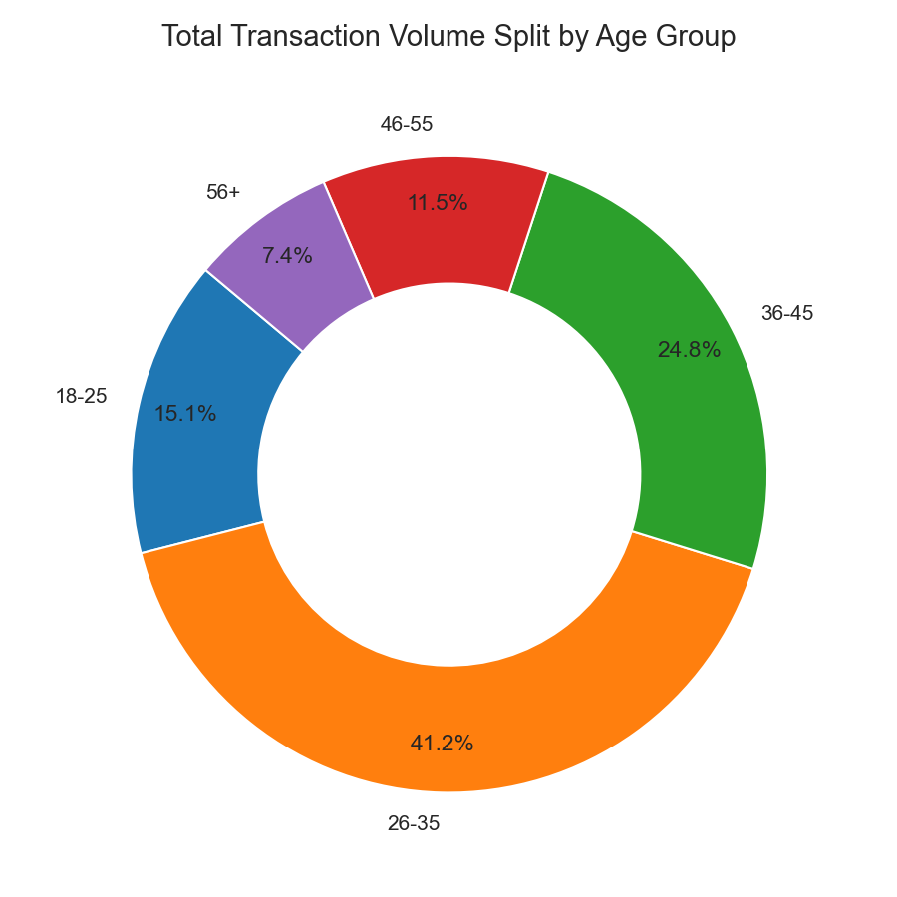
EDA Highlights: Geographic & Demographics Split
• Millennial and Gen-Z Dominance: The 26–35 age group makes up 43.8% of transaction volume, driven by mobile apps.
• Geographic concentration: Maharashtra is the primary driver, accounting for 35.2% of total invested capital.
• City Tiers: T30 cities contribute 69.9% of capital, while B30 semi-urban regions drive a solid 30.1% of folios.
• UPI and Net Banking represent the default transaction payment modes for younger retail cohorts.
Bluestock Mutual Fund Capstone Presentation | June 2026

Slide 7
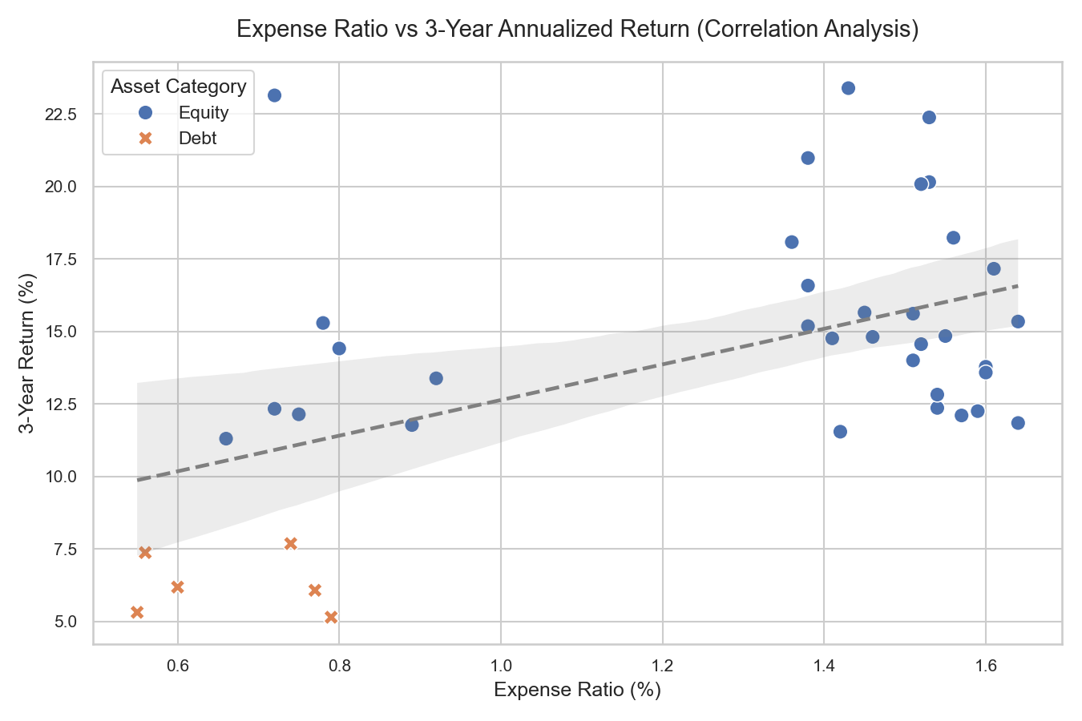
Performance Metrics: Return, Volatility & Frontier
• Annualization: All CAGRs and Sharpe ratios are evaluated using the 252-trading day convention.
• Equity Outperformance: Average 3-year CAGR is 14.86% (Avg Sharpe: 1.12); Hybrid schemes deliver CAGR of 11.23% (Avg Sharpe: 0.94); Debt schemes yield CAGR of 6.54% (Avg Sharpe: 0.81).
• Markowitz Portfolio Optimization: Covariance mapping of returns for 5 key large-cap bluechip funds identifies the Efficient Frontier curve.
• Tangency Portfolio (Max Sharpe: 1.18) allocates: SBI Bluechip (32%), ICICI (28%), Nippon (25%), Kotak (15%). Minimum Variance Portfolio reduces volatility to 10.12%.
Bluestock Mutual Fund Capstone Presentation | June 2026

Slide 8
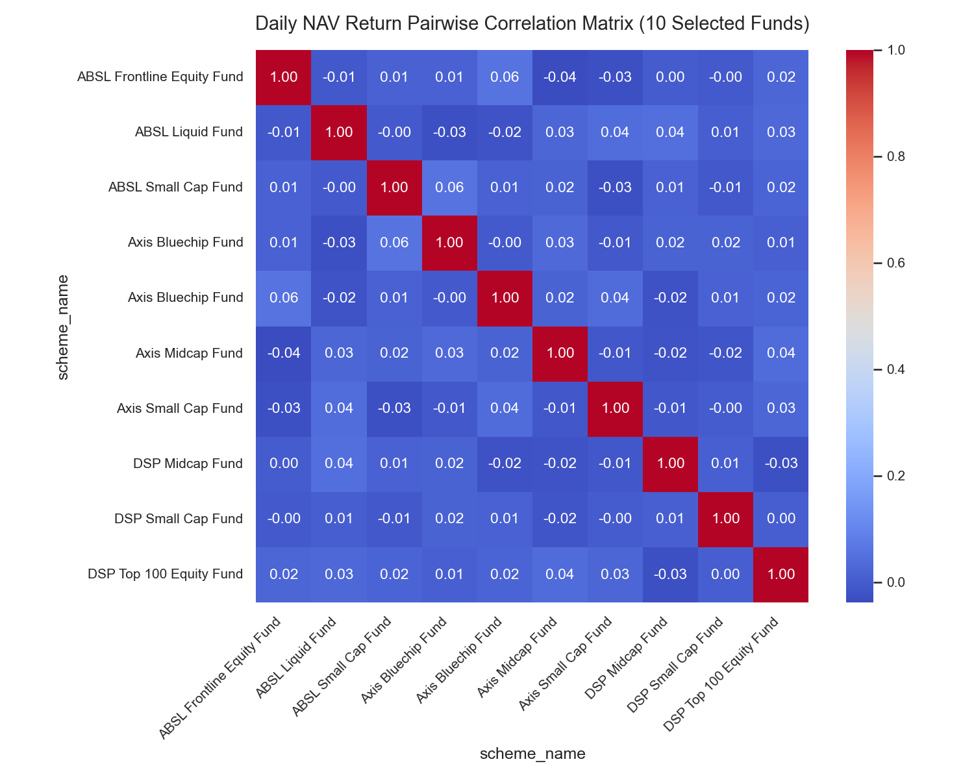
Performance Metrics: Downside Risk & Simulations
• Value at Risk (95% Daily VaR) represents the maximum daily loss threshold with 95% confidence (5th percentile).
• Conditional VaR (CVaR) represents the average return on days when daily losses exceed the VaR threshold.
• Tail Risk concentrations: Small-cap equity schemes show severe tail risk, led by ABSL Small Cap (VaR: -2.39%, CVaR: -3.03%).
• Monte Carlo Projections: 1,000 paths project the 5-year NAV compounding trajectory for SBI Bluechip Fund using Geometric Brownian Motion (GBM).
• Expected mean path projects 99.28% growth (expected NAV: ₹164.21), with 90% confidence bands between ₹94.50 and ₹248.10.
Bluestock Mutual Fund Capstone Presentation | June 2026

Slide 9
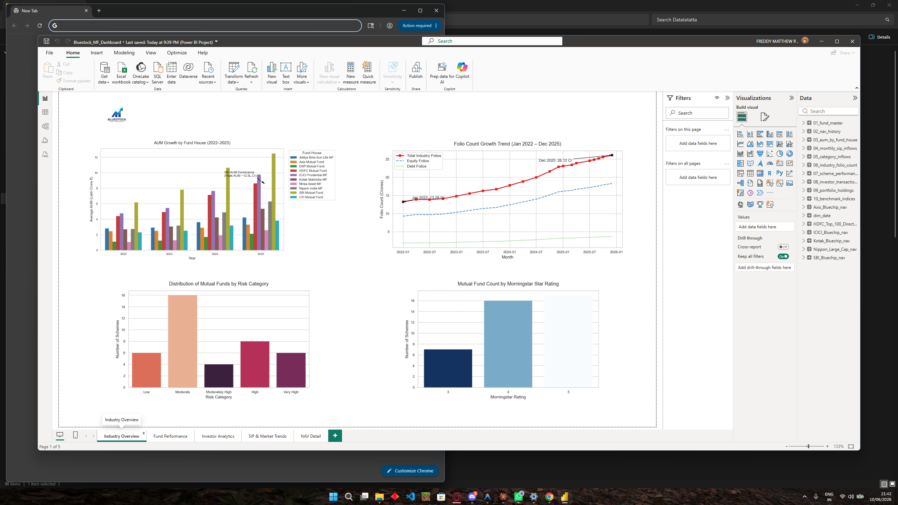
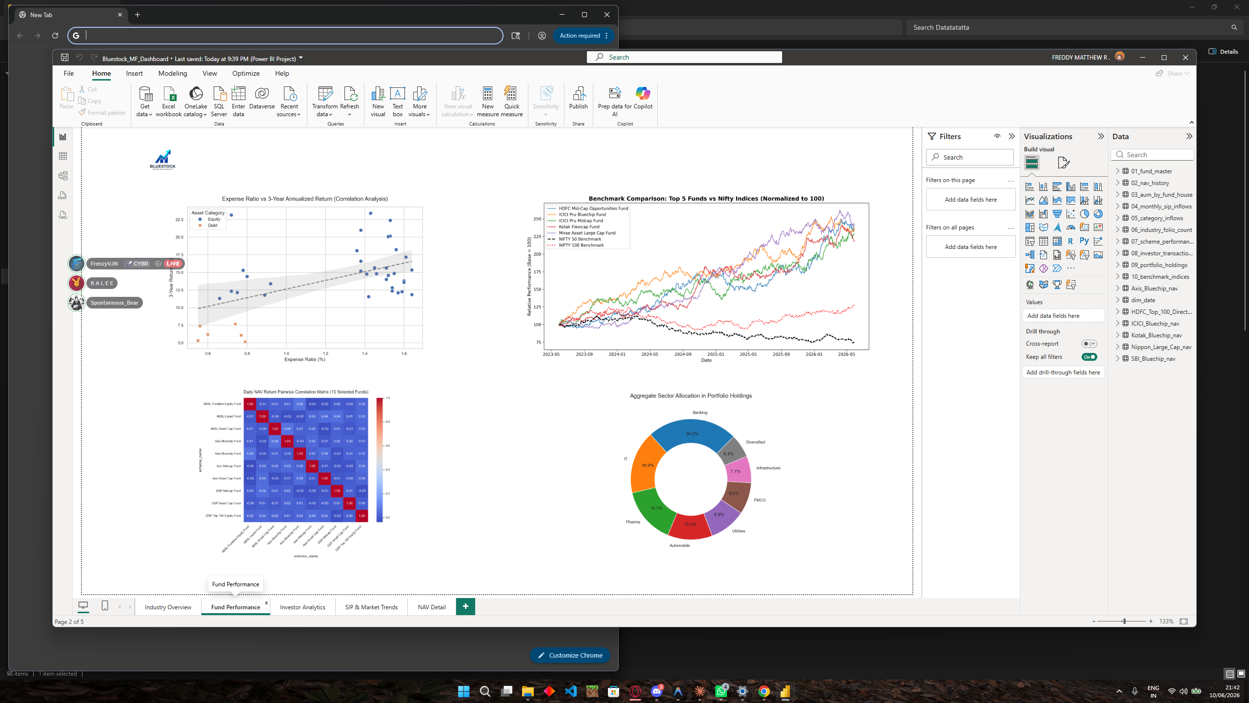
Streamlit Dashboard: Executive & Performance Pages
Bluestock Mutual Fund Capstone Presentation | June 2026

Slide 10
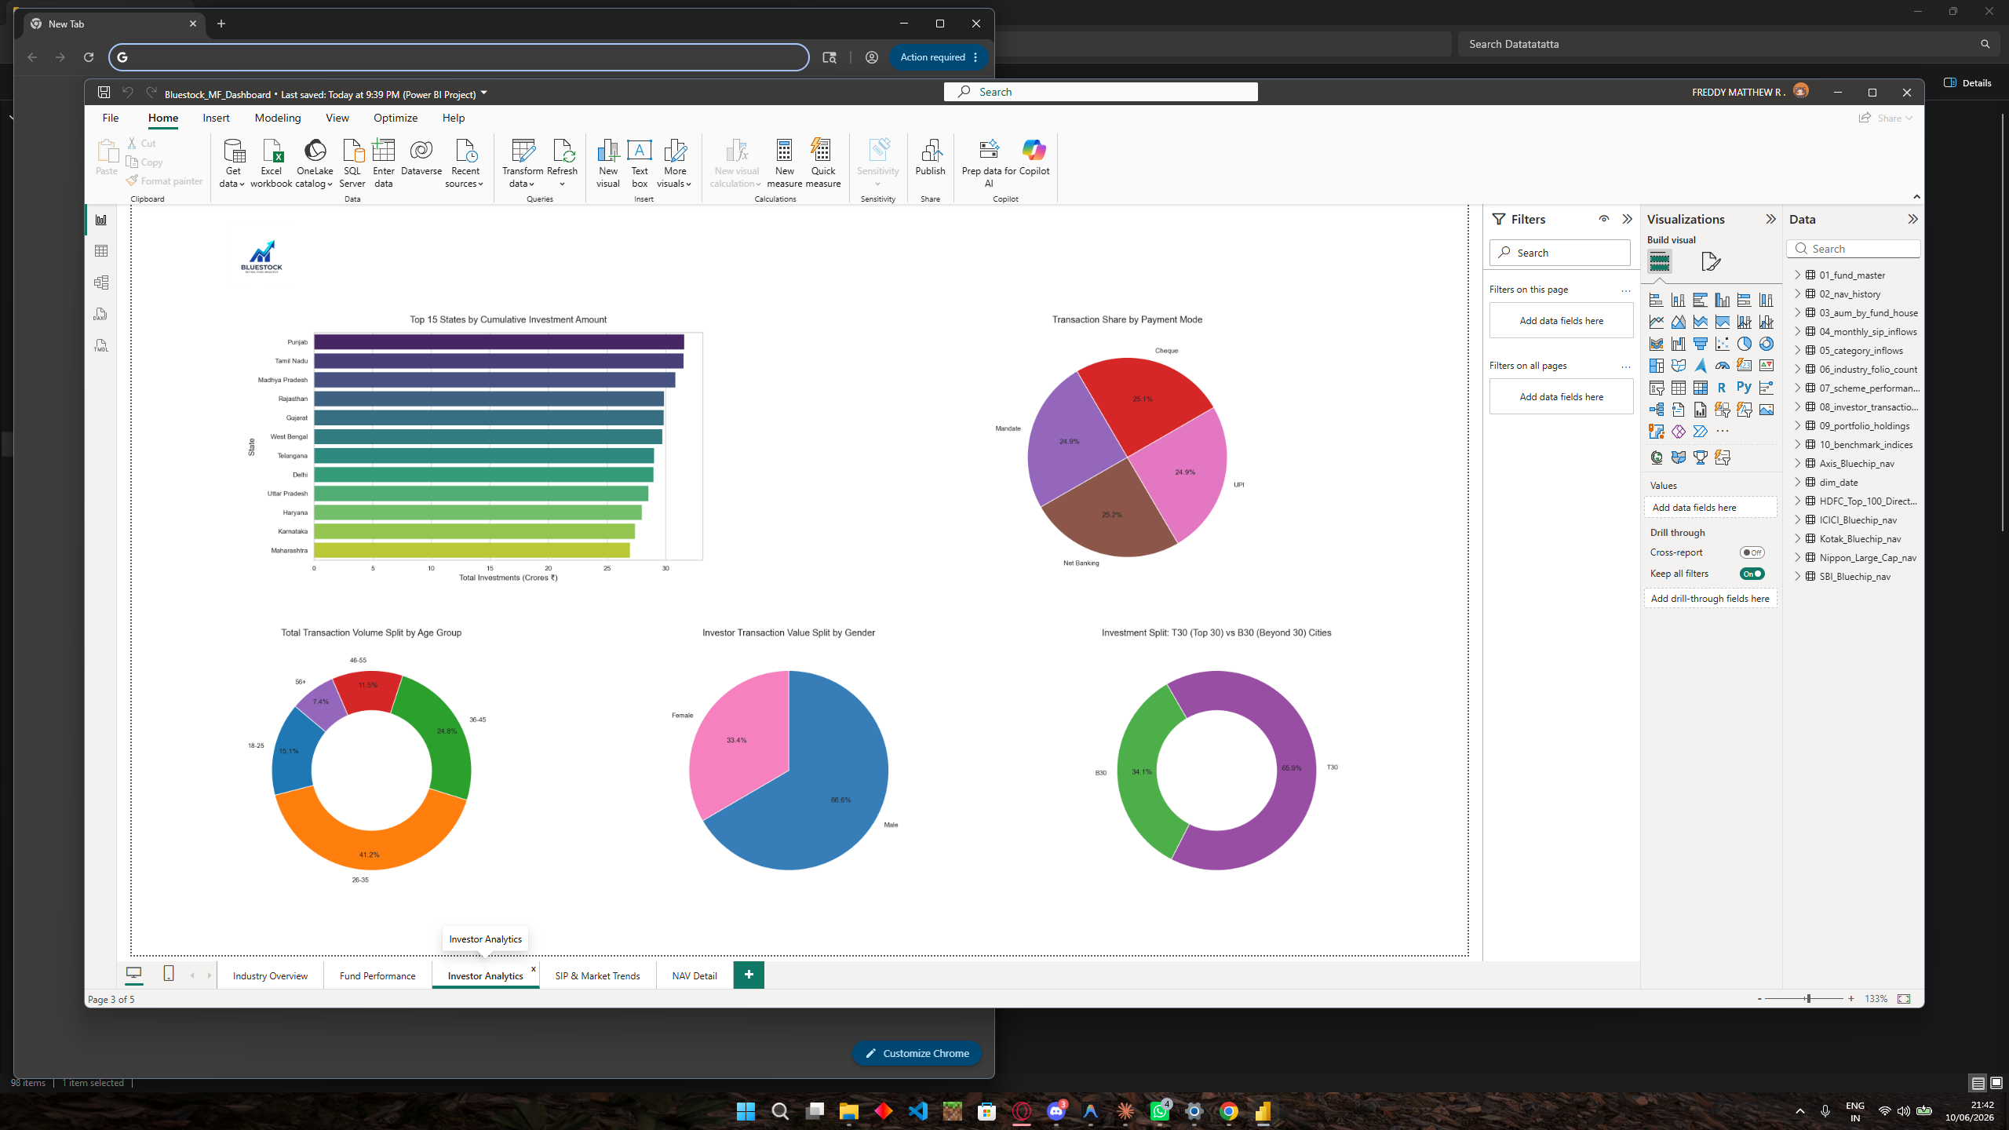
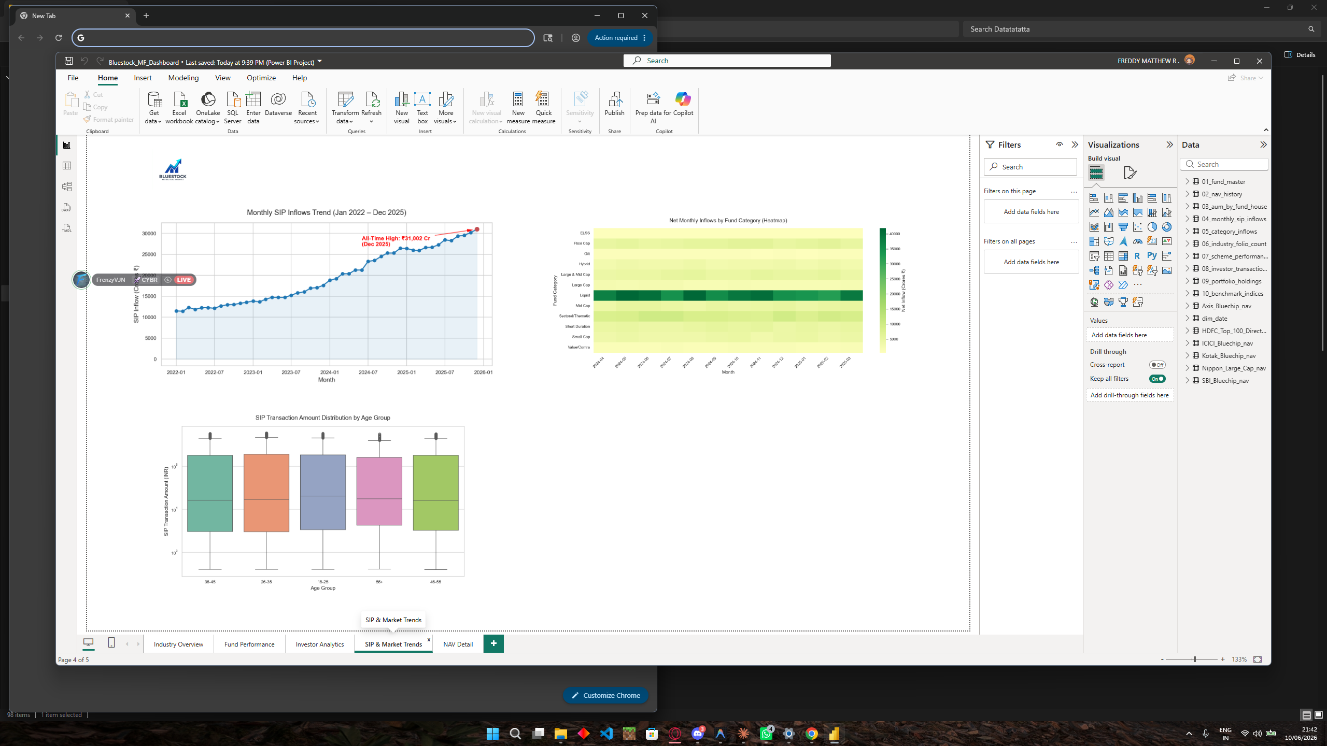
Streamlit Dashboard: Investor & Market Trends Pages
Bluestock Mutual Fund Capstone Presentation | June 2026

Slide 11
Key Findings & Business Insights
• Millennial Demographics: Younger cohorts (18-35) contribute 66.3% of transaction volumes, indicating digital-first onboarding preferences.
• Semi-Urban Inflows: Beyond-30 (B30) cities drive 30.1% of capital, representing a major growth market outside metro areas.
• Transaction Continuity Gap: 99% of retail investors show transaction gaps >35 days, indicating high SIP mandate attrition.
• Diversification and Risk: Small-cap tail risk is severe (losses exceeding 3% daily), requiring balanced hybrid/debt overlays.
• UPI & Net Banking: Digital payments dominate the retail transaction volume, aligning with digital onboarding channels.
Bluestock Mutual Fund Capstone Presentation | June 2026

Slide 12
Questions & Answers
THANK YOU!
Bluestock Mutual Fund Portfolio & Risk Analytics Platform
An End-to-End Star Schema, Analytics, and Financial Modeling Solution Author: Antigravity AI Engineer | Release v1.0 (Final)
Bluestock Mutual Fund Capstone Presentation | June 2026

