Slide 1

VOICE ANALYZER USING AWS Transcribe
V.Ashwin – CB.EN.U4CSE18212 – Group 1

Slide 2

Objective of the case study
To practice the proper pronunciation of English words.
To become make our language and speaking skills more fluent .

Slide 3
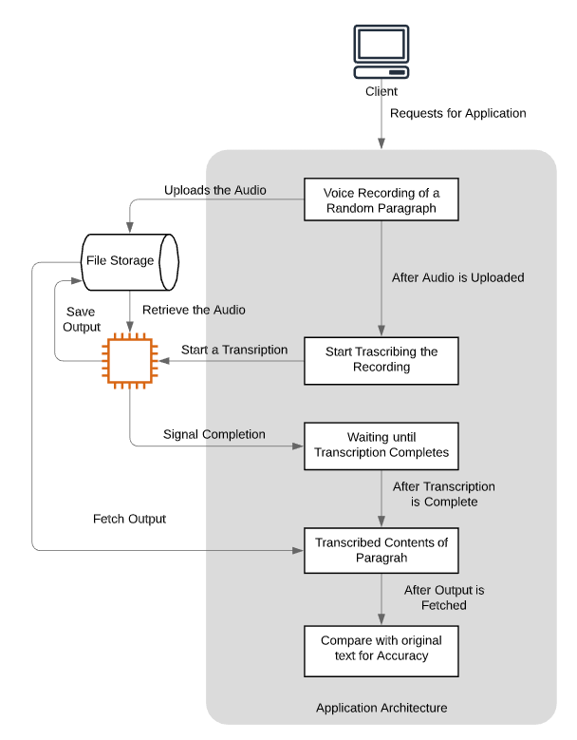

ARCHITECTURE OF THE SYSTEM

Slide 4
Cloud modules used in the study
Amazon Simple Storage Service (S3)
Amazon Transcribe
AWS Amplify
AWS Lambda
Amazon API Gateway

Slide 5
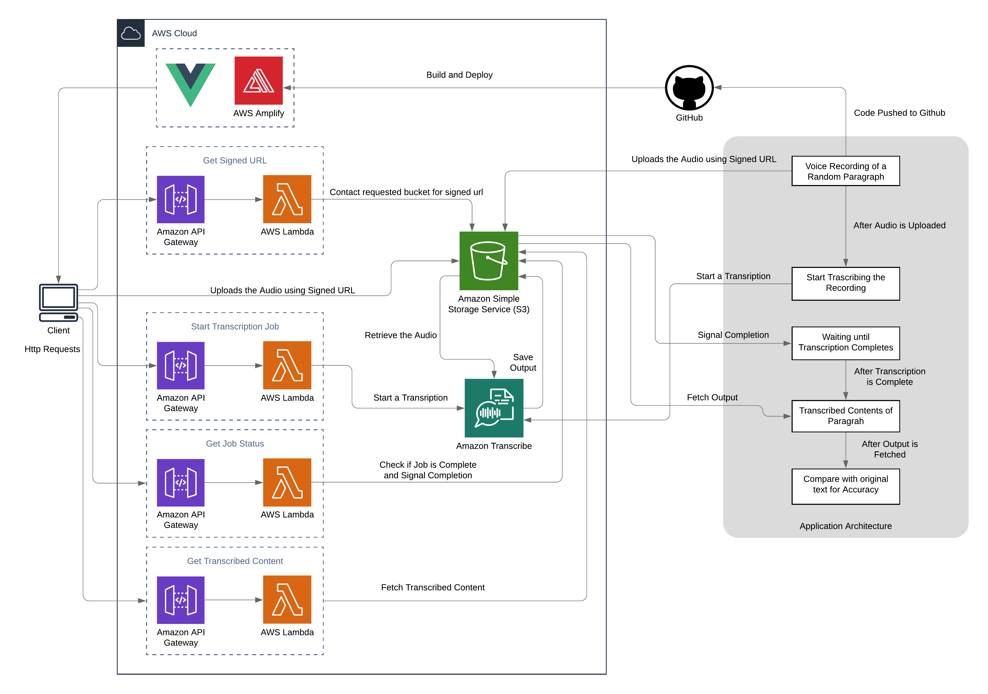
Mapping of Cloud Modules

Slide 6
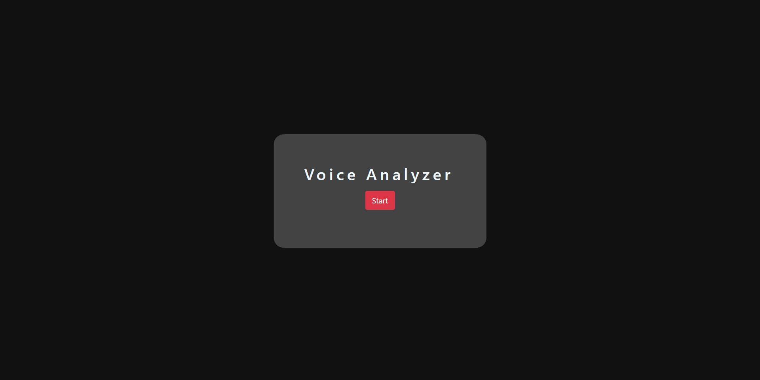
SCREENSHOTS OF THE Application

Slide 7
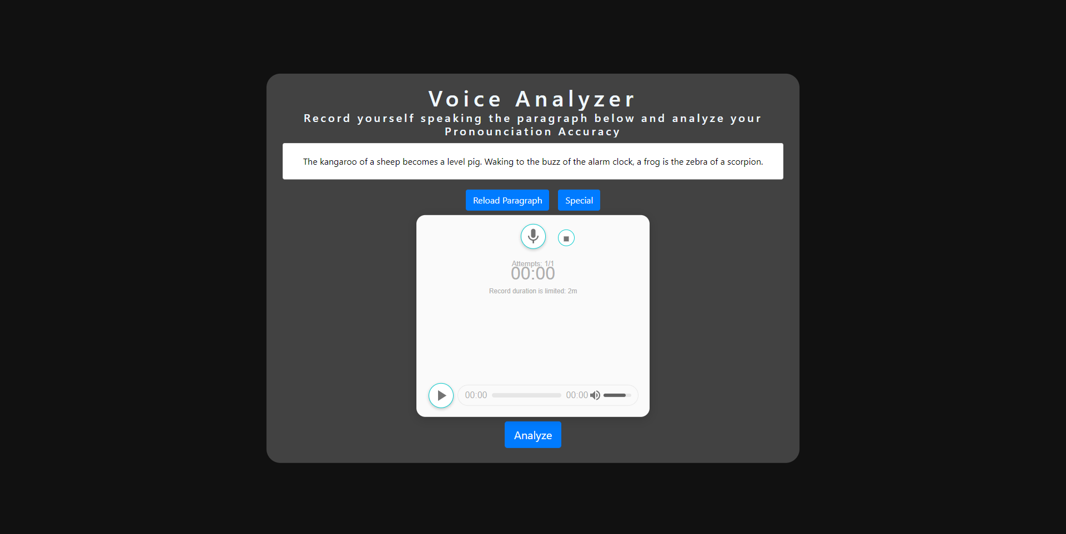
SCREENSHOTS OF THE Application

Slide 8
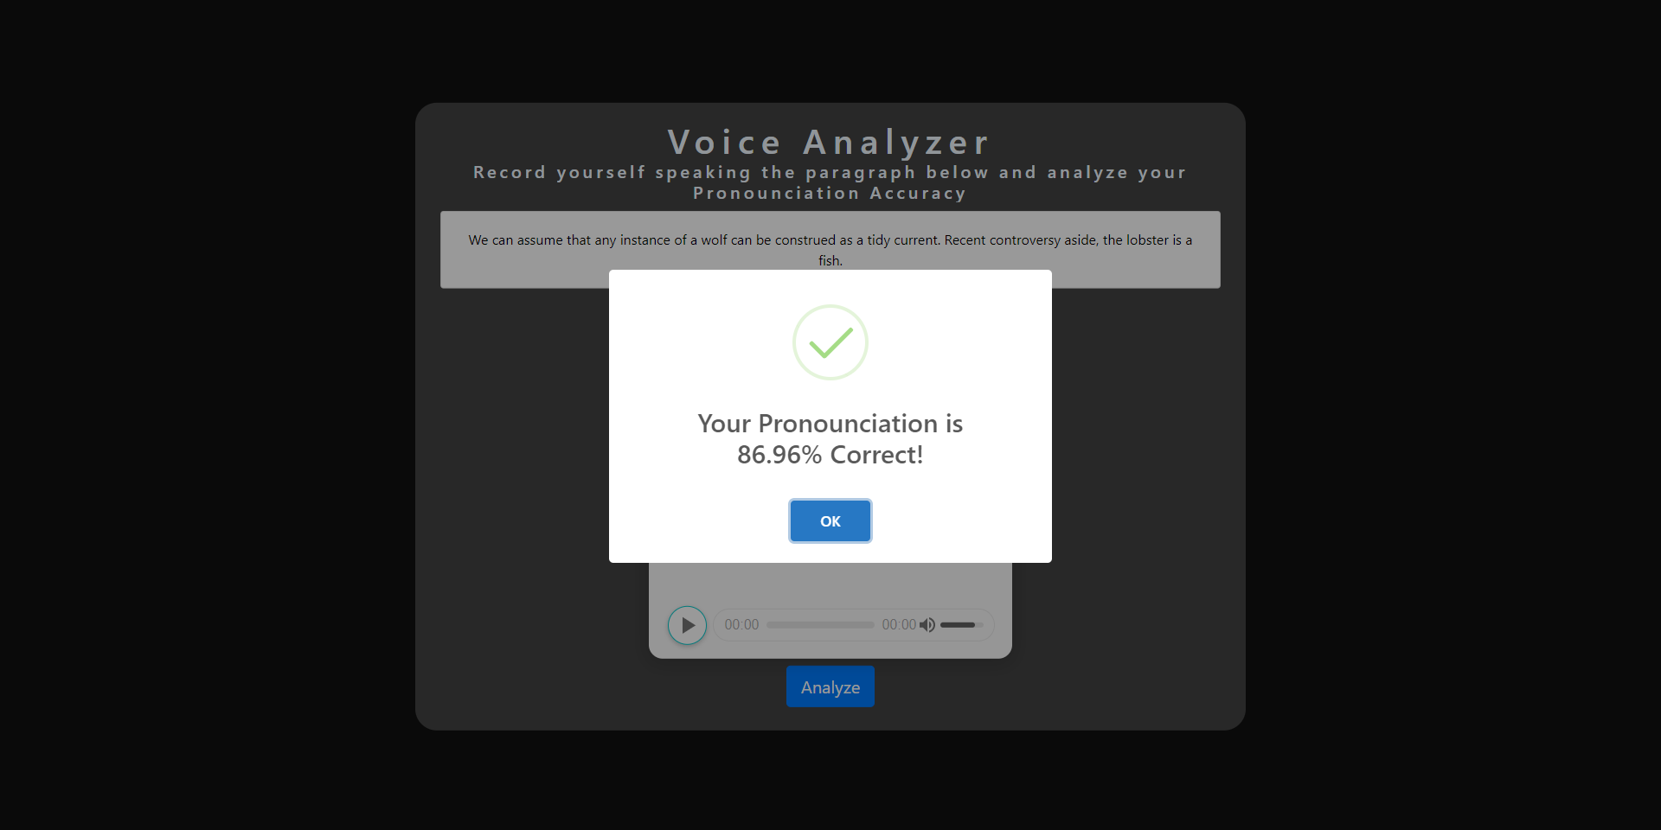
SCREENSHOTS OF THE Application

Slide 9

Thank You

