Slide 1


Introducing StackNet Meta-Modelling Framework
Marios Michaildis
Research Data Scientist at Email: marios@h2o.ai

Slide 2

What is StackNet (methodology)?
StackNet is…
A scalable meta modelling methodology that
utilizes Wolpert’s stacked generalization (1992) of combining multiple models assuming
a feedforward neural network architecture of multiple levels
Each node represents a machine learning algorithm
A version of it with several algorithms is available in Java
Supervisors:
Prof. Philip Treleaven
Giles Pavey

Slide 3

Why bother learning more about StackNet?
It helps to improve predictions given the same input data
Its is educational in its own way, especially in understanding Stacking.
Compiles the pinnacle of machine learning into one framework-and-library.
Has won 2 kaggle competitions (link A and Link B)
Has helped many people get top 10 results in kaggle.
It has helped me become kaggle #1

Slide 4
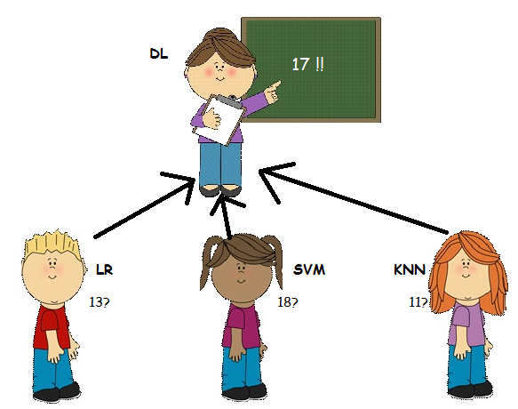
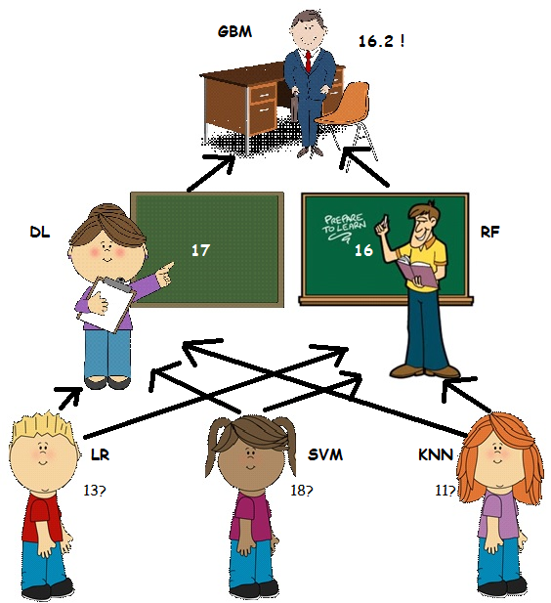
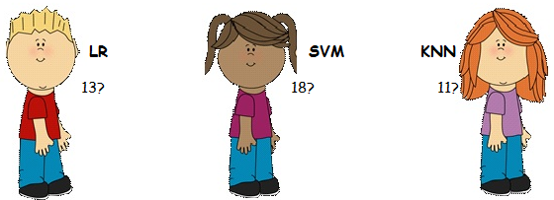
Why meta modelling?

Slide 5
Inspiration - Stacking
Wolpert in 1992 introduced stacking – a Meta-modelling technique.
Split the training set into two disjoint sets.
Train several base learners on the first part.
Make predictions with the base learners on the second part.
Using the predictions from (3) as the inputs, and the correct responses as the outputs, train a higher level learner.

Slide 6

Still confused about Stacking?
Train algorithm 0 on A and make predictions for B and C and save to B1, C1
Train algorithm 1 on A and make predictions for B and C and save to B1, C1
Train algorithm 2 on A and make predictions for B and C and save to B1, C1
Consider datasets A,B,C. Target variable (y) is known for A,B
Train algorithm 3 on B1 and make predictions for C1

Slide 7
Inspiration – Neural Networks
Artificial networks were first created in an attempt to mimic the biological neural networks in the human Brain. [ Rosenblatt ,1958] was the first to create – the perceptron.
The advances in computing power and specifically the usages of GPUs has allowed them to be run at greater speeds in comlex structures taking the form of today’s deep learning [Schmidhuber, 2015] .
Their structure is considered state-of-the-art for many tasks

Slide 8

Inspiration – Why Java
is less verbose than C and very popular
Can be used in any operational system
Almost every computer/device has it by default
Statically typed and better defined
Java Does not have Scikit-learn!

Slide 9
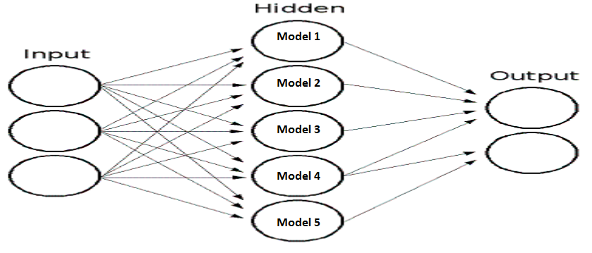
Available Algorithms
1st batch of models includes
Linear Regression
Logistic regression
Kernel models
K nearest neighbours
GBMs
Naïve Bayes
LibFm
Multilayer Perceptron
Decision trees
Random Forests
2nd batch of models includes
H2O
Xgboost
LIGHTgbm
Sklearn
Keras
Fast_Rgf

Slide 10
How it works - General
In a neural network , every node is a simple linear model (like linear regression) maybe with some non linear transformation.
Instead of a linear model , StackNet proposes any modelling function.
In other words:

Slide 11
Training – Reusable Holdout
Limited data based on which multiple models must be built on , enhances the notion of a re-usable holdout
It uses stratified k-folding – which is a hyper parameter.

Slide 12
Training - Modes
The training process is a straight one-pass. There is no notion of re-optimizing in multiple epochs. Convergence needs to reached within that 1 epoch.

Slide 13
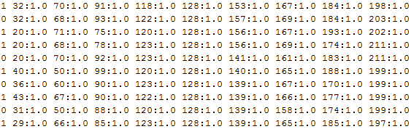
Command Line parameters
Target variable
Command | Explanation
sparse | True if the data to be imported are in sparse format (libsvm)
has_head | True if train_file and test_file have headers else false
model | Name of the output model file.
pred_file | Name of the output prediction file.
train_file | Name of the training file.
test_file | Name of the test file.
test_target | True if the test file has a target variable in the beginning
params | Parameter file where each line is a model.
verbose | True if we need StackNet to output its progress else false
threads | Number of models to run in parallel.
metric | Logloss, Rmse, accuracy or auc (for binary only)
stackdata | True for restacking else false
seed | Integer for randomised procedures
folds | Number of folds for re-usable kfold
Java –jar stacknet.jar
train task=classification
sparse=false
model=model.mod
pred_file=pred.csv
train_file=sample_train.csv
test_file=sample_test.csv
params=params.txt
verbose=true
threads=3
metric=logloss
Input data
Sample Parameter’s File
LogisticRegression Type:Liblinear C:2.0 threads:1 usescale:True
GradientBoostingForestClassifier estimators:300 shrinkage:0.10 max_depth:6 max_features:0.5
RandomForestClassifier estimators:300 threads:5 max_depth:16 max_features:0.25
RandomForestClassifier estimators:1500 max_depth:7 max_features:0.2 min_leaf:1.0

Slide 14
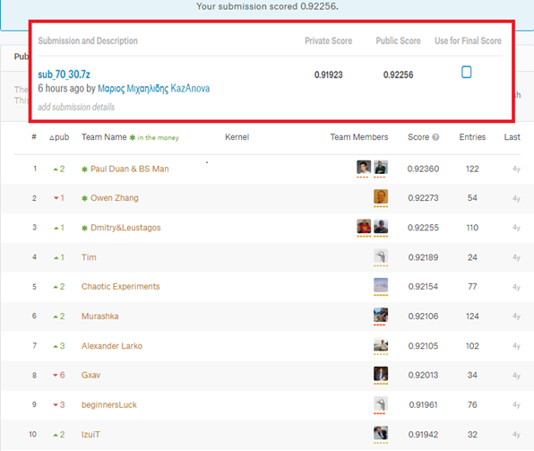

Top 10 example Using StackNet for amazon classification challenge
Popular competition - kaggle in 2013 (my first competition).
Only 9 columns (8 unique variables and 1 duplicate).
high cardinality – thousands of unique values.
90K rows combined for train and test.
Scope: determine an employee's access needs.
Metric to optimize was AUC(or Area Under Curve).
competition: https://www.kaggle.com/c/amazon-employee-access-challenge
Tutorial: https://github.com/kaz-Anova/StackNet/blob/master/example/example_amazon/EXAMPLE.MD

Slide 15
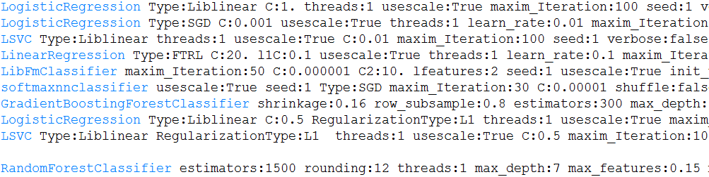
Parameters’ File
Many models
Diverse models
At least one representative of common model families. Model families defined as:
Linear models, Radnom Forests, Gbms, Factorizations, svms, nns
Having good (hyper)parameters for each model

Slide 16
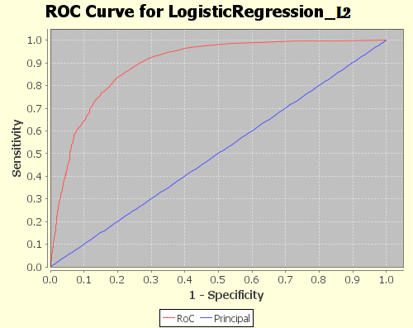
Results in Graphical format
LogisticRegression_L2
LogisticRegression_L2_SGD
LSVC_L2
LinearRegression
LibFmClassifier
Random Forest
softmaxnnclassifier
AUC : 0.901 (+0.08)
GradientBoostingClassifier
LogisticRegression_L1
LSVC_L1
Best AUC : 0.893

Slide 17
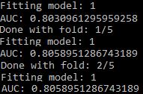
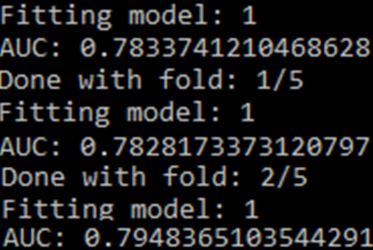
Finding good parameters vol 1
RandomForestClassifier estimators:100 max_depth:5
RandomForestClassifier estimators:100 max_depth:6
GradientBoostingForestClassifier estimators:100
LogisticRegression C:0.5

Slide 18
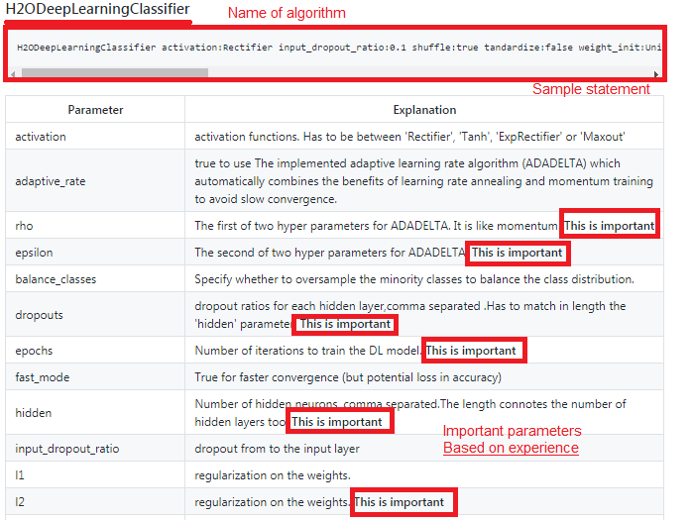
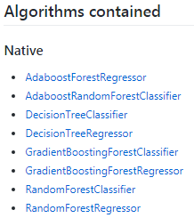
Finding good parameters vol 2
How to know which parameters to tune?
Fin list of current available algorithms: https://github.com/kaz-Anova/StackNet#algorithms-contained
Click on the name or go to https://github.com/kaz-Anova/StackNet/blob/master/parameters/PARAMETERS.MD#[Your_estimators_name]
For example for deep learning try: https://github.com/kaz-Anova/StackNet/blob/master/parameters/PARAMETERS.MD#h2odeeplearningclassifier
There you can find a statement for StackNet as well as the most important parameters.

Slide 19
Important elements for StackNet
Having diverse models
Having good (hyper)parameters for each model
Having good features
Avoid temporal elements
Avoid small data – StackNet is a Big Data tool

Slide 20
Useful Links and resources
Github repository: https://github.com/kaz-Anova/StackNet .
Facebook page : https://www.facebook.com/StackNet/ .
Search “StackNet examples” on google for various resources.
General blog about StackNet .
General information on Stacking with H2O .
Blog on StackNet winning a kaggle challenge .

Slide 21

Any questions

