Slide 1
GitHub Analytics

Slide 2
Agenda
Problem Statement
Existing Process & Limitations
Objectives
GitHub Apps
Solution Architecture
Quality Metrics
Demo

Slide 3
Problem Statement
A large number of organizations are using GitHub as their primary source for collaborative development
There is a good amount of metadata generated as part of any operations which are performed in the GitHub
A new branch is created in the repository – CREATE event
A new pull request is created - PULL_REQUEST event
Can be used to improve the quality of the cloud delivery process
Proper ways for extracting this metadata
Derive useful information from the metadata

Slide 4
Existing Process & Limitations
Manual process of collecting metadata from GitHub
Available alternative solutions : active monitoring of the data:
Active monitoring require user to query the GitHub APIs to fetch the data, It involves:
A lot of data transfer
Good amount of processing on the server side
Data is fetched in a scheduled manner during fixed time periods. Hence the real-time data is not used for the analytics. The fetched data is already old
Users need to fetch the complete set of data every time

Slide 5
Objectives
Data Extraction - Passive data extraction using GitHub Webhooks
Creation of GitHub App with the required configurations for the data extraction
Installation of the GitHub App in the target organizations
Passive data extraction via GitHub Webhooks
Data analysis – Data analysis and generation of meaningful insights
State of open PRs
Inactive branches in a repository
Quality of the PR reviews
Ownership of different modules
Stability of the pipeline
Persistence of the useful data
Defining SQL Views to fetch aggregated results from the bulk data at run time
Cleanup of unused data
Visualization - This feature allows the users to view the derived information using graphs and tables in a centralized UI
Plotting various graphs and table to make best sense out of the available information

Slide 6
GitHub Apps
Modern way for third party application or users to integrate with GitHub via the api (i.e. building integrations on top of GitHub)
Benefits of GitHub Apps
The best way for third parties to act autonomously on protected GitHub resources
Improved security model - Tokens expire for additional security
Dedicated rate limits
Supported by rich ecosystem of libraries and tools
Granular permissions
Singular WebHook for all events (across different organizations and repositories)
Grantable on individual resources (e.g., giving access to only one repo in the organization)
Better insights to user identity

Slide 7
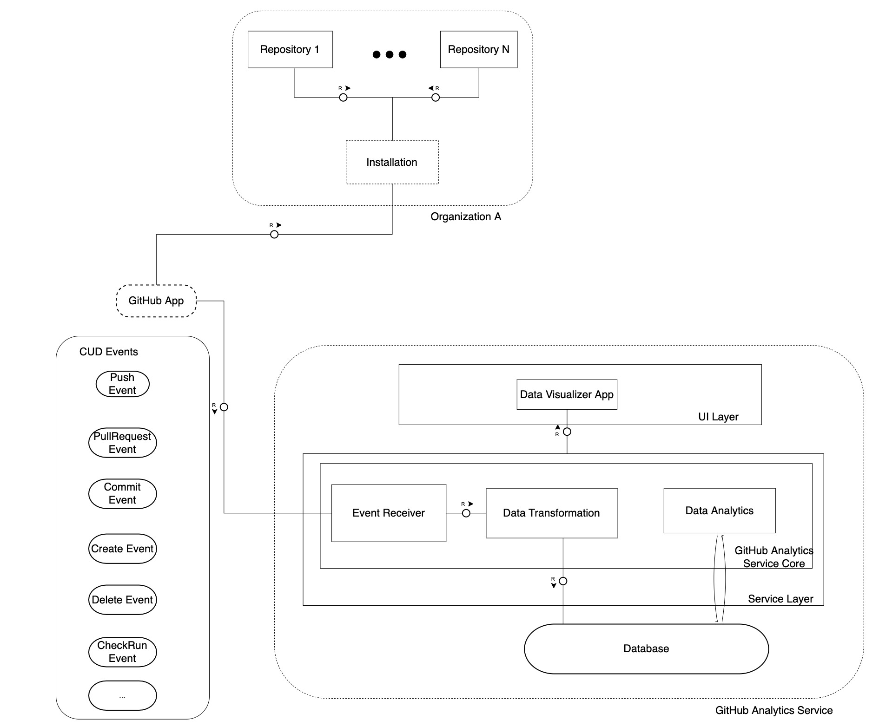
Solution Architecture

Slide 8
Quality Metrics

Slide 9
Demo

