Slide 1

MURROR · CODEPET
BRAND GUIDELINES · v1.0 · APRIL 2026
Brand
Guidelines.
A working reference for the Codepet brand system.
Logo, color, typography, voice, and character standards.
For internal teams, partners, and external collaborators.
CODEPET · BRAND GUIDELINES v1.0
01 / 13

Slide 2
01
THE BRAND AT A GLANCE
An AI coding companion built for sustained practice.
8
AI companions
16
Coding skills
Codepet is a macOS application that helps people develop their thinking and ship products of their own. Guided agentic coding, adaptive feedback, and a daily-practice loop turn early exposure to programming into durable skill. Built and maintained by MURROR.
4
Learning domains
1
macOS application
CODEPET · BRAND GUIDELINES v1.0
01 · AT A GLANCE
02 / 13

Slide 3
02
WHY WE EXIST
Mission, vision, aim.
What Codepet is for, where it is going, and what we want for every user.
MISSION
VISION
AIM
Train people
to build real
software with AI.
The most intelligent
and engaging AI
for building apps.
Ship real products.
Learn from
every build.
Go beyond tutorials. Coach every learner through project work — from first line of code to a shipped product.
The go-to AI training platform for people who want to develop their thinking and ship intelligent, original products.
Users build and deliver their own products, with lessons personalized to the project in front of them.
CODEPET · BRAND GUIDELINES v1.0
02 · MISSION · VISION · AIM
03 / 13

Slide 4
03
BRAND VALUES
Values.
What Codepet stands for, written plainly.
Innovation.
We push past templates and tutorials. Approaching problems from new angles so people ship products with AI — faster and better, in a fraction of the time.
Creativity.
We exist so people can make things that didn't exist before. Every session is a chance to turn an idea into a running product of one's own.
Approachability.
No matter your age or where you're starting — bring an idea, and we'll go from zero to a real, shipped product together.
CODEPET · BRAND GUIDELINES v1.0
03 · BRAND VALUES
04 / 13

Slide 5

04
LOGO SYSTEM
Logo system.
The primary mark is a pixel-art C on a white square. The wordmark is reserved for dark surfaces.
CLEAR SPACE & SCALE
Clear space At least 1× the logo height on every side. Minimum size 32 px (digital) / 0.4 in (print). Rendering Always nearest-neighbor. Never bilinear, bicubic, or anti-aliased — it destroys the pixel grid.
PRIMARY MARK
WORDMARK · DARK SURFACE
CODEPET · BRAND GUIDELINES v1.0
04 · LOGO
05 / 13

Slide 6
05
COLOR · THE CORE
From the logo.
Codepet Purple is the only primary. Everything starts with the mark.
THE LOGOMARK
THE CORE
ONE PRIMARY
Codepet
Purple.
Everything comes
back to purple.
The Codepet brand runs on a single purple — the one drawn into the logomark itself. Use it for buttons, CTAs, links, headlines, and any moment the brand signs its name.
Deep Violet (#534AB7) is the shadow inside the mark — not a second brand color, but the depth that makes the first one read.
#7B6BD8 RGB 123 · 107 · 216
CODEPET · BRAND GUIDELINES v1.0
05 · COLOR · THE CORE
06 / 13

Slide 7
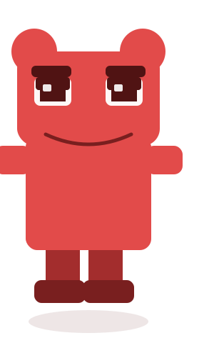
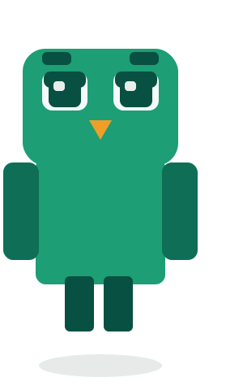
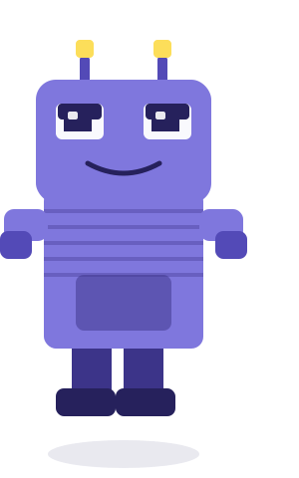
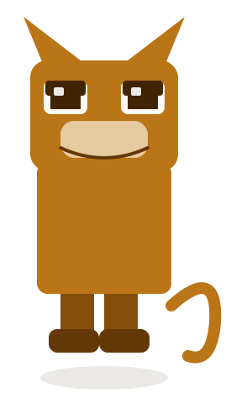
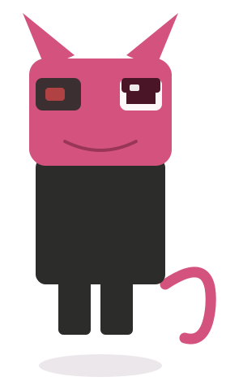
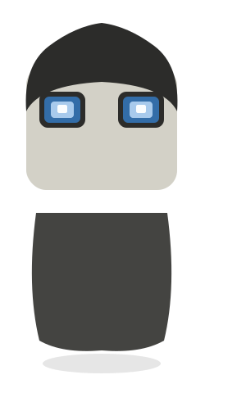
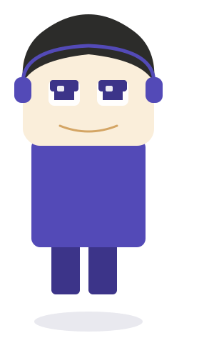
06
COLOR · SECONDARY
The character palette.
Seven saturated tones that live with the cast. For illustration, kingdom scenes, and mood — never a primary surface.
Crash
Sage
Byte
Nova
Glitch
Zero
Luna
THE DEBUGGER
THE MENTOR
THE BUILDER
THE EXPLORER
THE REBEL
THE MINIMALIST
THE DREAMER
#E24B4A
#029902
#FCBE1D
#1C40CF
#9538CF
#F58345
#FF8CC9
USAGE · One character, one color. Apply secondary tones to illustration and kingdom art. Never as a primary brand surface — that is purple's job.
CODEPET · BRAND GUIDELINES v1.0
06 · COLOR · SECONDARY
07 / 13

Slide 8
07
COLOR · NEUTRALS
Supporting neutrals.
Three tones that hold the system together around the purple core.
THE HIGHLIGHT
THE ANCHOR
THE CANVAS
Luna Lilac.
Midnight Ink.
Cream Lavender.
#A89BF2
#1E1848
#F7F5FC
RGB 168 · 155 · 242
RGB 30 · 24 · 72
RGB 247 · 245 · 252
Optimism and lift. Used for highlights on pixel art, accent text on dark surfaces, and the brightest layer of the purple family.
The serious, grown-up purple. Primary dark for text, hero backgrounds, and moments where the brand needs gravity over play. Null, the philosopher, lives here.
Never pure white. A warm, whispered lavender that lets the purple family breathe. The background for every long-form Codepet surface.
CODEPET · BRAND GUIDELINES v1.0
07 · COLOR · NEUTRALS
08 / 13

Slide 9
08
TYPOGRAPHY
Typography system.
A serif display anchors the brand. A clean sans-serif carries every UI and long-form surface.
DISPLAY
BODY
Aa
Aa
Calibri
Georgia
UI · Body copy · Captions · Data
Headlines · Section titles · Pull quotes · Campaign copy
11–16 pt · Regular & Bold · 1.4 line-height
28–96 pt · Bold or italic · Mixed case only
CODEPET · BRAND GUIDELINES v1.0
08 · TYPOGRAPHY
09 / 13

Slide 10
09
VOICE & TONE
Tone of voice.
A companion that keeps the mood light, the feedback kind, the advice open, and the knowledge deep.
Playful
Encouraging
Open-minded
Knowledgeable
A light, warm atmosphere. Work shouldn't feel like a chore — a well-placed joke is a feature, not a bug.
When someone feels stuck or overwhelmed, meet them with belief. Progress over perfection, every session.
Offer options, not orders. Surface multiple angles on the problem so the builder can choose for themselves.
Pull the right knowledge for the project in front of them. Deep training, applied to a single builder's context.
DO
DON'T
Nice instinct on that loop. Shorter with .map(), looser with a for-loop — try both and see which feels right?
This is inefficient. Use .map() instead.
CODEPET · BRAND GUIDELINES v1.0
09 · VOICE & TONE
10 / 13

Slide 11
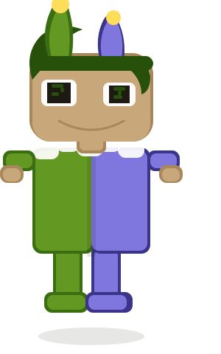
10
CHARACTERS
The character system.
Eight starter companions, each tuned to a distinct learning archetype.
Byte
Nova
Crash
Luna
Sage
Glitch
Zero
Null
The builder
The explorer
The debugger
The dreamer
The mentor
The rebel
The minimalist
The philosopher
CHARACTER USAGE
Always full-body · never crop to face. Always nearest-neighbor · never blur or bevel. Always in character · respect their personality.
CODEPET · BRAND GUIDELINES v1.0
10 · CHARACTERS
11 / 13

Slide 12
11
PIXEL ART PRINCIPLES
Pixel art standards.
Pixel art is a core brand asset. Rendering, scale, and source fidelity are non-negotiable.
01
02
03
Nearest-neighbor, always.
Integer scales only.
Kingdom scenes stay put.
Use .interpolation(.none) in SwiftUI and image-rendering: pixelated in CSS. No bilinear. No bicubic. Ever.
Ship art at 1×, 2×, 3×. Fractional scales (1.5×, 2.25×) create shimmer — use the next integer up and crop.
1280 × 800 PNGs. Never re-render or AI-upscale. Replace a kingdom only with a new 1280 × 800 source.
DO · Crisp, integer-scaled
DON'T · Smoothed, blurred, re-drawn
Pixels aligned. Every edge on the grid, every color from the palette.
No AI upscaling. No drop shadows, gradients, or “modern” redraws of the cast.
CODEPET · BRAND GUIDELINES v1.0
11 · PIXEL ART
12 / 13

Slide 13
MURROR · CONTACT
Questions,
feedback,
partnerships.
This is a living document. Version 1.0 — April 2026. The Codepet brand team maintains this reference and updates it as the product evolves. For clarification, approvals, or partnership inquiries, the team is reachable below.
hello@murror.app murror.app · @codepet · San Francisco + Ha Noi
CODEPET · BRAND GUIDELINES v1.0 · APR 2026
13 / 13

