Slide 1
REVIEW I · 8 OCTOBER 2026
Diabetes Prediction System
A leakage-safe artificial neural network for binary diabetes-outcome classification
Dataset
Model
Baselines
Review I
Pima Indians Diabetes
768 rows · 8 predictors
Feed-forward ANN
8 → 16 → 8 → 1
Logistic regression
and random forest
Problem to feature
selection · 40 marks
Educational model only — not a medical diagnostic tool.
The table is limited to adult women (age 21+) of Pima heritage. Results do not generalise to everyone and must not be used to diagnose diabetes.
Student name · Register number · Guide · Department (fill before presenting)
Educational model only — not a medical diagnostic tool. Pima women, age 21+.
1 / 10

Slide 2
1. Problem, aim, and objectives
Review I criterion — 5 marks
PROBLEM
Given eight numeric measurements, classify each row as Outcome = 1 (tested positive) or 0 (tested negative). This is binary classification, not a clinic visit.
AIM
RESEARCH QUESTIONS
Train a small feed-forward ANN with a leakage-safe pipeline and compare it fairly with logistic regression and a random forest.
How does the ANN compare on sensitivity, specificity, F1, ROC-AUC, and PR-AUC? Which features does SelectKBest keep inside each fold?
Measurable objectives
• Profile the local table: balance, zeros, duplicates
• Recode implausible zeros; keep Pregnancies = 0
• Fit impute / scale / select only on training folds
• EDA plus fold-wise SelectKBest (k = 5)
• Report the full metric set — not accuracy alone
IN SCOPE
OUT OF SCOPE
• 768-row Pima table
• Small MLP ANN
• LR and forest
• Classroom metrics
• Medical diagnosis
• Other populations
• Deep / GPU stacks
• Test-set tuning
Educational model only — not a medical diagnostic tool. Pima women, age 21+.
2 / 10

Slide 3
2. Literature survey and research gap
Review I criterion — 8 marks
Work | Dataset / method | What they reported
Smith et al. 1988 | Pima women; ADAP neural model | 576 / 192; sensitivity = specificity = 76%; ROC
Temurtas et al. 2009 | UCI Pima; MLNN and PNN | Train/test and 10-fold CV; accuracy-focused
Sisodia & Sisodia 2018 | UCI PIDD; DT, SVM, naïve Bayes | NB accuracy 76.30% (abstract); ROC
Hasan et al. 2020 | Pima; MLP + ensembles | Ensemble AUC 0.950 — treat as a caution
MODEST RESEARCH GAP
Many classroom Pima papers leak preprocessing, mishandle zeros (or treat every zero as missing), and quote accuracy even though 65% of rows are class 0.
This project answers that gap: medically justified zero handling, imputation / scaling / SelectKBest fitted only on each training fold, an ANN compared with logistic regression and a random forest, and the full metric set.
Educational model only — not a medical diagnostic tool. Pima women, age 21+.
3 / 10

Slide 4
3. Dataset and features
Review I criterion — 8 marks · Pima Indians Diabetes
WHO IS IN THE TABLE
Feature | Meaning | Zero?
Pregnancies | Times pregnant | Valid
Glucose | 2-hour OGTT (mg/dL) | Missing code
BloodPressure | Diastolic mm Hg | Missing code
SkinThickness | Triceps skinfold mm | Missing code
Insulin | 2-hour serum insulin | Missing code
BMI | kg / m² | Missing code
Pedigree | Family-history score | Keep
Age | Years (minimum 21) | Keep
• 768 rows, 8 predictors + binary Outcome
• Adult women, age 21+, Pima heritage
• NIDDK community near Phoenix, Arizona
• Local CSV / ARFF only — code never downloads
• Not UCI Diabetes ID 34 (a different time-series set)
TARGET AND LIMITS
• Outcome 1 = tested positive under the study rule
• Original rule: 2-hour glucose ≥ 200 mg/dL (Smith et al.)
• Small n; one sex; one community; 1980s extract
• Cannot generalise to men, children, or other groups
Educational model only — not a medical diagnostic tool. Pima women, age 21+.
4 / 10

Slide 5
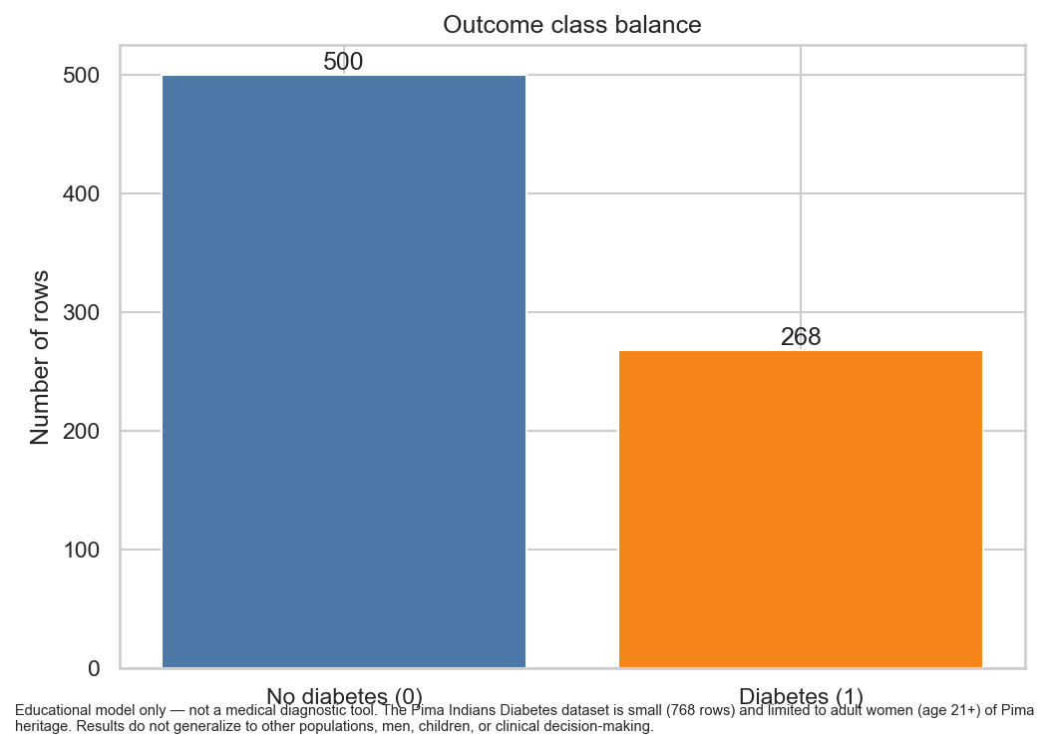
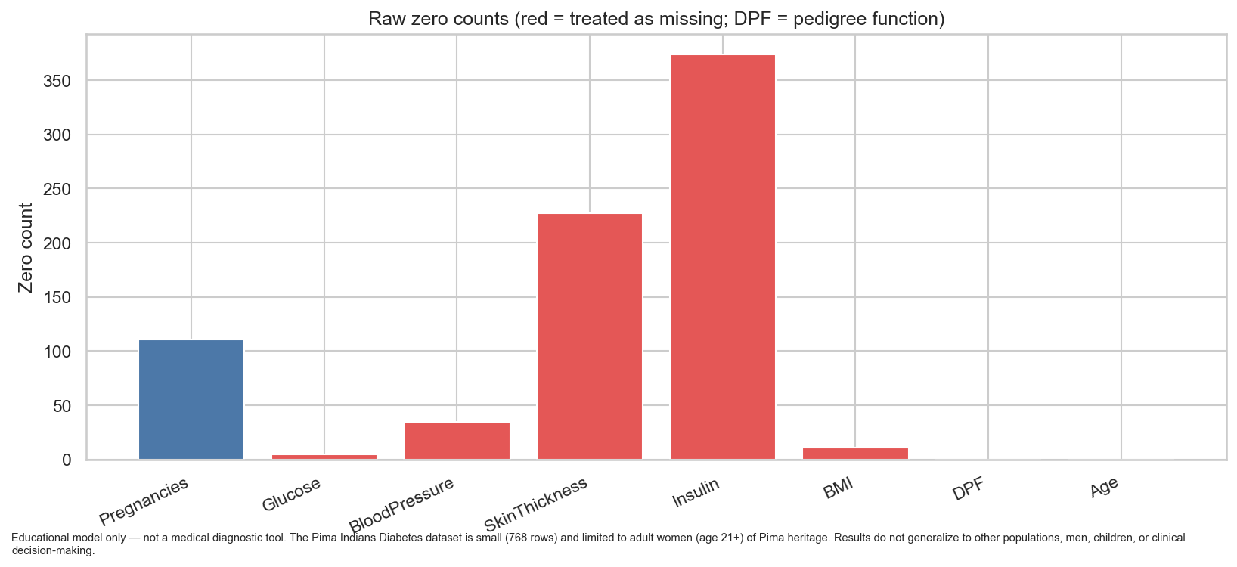
3. Data quality — computed from the local CSV
768 rows · 0 duplicates · 0 true NaNs
500 / 268
111
374 / 227
48.7%
No diabetes / diabetes
Dummy accuracy ≈ 65%
Pregnancies = 0
kept as valid
Insulin / Skin zeros
recoded as missing
Insulin missing
after recode
Educational model only — not a medical diagnostic tool. Pima women, age 21+.
5 / 10

Slide 6
4. Preprocessing without leakage
Review I criterion — 5 marks · fitted on each training fold only
1
2
3
4
5
6
Zero → NaN
Median impute
SelectKBest
Standard scale
Oversample
Classifier
→
→
→
→
→
Glucose, BP, skin,
insulin, BMI only
Learned on the
training fold
Optional · k = 5
ANOVA F-test
Mean / variance
from train fold
Optional · train
fold only
Dummy, LR,
forest, or MLP
REPRODUCIBILITY
NOT ALLOWED
• Random seed 42 for Python, NumPy, and models
• Stratified 5-fold CV, same splits for every model
• Local CSV only; python run_experiment.py
• IQR outliers reviewed, not auto-deleted
• Fit scaler / imputer / selector on all 768 rows
• Oversample the whole table, then cross-validate
• Treat Pregnancies = 0 as missing
• Tune hidden size on the test fold
Educational model only — not a medical diagnostic tool. Pima women, age 21+.
6 / 10

Slide 7
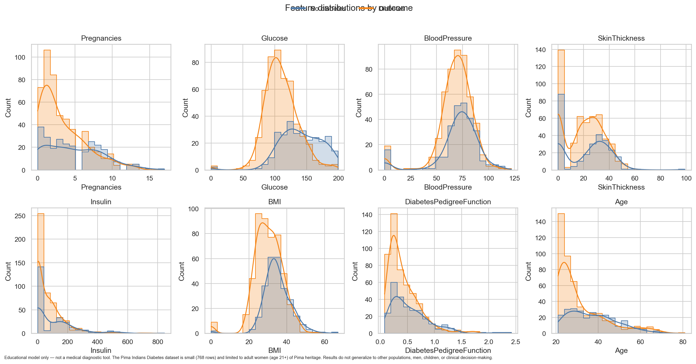
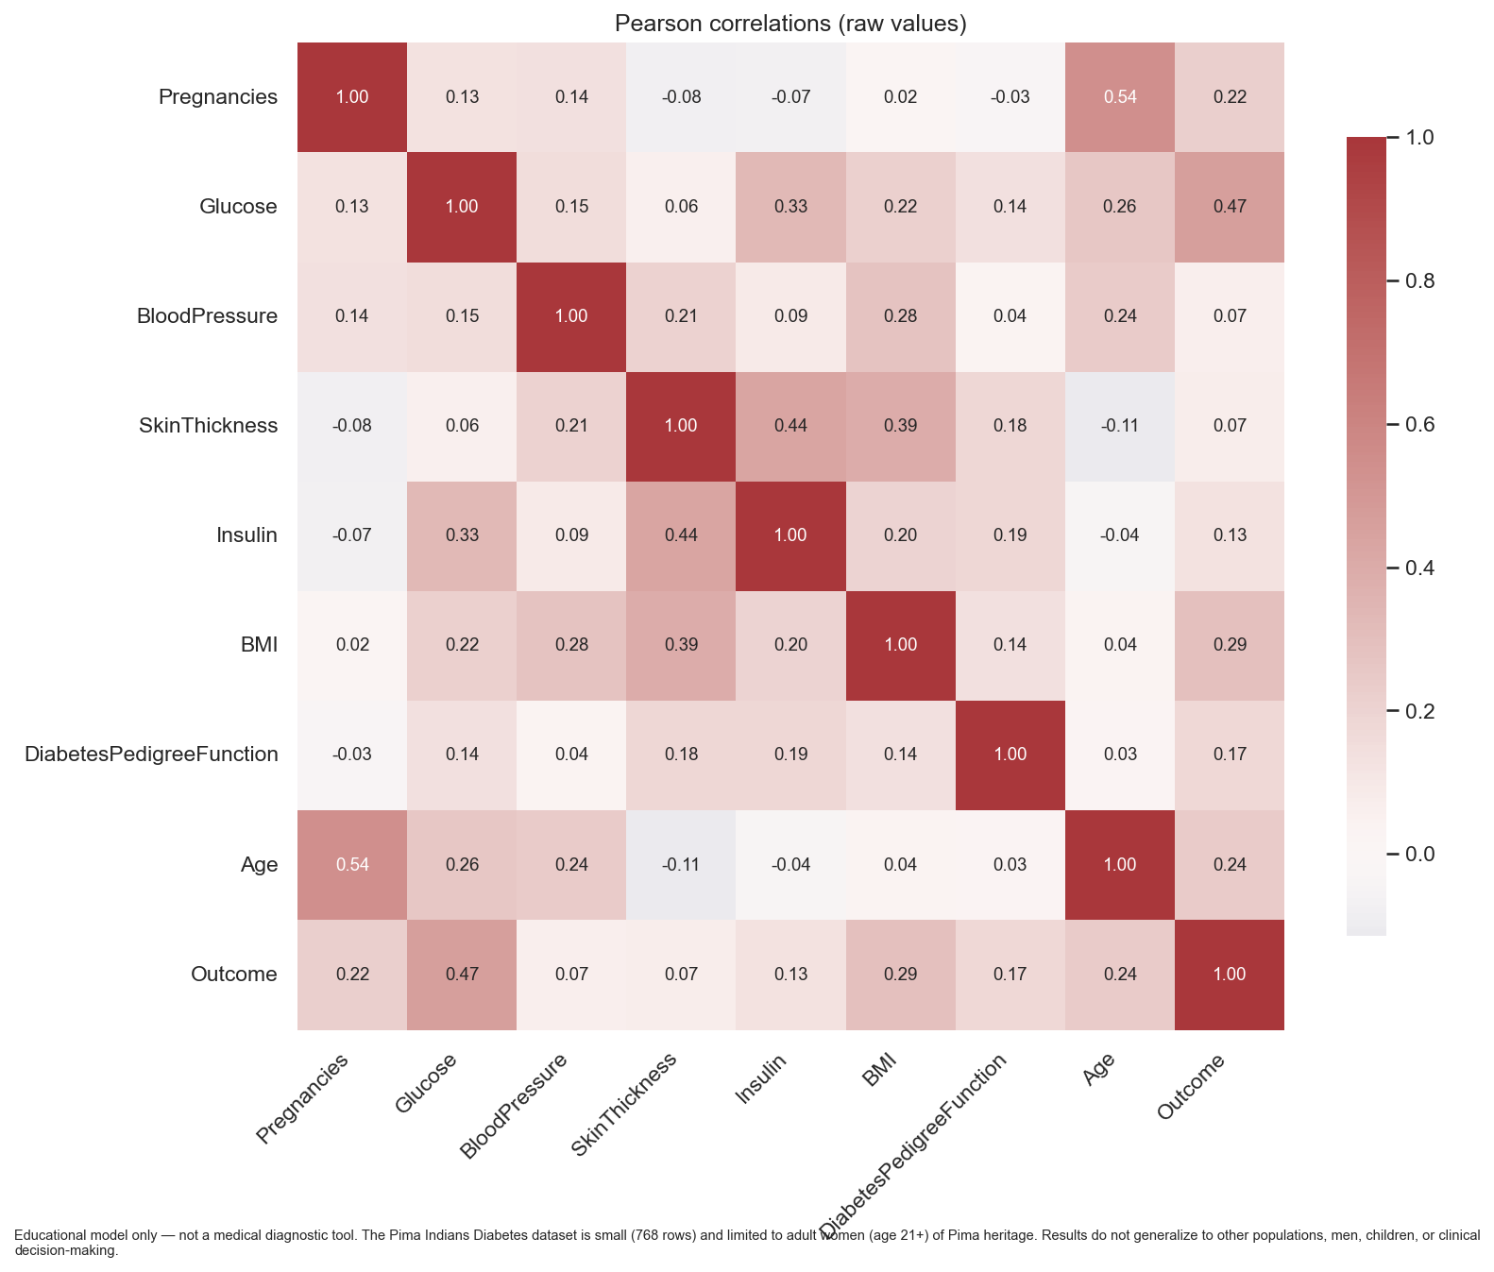
5. Exploratory data analysis — computed
Review I criterion — 7 marks · describes this table only
• Positive rows have higher glucose, BMI, and age. After recoding zeros, insulin and skinfold separate more clearly.
• Pearson r with Outcome (after recode): Glucose 0.50, BMI 0.31, Insulin 0.30. Skin–BMI r = 0.65; Glucose–Insulin r = 0.58.
Educational model only — not a medical diagnostic tool. Pima women, age 21+.
7 / 10

Slide 8
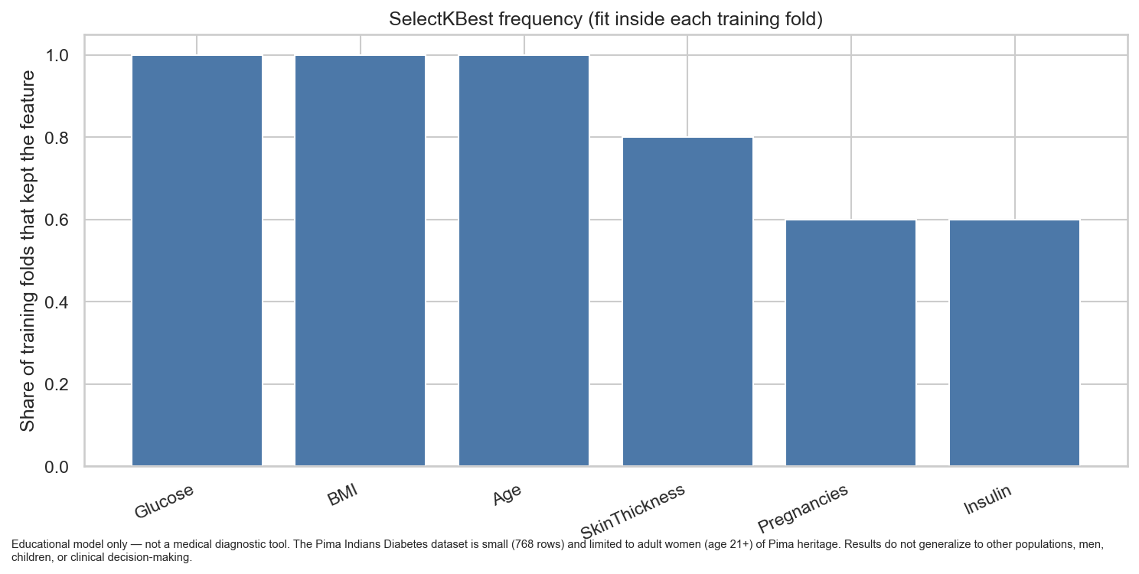
6. Feature-selection experiment
SelectKBest fitted inside each training fold · seed 42
COMPARISON
• All 8 features vs SelectKBest k = 5
• ANOVA F-test, same 5 stratified folds
• Selected names are allowed to change by fold
• Never chosen on all 768 rows first
COMPUTED FREQUENCY
• Every fold: Glucose, BMI, Age (5 / 5)
• Often: SkinThickness (4 / 5)
• Sometimes: Pregnancies, Insulin (3 / 5)
• Not selected here: BloodPressure, Pedigree
Educational model only — not a medical diagnostic tool. Pima women, age 21+.
8 / 10

Slide 9
6. ANN, baselines, and metrics
Same folds and the same pipeline for every model
FEED-FORWARD ANN · scikit-learn MLPClassifier · Adam · early stopping on the training fold
8
16
8
1
→
→
→
Inputs
ReLU
ReLU
Logistic
Dummy
Logistic regression
Random forest
MLP ANN
Always majority class
Sanity floor ≈ 65% acc.
Linear baseline
class_weight balanced
Tree baseline
max_depth = 6
16 and 8 hidden units
Compared, not crowned
WHY ACCURACY IS NOT ENOUGH
Report accuracy, precision, recall / sensitivity, specificity, F1, ROC-AUC, PR-AUC, and the confusion matrix.
A model that always predicts “no diabetes” is already about 65% accurate and 0% sensitive.
Smith et al. (1988) already reported sensitivity, specificity, and ROC — not accuracy alone.
Full CV tables live in reports/model_comparison.md for a later review. They are not a diagnostic claim.
Educational model only — not a medical diagnostic tool. Pima women, age 21+.
9 / 10

Slide 10
Limits, next steps, and questions
This is an educational ANN — not a diagnostic device
LIMITS
ALREADY IN THE REPO
• 768 rows is small for a neural net
• Adult women of Pima heritage only
• Insulin and skinfold are mostly imputed
• No external hospital or mixed-sex test set
• Not for screening, treatment, or diagnosis
• Local CSV and ARFF (no silent download)
• EDA figures and data profile
• Leakage-safe pipeline and unit tests
• Seeded 5-fold comparison for later review
• Review I report, references, and checklist
PLEASE ASK US ABOUT
Why Pregnancies = 0 is kept · How imputation and SelectKBest stay inside each training fold · Why PR-AUC and the dummy baseline matter · Why 65% accuracy is not success.
Thank you.
Educational model only — not a medical diagnostic tool. Pima women, age 21+.
10 / 10

