Slide 1

21CSE326T · ARTIFICIAL NEURAL NETWORKS · OCTOBER 2026
Diabetes Prediction System
A leakage-safe artificial neural network for binary diabetes-outcome classification
Dataset
Model
Evaluation
Headline result
Pima Indians Diabetes
768 rows · 8 predictors
Feed-forward ANN
8 → 16 → 8 → 1 · 289 params
10 × 5 repeated CV
+ 154-row hold-out
ROC-AUC 0.834
Sensitivity 0.768
Educational model only — not a medical diagnostic tool.
The table is limited to adult women (age 21+) of Pima heritage near Phoenix, Arizona. Results do not generalise to other populations and must not be used to diagnose diabetes.
Shanmugapriyan J (RA2411026050011) · Deepak V F (RA2411026050015)
B.Tech. CSE (AI & ML) · III Year / V Semester · Section A · SRM Institute of Science and Technology, Tiruchirappalli
Educational model only — not a medical diagnostic tool. Pima women, age 21+.
1 / 16

Slide 2
1. Problem, aim, and objectives
Chapter 1 · binary classification on eight numeric measurements
PROBLEM
Given eight measurements (pregnancies, 2-hour glucose, blood pressure, skinfold, insulin, BMI, pedigree, age), classify each row as Outcome = 1 or 0. This is a classroom ANN task, not a clinic visit.
AIM
RESEARCH QUESTIONS
Train a small feed-forward ANN with a leakage-safe pipeline and compare it on identical folds with logistic regression and a random forest.
Does the ANN beat linear and tree baselines on sensitivity, F1, ROC-AUC, and PR-AUC? How much do protocol shortcuts inflate those numbers?
Measurable objectives
• Profile the local table: balance, zeros, duplicates
• Recode impossible zeros; keep Pregnancies = 0
• Fit impute / scale / oversample only on training folds
• Train an 8–16–8–1 MLP with Adam, L2, and early stopping
• Report the full metric set — not accuracy alone
• Ablate components and measure leakage optimism
IN SCOPE
OUT OF SCOPE
• 768-row Pima table
• Small MLP ANN
• LR and forest
• Repeated CV + hold-out
• Ablation and leakage
• Medical diagnosis
• Other populations
• Deep / GPU stacks
• Test-set tuning
• External hospital data
Educational model only — not a medical diagnostic tool. Pima women, age 21+.
2 / 16

Slide 3
2. Literature survey — comparison of published work
Chapter 2 · comparison table is mandatory · numbers as reported by the authors
Work | Technique | Evaluation | Reported result | Limitation
Smith et al. 1988 | ADAP (early neural) | 576 / 192 split | Sens. = Spec. = 76%; ROC | Single split; one community
Temurtas et al. 2009 | MLNN-LM and PNN | Split + 10-fold CV | MLNN 82.37% accuracy | Accuracy as the headline metric
Sisodia & Sisodia 2018 | DT, SVM, naïve Bayes | Cross-validation | NB accuracy 76.30% | No neural network compared
Hasan et al. 2020 | MLP + weighted ensemble | k-fold CV | Ensemble AUC 0.950 | Aggressive cleaning; leakage risk
Howlader et al. 2022 | Many selectors + GBR | Cross-validation | GBR accuracy 90.91% | Far above typical 75–82% range
This work | Leakage-safe MLP 8–16–8–1 | 10×5 repeated CV + hold-out | ROC-AUC 0.834; Sens. 0.768 | Single population; no external set
RESEARCH GAP
Many Pima papers leak preprocessing, mishandle zeros, and quote accuracy even though 65% of rows are class 0. This project answers that gap with medically justified zeros, fold-wise imputation / scaling / oversampling, same-fold LR and forest baselines, a full metric set, an ablation, and a measured leakage experiment.
Educational model only — not a medical diagnostic tool. Pima women, age 21+.
3 / 16

Slide 4
3. Dataset and features
Chapter 4.2 · Pima Indians Diabetes · NIDDK / Smith et al. 1988 · local CSV only
WHO IS IN THE TABLE
Feature | Meaning | Zero?
Pregnancies | Times pregnant | Valid — keep
Glucose | 2-hour OGTT (mg/dL) | Missing code
BloodPressure | Diastolic mm Hg | Missing code
SkinThickness | Triceps skinfold mm | Missing code
Insulin | 2-hour serum insulin | Missing code
BMI | kg / m² | Missing code
Pedigree (DPF) | Family-history score | Keep
Age | Years (minimum 21) | Keep
• 768 rows, 8 predictors + binary Outcome
• Adult women, age ≥ 21, Pima heritage
• NIDDK community near Phoenix, Arizona
• Local CSV / ARFF — code never downloads
• 0 duplicates · 0 empty cells · zeros are codes
TARGET AND LIMITS
• Outcome 1 = 2-hour glucose ≥ 200 mg/dL
• 500 negative (65.1%) / 268 positive (34.9%)
• Dummy majority accuracy is already 65.1%
• One sex, one community, 1980s extract
• Cannot generalise to men, children, or other groups
Educational model only — not a medical diagnostic tool. Pima women, age 21+.
4 / 16

Slide 5
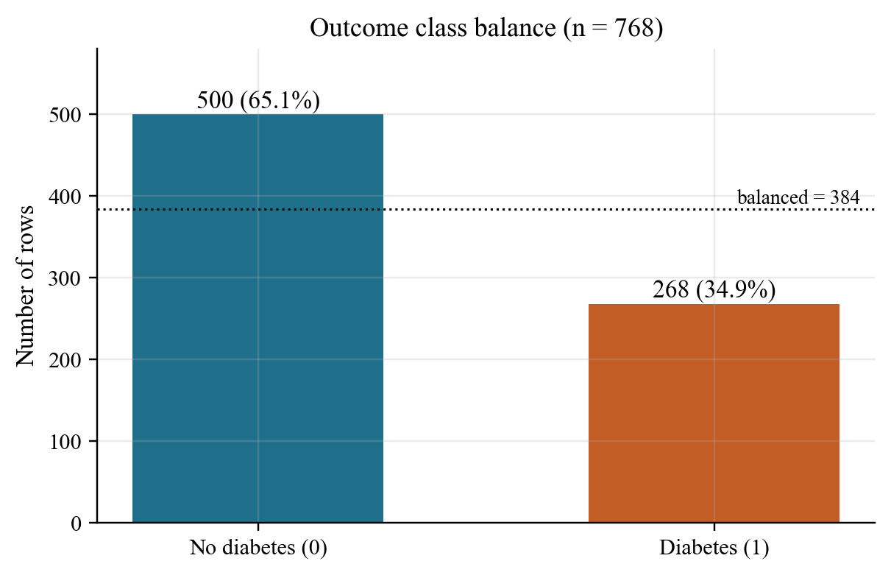
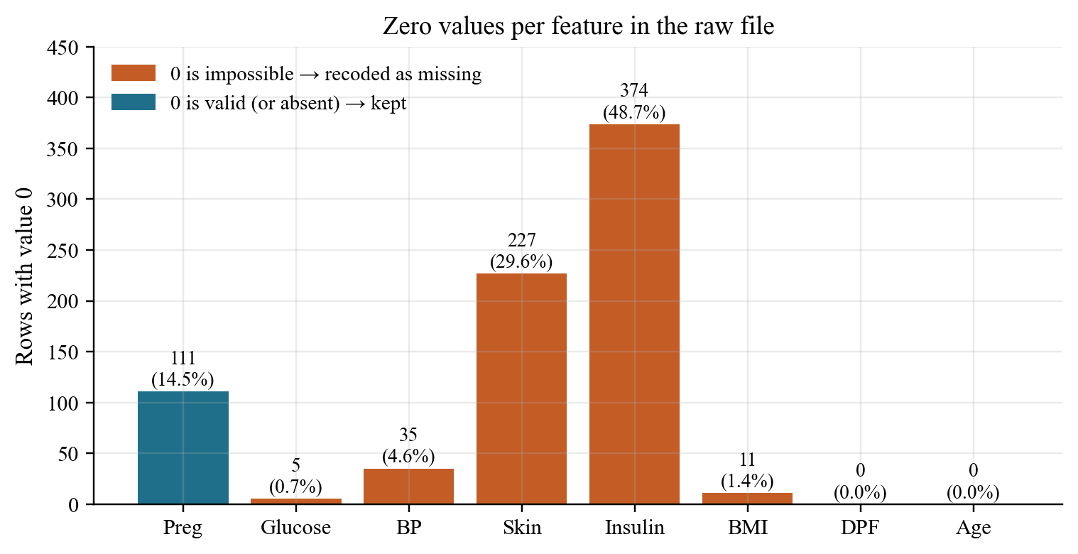
4. Data quality — computed from the local CSV
768 rows · 0 duplicates · 0 true NaNs · zeros in five lab columns are missing-value codes
500 / 268
111
374 / 227
48.7%
No diabetes / diabetes
Dummy accuracy ≈ 65%
Pregnancies = 0
kept as valid
Insulin / Skin zeros
recoded as missing
Insulin missing
after recode
Educational model only — not a medical diagnostic tool. Pima women, age 21+.
5 / 16

Slide 6
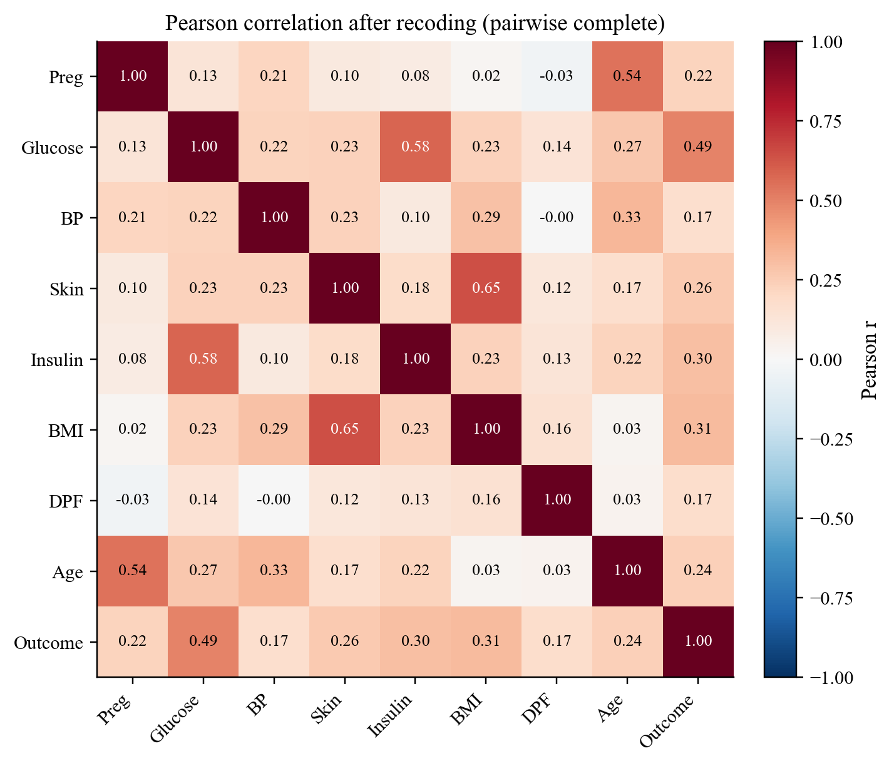
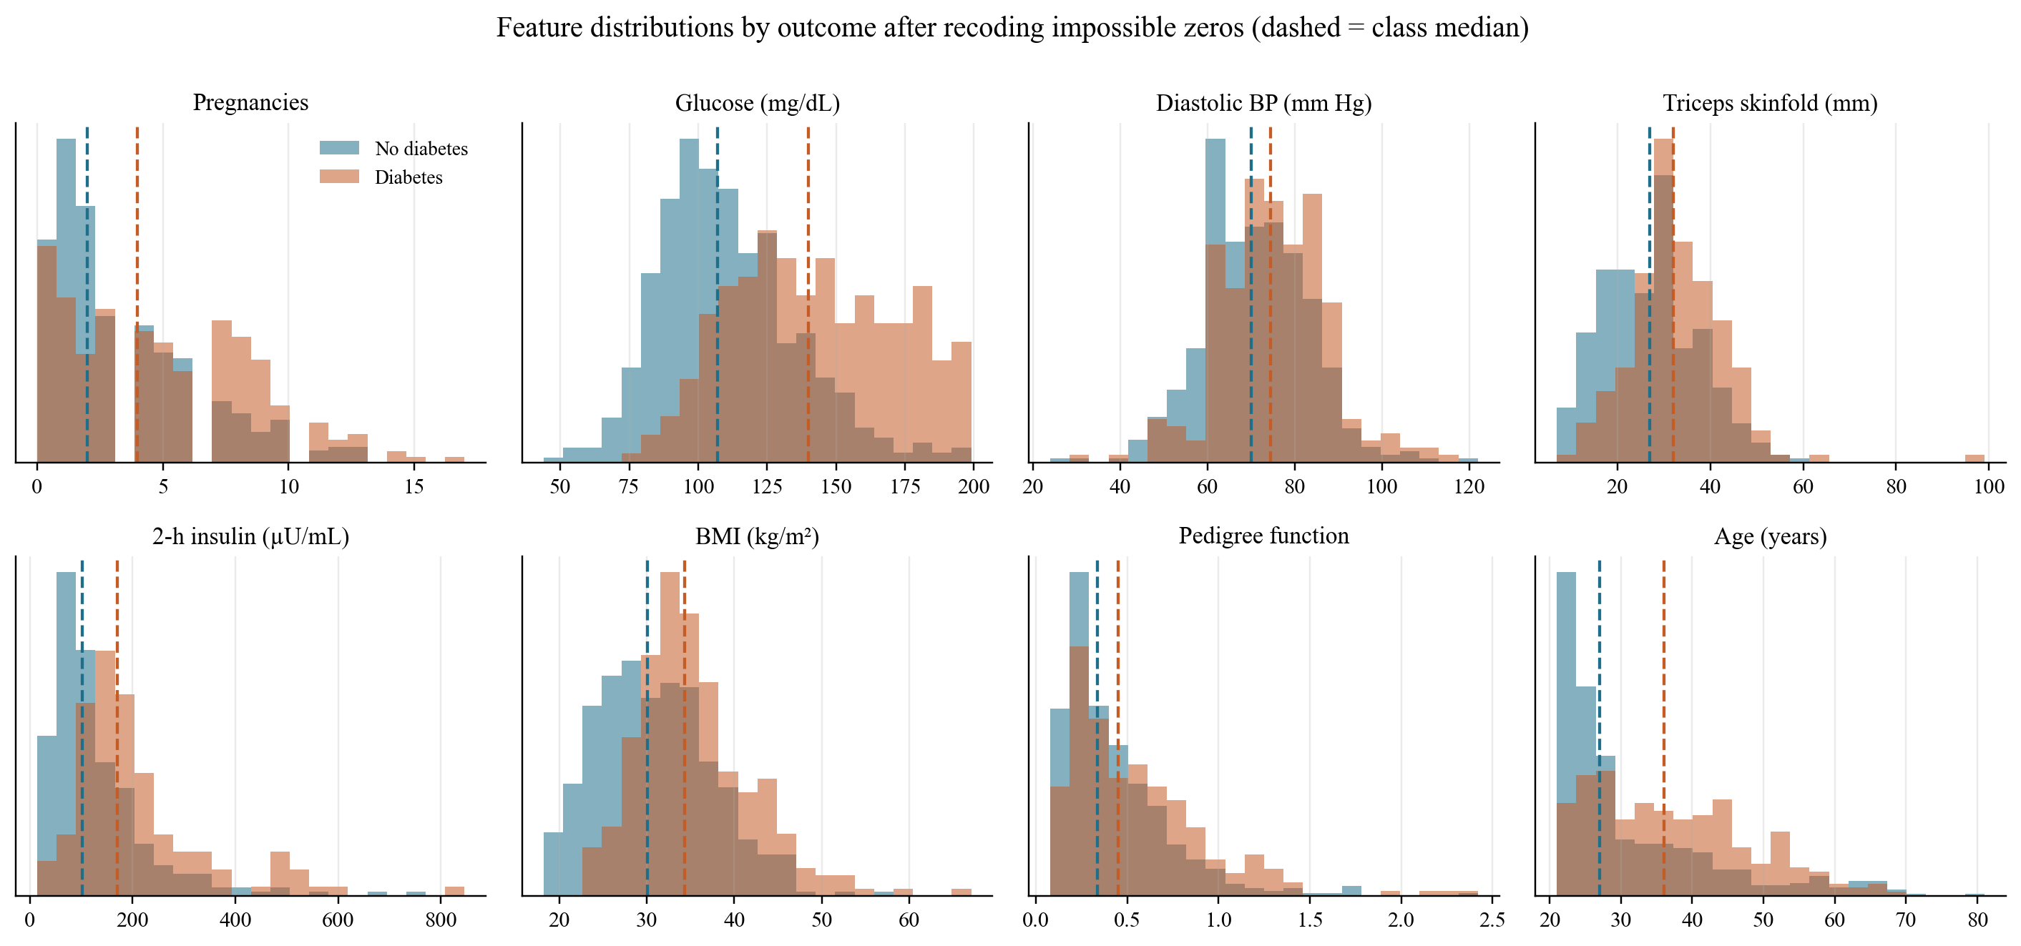
5. Exploratory data analysis
Positive rows have higher glucose, BMI, and age · Pearson r with Outcome after recoding zeros
• Glucose separates the classes most clearly (median 107 vs 140 mg/dL). Insulin and skinfold only separate once zeros are recoded.
• Pearson r with Outcome: Glucose 0.49, BMI 0.31, Insulin 0.30, Age 0.24. Skin–BMI r ≈ 0.65; Glucose–Insulin r ≈ 0.58.
Educational model only — not a medical diagnostic tool. Pima women, age 21+.
6 / 16

Slide 7
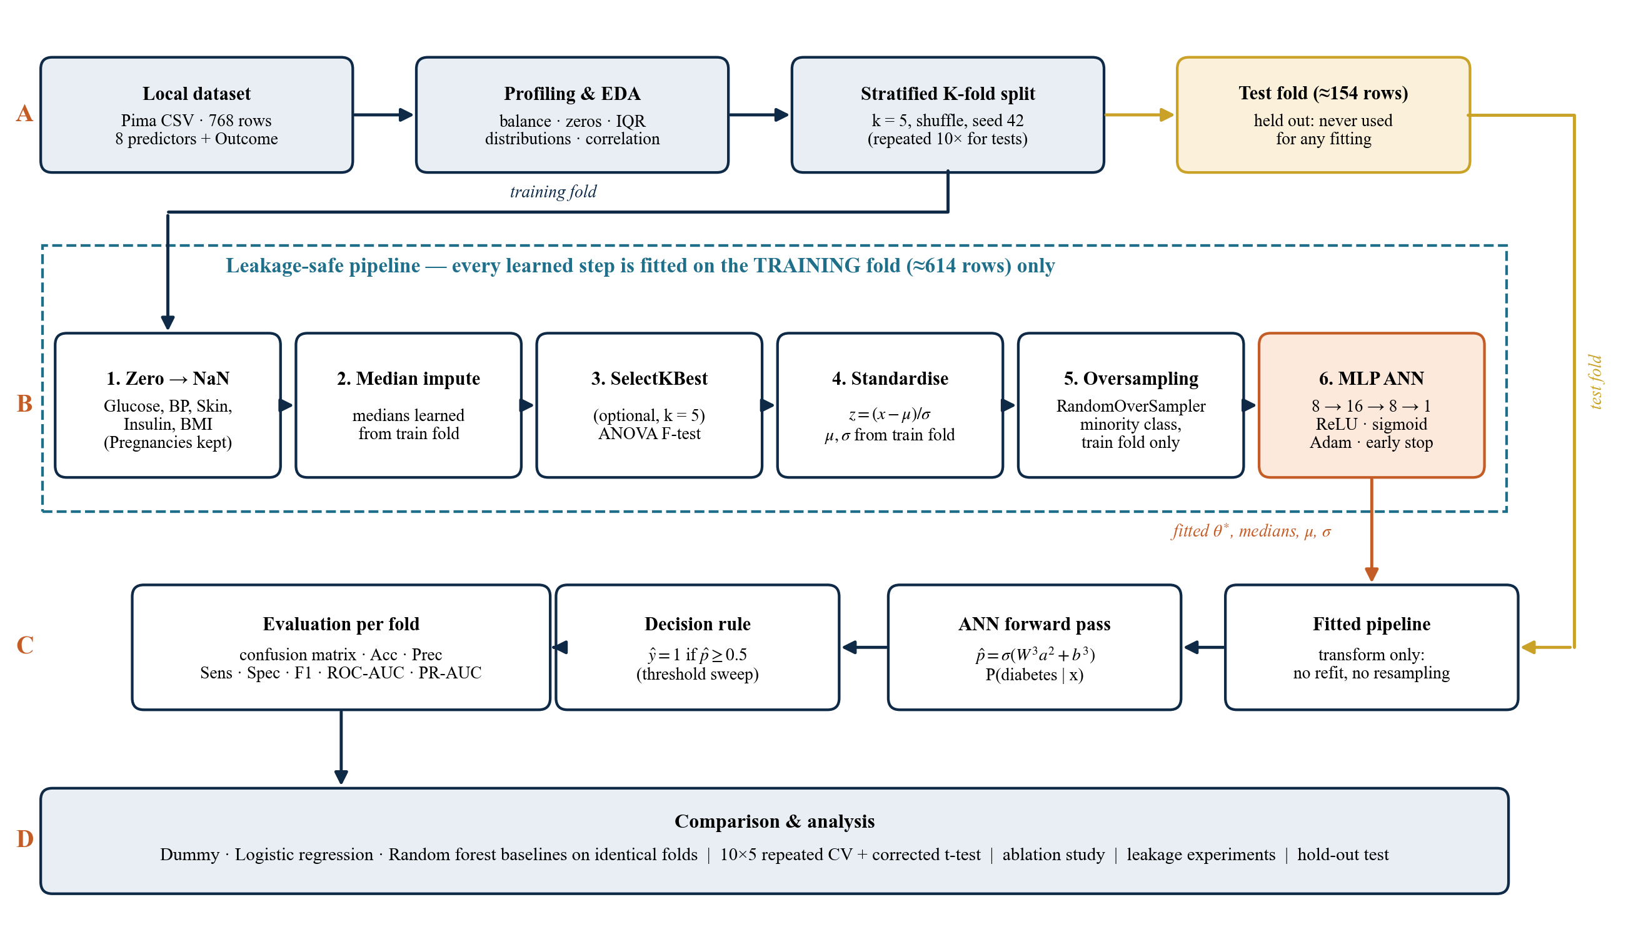
6. Proposed methodology — block schematic
Chapter 3 · Stage B is fitted on the training fold only · the test fold is transformed, never refit
Educational model only — not a medical diagnostic tool. Pima women, age 21+.
7 / 16

Slide 8
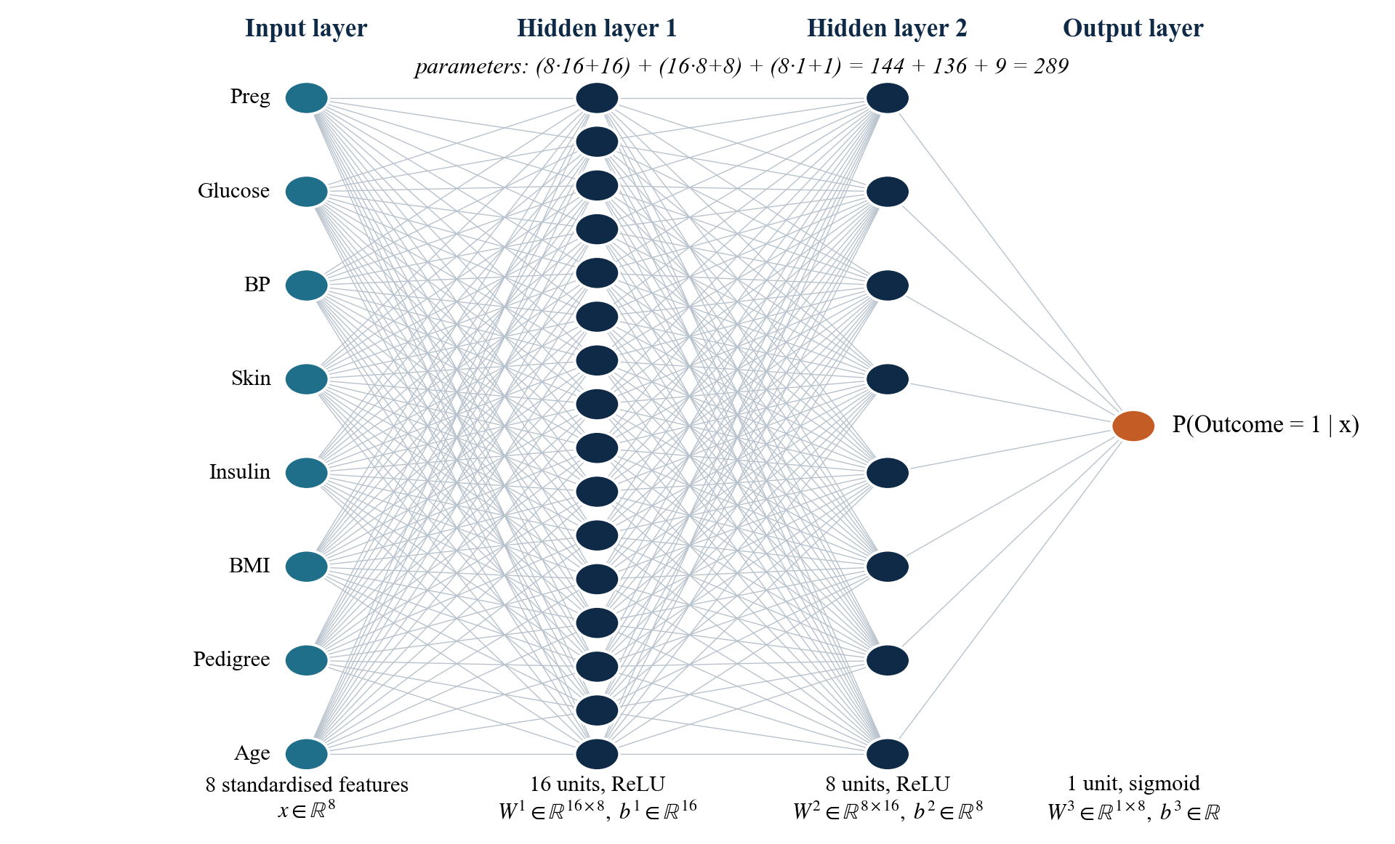
7. ANN architecture and governing equations
Multilayer perceptron · 8 → 16 → 8 → 1 · 289 parameters · ReLU hidden units · sigmoid output
FORWARD PASS
a⁰ = x (standardised inputs)
zˡ = Wˡ aˡ⁻¹ + bˡ
aˡ = g(zˡ), g(z) = max(0, z) ReLU
ŷ = σ(z³) = 1 / (1 + e⁻ᶻ³)
TRAINING OBJECTIVE
L = −[ y log ŷ + (1−y) log(1−ŷ) ]
+ (α / 2) ||W||²
Adam, α = 10⁻³, batch 32
Early stop on a train-fold split
DECISION RULE
ŷ_class = 1 if ŷ ≥ 0.5
Parameters: (8·16+16)+(16·8+8)+(8·1+1)
= 144 + 136 + 9 = 289
Educational model only — not a medical diagnostic tool. Pima women, age 21+.
8 / 16

Slide 9
8. Leakage-safe pipeline and training algorithm
Every learned statistic comes from the training fold · the test fold is scored once
1
2
3
4
5
6
Zero → NaN
Median impute
Standard scale
Oversample
Train MLP
Score test
→
→
→
→
→
Glucose, BP, skin,
insulin, BMI only
Medians learned
on the train fold
μ and σ from the
training fold
Random ROS of the
minority, train only
Adam + L2 +
early stopping
Transform only
no refit, no ROS
ALGORITHM — STRATIFIED CROSS-VALIDATION
NOT ALLOWED
1. Split D into K = 5 stratified folds (seed 42).
2. For each fold k, let Train = D \ Fold_k, Test = Fold_k.
3. Recode zeros; fit imputer and scaler on Train; apply to both.
4. Oversample Train only. Fit the MLP with early stopping on Train.
5. Transform Test with the fitted objects (never resample Test).
6. Predict and score. Repeat. Report mean ± sd over folds.
7. Repeat the 5-fold split 10 times for the headline estimate.
• Fit scaler / imputer on all 768 rows
• Oversample the whole table, then CV
• Treat Pregnancies = 0 as missing
• Tune hidden size on the test fold
• Delete outliers using all rows
Educational model only — not a medical diagnostic tool. Pima women, age 21+.
9 / 16

Slide 10
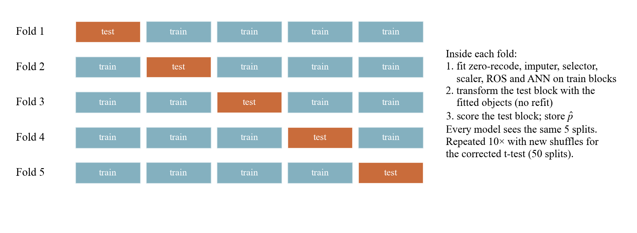
9. Experimental setup
Apple M5 CPU · no GPU · seed 42 · full suite ≈ 3 minutes · four protocols, each for a stated purpose
P1 · seeded 5-fold
P2 · 10 × 5 repeated
P3 · 3 × 5 repeated
P4 · 80 / 20 hold-out
Seed 42, five stratified folds.
13 configurations compared.
OOF ROC, PR, confusion.
50 splits. Headline means.
Corrected resampled t-tests
vs logistic and forest.
15 identical splits.
Ablation of components,
architecture, and leakage.
614 train / 154 test.
Choices frozen first.
Single unseen test.
MODELS ON IDENTICAL FOLDS
• Dummy most-frequent (sanity floor)
• Logistic regression, class_weight balanced
• Random forest, 100 trees, depth 6
• MLP, no rebalancing (specificity-heavy)
• Proposed MLP + training-fold ROS
• Metrics: Acc, Prec, Sens, Spec, F1, ROC-AUC, PR-AUC
Educational model only — not a medical diagnostic tool. Pima women, age 21+.
10 / 16

Slide 11
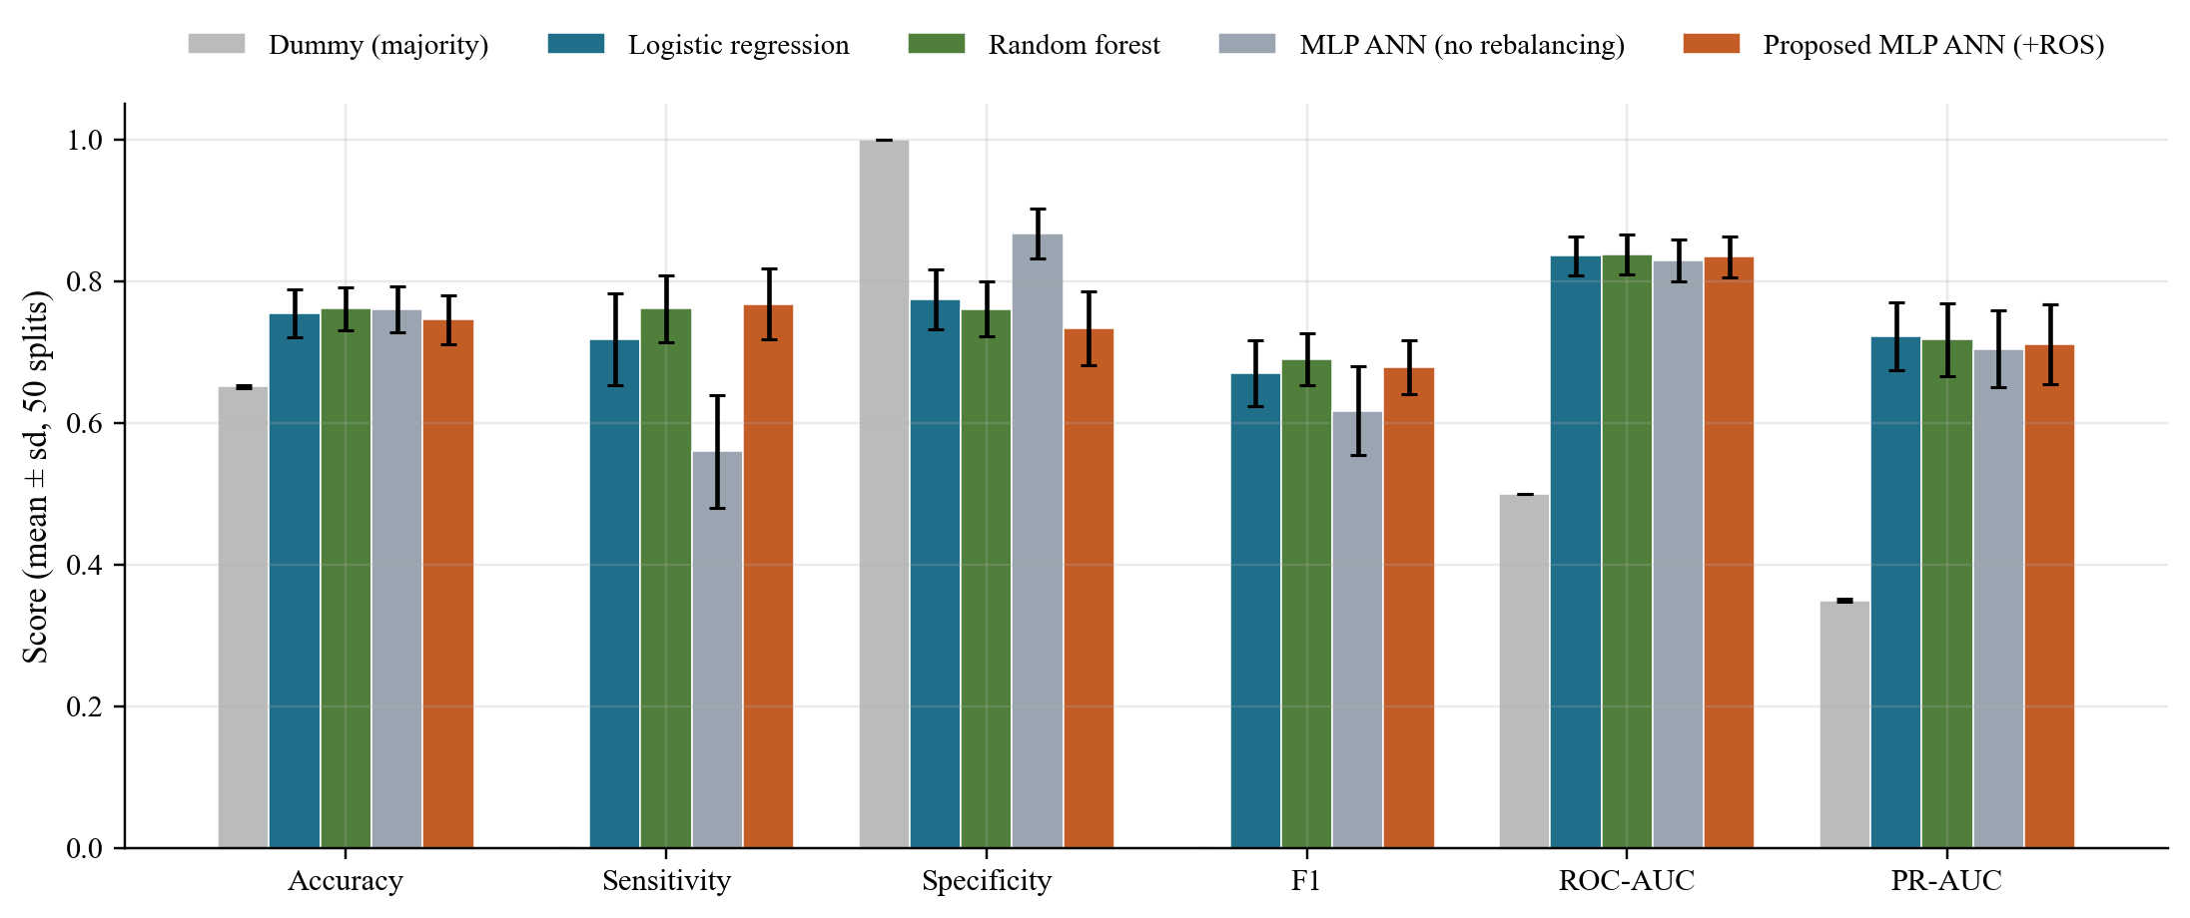
10. Experimental results — repeated cross-validation
Protocol P2 · mean over 10 × 5 = 50 stratified splits · proposed row highlighted
Model | Accuracy | Sensitivity | Specificity | F1 | ROC-AUC | PR-AUC
Dummy (majority) | 0.651 | 0.000 | 1.000 | 0.000 | 0.500 | 0.349
Logistic regression | 0.754 | 0.718 | 0.774 | 0.671 | 0.836 | 0.722
Random forest | 0.761 | 0.761 | 0.761 | 0.690 | 0.838 | 0.717
MLP ANN (no ROS) | 0.760 | 0.560 | 0.867 | 0.617 | 0.830 | 0.704
Proposed MLP (+ROS) | 0.746 | 0.768 | 0.734 | 0.679 | 0.834 | 0.711
WHAT THE NUMBERS SAY
Ranking (ROC-AUC) is statistically the same for LR, forest, and the ANN (p > 0.7).
Training-fold oversampling raises ANN sensitivity by +0.208 (p < 0.001) — that is the operating-point choice, not extra signal.
Educational model only — not a medical diagnostic tool. Pima women, age 21+.
11 / 16

Slide 12
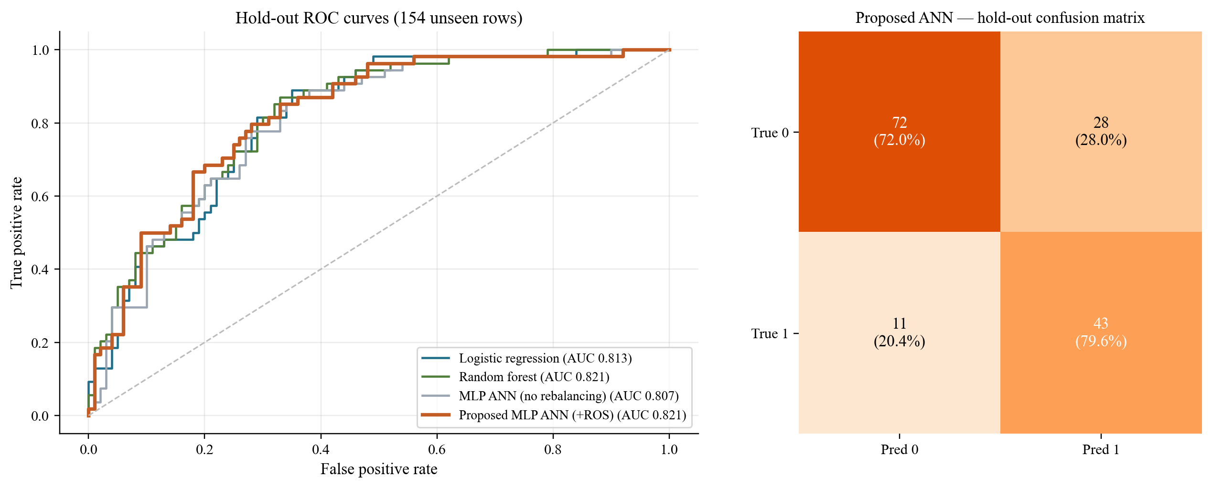
11. Hold-out test and out-of-fold curves
Protocol P4 · 154 unseen rows · proposed ANN found 43 of 54 diabetic cases · ROC-AUC 0.821
43 / 54
72 / 100
0.796
0.821
True positives
missed 11 cases
True negatives
28 false alarms
Hold-out
sensitivity
Hold-out
ROC-AUC
Educational model only — not a medical diagnostic tool. Pima women, age 21+.
12 / 16

Slide 13
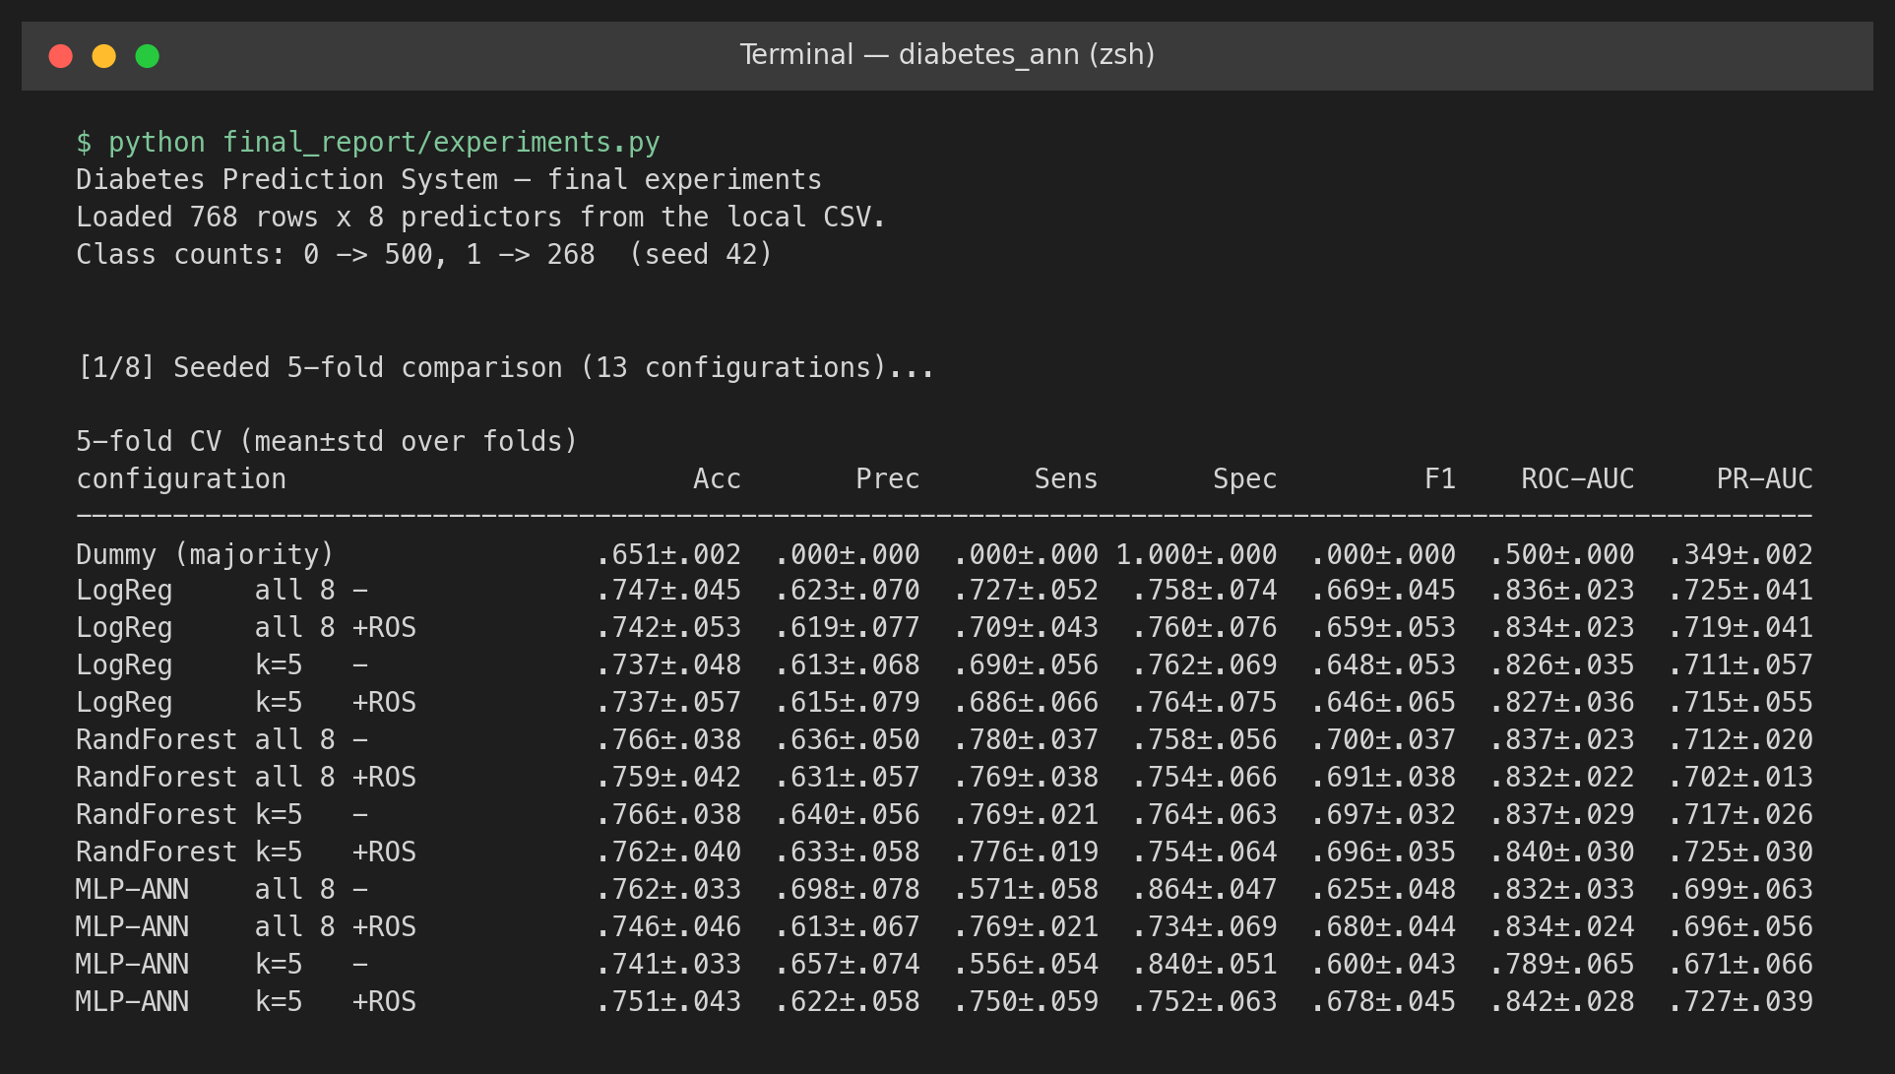
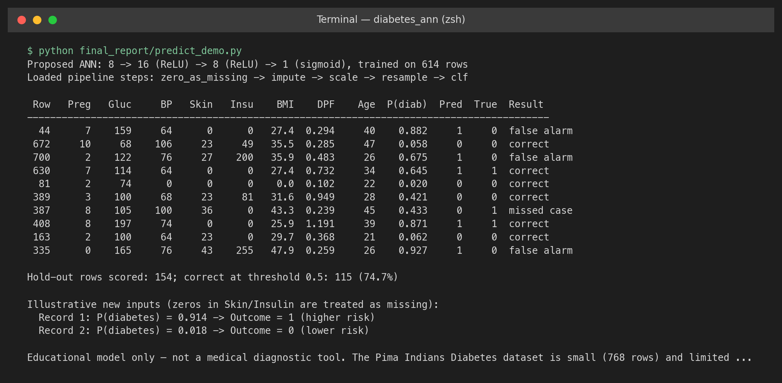
12. Output screenshots from the experiment scripts
Left: seeded 5-fold comparison of 13 configurations · Right: hold-out predictions on unseen rows
Educational model only — not a medical diagnostic tool. Pima women, age 21+.
13 / 16

Slide 14
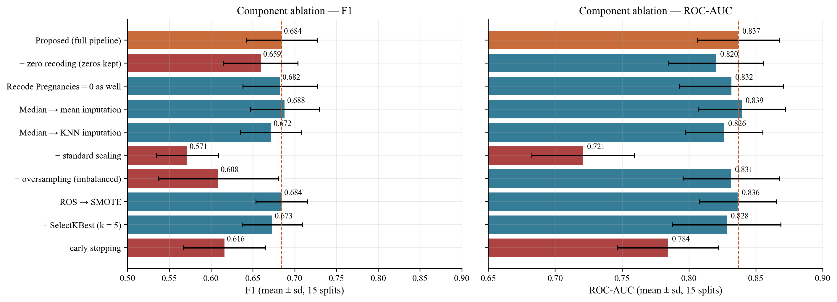
13. Ablation study
Protocol P3 · one component changed at a time · red = drop of more than 0.02 from the proposed system
− scaling
− early stop
− oversample
− zero recode
ROC-AUC 0.721
network ignores small-scale inputs
ROC-AUC 0.784
289 parameters over-fit 700 rows
Sens. 0.553
ranking unchanged; threshold shifts
ROC-AUC 0.820
coded zeros look like real lows
Educational model only — not a medical diagnostic tool. Pima women, age 21+.
14 / 16

Slide 15
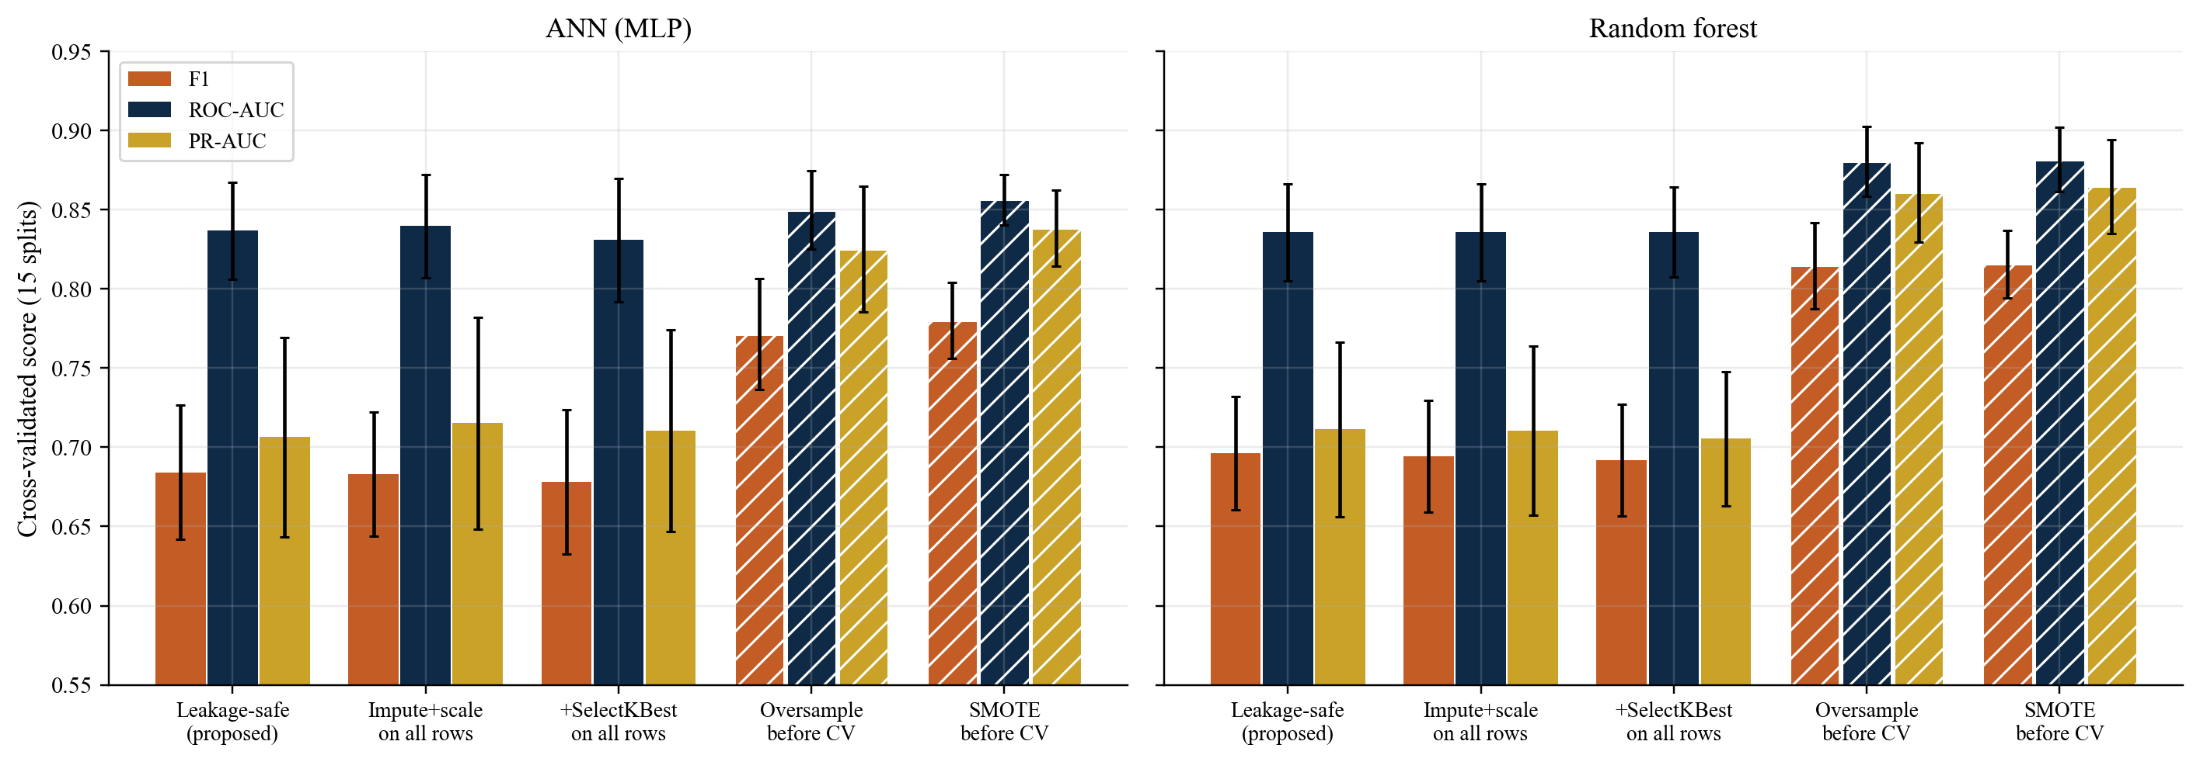
14. Leakage experiment and state-of-the-art comparison
Oversampling before CV inflates PR-AUC by ~0.12 · nested CV drops the tuned ROC-AUC from 0.835 to 0.819
LEAKAGE (ANN)
Safe protocol F1 0.684 PR-AUC 0.706
Oversample before CV
F1 0.771 PR-AUC 0.825
The gain is an artefact: copies of the same patient land in both folds. Impute/scale on all rows barely moves the score. Nested CV is 0.016 lower than the non-nested best.
Study | Headline | This work, same spirit
Smith 1988 | Sens. = Spec. = 76% | Sens. 0.768 · Spec. 0.734
Temurtas 2009 | 82.4% accuracy | Accuracy 0.746 (not the goal)
Sisodia 2018 | NB 76.3% accuracy | ANN F1 0.679 · ROC-AUC 0.834
Hasan 2020 | Ensemble AUC 0.950 | Leakage-safe AUC 0.834
Howlader 2022 | GBR 90.9% accuracy | We do not chase 90%+ on 768 rows
Educational model only — not a medical diagnostic tool. Pima women, age 21+.
15 / 16

Slide 16
15. Conclusion
A small ANN is competitive with, but not superior to, classical models on this benchmark
1
Honest ranking
2
Operating point
3
What actually matters
ROC-AUC 0.834 is statistically indistinguishable from logistic regression (0.836) and the random forest (0.838).
Training-fold oversampling raises sensitivity by 0.208 (p < 0.001) without changing ranking — the ANN’s practical advantage.
Standardisation, early stopping, and justified zero recoding. Depth, activation, L2, and SelectKBest do not.
4
Protocol is the story
5
Clinical reading
6
Limits
Leaky oversampling inflates PR-AUC by 0.12. Nested CV costs ~0.02 of ROC-AUC. Seed spread is ~0.04.
Glucose, age, BMI, pregnancies dominate permutation importance. The system is educational, not a diagnostic device.
768 rows, one community of adult women, 48.7% of insulin imputed, no external cohort.
Educational model only — not a medical diagnostic tool. Pima women, age 21+.
16 / 16

