Slide 1

A file is a collection of related data that a computers treats as a single unit.
Computers store files to secondary storage so that the contents of files remain intact when a computer shuts down.
When a computer reads a file, it copies the file from the storage device to memory; when it writes to a file, it transfers data from memory to the storage device.
C uses a structure called FILE (defined in stdio.h) to store the attributes of a file.

Slide 2

1. Create the stream via a pointer variable using the FILE structure:
eg: FILE *p;
2. Open the file, associating the stream name with the file name.
3. Read or write the data.
4. Close the file.

Slide 3

fopen - open a file- specify how its opened (read/write) and type (binary/text)
fclose - close an opened file
fread - read from a file
fwrite - write to a file
fseek/fsetpos - move a file pointer to somewhere in a file.
ftell/fgetpos - tell you where the file pointer is located.

Slide 4

The file open function (fopen) serves two purposes:
  It makes the connection between the physical file and the stream.
  It creates “a program file structure to store the information” C needs to process the file.
Syntax:
filepointer=fopen(“filename”, “mode”);

Slide 5

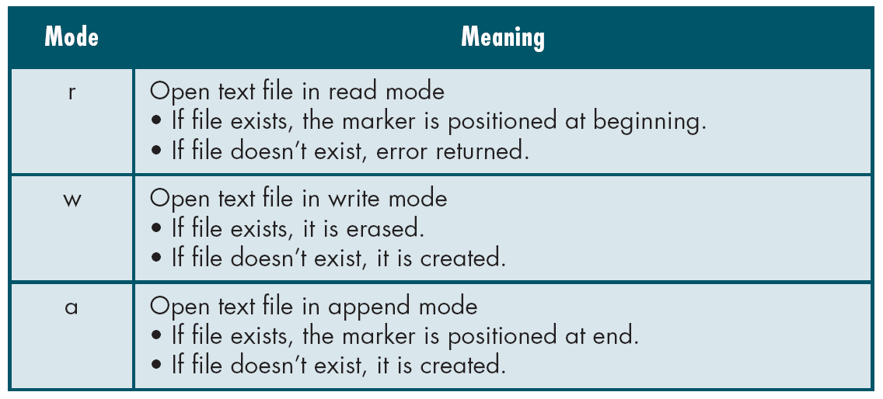

Slide 6

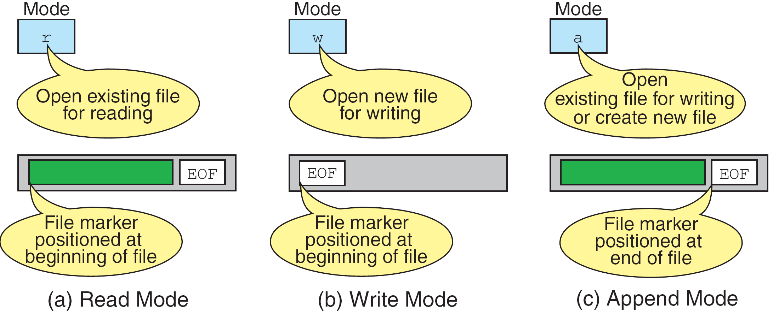

Slide 7

r+ - open for reading and writing, start at beginning
w+ - open for reading and writing (overwrite file)
a+ - open for reading and writing (append if file exists)

Slide 8

The file mode tells C how the program will use the file.
The filename indicates the system name and location for the file.
We assign the return value of fopen to our pointer variable:
spData = fopen(“MYFILE.TXT”, “w”);
spData = fopen(“A:\\MYFILE.TXT”, “w”);

Slide 9
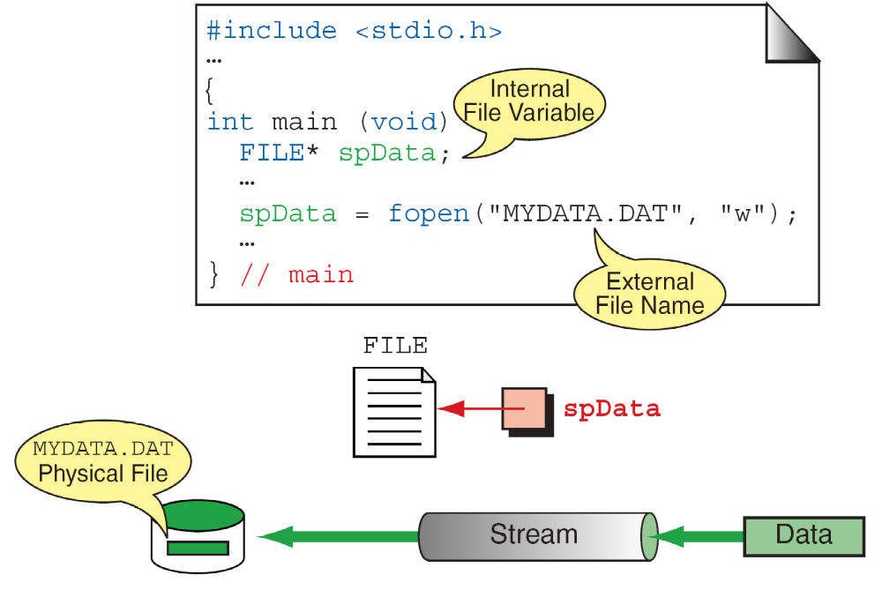

Slide 10

When file is no longer needed then we close the file.
FILE close will flush out all the entries from buffer
When we finish with a mode, we need to close the file before ending the program or beginning another mode with that same file.
To close a file, we use fclose and the pointer variable
SYNTAX:
fclose(spData);

Slide 11

Writing Formatted Output into the File
Syntax:
fprintf (fp,"string",variables);
Example:
  int i = 12;
  float x = 2.356;
  char ch = 's';
  FILE *fp;
  fp=fopen(“out.txt”,”w”);
  fprintf (fp, "%d %f %c", i, x, ch);

Slide 12
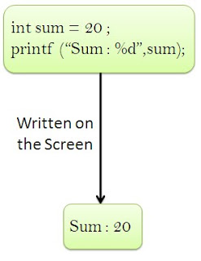
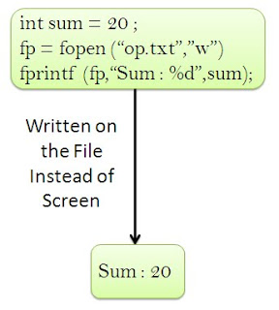
Normal printf statement
Fprintf statement

Slide 13

Syntax:
fscanf (fp,"string",identifiers);
Example:
    FILE *fp;
    Fp=fopen(“input.txt”,”r”);
    int i;
    fscanf (fp,“%d",i);

Slide 14

#include <stdio.h>
int main ( )
{
FILE *outfile, *infile ;
int b = 5, f ;
float a = 13.72, c = 6.68, e, g ;
outfile = fopen ("testdata.txt", "w") ;
fprintf (outfile, “ %f %d %f ", a, b, c) ;
fclose (outfile) ;
infile = fopen ("testdata.txt", "r") ;
fscanf (infile,"%f %d %f", &e, &f, &g) ;
printf (“ %f %d %f \n ", e, f, g) ;
}

Slide 15

Get a single character from the output file, pointed to by fp.
Syntax:
identifier = getc (fp);
Example:
FILE *fp;
fp=fopen(“input.txt”,”r”);
char ch;
ch = getc (fp);

Slide 16

#include <stdio.h>
#include<conio.h>
void main()
{
  char ch;
  FILE *fp;
  fp=fopen("out.txt","r");
  while(!feof(fp))
    {
    ch=getc(fp);
    printf("\n%c",ch);
  }
  getch();
}

Slide 17

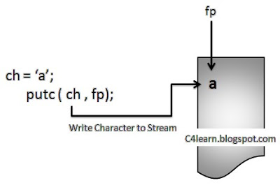
write a single character to the output file, pointed to by fp.
SYNTAX
putc(identifier, fp);
Example:
FILE *fp;
char ch;
putc (ch,fp);

Slide 18

SYNTAX:
size_t fwrite(const void *ptr, size_t size, size_t n, FILE*stream);
Remarks:
fwrite writes a specified number of equal-sized data items to an output file.[BLOCK OF DATA]
ptr = Pointer to any object; the data written begins at ptr
size = Length of each item of data
n =Number of data items to be appended
stream = file pointer

Slide 19

  #include <stdio.h>
  int main()
  {
    char a[10]={'1','2','3','4','5','6','7','8','9','a'};
    FILE *fs;
    fs=fopen("Project.dat","w");
    fwrite(a,1,10,fs);
    fclose(fs);
    return 0;
  }

Slide 20

Declaration:
size_t fread(void *ptr, size_t size, size_t n, FILE *stream);
Remarks:
fread Reads Block of Data From Binary File and Assigns it to Some Memory
ptr = Points to a block into which data is read
size = Length of each item read, in bytes
n = Number of items read
stream = file pointer
NOTE: BOTH FREAD AND FWRITE ARE FOR BINARY FILES [ .DAT FILES]

Slide 21

  #include <stdio.h>
  int main()
  {
  FILE *f;
  char buffer[12];
  if (f = fopen("fred.dat", “r”))
  {
  fread(buffer, 1, 10, f);
  buffer[11] = ‘\0’;
  fclose(f);
  printf("first 10 characters of the file:\n%s\n", buffer);
  }
  return 0;
  }

Slide 22
struct student
{ char name[50];
int roll;
};
int main()
{ FILE *fptr; struct student st[20];
int num;
if((fptr = fopen("ip.dat","wb"))==NULL)
{ printf("\nError in Opening File");
exit(0); }
printf("How many Students : ");
scanf("%d",&num);
for(i=0;i<num;i++)
{ printf("\nEnter the Name and Roll Number");

Slide 23
scnaf("%s %d",st.name,&st.roll);
fwrite(&st,sizeof(st),1,fptr);
} //Structure is Written on File //Now Read File
if((fptr = fopen("ip.dat","rb"))==NULL)
{ printf("\nError in Opening File");
exit(0); }
while((fread(&st,sizeof(st),1,fptr))
{ printf("\nName : %s",st.name);
printf("\nRoll : %d",st.roll);
} fclose(); }

Slide 24

This function sets the file position indicator for the stream pointed to by stream or you can say it seeks a specified place within a file and modify it.
  SEEK_SET Seeks from beginning of file
  SEEK_CUR Seeks from current position
  SEEK_END Seeks from end of file
Example:
#include <stdio.h>
int main()
{
FILE * f;
f = fopen("myfile.txt", "w");
fputs("Hello World", f);
fseek(f, 6, SEEK_SET); //SEEK_CUR, SEEK_END
fputs(" India", f);
fclose(f);
return 0;
} // HELLO INDIA IN FILE

Slide 25

IDENTIFIER= ftell( file pointer );
"ftell" returns the current position for input or output on the file
#include <stdio.h>
int main(void)
{
FILE *stream;
stream = fopen("MYFILE.TXT", "w");
fprintf(stream, "This is a test");
printf("The file pointer is at byte %ld\n", ftell(stream));
fclose(stream);
return 0;
}

Slide 26

Syntax :
int feof(FILE *stream);
What it does ?
It tests if end-of-file has been reached on a stream.
feof is a macro that tests the given stream for an end-of-file indicator.
The end-of-file indicator is reset with each input operation.

Slide 27
Ways of Detecting End of File :
A ] In Text File :
Special Character EOF denotes the end of File
As soon as Character is read,End of the File can be detected
EOF is defined in stdio.h
Equivalent value of EOF is -1
Printing Value of EOF :
void main()
{
printf("%d", EOF);
}
B ] In Binary File :
feof function is used to detect the end of file
It can be used in text file
feof Returns TRUE if end of file is reached
Syntax :
int feof(FILE *fp);Ways of Writing feof Function :
Way 1 : In if statement :
if( feof(fptr) == 1 ) // as if(1) is TRUE
printf("End of File");Way 2 : In While Loop
while(!feof(fptr))
{
--- - --
--- - --
}

Slide 28
B ] In Binary File :
feof function is used to detect the end of file
It can be used in text file
feof Returns TRUE if end of file is reached
Syntax :
int feof(FILE *fp);
Ways of Writing feof Function :
Way 1 : In if statement :
if( feof(fptr) == 1 ) // as if(1) is TRUE
printf("End of File");
Way 2 : In While Loop
while(!feof(fptr))
{
--- - --
--- - --
}

Slide 29

Early in computing history, secondary storage was in the form of magnetic tape and punched cards. Storage was cheap but access was limited to sequential.
In 1956, IBM introduced the RAMAC magnetic disk device. It could be leased for $620 month and could store approximately 5 Mb of data. Data could be accessed directly instead of sequentially. Conserving the space on the disk and getting to the data quickly became an area of research. This was the dawn of the study of file structures.
RAMAC Video

Slide 30

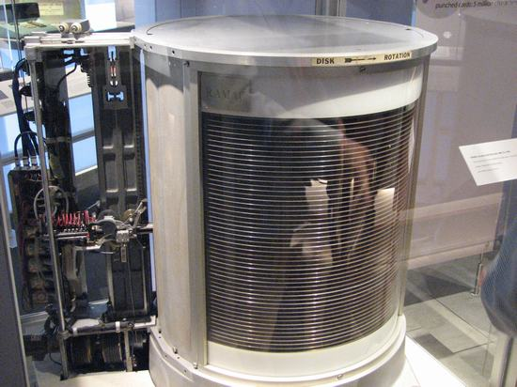

Slide 31
Advances in operating systems gave rise to more research in operating systems. The ability to multi-task processes was a new concept. Disk drives were slow (and still are) and became a big bottleneck in software. It was important to come up with ways to speed up the file I/O process.

Slide 32
The development of high level languages moved file processing from a physical level (hardware dependent) to a logical level (software dependent with the OS handling the specifics of the hardware).
Code became more portable but lost some in the efficiency area.

Slide 33
Today, with shared data everywhere (networks, internets, etc…) efficient file structures are even more crucial. People want data fast. Crowded networks do not need extra bits to transmit.

Slide 34
THANK YOU

